Slide 1
Williamstown Elementary
Counseling Review:
Girl’s Self-Esteem Tier 2 Intervention

Slide 2
Context
Results from the beginning of the year Needs Assessment indicated that teachers as well as students believed Self-Esteem groups would greatly benefit students.

Slide 3
Rationale for Intervention
Group counseling has been shown to positively impact students’ academic achievement and personal growth (ASCA, 2014).
A Tier 2 small group intervention that focuses on social skills will prepare the students to be more successful in the classroom, both academically and socially.
Students will be selected through a self-referral process as well as teacher recommendations.

Slide 4
The Goal
Students will gain self-awareness, develop positive coping mechanisms, improve daily problem-solving skills, and feel connected with other students as measured by the pre/post assessment.

Slide 5
The Intervention
3 groups of girls: one from third, one from fourth, one from fifth. (20 girls total.)
Pre-assessment given to girls first session. Post-assessment given to girls last session.
Meetings for six weeks, thirty minutes apiece.
Focused on the following topics:
Self-Discovery
Understanding Emotions
Healthy Friendships
Self-Esteem
Dealing with Difficult Issues
Asking for Help/ Reaching Out
Tier 1
Small Groups
Tier 2
Tier 3

Slide 6
Results
The following slides illustrate the results of the Tier 2 Friendship (Social Skills) groups
Results are based on student pre/post assessments (perception data)

Slide 7
3rd- 5th Grade Self-Awareness
Questions Regarding Self-Awareness
I feel that I know myself and what makes me happy.
I am happy with the way I look.
I always know how I am feeling in different situations.
I feel good about myself.

Slide 8
3rd- 5th Grade Coping Skills
Questions Regarding Coping Skills
I feel that I can talk openly to my friends and family about my true feelings.
I know who to go to when I need support.

Slide 9
3rd – 5th Grade Problem-Solving Skills
Questions Regarding Problem-Solving
I practice good decision-making skills and don’t feel pressure from my friends to do things I don’ want to do.

Slide 10
3rd- 5th Grade On Being Connected with Others
Questions Regarding Being Connected with Others
I feel that I am always a good friend and can be trusted.
I know that other girls often have trouble with the same things that I do.
I know that I am an important part of this world.

Slide 11
3rd Grade Self-Awareness
Questions Regarding Self-Awareness
I feel that I know myself and what makes me happy.
I am happy with the way I look.
I always know how I am feeling in different situations.
I feel good about myself.

Slide 12
3rd Grade Coping Skills
Questions Regarding Coping Skills
I feel that I can talk openly to my friends and family about my true feelings.
I know who to go to when I need support.

Slide 13
3rd Grade Problem-Solving Skills
Questions Regarding Problem-Solving
I practice good decision-making skills and don’t feel pressure from my friends to do things I don’ want to do.

Slide 14
3rd Grade Connectedness
Questions Regarding Being Connected with Others
I feel that I am always a good friend and can be trusted.
I know that other girls often have trouble with the same things that I do.
I know that I am an important part of this world.

Slide 15
4th Grade Self-Awareness
Questions Regarding Self-Awareness
I feel that I know myself and what makes me happy.
I am happy with the way I look.
I always know how I am feeling in different situations.
I feel good about myself.

Slide 16
4th Grade Coping Skills
Questions Regarding Coping Skills
I feel that I can talk openly to my friends and family about my true feelings.
I know who to go to when I need support.

Slide 17
4th Grade Problem-Solving Skills
Questions Regarding Problem-Solving
I practice good decision-making skills and don’t feel pressure from my friends to do things I don’ want to do.

Slide 18
4th Grade Connectedness
Questions Regarding Being Connected with Others
I feel that I am always a good friend and can be trusted.
I know that other girls often have trouble with the same things that I do.
I know that I am an important part of this world.

Slide 19
5th Grade Self-Awareness
Questions Regarding Self-Awareness
I feel that I know myself and what makes me happy.
I am happy with the way I look.
I always know how I am feeling in different situations.
I feel good about myself.

Slide 20
5th Grade Coping Skills
Questions Regarding Coping Skills
I feel that I can talk openly to my friends and family about my true feelings.
I know who to go to when I need support.

Slide 21
5th Grade Problem-Solving Skills
Questions Regarding Problem-Solving
I practice good decision-making skills and don’t feel pressure from my friends to do things I don’ want to do.

Slide 22
5th Grade Connectedness
Questions Regarding Being Connected with Others
I feel that I am always a good friend and can be trusted.
I know that other girls often have trouble with the same things that I do.
I know that I am an important part of this world.

Slide 23
Summation of Results
Each grade level made improvements on coping skills and problem solving skills
The fourth grade is the only group that improved in self-awareness and connectedness

Slide 24
Implications
The G.I.R.L.S. small group intervention helped increase coping skills and problem solving skills, however, it was only effective regarding self-awareness and connectedness in the 4th grade.
Next year:
I will use the lessons on coping skills and problem solving skills but I will also implement more activities to help the girls bond and feel connected with one another.
In addition, I will allow time each session for the girls to explore some aspect of their lives to improve self-awareness.

Slide 25
Other Findings
There was a correlation between the interventions the G.I.R.L.S. group received and attendance.
There was no statistically significant correlation with G.I.R.L.S and changes in Reading or Math MAP scores.

Slide 26
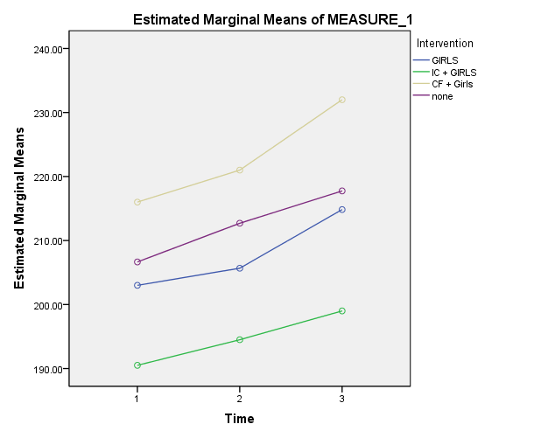
Math MAP Scores
X axis: 1 = Fall, 2 = Winter, 3 = Spring
Y axis: Mean of Test Score
Reading MAP Scores
X axis: 1 = Fall, 2 = Winter, 3 = Spring
Y axis: Mean of Test Score

