Slide 1
Introduction to Teacher Clarity
The Teacher Clarity Playbook

Slide 2
Objectives for Today
Participants will:
Understand the four elements that comprise teacher clarity
Examine the evidence of impact of student learning of:
Teacher Expectations
Learning Intentions and Success Criteria
Teacher Collaboration
Become familiar with the organization of modules

Slide 3
What is Teacher Clarity?
“A cluster of teaching behaviors that result in learners gaining knowledge or understanding of a topic.”(Cruickshank, 1985, p. 43)
“Clarity, then, is the teacher’s ability to present knowledge in a way that students can understand.” (Simonds, 2009, p. 279)
“Making content clear and accessible to students.” (Saphier, Haley-Speca, & Gower, 2009, p. 3)
“A state in which a teacher who is in command of the subject matter to be transmitted is able to do that which is required to communicate with learners successfully.” (Hines, 1981, p. 88).

Slide 4
Elements of Teacher Clarity
Fendick (1990) defined teacher clarity as “a measure of the clarity of communication between teachers and students in both directions” (p. 10)
Clarity of organization
Clarity of explanation
Clarity of examples and guided practice
Clarity of assessment of student learning

Slide 5
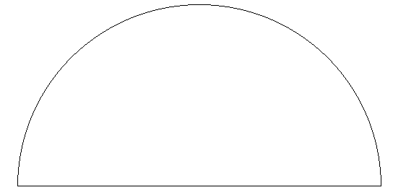
0.4
0.5
0.6
0.3
0.7
0.2
Medium
0.8
0.1
High
0.9
Low
0.0
1.0
Teacher effects
1.1
-0.1
Developmental effects
Negative
1.2
-0.2
Reverse effects
Zone of desired effects
Teacher Clarity: d = 0.75
Hattie, J. (2009). Visible learning: A synthesis of over 800 meta-analyses related to achievement.
New York: Routledge.

Slide 6
0.4
0.5
0.6
0.3
0.7
0.2
Medium
0.8
0.1
High
0.9
Low
0.0
1.0
Teacher effects
1.1
-0.1
Developmental effects
Negative
1.2
-0.2
Reverse effects
Zone of desired effects
Teacher Expectations: d = 0.43
Hattie, J. (2009). Visible learning: A synthesis of over 800 meta-analyses related to achievement.
New York: Routledge.

Slide 7
0.4
0.5
0.6
0.3
0.7
0.2
Medium
0.8
0.1
High
0.9
Low
0.0
1.0
Teacher effects
1.1
-0.1
Developmental effects
Negative
1.2
-0.2
Reverse effects
Zone of desired effects
Success Criteria: d = 0.54
Hattie, J. A. C., & Donoghue, G. M. (2016). Learning strategies: A synthesis and conceptual model. Science of Learning, 1. doi:10.1038/npjscilearn2016.

Slide 8
Why Is Success Criteria Important?
Students are more likely to:
Plan and predict
Set goals
Accurately judge their own progress

Slide 9
0.4
0.5
0.6
0.3
0.7
0.2
Medium
0.8
0.1
High
0.9
Low
0.0
1.0
Teacher effects
1.1
-0.1
Developmental effects
Negative
1.2
-0.2
Reverse effects
Zone of desired effects
Collective Teacher Efficacy: d = 1.57
Hattie, J. (2009). Visible learning: A synthesis of over 800 meta-analyses related to achievement.
New York: Routledge.

Slide 10
Collective Efficacy Requires Meaningful Contact
“…perceptions are based on experiences. When teachers experience success collaborating with peers and those collaborations improve teaching and learning, they notice. These accumulated data points become the collective efficacy that researchers note is so powerful.”

Slide 11
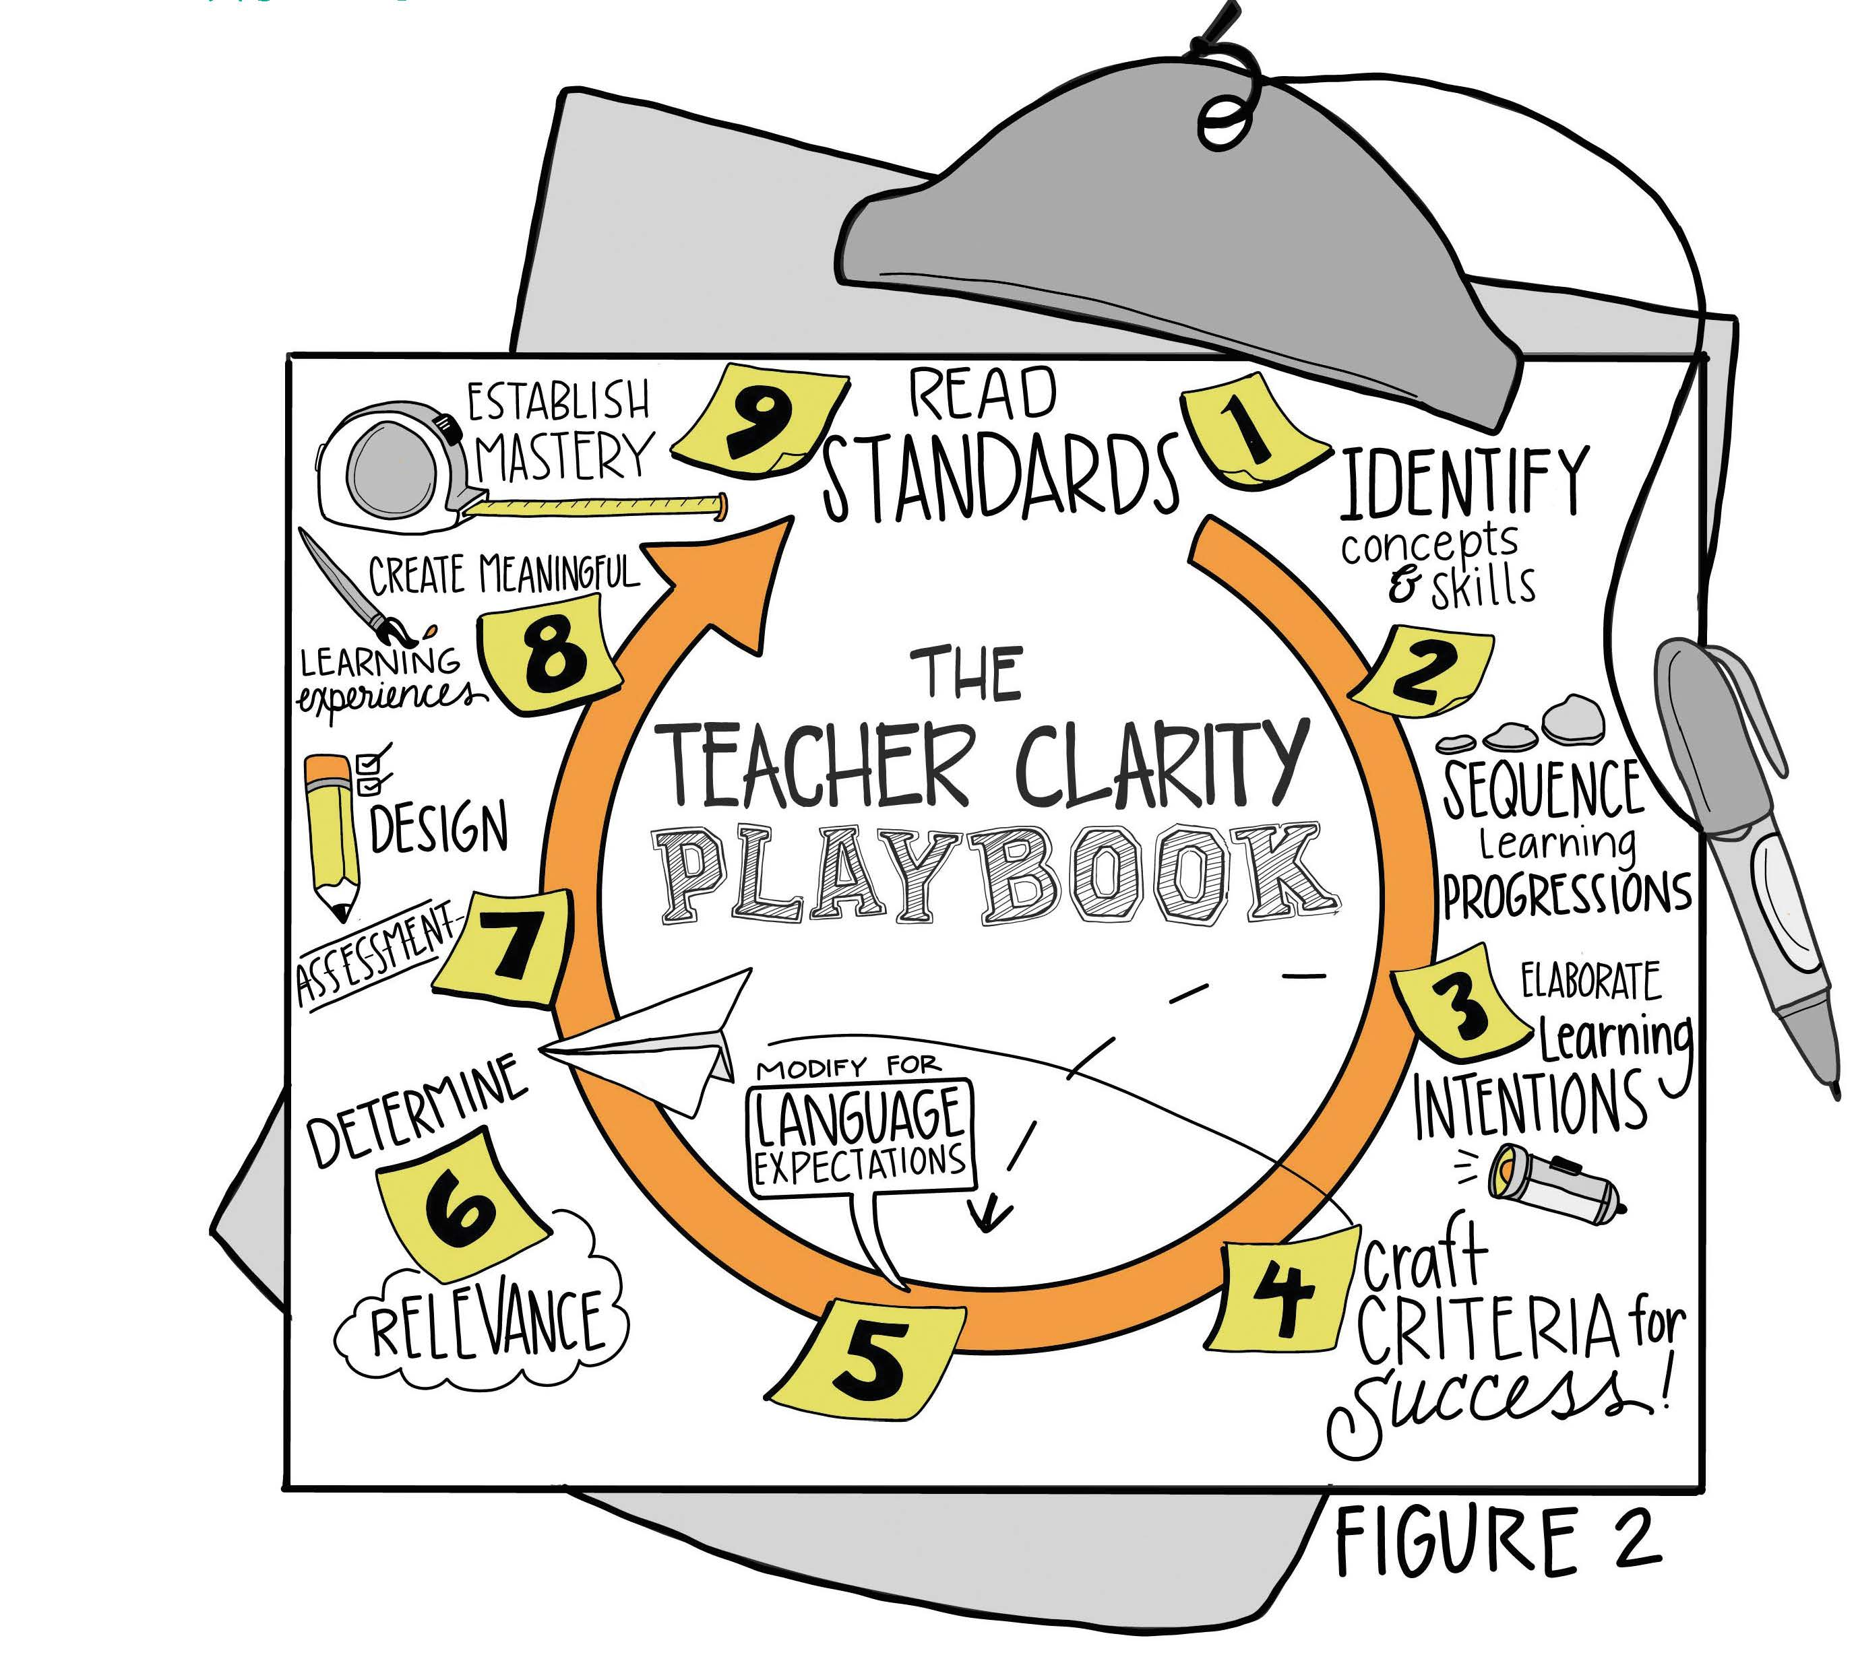

Slide 12
Key Points for Using the Modules
The intent is to build habits for mobilizing teacher clarity in classrooms.
Modules adhere to a gradual release of responsibility instructional framework (Fisher & Frey, 2014).
Each module is modeled through 4 examples
Guided practice with suggested answers
On Your Own guides for your own planning
Collaboration with others throughout

Slide 13
An Active Learning Process
Select a standard relevant to your own practice, preferably one you will soon be addressing in your classroom.
You will use your selected standard to work through a process to increase teacher clarity from learning intentions to success criteria, design modifications and assessments, and create meaningful learning experiences.
The Playbook is a crucial tool for your learning and contains further directions for your planning.

Slide 14
Wrap Up: Why Are We Doing This?
“When learning is organized and intentional, and when the learner knows what he or she is learning, great things can happen. When students don’t know what they are learning, don’t care about their learning, and have no idea if they are learning, great things are unlikely to happen.”

