Slide 1
Module 9. Establishing Mastery of Standards
The Teacher Clarity Playbook

Slide 2
Objectives for Today
Participants will:
Understand principles of summative assessment.
Examine examples of summative assessment items in four grade levels
Complete two guided learning exercises to check for understanding
Apply the process outline summative assessment details for the selected standard

Slide 3
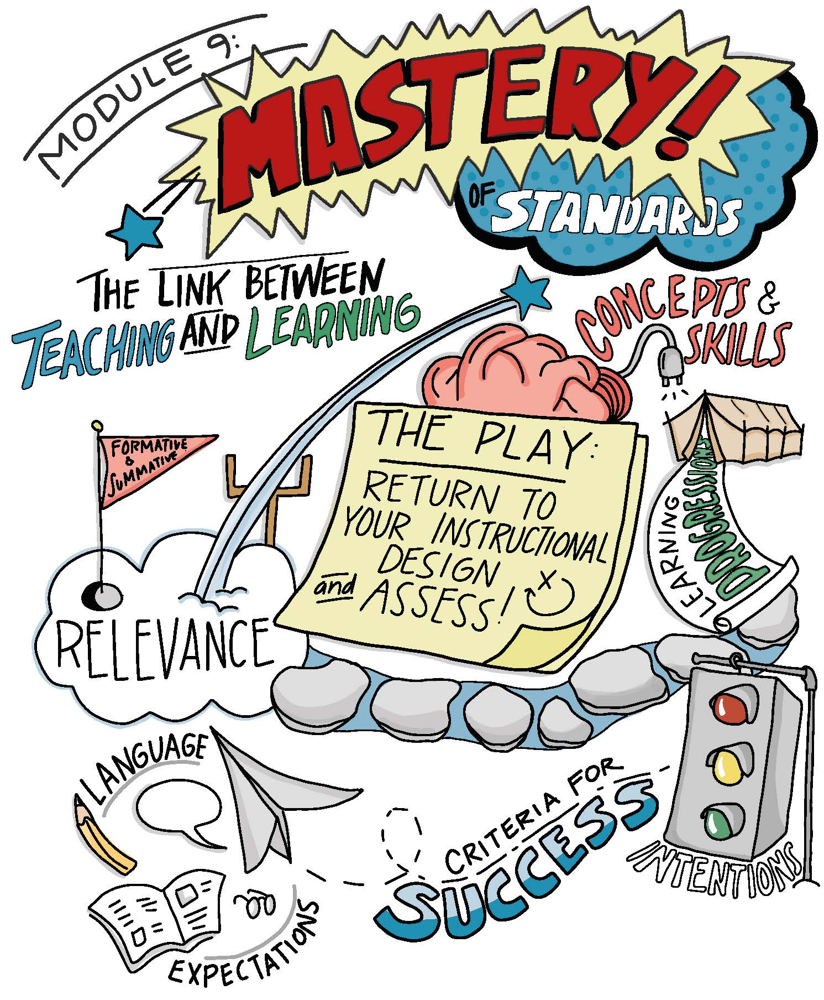

Slide 4
Modeling
Read and discuss the four examples beginning on page 108.
Examine how the summative assessment is linked to the Standard, Learning Progression, daily Learning Intention, Success Criteria, and Relevancy Check.
In what ways does this ensure that students are assessed on what they have learned?

Slide 5
Guided Practice
For the first task on page 115, design an sample item or assessment task aligned to the learning intention and assessment format listed.
Complete the second task on page 116 by completing a relevancy check for the assessment item listed. There may be more than one response for each item.
Check for understanding by viewing the possible answers in The Teacher Clarity Playbook appendix.

Slide 6
On Your Own
Individually or in teams, use the same process to plan a summative assessment using the template.
This is a new template designed to capture your ideas for ways to determine mastery of the standard selected.
Complete this on chart paper, or using digital collaboration tools.

Slide 7
PLC Conversations
What challenged you in this module?
What does it mean to have really learned something at a deep level?
What will we do if students do not master the standards?

Slide 8
Wrap Up: Why Are We Doing This?
“Summative assessment is the link between teaching and learning. It is not sufficient to say that by virtue of the fact that we have taught something, students have learned it. On the other hand, it is also unacceptable to blame students for not learning. Summative assessments give students information about their learning, and they give teachers feedback about their teaching.” (p. 106)

