Slide 1
Module 8: Supporting Students as Collaborative Learners
By ReLeah Lent

Slide 2
Bring It Back Activity
Find a discussion partner.
Discuss the moves you feel you need to make to facilitate successful collaborative learning in your classroom based on your reading of ReLeah Lent’s This Is Disciplinary Literacy….”
If you have already made some of these moves, discuss their effect on learning.

Slide 3
Objectives for This Session
Participants will:
examine the student’s role in a collaborative learning experience.
consider the importance of co-created norms in helping students hold themselves account for their own and their group’s learning.
be introduced to three collaborative learning activities that can be used successfully in any discipline.

Slide 4
During collaborative learning activities, students learn to…
use the language of the discipline appropriately.
listen carefully to other people’s perspectives.
hold on to their thinking.
question the status quo
participate in the activities of a discipline to construct meaning.

Slide 5
Picture This!
ReLeah Lent says,
“The goal is for students to be so immersed in their discussion that they hardly notice you’re there, not suddenly ‘getting on task’ when they see the teacher approaching.”

Slide 6
However…
“Kids don’t come to school knowing how to move from social to academic talk, so setting norms and scaffolding this challenging but essential skill is mandatory for success.”

Slide 7
Remember…
STUDENTS
must be involved in the establishment of norms for collaborative work.
8-7

Slide 8
Growing through Collaboration
ReLeah Lent advises us:
“All students need the opportunity to learn how to participate in the authentic give-and-take of a dialogue where they engage in the risks necessary for growth.”

Slide 9
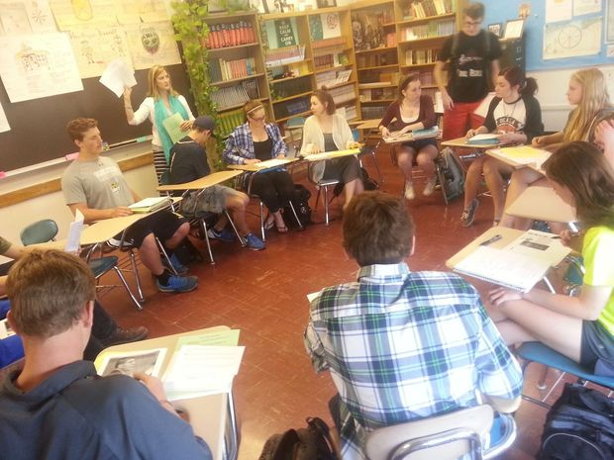
Some Suggested Collaborative Learning Activities
Student-Led Whole-Group Discussions
Seminars—With or Without Socrates
Learning Beyond the Classroom

Slide 10
Student-Led Whole-Group Discussions
Discipline-specific topics relevant to the unit of study are brainstormed by students with guidance from the teacher.
Students research how the topic relates to the overall unit.
Students then prepare an introduction and open-ended questions to guide the rest of the class in a discussion of their topic.
Students take turns leading the discussions to build deeper knowledge for the entire group.

Slide 11
Seminars
Value inquiry over information
Are formal in nature and always based on a text
Use protocols to guide the discussion
Require a facilitator (the teacher at first to serve as a model) who takes the group back to the text as well as encouraging thoughtful responses

Slide 12
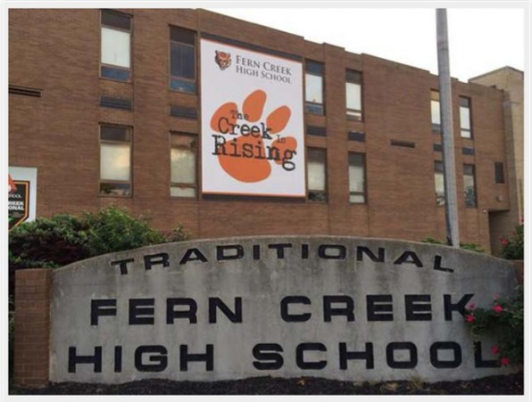
Service Learning Projects
Immerse students in the work of the discipline
Make a meaningful impact

Slide 13
For Further Reading
Finish reading Chapter 5 in This Is Disciplinary Literacy. . . It will more fully explain the collaborative learning activities we have discussed.
Read Chapter 6 in This Is Disciplinary Literacy. . . It will give you an amazing glimpse into the life of a school that fully embraced disciplinary literacy and help you understand the power of this type of learning.

Slide 14
Reflection
Please think about everything you have learned about disciplinary literacy in these professional development sessions.
Jot down the three most important things you

Slide 15
Student Wisdom
“When we rely on each other to come up with something that is important or meaningful, we really begin working together rather than just doing what the teacher tells us to do in a group.”
—from This Is Disciplinary Literacy…
by ReLeah Lent

