Slide 1
Module 8. Creating Meaningful Learning Experiences
The Teacher Clarity Playbook

Slide 2
Objectives for Today
Participants will:
Understand instructional design using the gradual release of responsibility to promote access to learning.
Examine examples of lesson design in four grade levels
Complete two guided learning exercises to check for understanding
Apply the process to design a meaningful learning experience for the selected standard

Slide 3
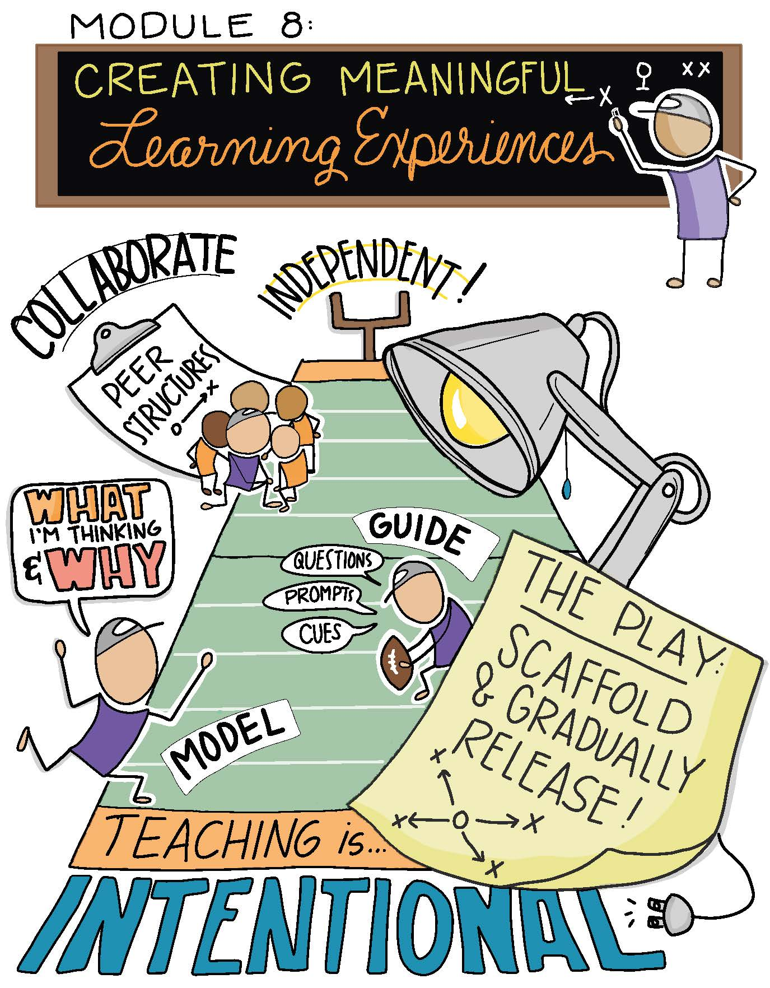

Slide 4
Modeling
Read and discuss the four examples beginning on page 91.
Examine how the lesson design is linked to the daily Learning Intention, Success Criteria, Relevance Talking Points, and Assessment Opportunities.
How does this promote access for all students?
In what ways does the reminder to “plan backward, teach forward” link to this approach to lesson design?

Slide 5
Guided Practice
For the first task on page 99, design an access point for the learning intention and assessment opportunity listed.
Complete the second task on page 100 by developing a possible access point using the gradual release of responsibility that is aligned to the listed learning intentions.
Check for understanding by viewing the possible answers in The Teacher Clarity Playbook appendix.

Slide 6
On Your Own
Individually or in teams, use the same process to develop a Meaningful Learning Experience using all the elements you have developed in Modules 1-7.
This is a new template, which includes modeling, guided instruction, collaborative learning, and independent learning.
Complete this on chart paper, or using digital collaboration tools.

Slide 7
PLC Conversations
What challenged you in this module?
Which of these areas are our collective strengths? How can we develop our skill set in all phases of instruction?
How can we match instructional routines and strategies to the learning intentions?

Slide 8
Wrap Up: Why Are We Doing This?
“When instruction is intentional, meaning that the tasks, activities, and assignments are directly linked with learning intentions and success criteria, students have a better chance of learning. It really is that simple… Student learning is our goal, and there are clear pathways to ensure that students learn more and better as a result of the experiences they have.” (p. 90)

