Slide 1
Module 7. Designing Assessment Opportunities
The Teacher Clarity Playbook

Slide 2
Objectives for Today
Participants will:
Understand methods for checking for understanding such that teachers and students can monitor progress.
Examine examples of formative assessment in four grade levels
Complete two guided learning exercises to check for understanding
Apply the process to design assessment opportunities for the selected standard

Slide 3
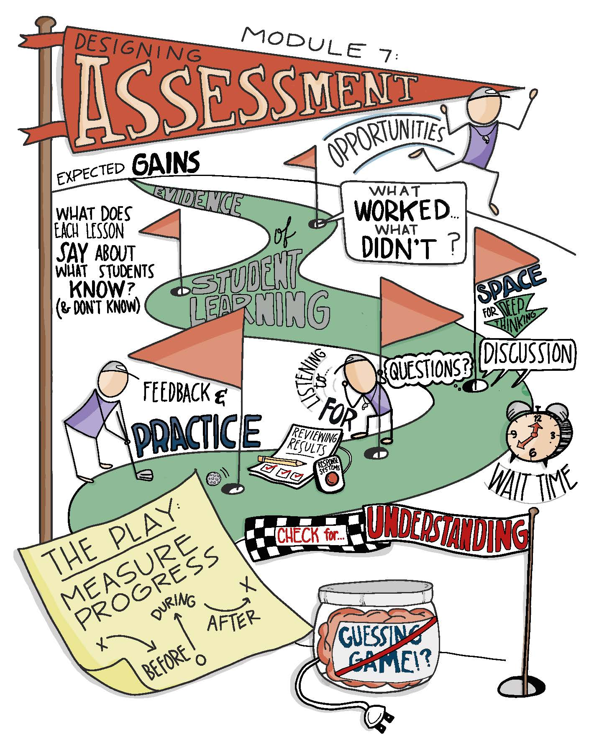

Slide 4
Modeling
Read and discuss the four examples beginning on page 73.
Examine how the Assessment Opportunities and linked directly to the Learning Intention.
In what ways do these Assessment Opportunities provide information to students about their learning?

Slide 5
Guided Practice
For the first task on page 81, choose the Assessment Opportunity you prefer and explain why. There is no wrong answer.
Complete the second task on page 83 by developing a possible formative Assessment Opportunity aligned to the listed learning intentions.
Check for understanding by viewing the possible answers in The Teacher Clarity Playbook appendix.

Slide 6
On Your Own
Individually or in teams, use the same process to develop Assessment Opportunities for the learning intentions you modified in Module 5.
Check for alignment between the learning progression, learning intentions, and success criteria. Adjust accordingly.
Complete this on chart paper, or using digital collaboration tools.

Slide 7
PLC Conversations
What challenged you in this module?
What assessments and checks for understanding are we already using that we can continue to use? What new tools do we need to explore?
How can we ensure that our assessments provide feedback to us about the impact of our teaching?

Slide 8
Wrap Up: Why Are We Doing This?
“Using assessments for the purpose of formative evaluation casts a light on teaching practices. It has the potential to be eye-opening—to help teachers consider what worked and what didn’t as they carefully examine the evidence of student progress. ” (p. 70)

