Slide 1
Module 6. Determining the Relevance of the Learning
The Teacher Clarity Playbook

Slide 2
Objectives for Today
Participants will:
Understand three ways of communicating relevance and its importance in teacher clarity.
Examine examples of relevance talking points in four grade levels
Complete two guided learning exercises to check for understanding
Apply the process to develop relevance talking points for the selected standard

Slide 3
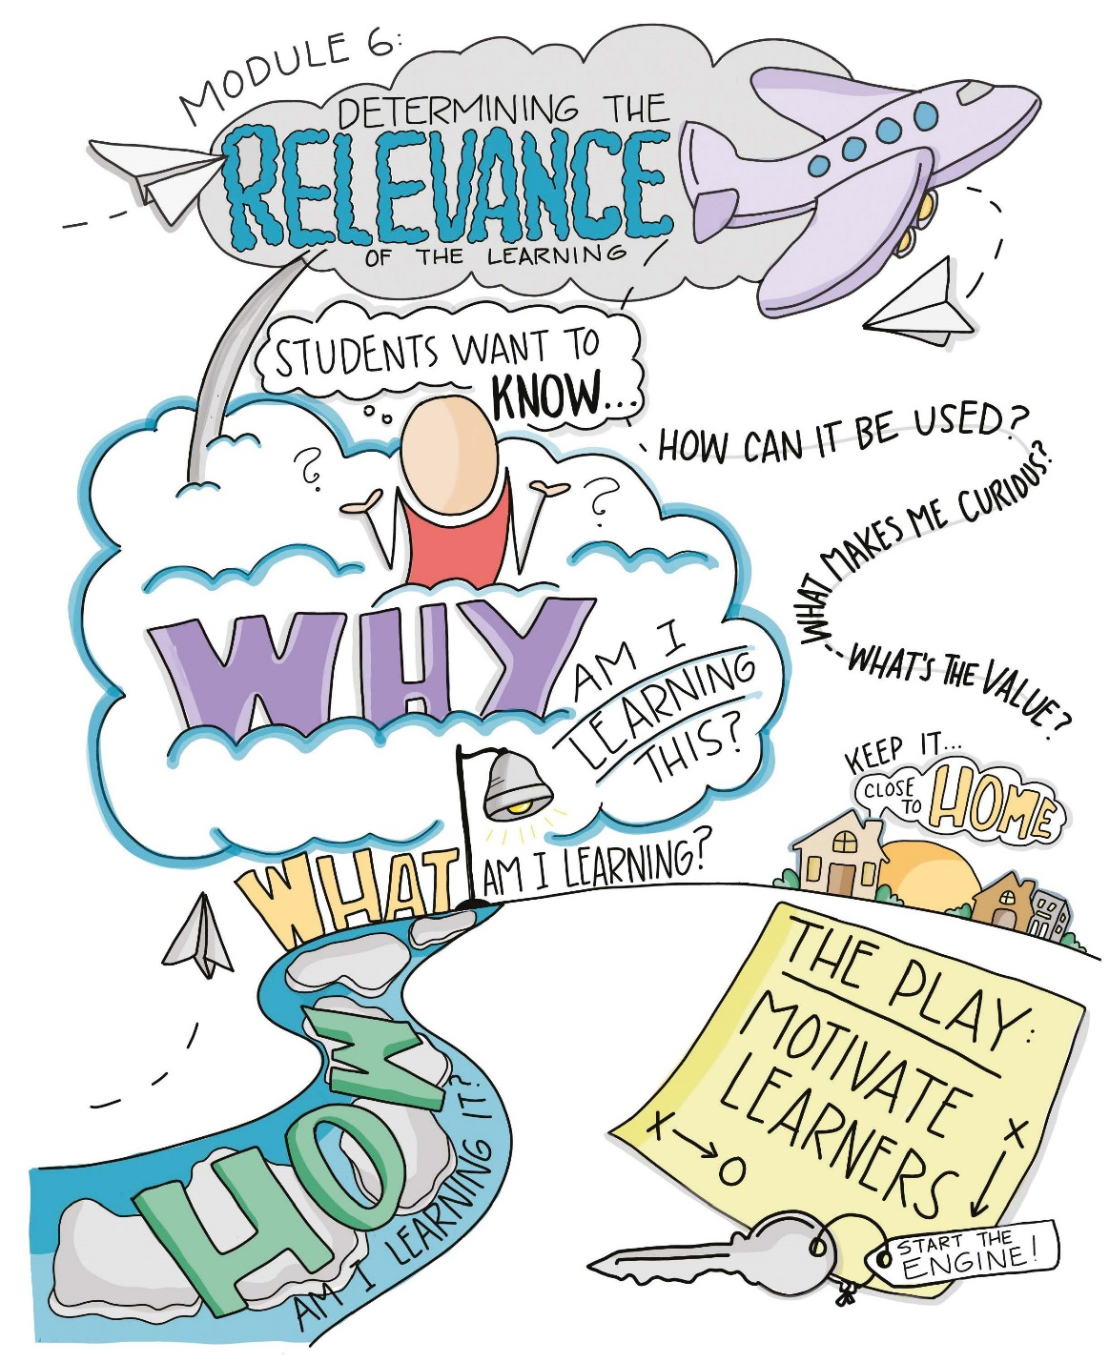

Slide 4
Modeling
Read and discuss the four examples beginning on page 56.
Examine how the Relevance Talking Points enhance the value of the success criteria.
In what ways do these Relevance Talking Points strengthen the teacher’s ability to clearly communicate the learning intentions?

Slide 5
Guided Practice
For the first task on page 63, choose the Relevance Talking Point you believe is more effective and explain why.
Complete the second task on pages 64-65 by developing a possible Relevance Talking Point aligned to the listed learning intentions.
Check for understanding by viewing the possible answers in The Teacher Clarity Playbook appendix.

Slide 6
On Your Own
Individually or in teams, use the same process to develop relevance Talking Points for the learning intentions you modified in Module 5.
Check for alignment between the learning progression, learning intentions, and success criteria. Adjust accordingly.
Complete this on chart paper, or using digital collaboration tools.

Slide 7
PLC Conversations
What challenged you in this module?
What makes learning relevant for our students? What do we know about them that we could use to make connections?
How can we develop internal motivation in our students?

Slide 8
Wrap Up: Why Are We Doing This?
“Students ask themselves these questions, whether we address them explicitly, or not.
What am I learning today?
Why am I learning this?
How will I know that I learned it?
The stated daily learning intentions address the first question, and success criteria supply the tools needed to answer the third question as students gauge their own progress. But the second question is about relevancy.” (p. 54)

