Slide 1
Module 5: Inquiry in the Content Areas
By ReLeah Lent

Slide 2
Bring It Back Activity
Find a discussion partner. Reflect on the writing activity you chose to use in your classroom. Use these questions to guide you:
Why did you decide to try that particular activity?
How did you tie the writing to your discipline?
What impact (if any) do you think the writing had on the students’ grasp of the content?
What would you do differently—if anything—and why?
You have 10 minutes for your discussion.

Slide 3
Objectives for the Day
Participants will:
examine the link between curiosity and inquiry.
be introduced to the four levels of inquiry.
consider the shifts that must be made to move from a transmission to an inquiry-based model of learning.

Slide 4
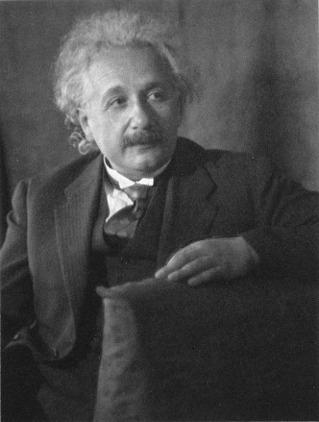
Do You Remember?
As you may remember, Albert Einstein said,
“It is a miracle that curiosity survives formal education.”

Slide 5
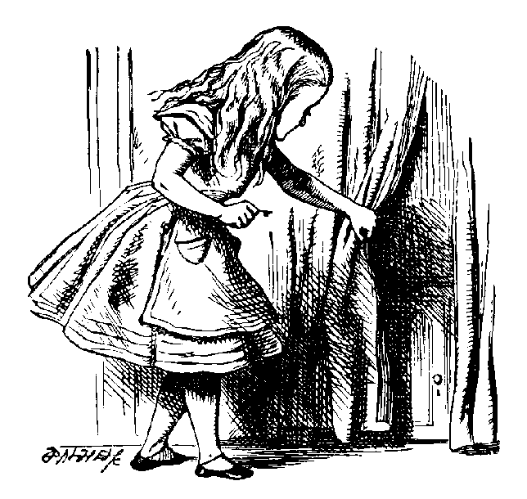
Think about It
Remember a time when you were curious about something.
About what were you curious?
What did you do as a result of your curiosity?

Slide 6
Think about It
Intellectual curiosity leads to…….
INQUIRY!!

Slide 7
The Importance of Inquiry
“Inquiry is at the core of learning in all disciplines.”
“When students become habitual inquirers, they develop intrinsic motivation and learn to think strategically about core academic concepts.”
—ReLeah Lent

Slide 8
And One More Good Thing
ReLeah Lent points out that “…teachers who focus heavily on inquiry-based instruction had students who significantly outperformed students who had had traditional instruction.”
So, let’s make Einstein happy and support curiosity by providing inquiry-based instruction for our students.

Slide 9
The Inquiry Balancing Act
The student…
can’t construct meaningful questions if they lack background knowledge or basic information on the topic.
The teacher… must provide enough information to ignite inquiry without giving so much information that curiosity is doused.

Slide 10
Guidance from ReLeah Lent
“Inquiry-based teaching doesn’t mean that kids are sent out as explorers to find the New World; it means, rather, that the teacher’s role moves from one who parcels out information to one who guides learning based on her own expertise and ability to mentor students in their ‘doing.’”

Slide 11
A Shift in Thinking
One remarkable characteristic of inquiry is that it is done by the individual not to the individual….” ReLeah Lent

Slide 12
A Shift in Practice
Transmission Model
Inquiry-Based Classroom

Slide 13
Bring It Back Task
Read Chapter 4, pages 112-113 from the beginning to the end of the FAQs.
This section of the text should relieve any anxiety you have about an inquiry-based classroom because it builds on the ideas we’ve discussed today and gives specific examples from each discipline.
While reading, jot notes about your reactions to the ideas presented. We will discuss them at the next session.

