Slide 1
Module 4: Writing Effectively in the Content Areas
By ReLeah Lent

Slide 2
Bring It Back Activity
Gloria Park once said,
“Writing is a way of knowing.”
Think about how your written reflection on the assigned reading affected your understanding and retention of the information presented there.
Discuss your reactions with a partner.
You will have 5 minutes for your discussion.

Slide 3
Objectives for This Session
Participants will:
reflect on writing as a way of gaining knowledge.
explore four instructional writing practices that help engage students’ with content and make sense of their learning.

Slide 4
A Few Paths to Authentic Writing
Bell Ringer Questions/Answers
Read/Think/Respond
Talk Back
Differentiated Learning Logs

Slide 5
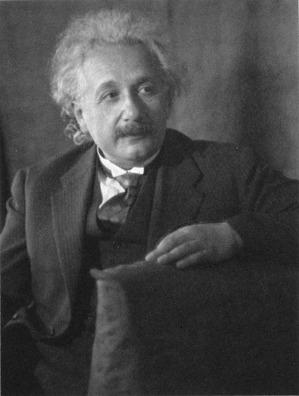
Bell-Ringer Questions/Answers
Albert Einstein once said,
“It is a miracle that curiosity survives formal education.”
Do you agree or disagree with this statement—and why? Please write your response.

Slide 6
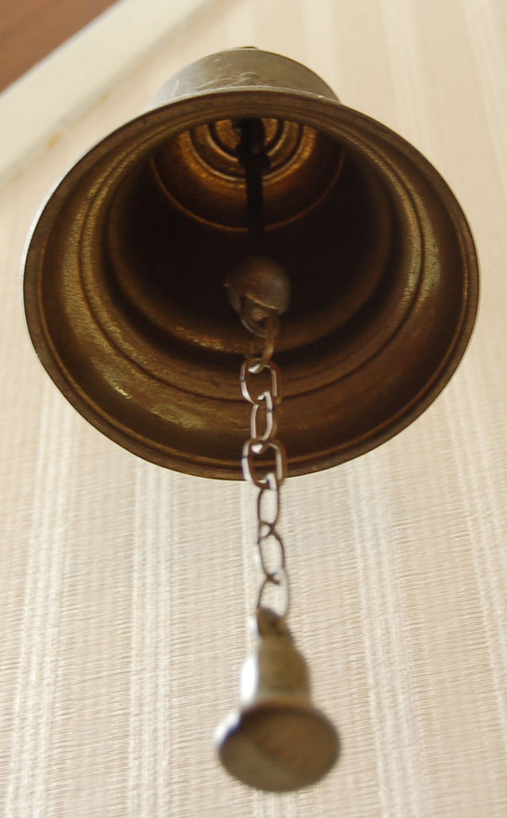
Bell Ringer Questions
Bell ringer questions should—
build background knowledge.
require thinking.
require evaluation.
require decision making.

Slide 7
Read/Think/Respond
At your tables, discuss this question:
What does it mean to respond?
“A response differs from an analysis in that writers interpret the text through a subjective stance, making connections and bringing background knowledge as they seek to interpret the author’s message.”
—Releah Lent

Slide 8
Read, Think, Respond
Students read a short piece of complex text related to your discipline.
They think for a few moments about the text
They write a response to the text.
—Releah Lent

Slide 9
Possible Prompts for Read/Think/Respond
What did the author say? What was his/her message?
What in the text is insightful, interesting, confusing, or just plain wrong?
What do I think about the author’s message?
REMEMBER: This is a subjective response based on the student’s thinking.

Slide 10
Talk Back
Talk back gives students a chance to “talk back” to a text, focusing on a specific point the student feels is worthy of discussion.
ReLeah Lent advises: “This activity works best when there is some question about the topic or when the author is taking a strong, perhaps biased position…look for topics that represent controversial or thought-provoking issues in your discipline.”

Slide 11
Differentiated Learning Logs
Take a minute at your tables to talk about how you use or have used learning logs in your classroom.
Notes:
Note to editor: This needs an image of people involved in a group discussion.

Slide 12
Is This a Change in Your Thinking?
Releah Lent says:
“The purpose of this log is to hold ongoing reflection, analysis, evaluation, and application of new information.”
“It is important to note that the log belongs to the student and no two will look exactly alike.”
“…allow students autonomy regarding its organization, decoration, and, to some extent, its contents.”

Slide 13
Remember….
“If the teacher takes control of the ‘notebook,’ the motivation for learning diminishes.”
“This learning tool…starts where all individualized instruction must start: with the learner.”
—ReLeah Lent

Slide 14
Bring It Back Task
Read Chapter 3, pp. 62–102.
Choose ONE of the ideas explained in the chapter and include it in a lesson between now and the next time we meet.
Be prepared to talk with a partner about the celebrations and challenges of your experience.

Slide 15
Other Practices You Will Explore
Exit, Enter, Middle of the Class QuickJots
Writing a Story
Blogs

