Slide 1
Module 4. Crafting Success Criteria
The Teacher Clarity Playbook

Slide 2
Objectives for Today
Participants will:
Understand the components of success criteria and their role in teacher clarity.
Examine examples of success criteria in four grade levels
Complete two guided learning exercises to check for understanding
Apply the process to develop success criteria for the selected standard

Slide 3
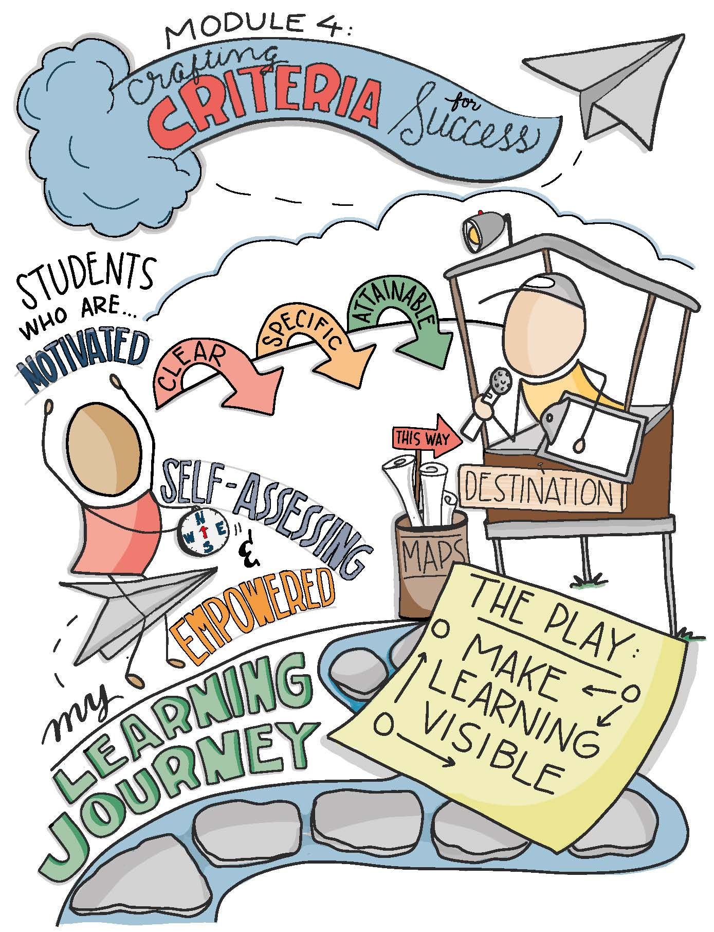

Slide 4
Modeling
Read and discuss the four examples on pages 31 and 32.
Examine how the Learning Progression, Learning Intentions, and Success Criteria align. Why do clear success criteria illuminate learning for students?
In what ways would these success criteria contribute to teacher clarity?

Slide 5
Guided Practice
Use the example on page 37 to evaluate the list of success criteria generating during a brainstorming session. Which are appropriate and which are not?
Complete the second task on page 38 to craft success criteria for each of the learning intentions listed.
Check for understanding by viewing the possible answers in The Teacher Clarity Playbook appendix.

Slide 6
On Your Own
Individually or in teams, use the same process to craft success criteria for each of the learning intentions you developed in Module 3.
Check for alignment between the learning progression, learning intentions, and success criteria. Adjust accordingly.
Complete this on chart paper, or using digital collaboration tools.

Slide 7
PLC Conversations
What challenged you in this module?
How do you define success and the appropriate level of learning for students?
How will we respond if students meet the success criteria in advance of our teaching?

Slide 8
Wrap Up: Why Are We Doing This?
“The daily learning intentions that are communicated by the teacher are an end product of careful planning. The success criteria provide a means for students and the teacher to gauge progress toward learning, thereby making learning visible to the teacher and the student.” (p. 30)

