Slide 1
Module 3: Writing in the Content Areas
By ReLeah Lent

Slide 2
Celebrations and Challenges
Take a minute to think about and/or jot down what you consider to have been the biggest celebration about the reading activity you chose to try in your classroom and what you consider to be the activity’s greatest challenge.

Slide 3
Objectives for This Session
Participants will:
examine their current use of writing in the classroom.
understand writing’s impact on the brain and learning.
examine effective feedback as a form of formative assessment.
compare the characteristics of writing in the four main disciplines.

Slide 4
Reflection
Consider this statement from the College Board:
“…if students are to learn, they must write.”
Take 2-3 minutes to discuss this honestly at your tables.

Slide 5
Relief from ReLeah
“Where did we get the idea that every word students write has to be assessed, assigned a grade, and duly recorded to create a score that somehow reflects the writing worth of a student?...students should have many, many opportunities to write—with reduced pressure on the teacher to formally assess each piece of writing.”
Notes:
Note to editors—I think an image of something like AlkaSeltzer would be good here—pain relief!

Slide 6
Formative vs. Summative Assessment of Writing
Formative assessment occurs during instruction to give students feedback that redirects their thinking and deepens their knowledge about both content and written expression. It offers guidance at the moment of need.
Summative assessment is provided after the learning to evaluate what the student has actually learned.

Slide 7
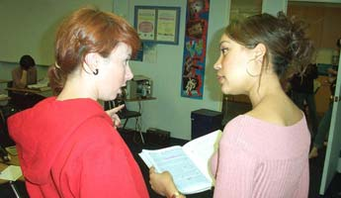
What is Feedback?
According to ReLeah Lent, feedback is—
“…comments you would make to an adult in the field who asked your advice about a piece of writing.”

Slide 8
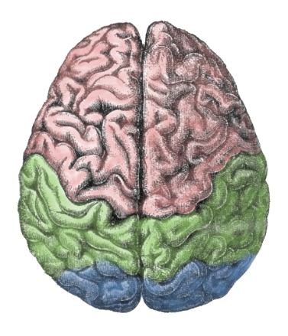
Writing Embedded Across the Curriculum
promotes the brain’s attentive focus to classwork and homework.
boosts long-term memory.
illuminates patterns.
gives the brain time for reflection.
is a source of conceptual development and stimulus of the brain’s highest cognition.

Slide 9
Points to Consider
“The skills and strategies that work well for writing in an English class may not lead to effective writing in other subjects.”—Applebee & Langer
“Writing, as well as reading, is now understood to be rooted within content areas, not across them.”—ReLeah Lent

Slide 10
Sort It Out!
Open your envelope to find 29 sentences describing disciplinary writing in one of the four main disciplines: science, math, history/social sciences, English/language arts.
Think about which disciplinary writing the sentence best describes.
Group the sentence strips by the discipline to which they refer.

Slide 11
Bring It Back Task
Read pp. 61–80 of Chapter 3.
At the end of your reading, write a short reflection on what you learned about disciplinary writing.
Bring your reflection to the next session.

