Slide 1
Module 3. Elaborating Learning Intentions
The Teacher Clarity Playbook

Slide 2
Objectives for Today
Participants will:
Understand the qualities of daily learning intentions and their importance for teacher clarity.
Examine examples of learning progressions in four grade levels
Complete two guided learning exercises to check for understanding
Apply the process to identify learning progressions in the selected standard

Slide 3
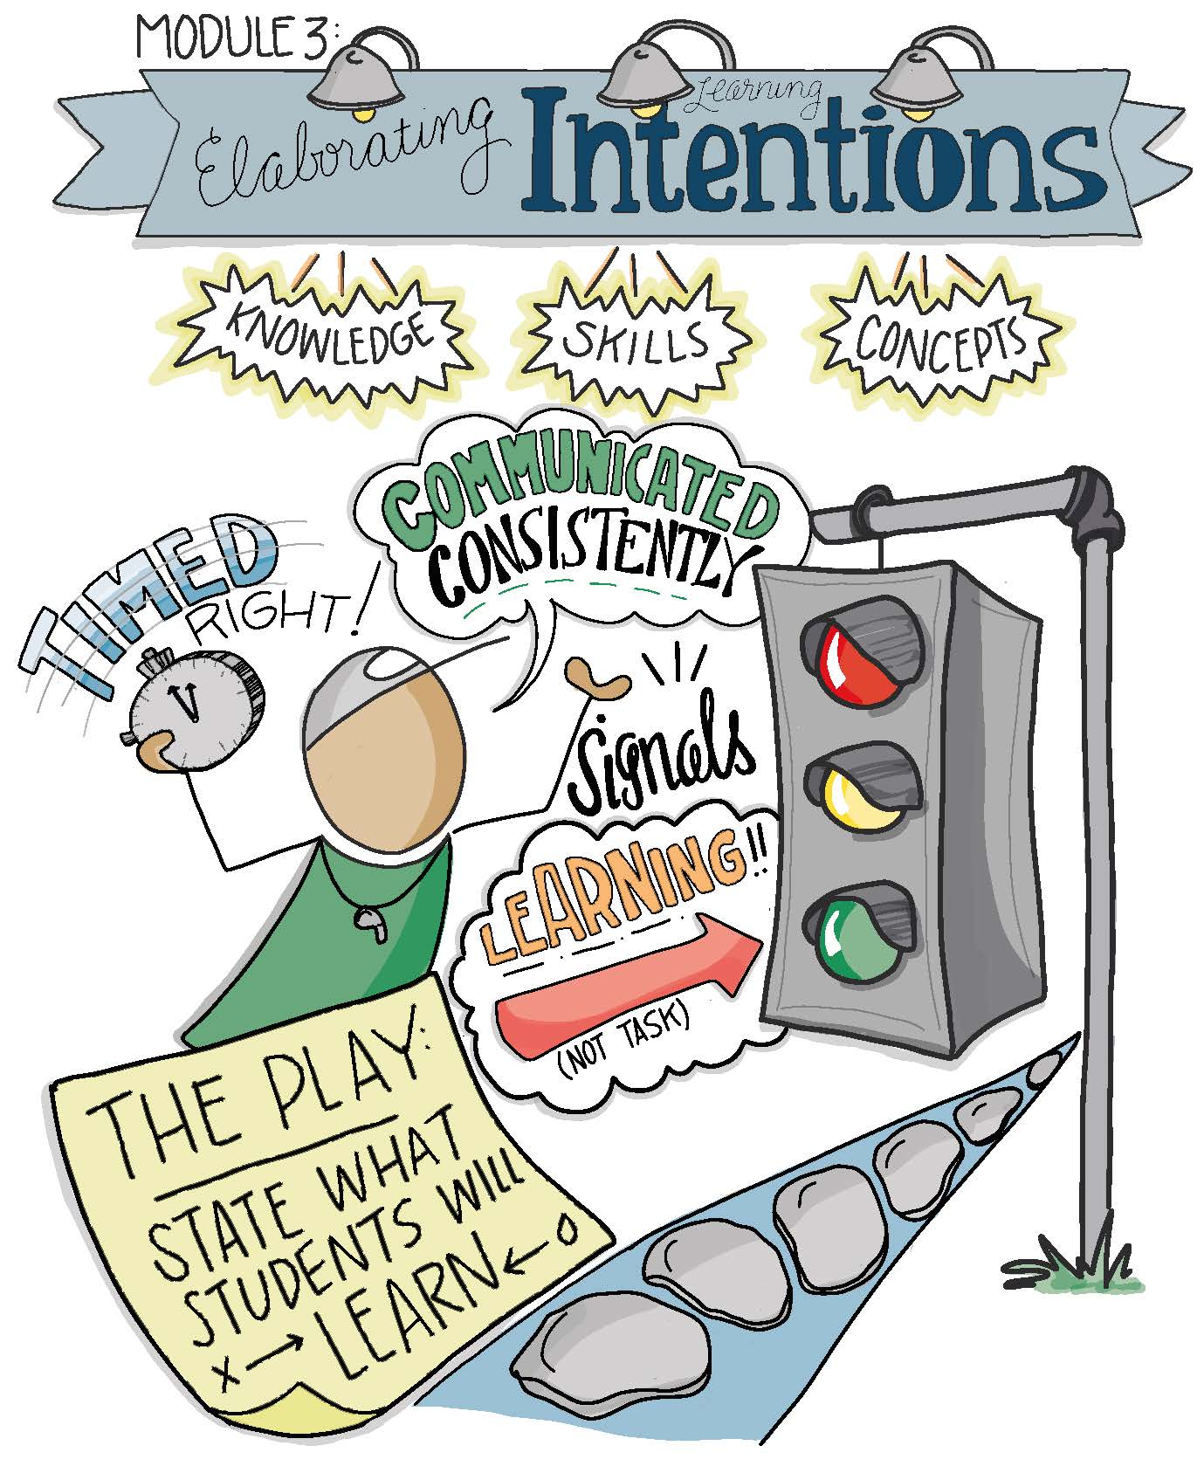

Slide 4
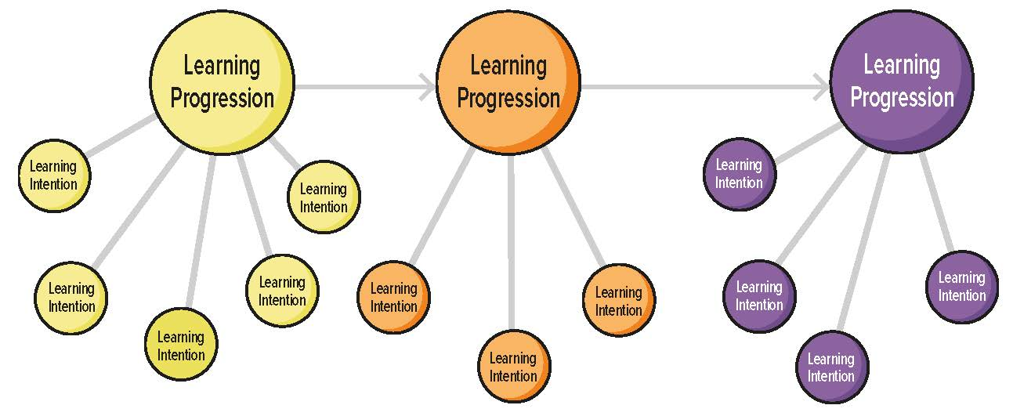
Learning Progressions vs. Learning Intentions

Slide 5
Modeling
Read and discuss the four examples on pages 22-24.
Are there points of divergence?
How might we come to consensus?

Slide 6
Guided Practice
Use the example on pages 25-26 to apply this process. Note that one in a series of learning progression has already been identified for you.
Follow the detailed instructions to complete the two related exercises.
Check for understanding by viewing the possible answers in The Teacher Clarity Playbook appendix.

Slide 7
On Your Own
Individually or in teams, use the same process for one of the learning progressions developed in Module 2.
Complete this on chart paper, or using digital collaboration tools.

Slide 8
PLC Conversations
What challenged you in this module?
Do any of our learning intentions focus more on tasks than expectations for learning?
What language should we use so students in our grade understand the learning intentions?

Slide 9
Wrap Up: Why Are We Doing This?
“Learning intentions have a priming effect on learners. They signal to the students what they will be learning or what they have learned. ” (p. 20)

