Slide 1
Module 2: Reading Effectively in the Content Areas
By ReLeah Lent

Slide 2
Bring It Back Activity
Find a partner with whom to share your thinking around the text you have chosen to use in your classroom. You will each talk 2 minutes.
Discuss these points:
What makes this text an authentic choice for yourstudents?
What will make this text engaging to your students?
How will this text build your students’ complex knowledge of your content area?
Which reading habits of experts in your field will students use when reading this text?

Slide 3
Reflection
Take a minute to reflect on the experience of finding a text to use in your classroom.
What were the biggest challenges in finding an authentic, engaging text to use with your students?

Slide 4
Objectives for This Session
Participants will:
reflect on the experience of choosing a text to use in the classroom.
explore five instructional practices that are effective tools in helping students construct deep knowledge through the reading of engaging, authentic texts in every discipline.

Slide 5
Five Paths to Authentic Reading
Current Events Short Takes
Read-Alouds
Reading Visually
Blog Reading
Collaborative Reading of Challenging Texts

Slide 6
Current Event Short Takes
Current event short takes increase—
relevance
interest
learning

Slide 7
Reflecting on Sample Texts
With the texts just shown you in mind, reflect on this question:
How might texts like these make my content area seem more interesting and relevant to my students?

Slide 8
How to Incorporate Current Event Short Takes
Use them to begin class each day to capture students’ interest and focus them on your content area.
Use them to introduce a lesson.
Create reading breaks during the lesson to recapture attention and encourage engagement.
Provide links to articles students can read during independent reading time or when students have finished their work.

Slide 9
How to Incorporate Current Events Short Takes
Place students in small groups and have one group member each day responsible for breaking in a current event the group can discuss.
Choose a longer article with parts and read one part a day for the week.
Provide one article a week for everyone to read and discuss.

Slide 10
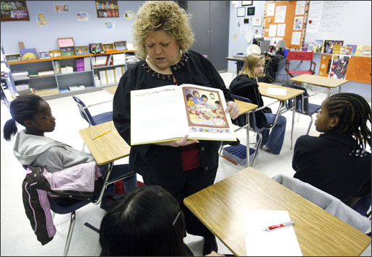
Reflection
What was the last text you read aloud to your students?
What was your purpose for reading it?

Slide 11
Read-Alouds
Read aloud to your students regularly from sources such as journals, novels, nonfiction, blogs, and commentaries to engage your students with your discipline.
“…students need to hear how experts in the field communicate—especially when text is too challenging for readers to access on their own.”
—ReLeah Lent

Slide 12
How to Read Aloud (from Releah Lent)
Read slowly and with as much showmanship as you possess.
Sprinkle in your own thoughts about the content as you read.
Have students jot questions in their learning logs for later discussion.
Stop periodically to ask questions about the content.
Model how you might disagree with the author or questions facts or sources.

Slide 13
How to Read Aloud (from ReLeah Lent)
Stop often to have students turn and talk.
You may want to project visuals or the complete text while reading.
Provide links to online sources so students can access the text later.
“…Try not to turn a read-aloud into an assignment; instead, approach it as a bonus—something enjoyable that you are sharing.”
—ReLeah Lent

Slide 14
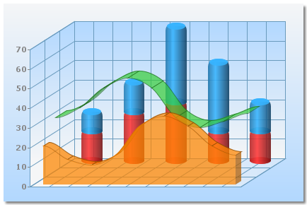
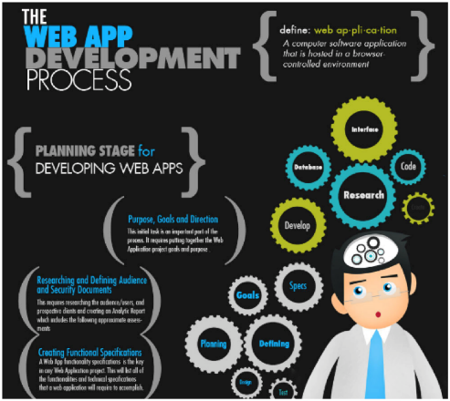
Reading Visually
Visual literacy is important because we know that nonlinguistic representations of a concept, especially when paired with print, can increase students’ ability to learn.”
--Releah Lent
Teach your students how to read
Infographics
Charts
Graphs
Political Cartoons
Photographs
Illustrations

Slide 15
Reflection
Think about this question:
How did the questions help guide your understanding of the visual?

Slide 16
Reading Blogs
“…a blog’s major function is to communicate with other web users around the world for the purpose of
informing
interacting with
or persuading
a large number of people.”
—ReLeah Lent

Slide 17
Ideas for Using Blogs in the Classroom
Read blogs reflecting two different opinions about the same topic and have students list the points on each side.
Have students evaluate blogs on credibility and impartiality.
Use blogs to help students understand author’s message.
Have students write a response to one blog a week in their learning logs.

Slide 18
Collaborative Close Reading of Challenging Text
Text selection is crucial. The text must be—
short
challenging
complex enough to engage students over multiple readings
Students will work with partners or in groups to comprehend and derive meaning from the text.

Slide 19
Bring It Back Task
Read the second half of Chapter 2 in This Is Disciplinary Literacy, pp. 33–58 (Beginning with How to Get Students Reading in Every Discipline Every Day to end of chapter) to deepen your understanding of what we discussed today.
Choose ONE of the ideas we explored today for reading in the content areas and include it in a lesson between now and the next time we meet.
Be prepared to talk with a partner about the celebrations and challenges of your experience.

