Slide 1
Module 2. Sequencing Learning Progressions
The Teacher Clarity Playbook

Slide 2
Objectives for Today
Participants will:
Understand the nature of learning progressions and their role in planning with clarity in mind.
Examine examples of learning progressions in four grade levels
Complete two guided learning exercises to check for understanding
Apply the process to identify learning progressions in the selected standard

Slide 3
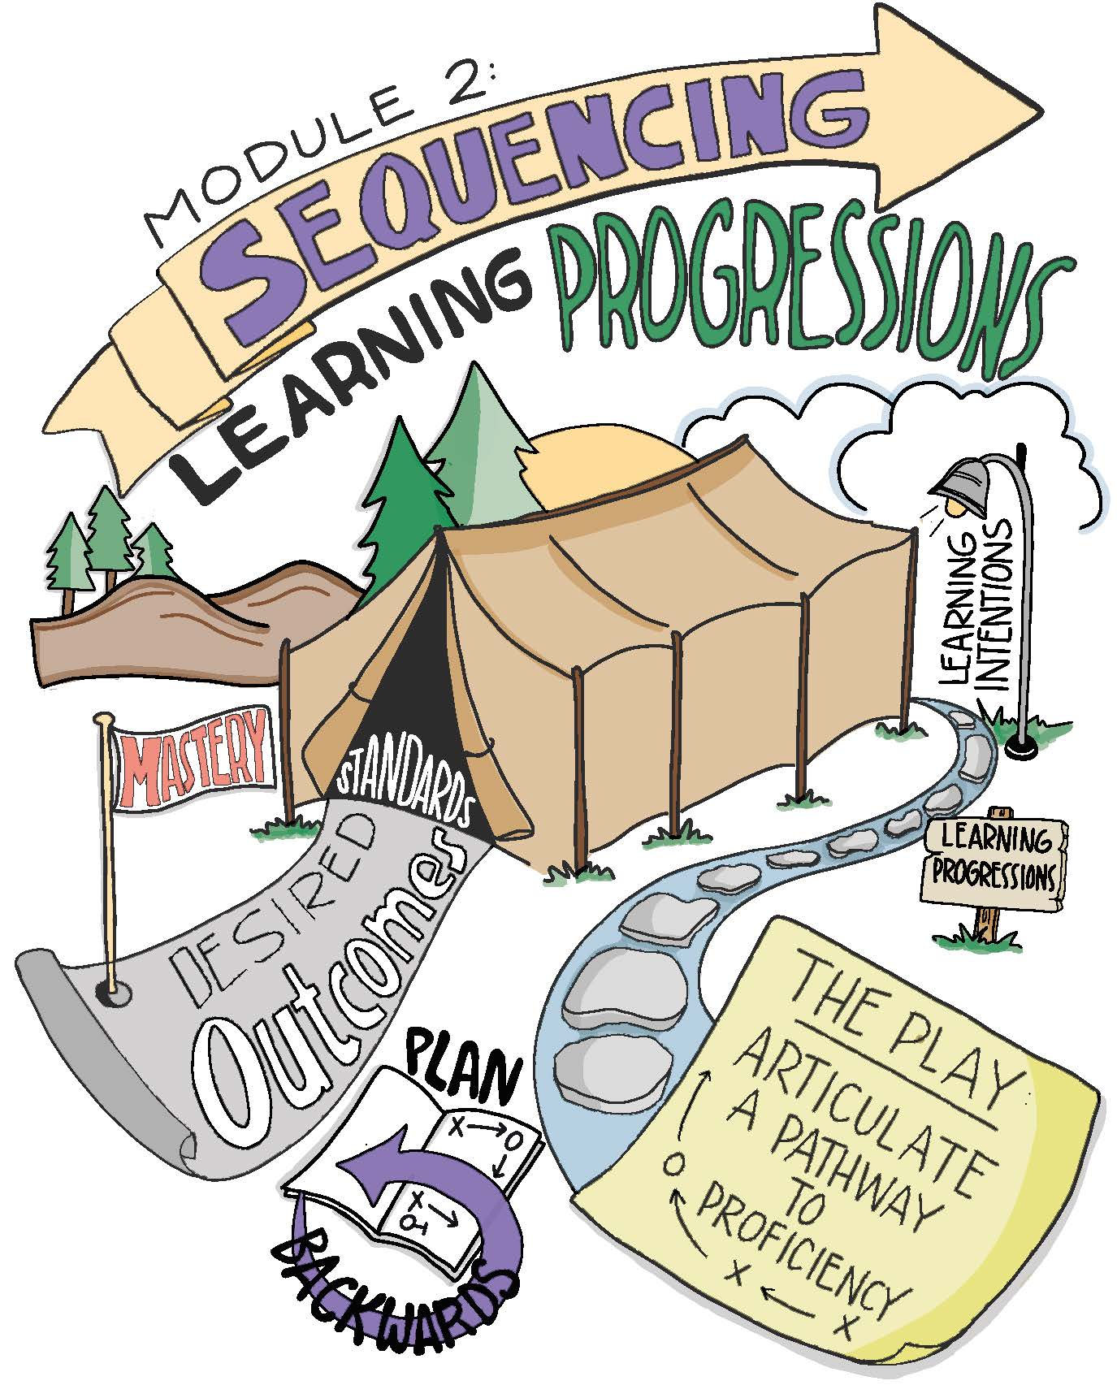

Slide 4
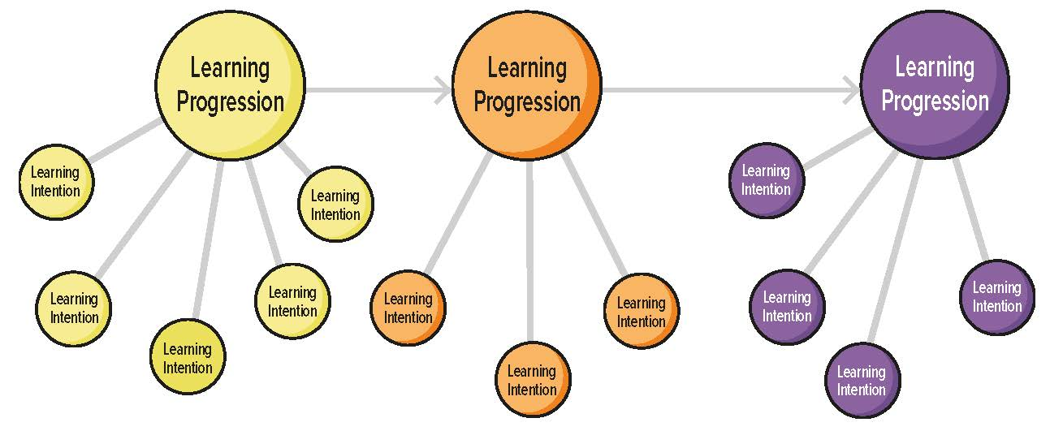
Learning Progressions vs. Learning Intentions

Slide 5
Modeling
Read and discuss the four examples on pages 13-15.
Are there points of divergence?
How might we come to consensus?

Slide 6
Guided Practice
Use the two examples on page 16 to apply this process.
Follow the detailed instructions to complete the exercises.
Check for understanding by viewing the possible answers in The Teacher Clarity Playbook appendix.

Slide 7
On Your Own
Individually or in teams, use the same process with your selected standard.
Complete this on chart paper, or using digital collaboration tools.

Slide 8
PLC Conversations
What challenged you in this module?
How are learning progressions different from learning intentions, and why is this important?
How can you reach agreement about the learning progressions for a given standard?

Slide 9
Wrap Up: Why Are We Doing This?
“Learning progressions articulate a pathway to proficiency. The learning progressions are like tent poles for a unit of study in that they delineate the major supports for the standard. To use another metaphor, they are the stones that mark a path.” (p. 10)

