Slide 1
Module 1: Disciplinary Literacy and Reading
By ReLeah Lent

Slide 2
Reflection
At the first staff meeting of the year, your administrators announce that this year all teachers will teach reading and writing.
Write your honest reaction to this statement.

Slide 3
Objectives for Today
Participants will:
distinguish between content area reading and disciplinary literacy.
understand the purpose of disciplinary literacy.
investigate how experts in the various disciplines read authentic texts.
broaden their concept of texts appropriate for use in the classroom.

Slide 4
Disciplinary Literacy
Disciplinary Literacy involves the use of
reading,
reasoning,
investigating,
speaking, and
writing
required to learn and form complex knowledge
appropriate to a particular discipline.
McConachie, 2010, p. 16

Slide 5
Guidance from ReLeah Lent
“…teachers…must be given permission to use their professional expertise, preferably within PLCs or with colleagues, in selecting
texts,
curriculum, and
tasks
that push students beyond superficial facts to deeper understanding through immersion in reading, writing, thinking, and social practices.”

Slide 6
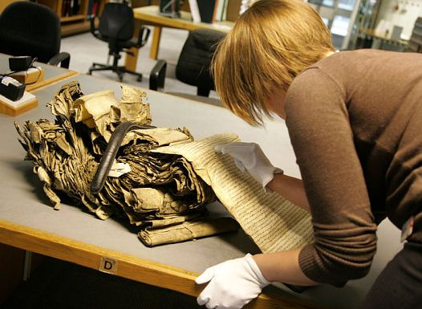
Reading in the Real World
What are the reading purposes and habits of people who work every day in these disciplines?

Slide 7
A New View of Reading
“…reading within a discipline doesn’t mean simply ‘unlocking’ the text or answering questions related to comprehension. It means students read for a purpose and consider what they are reading in light of the context and content. Most important, they learn how to apply the knowledge they have gained through reading. “—ReLeah Lent
So…what should our students be reading?

Slide 8
Direction from ReLeah Lent
“…as a content area teacher, your job is to make engaging, disciplinary-relevant texts available to your students, and give them time to read. “

Slide 9
Bring It Back Assignment
Please read pp. 1-33 in This Is Disciplinary Literacy to deepen your knowledge and understanding of what we’ve discussed today.
Locate one authentic text you can use with your students to develop complex knowledge of your subject.
Come back prepared to talk to a partner about why it is an authentic choice and which of the specific purposes and habits listed in Handout 1 this reading would foster.

