Slide 1
Module 6: Effective Inquiry in Content Area Classrooms
By ReLeah Lent

Slide 2
Bring It Back Activity
Think about the ideas presented about inquiry in the section of This Is Disciplinary Literacy that you read.
Using the notes you took on the reading as a guide, discuss your reactions to the possibilities and/or challenges of inquiry-based learning.

Slide 3
Objectives for this Session
Participants will:
understand how the elements of inquiry work together to build complex knowledge.
explore four types of questions that lead to effective inquiry.

Slide 4
Generating Complex Knowledge
Background Knowledge
generates
Curiosity
generates
Questions
generate
Inquiry
generates
Complex Knowledge

Slide 5
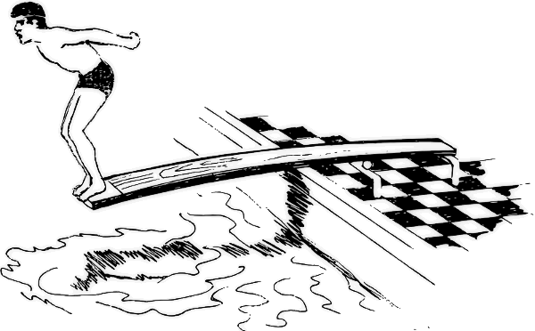
Good Questions
Good questions are…
the springboard to effective inquiry.

Slide 6
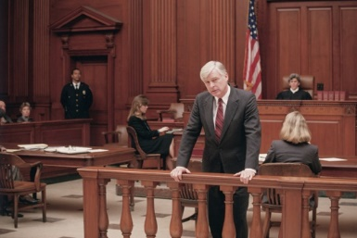
The Personality of Questions
Lawyers’ Questions
Lawyers’ questions are designed to build on what is known (background knowledge) to dig more deeply into a topic of interest.

Slide 7
The Personality of Questions
Reporters’ Questions
Reporters interview people with deep knowledge of a subject, asking questions which help them see things from an expert’s point of view.

Slide 8
21st Century Interviews
“No longer do students call for an appointment and then sit across the desk from an expert, notebook in lap. They can now reach out to just about anyone through communication tools such as Skype or email, making it easier to focus on the interview itself. “
—ReLeah Lent

Slide 9
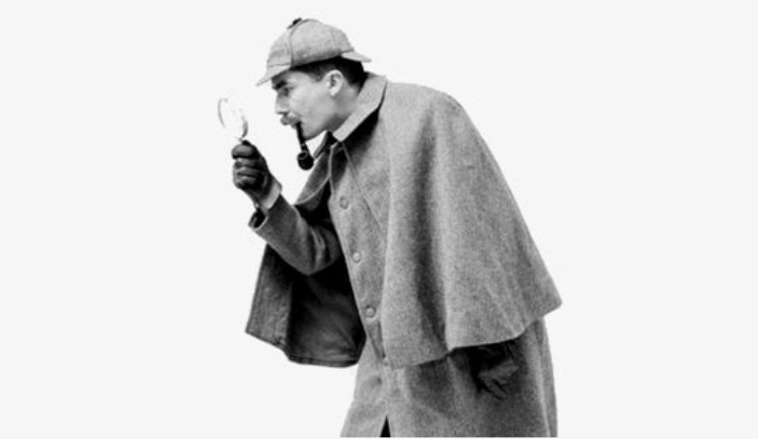
The Personality of Questions
Detectives’ Questions
Detectives’ questions try to solve a mystery, looking first at a problem and then attempting to find its cause.

Slide 10
The Power of Mystery
“A mystery is a hook for learning and students will respond enthusiastically if they can act as investigators rather than as passive learners.”
—ReLeah Lent

Slide 11
The Personality of Questions
The Skeptics’ Questions
Skeptics question everything, doubting validity until they have proven it for themselves

Slide 12
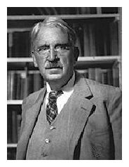
The Value of Skepticism
“Skepticism: the mark and even the pose of the educated mind.”
—John Dewey

Slide 13
ReLeah Lent reminds us…
“Students who think about information with a questioning eye learn to use inquiry in ways that will benefit them for life.”

Slide 14
Bring It Back Task
Read Chapter 4, from How to Get Students Inquiring to the end of chapter, pp. 124‒142.
This part of Chapter 4 will show you how to engage students in authentic activities that provide first-hand experience with the types of questions we discussed today.

Slide 15
You will learn about
Thinking as a Skeptic (Skeptics’ Questions)
Playing the Philadelphia Lawyer (Lawyers’ Questions)
Solving the Mystery (Detectives’ Questions)
Interviewing the Subject (Reporters’ Questions)
and
Independent or Small Group Inquiry Projects (A combination of all types of questions)

Slide 16
Bring It Back Task
Choose one inquiry practice to try in your classroom.
Jot notes on the success of the experience—what worked and what didn’t.
Think about what you might change.
Be prepared to discuss your experience with a partner.

