Slide 1
IMPACT OF THE
VOTING RIGHTS
ACT SLIDES

Slide 2
Source: spxChrome/iStock.com

Slide 3
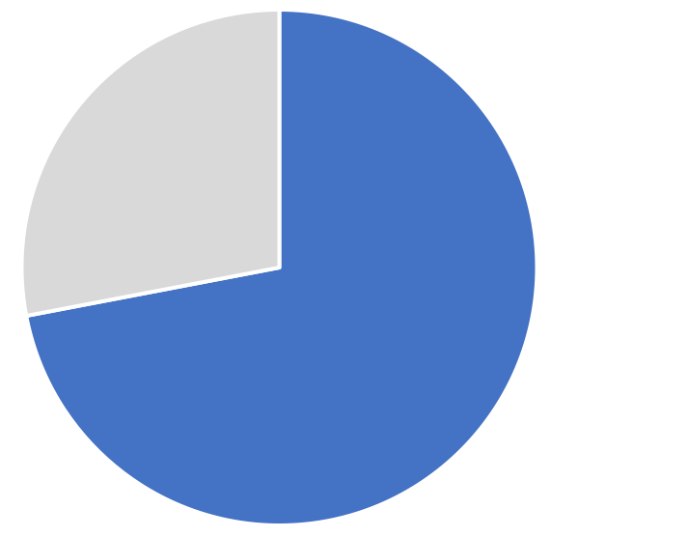
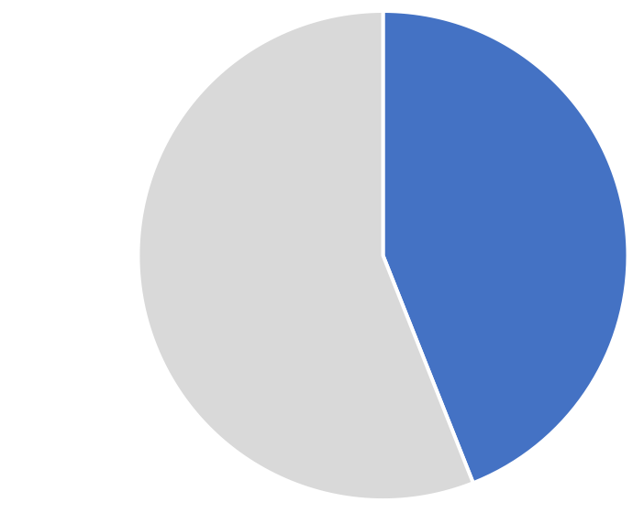
Black Voter Turnout, 1964 U.S. Presidential Election
Northern states: 72%
Southern states: 44%

Slide 4
From a 1964 Louisiana “Literacy” Test for Voter Registration
Source: Civil Rights Movement Archive, Civil Rights Movement Archive, https://www.crmvet.org/index.html

Slide 5
Black Voter Turnout in South and Elsewhere in U.S. Since 1965 Voting Right Act
Source of data: U.S. Census Bureau (https://www.census.gov/data/tables/time-series/demo/voting-and-registration/voting-historical-time-series.html)
Notes:
What do you notice or wonder about the graph?
Possible explanation: “Most notably, many more Black Americans are now registered to vote—and the difference between Southern and Northern turnout has disappeared.

Slide 6
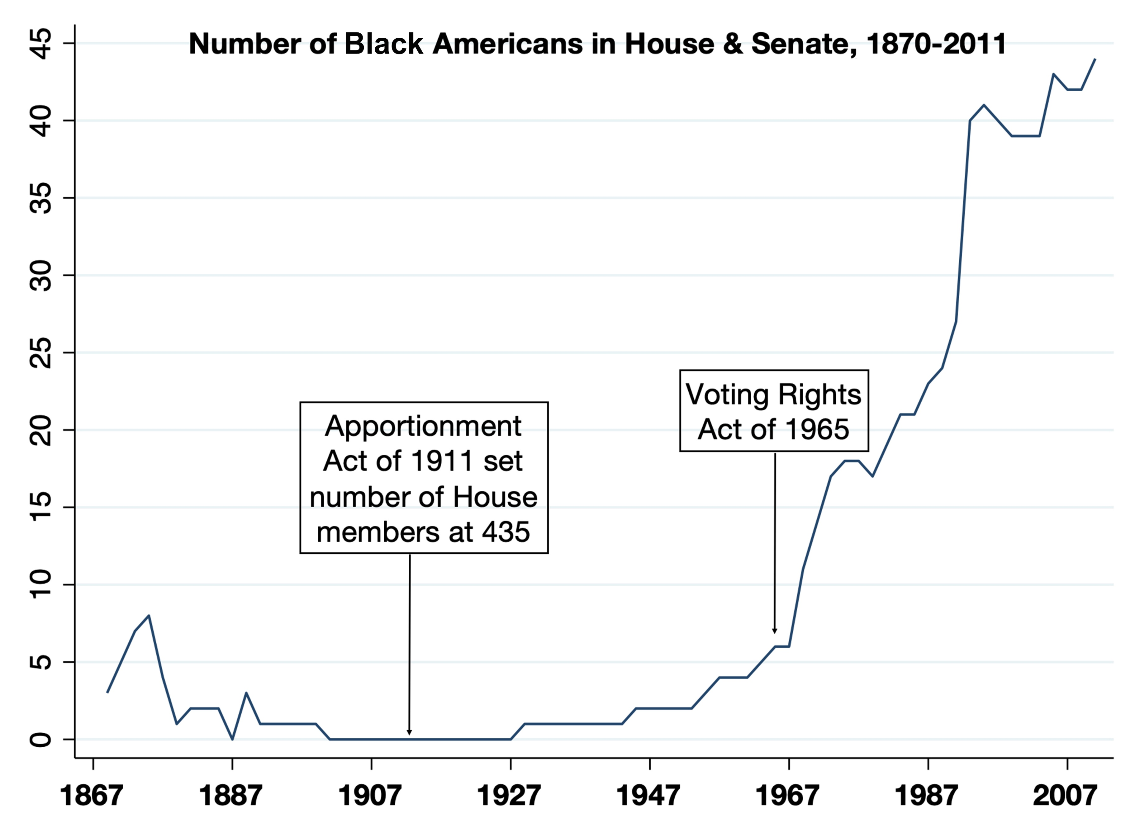
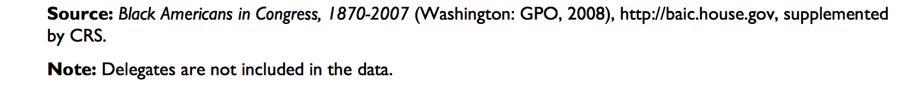
Indianapolis, IN

Slide 7
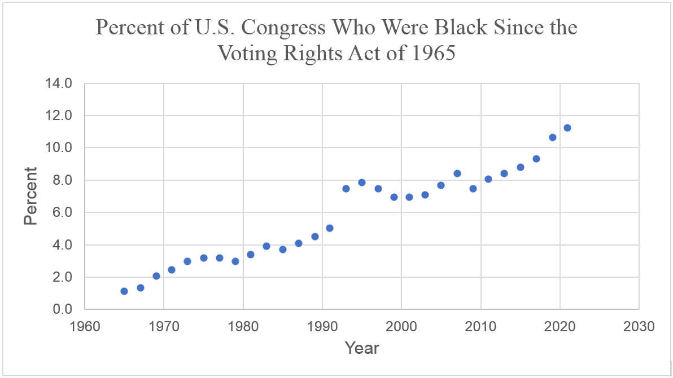
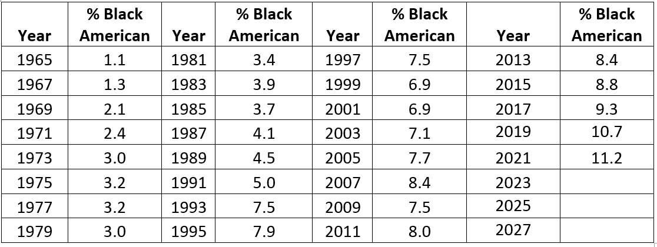
Indianapolis, IN

