Slide 1
SLIDES FOR
GERRYMAN-
DERING TASK

Slide 2
An 1812 political cartoon making fun of the shape of a voting district near Boston that was re-drawn to favor Governor Elbridge Gerry’s Democratic-Republican party over the Federalist party.
Source: "The Gerry-Mander” by Elkanah Tisdale. Originally published in the Boston Centinel, 1812. https://en.wikipedia.org/wiki/Gerrymandering#/media/File:The_Gerry-Mander_Edit.png

Slide 3
1957 redrawing of boundaries of Tuskegee, AL to exclude almost all African Americans.
Ruled unconstitutional in 1960.
https://www.facstaff.bucknell.edu/marsh/spatial_inequality/1_local_political_geographies.html

Slide 4
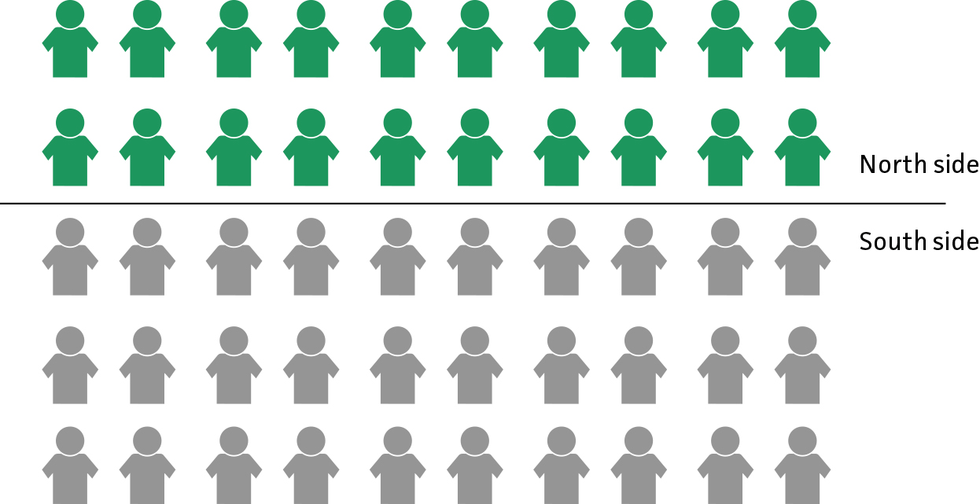

Slide 5
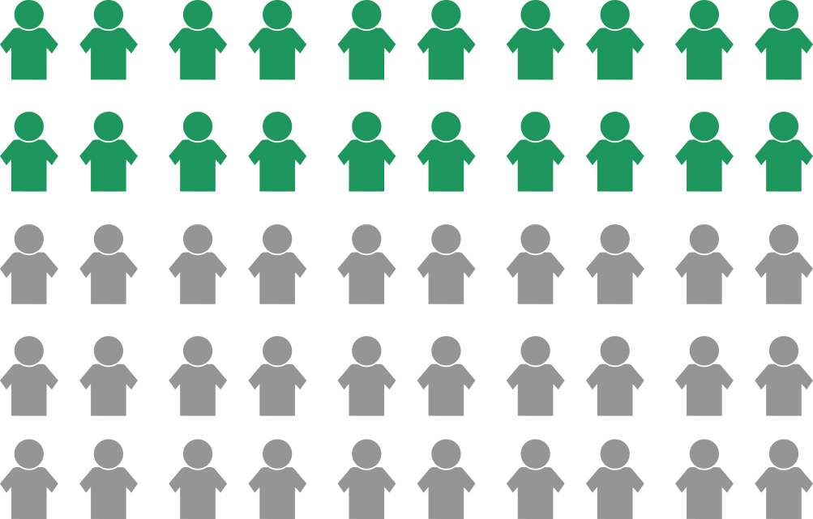

Slide 6
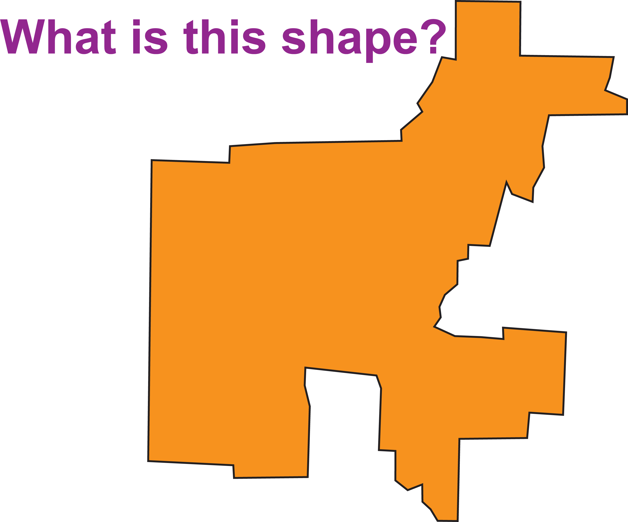

Slide 7
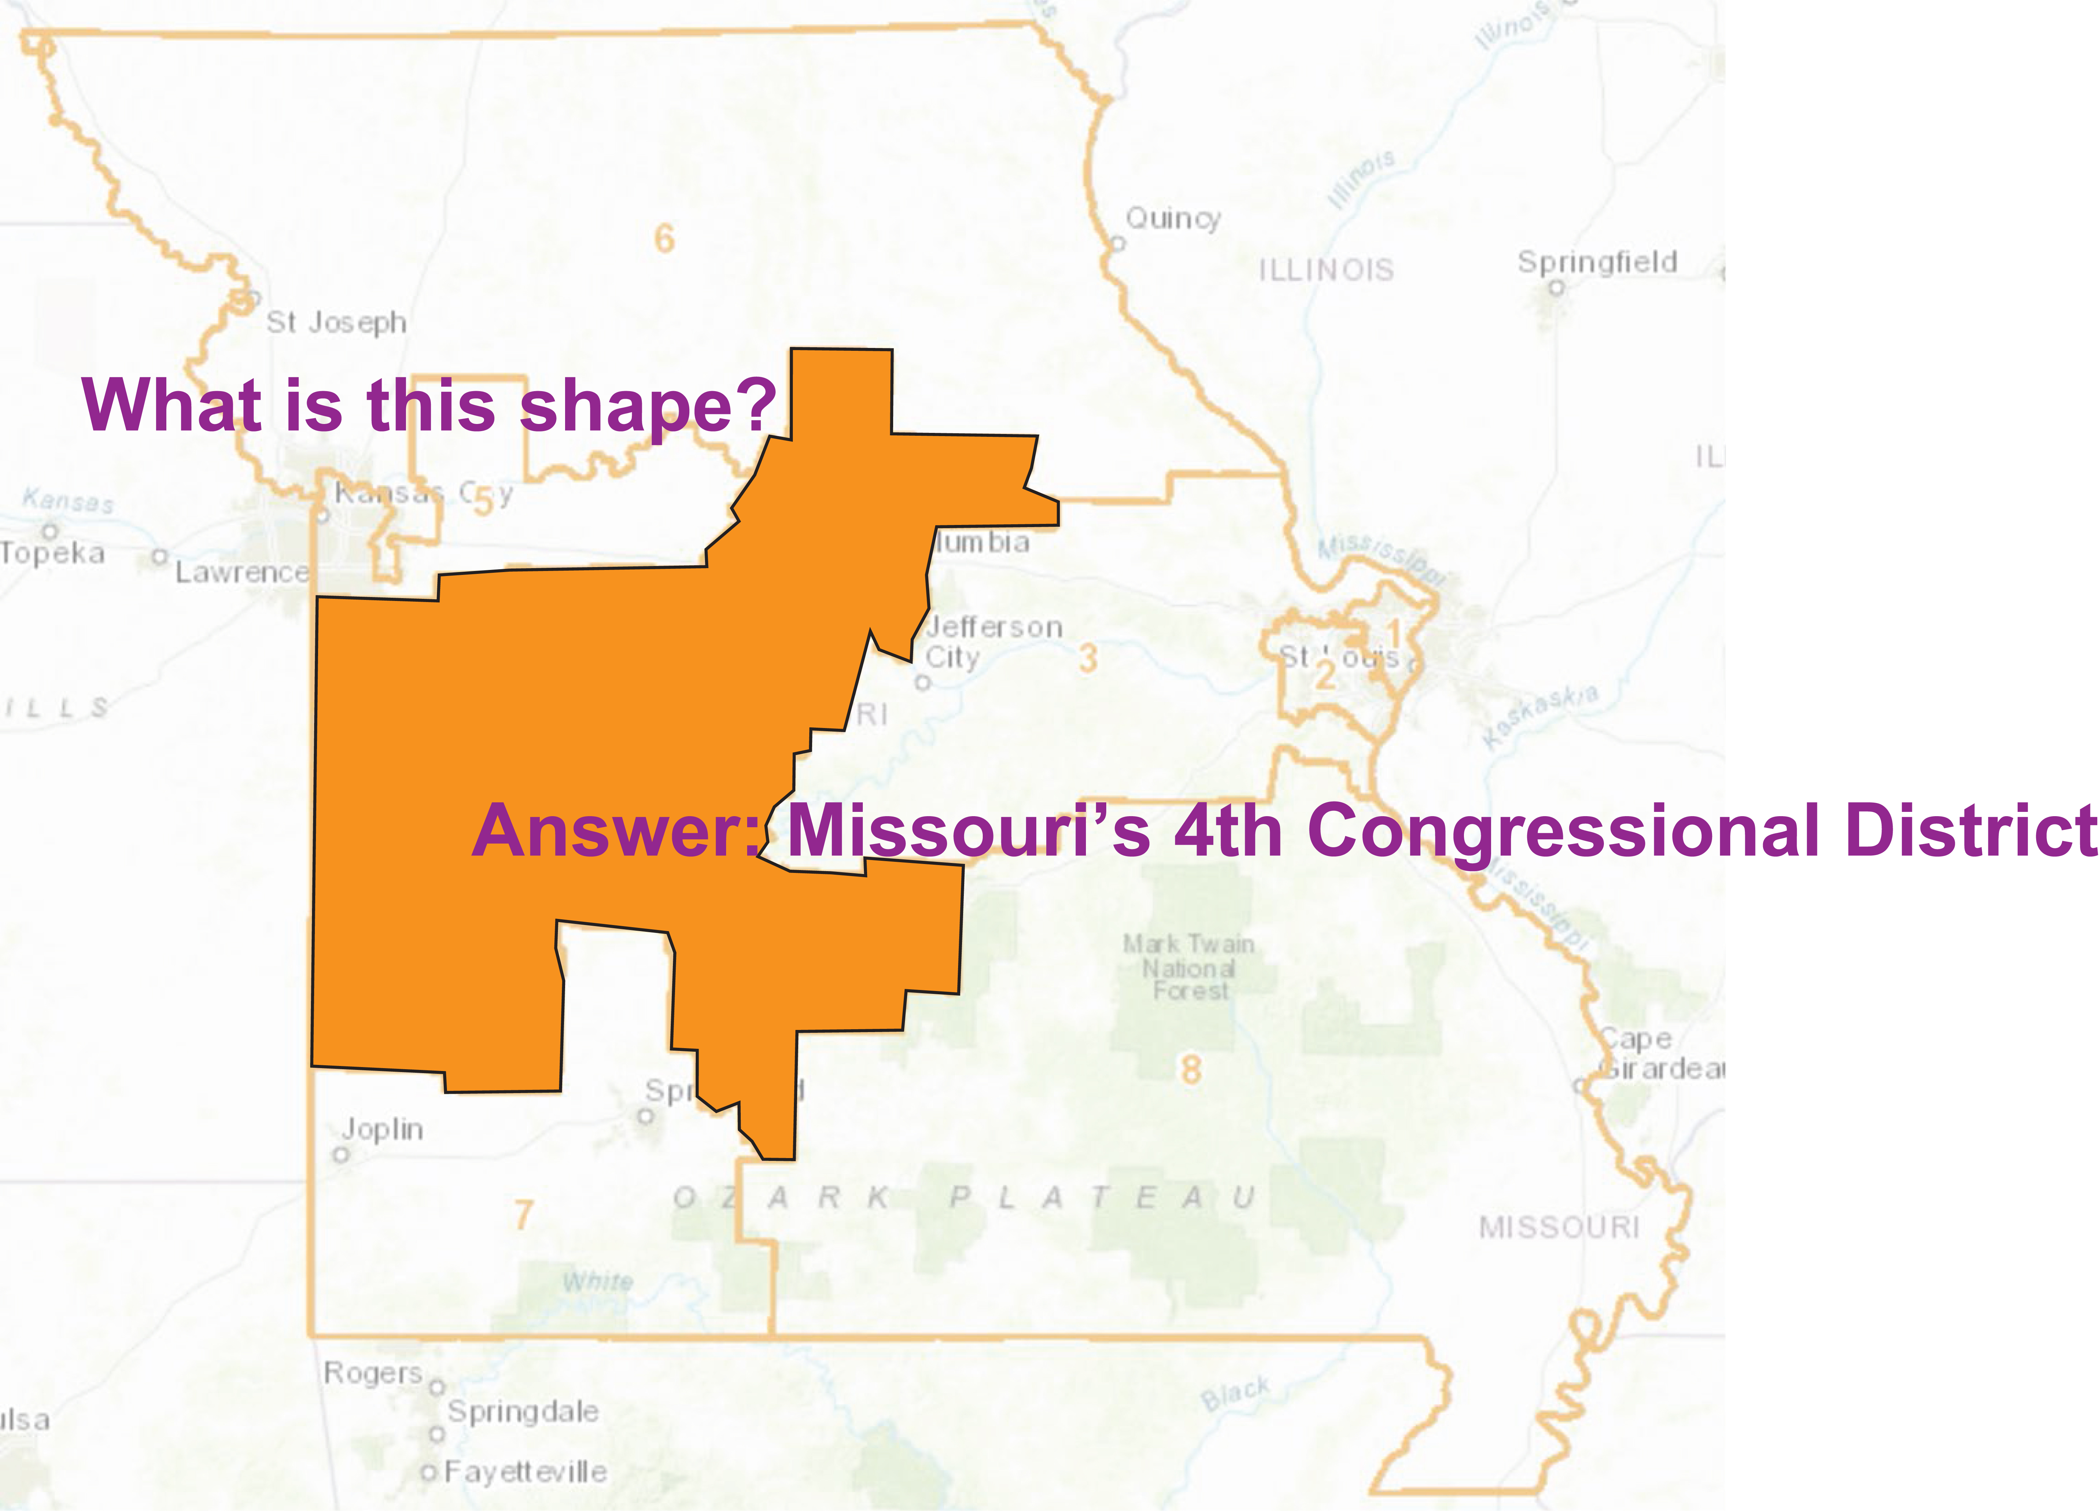

Slide 8
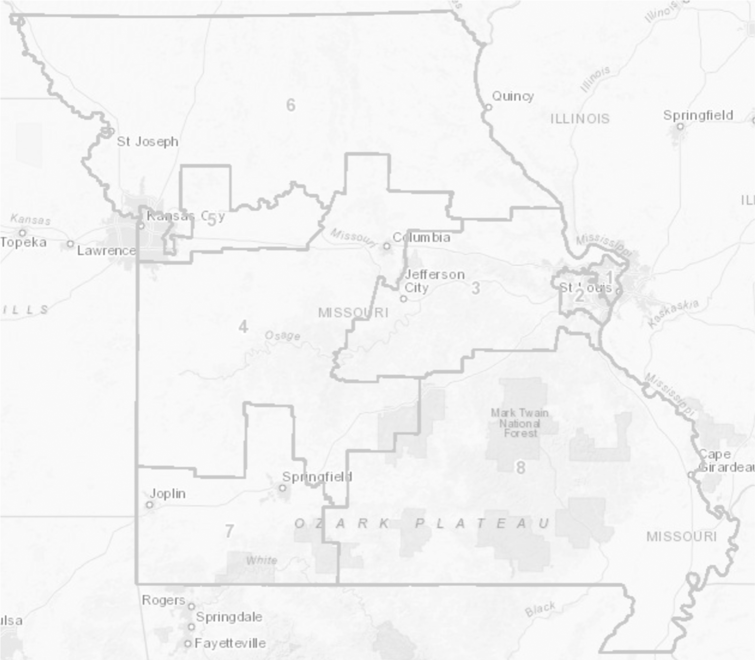
Based on the 2012 and 2016 presidential elections, about 55% of Missourians vote Republican.
So, how many of our 8 allotted U.S. representatives would you expect to be Republicans?
Source: 2012 Congressional Map from Missouri Secretary of State, www.sos.mo.gov.

Slide 9
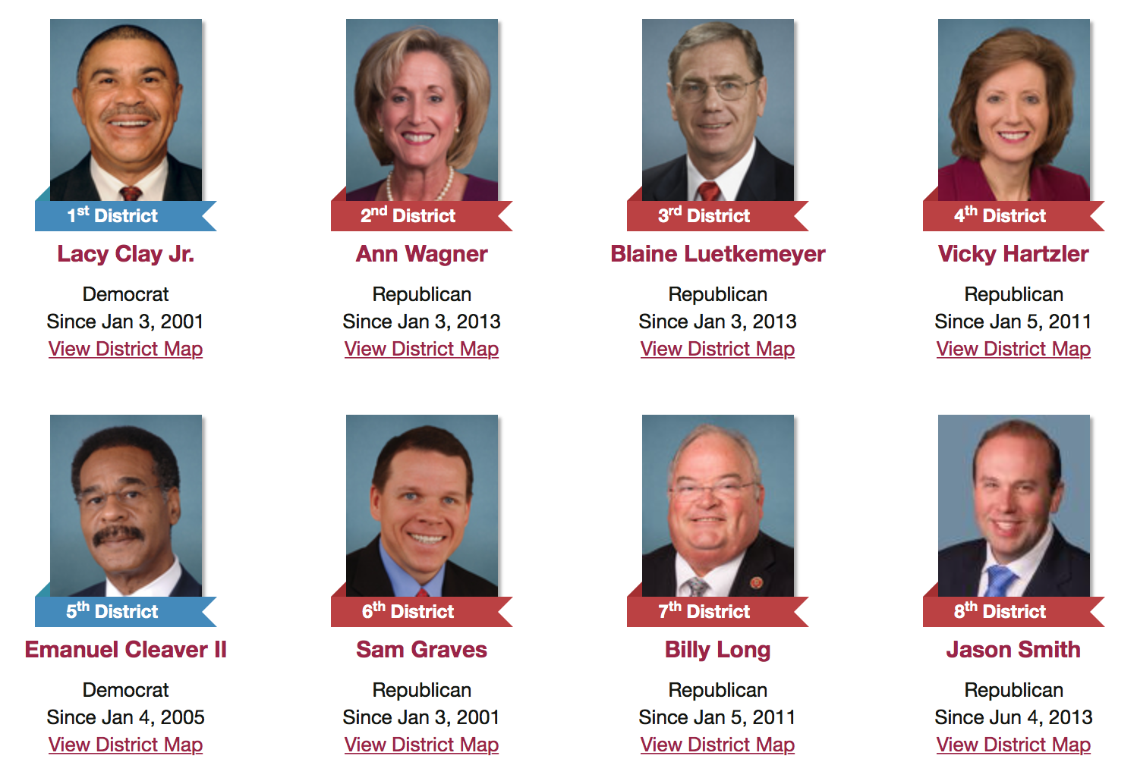
Based on the 2012 and 2016 presidential elections, about 55% of Missourians vote Republican.
So, how many of our 8 allotted U.S. representatives would you expect to be Republicans?
6
5
1
4
3
2
7
8
Is this OK? What would we need to decide if “cheating” had occurred?
Source: 2012 Congressional Map from Missouri Secretary of State, www.sos.mo.gov. Missouri Congress Members from www.congress.gov.

