Slide 1
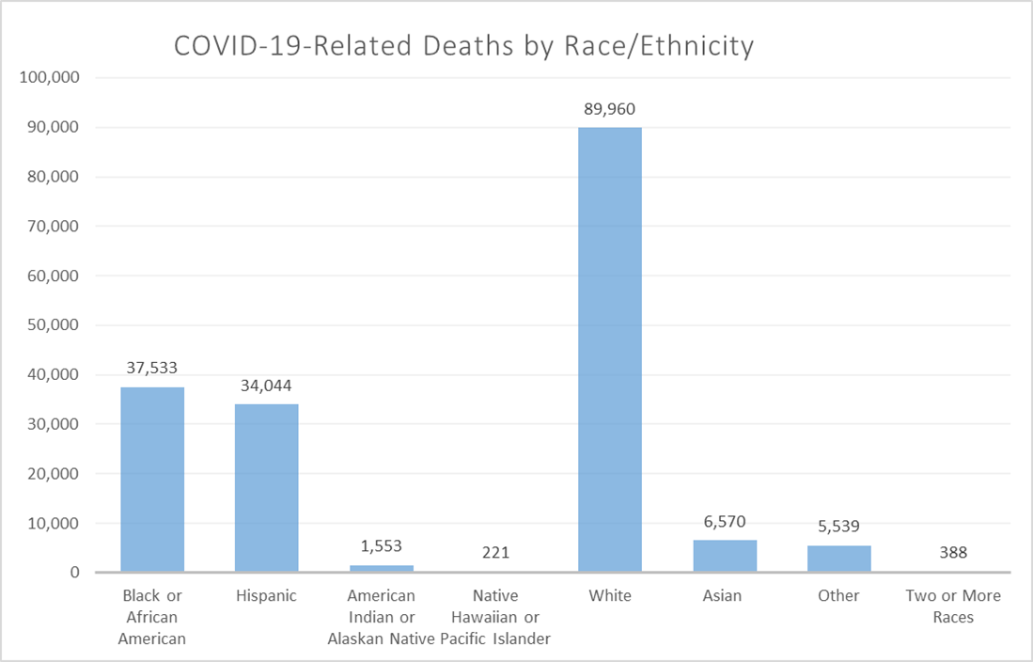

Slide 2
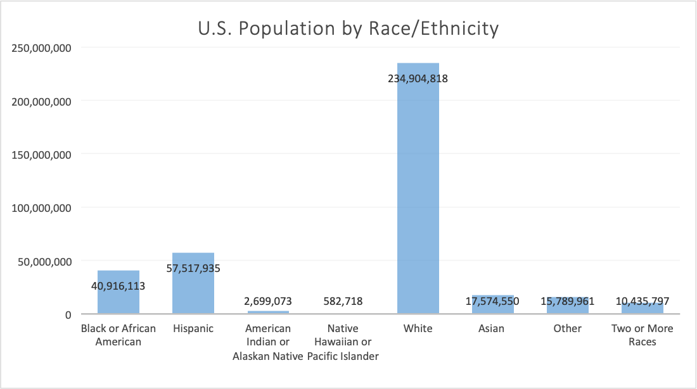

Slide 3
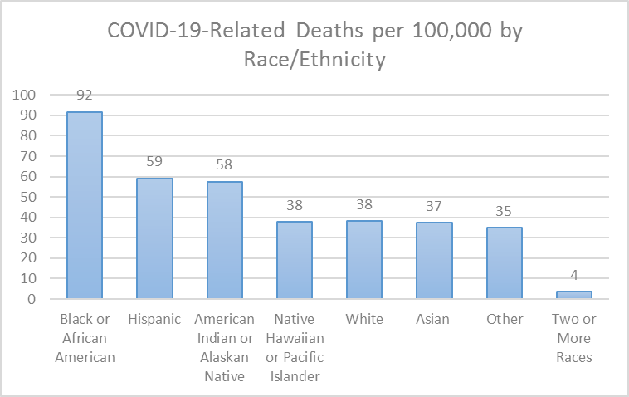

Slide 4
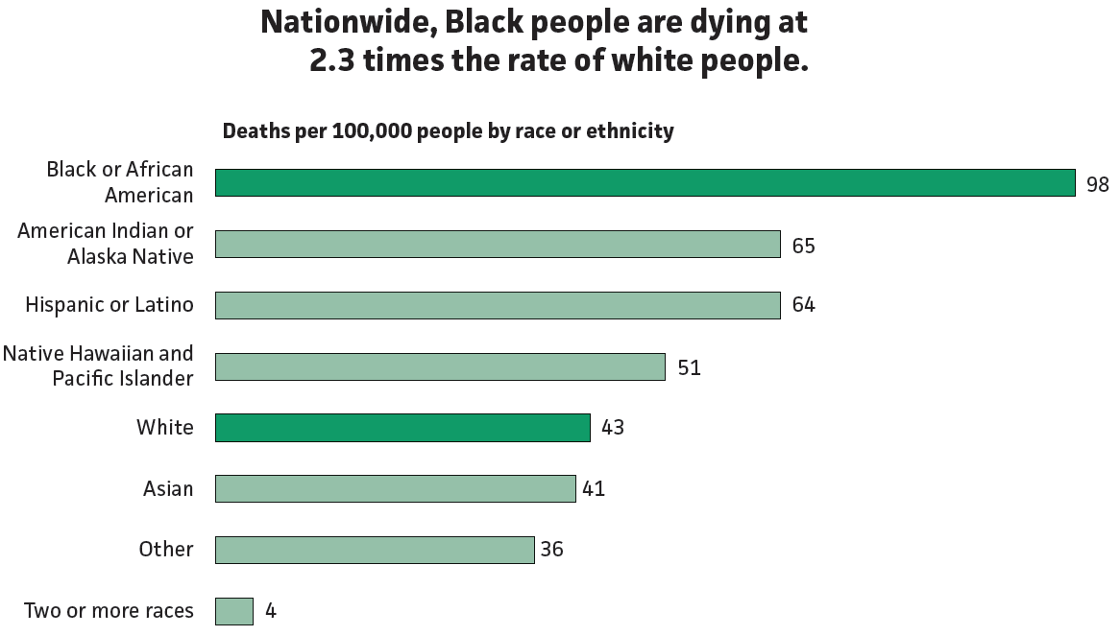
Source: The COVID Tracking Project at The Atlantic, covidtracking.com. CC BY 4.0. https://creativecommons.org/licenses/by/4.0/ (https://covidtracking.com/race)

Slide 5
Race/ethnicity | Percentage of population
Black or African American alone | 12%
Hispanic or Latino* | 39%
Asian alone | 5%
Native Hawaiian and Pacific Islander alone | <1%
American Indian or Alaska Native alone | <1%
Two or more races | 2%
White alone | 42%
Some other race alone | <1%
*Hispanic or Latino ethnicity, any race. All other race categories in this table are defined as Not Hispanic or Latino.
Replace with data from your state
Source: Racial Data Dashboard, The COVID Tracking Project at The Atlantic, covidtracking.com.
CC BY 4.0. https://creativecommons.org/licenses/by/4.0/ (https://covidtracking.com/race/dashboard)

Slide 6
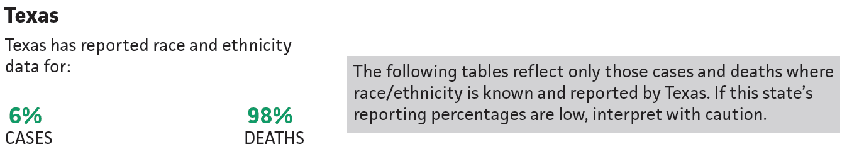
Replace with data from your state
Source: Racial Data Dashboard, The COVID Tracking Project at The Atlantic, covidtracking.com. CC BY 4.0. https://creativecommons.org/licenses/by/4.0/ (https://covidtracking.com/race/dashboard)

Slide 7
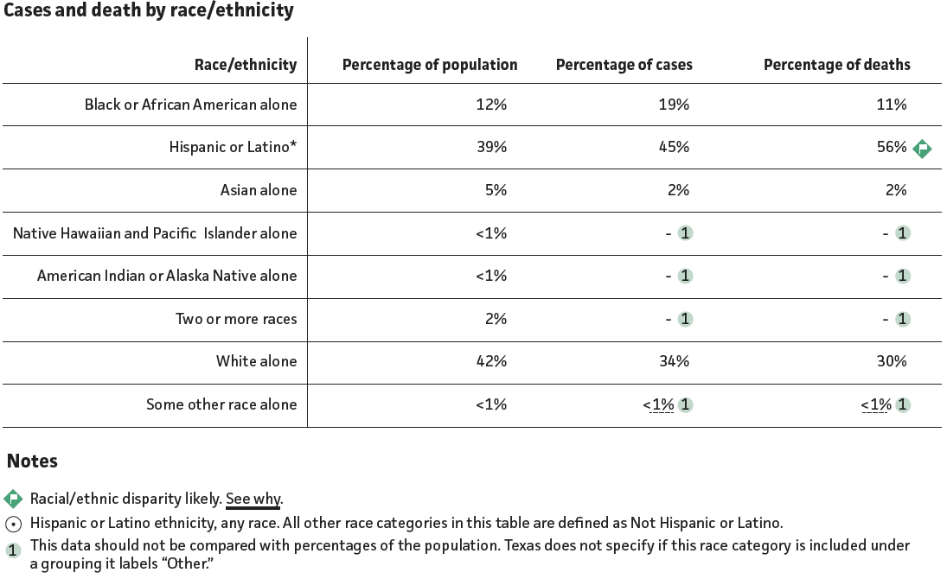
Replace with data from your state
Source: Racial Data Dashboard, The COVID Tracking Project at The Atlantic, covidtracking.com. CC BY 4.0. https://creativecommons.org/licenses/by/4.0/ (https://covidtracking.com/race/dashboard)

