Slide 1
Graphing Activity
Each person will select one Truth fact about smoking or vaping with an equation that represents the fact. There is a maximum of 4 students per fact.
You will need to complete the following on your slide:
Use the equation to complete the xy table.
Plot the ordered pairs on your graph paper.
Complete the summary statement by telling us what your Truth fact is about.
Be ready to share your work with the class.

Slide 2
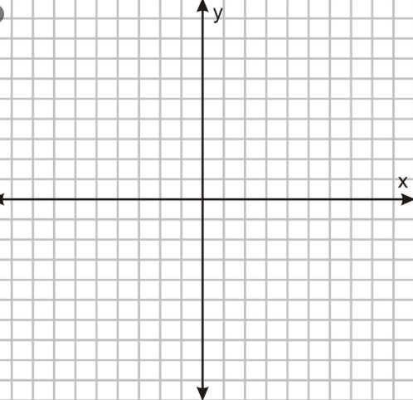
Name:
Truth fact 1: THE AVERAGE PACK-A-DAY SMOKER SPENDS MORE THAN $2,200 PER YEAR ON CIGARETTES.
y = 2200x
x (Years) | y (Money)
1 | $2200
2 | $4400
3

Slide 3
Name:
Summarize your Truth fact in the sentence frame below.
I determined . . . My xy table shows that for each year of ________, a smoker spends another $____________.

Slide 4

Name:
Truth fact 2: A LOT OF YOUNG PEOPLE HAVE BEEN FOOLED BY JUUL. A TRUTH STUDY SHOWED THAT 63% OF JUUL USERS DID NOT KNOW THAT THIS PRODUCT ALWAYS CONTAINS NICOTINE.
x (Number of People) | y (Number of People Fooled)
100 | 63
200 | 126
300

Slide 5
Name:
Summarize your Truth fact in the sentence frame below.
I determined the number of people fooled when given the number of . . . My xy table shows that for every 100 people vaping . . .

Slide 6

Name:
Truth fact 3: ONE IN FIVE PEOPLE DIE EVERY YEAR IN THE UNITED STATES FROM TOBACCO-RELATED ILLNESSES.
x (Number of Deaths) | y (Number of Tobacco-Related Deaths)
5 | 1
10 | 2
15

Slide 7
Name:
Summarize your Truth fact in the sentence frame below.
I determined . . . My xy table shows that for every 5 deaths, ___ dies from a _____________________________________ every year.

Slide 8
Name:
Truth fact 4: ONE TREE IS KILLED FOR 15 PACKS OF CIGARETTES.
y = 15x
x (Trees Killed) | y (Packs of Cigarettes)
1 | 15
2 | 30
3

Slide 9
Name:
Summarize your Truth fact in the sentence frame below.
I determined . . . My xy table shows that every _____________________ one tree.

Slide 10
Name:
Truth fact 5: BIG TOBACCO TARGETS BLACK AMERICANS. EACH YEAR MORE THAN 39,000 BLACK AMERICANS DIE FROM TOBACCO-RELATED CANCER.
y = 39,000x
x (Number of Years) | y (Deaths of Black Americans)
1 | 39,000
2 | 78,000
3

Slide 11
Name:
Summarize your Truth fact in the sentence frame below.
I determined . . . My xy table shows that for every year, another __________________________________________________________.

Slide 12
Name:
Truth fact 6: THE NICOTINE CONTENT IN ONE JUUL POD IS EQUIVALENT TO THE NICOTINE IN ONE PACK OF CIGARETTES (20 CIGARETTES).
y = 20x
x (Number of Pods) | y (Number of Cigarettes)
1 | 20
2 | 40
3

Slide 13
Name:
Summarize your Truth fact in the sentence frame below.
I determined . . . My xy table shows the nicotine in __________________________________________.

