Slide 1
Table of Contents
Lesson 1 | Lesson 2

Slide 2
Lesson 1
Back to top of document
Notes:
This slide is skipped while presenting

Slide 3



What do you notice? What do you wonder?
Images courtesy of trinketsandtrash.org, Rutgers School of Public Health.

Slide 4

What do you know about this?
Photo taken by Fair Expert. No changes made. CC BY-SA 4.0. https://creativecommons.org/licenses/by-sa/4.0/

Slide 5
Graphing Activity
Each person will select one Truth fact about smoking or vaping with an equation that represents the fact. There is a maximum of 4 students per fact.
You will need to complete the following on your slide:
Use the equation to complete the xy table.
Plot the ordered pairs on your graph paper.
Complete the summary statement by telling us what your Truth fact is about.
Be ready to share your work with the class.
Notes:
Teachers will need to adjust the amount of students allowed to select each fact based on the total class size. There are 6 facts in this lesson. This slide deck was set up for a class size of 24 students.

Slide 6
Truth Fact #1:
THE AVERAGE PACK-A-DAY SMOKER SPENDS MORE THAN $2,200 PER YEAR ON CIGARETTES.
Only 4 students can pick this Truth fact. Type your name below on one of the spots to claim this. If there are no spots left then you need to pick another one.
1.
2.
3.
4.
Notes:
You may want to upload these slides to google slides to allow students to edit them directly. In that case, you could also link each sign up slide to a separate slide deck for each truth fact.

Slide 7
Truth Fact #2:
A LOT OF YOUNG PEOPLE HAVE BEEN FOOLED BY JUUL. A TRUTH STUDY SHOWED THAT 63% OF JUUL USERS DID NOT KNOW THAT THIS PRODUCT ALWAYS CONTAINS NICOTINE.
Only 4 students can pick this Truth fact. Type your name below on one of the spots to claim this. If there are no spots left then you need to pick another one.
1.
2.
3.
4.

Slide 8
Truth Fact #3:
ONE IN FIVE PEOPLE DIE EVERY YEAR IN THE UNITED STATES FROM TOBACCO-RELATED ILLNESSES.
Only 4 students can pick this Truth fact. Type your name below on one of the spots to claim this. If there are no spots left then you need to pick another one.
1.
2.
3.
4.

Slide 9
Truth Fact #4:
ONE TREE IS KILLED FOR 15 PACKS OF CIGARETTES.
Only 4 students can pick this Truth fact. Type your name below on one of the spots to claim this. If there are no spots left then you need to pick another one.
1.
2.
3.
4.

Slide 10
Truth Fact #5:
BIG TOBACCO TARGETS BLACK AMERICANS. EACH YEAR MORE THAN 39,000 BLACK AMERICANS DIE FROM TOBACCO-RELATED CANCER.
Only 4 students can pick this Truth fact. Type your name below on one of the spots to claim this. If there are no spots left then you need to pick another one.
1.
2.
3.
4.

Slide 11
Truth Fact #6:
THE NICOTINE CONTENT IN ONE JUUL POD IS EQUIVALENT TO THE NICOTINE IN ONE PACK OF CIGARETTES (20 CIGARETTES).
Only 4 students can pick this Truth fact. Type your name below on one of the spots to claim this. If there are no spots left then you need to pick another one.
1.
2.
3.
4.

Slide 12
Lesson 2
Back to top of document

Slide 13
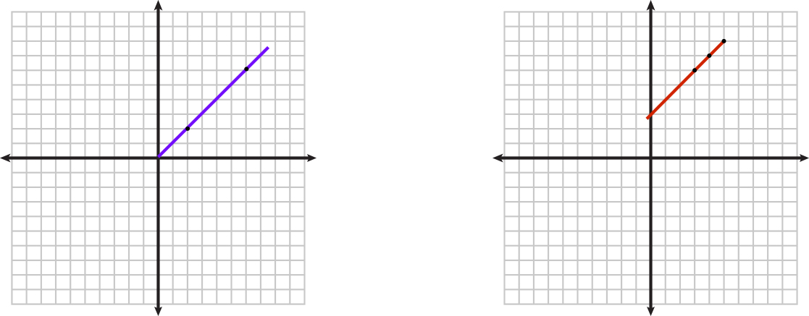
How are these similar? Different?
Notes:
As students share that they are both straight lines, teacher connects that with one of the requirements for being proportional. When a student notes the blue line goes through the origin and the red one doesn’t, teacher links that to the other requirement of being proportional. The discussion should be lead towards the left one being proportional because it is straight and it goes through the origin (0,0). The right one is non-proportional because the line will not go through the origin. Throughout the lesson we refer to rate of change, students may need to be told or reminded that rate of change of a line is the same as the slope of the line.

Slide 14
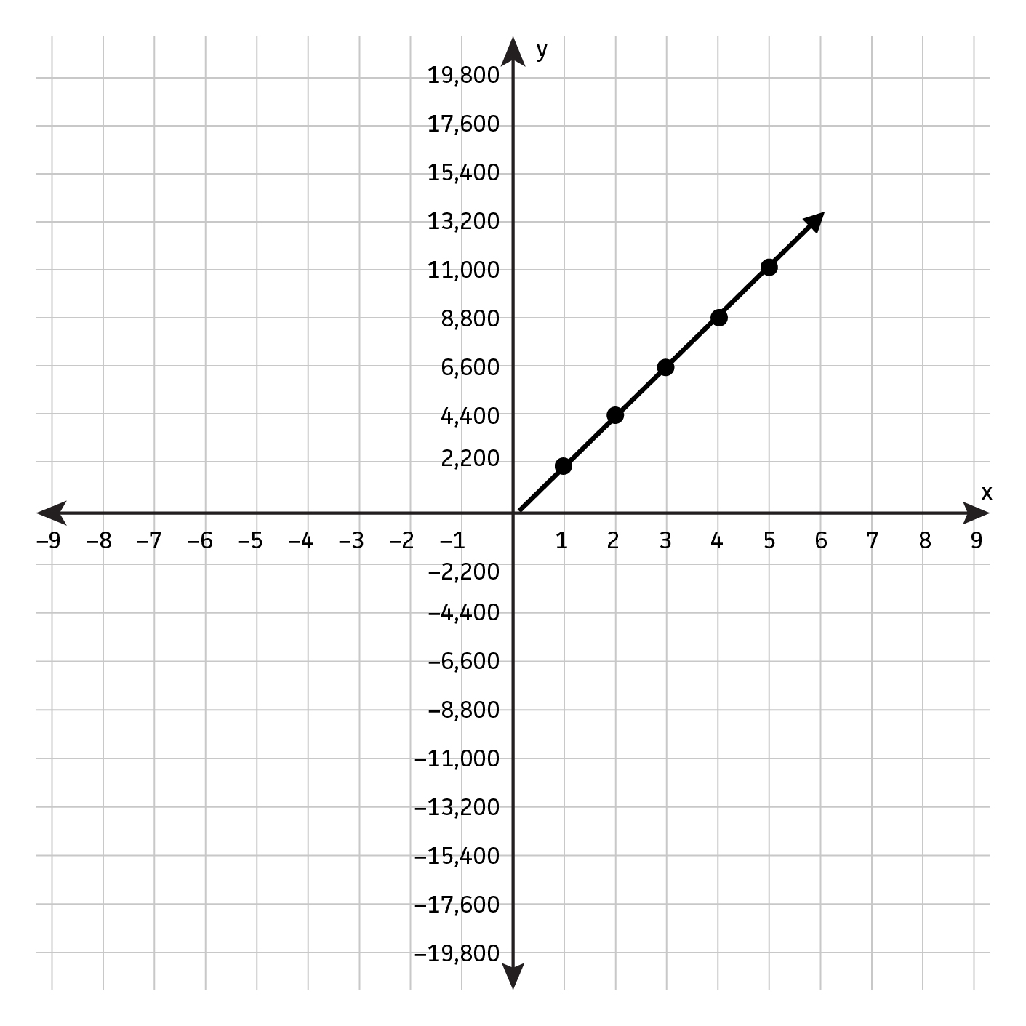
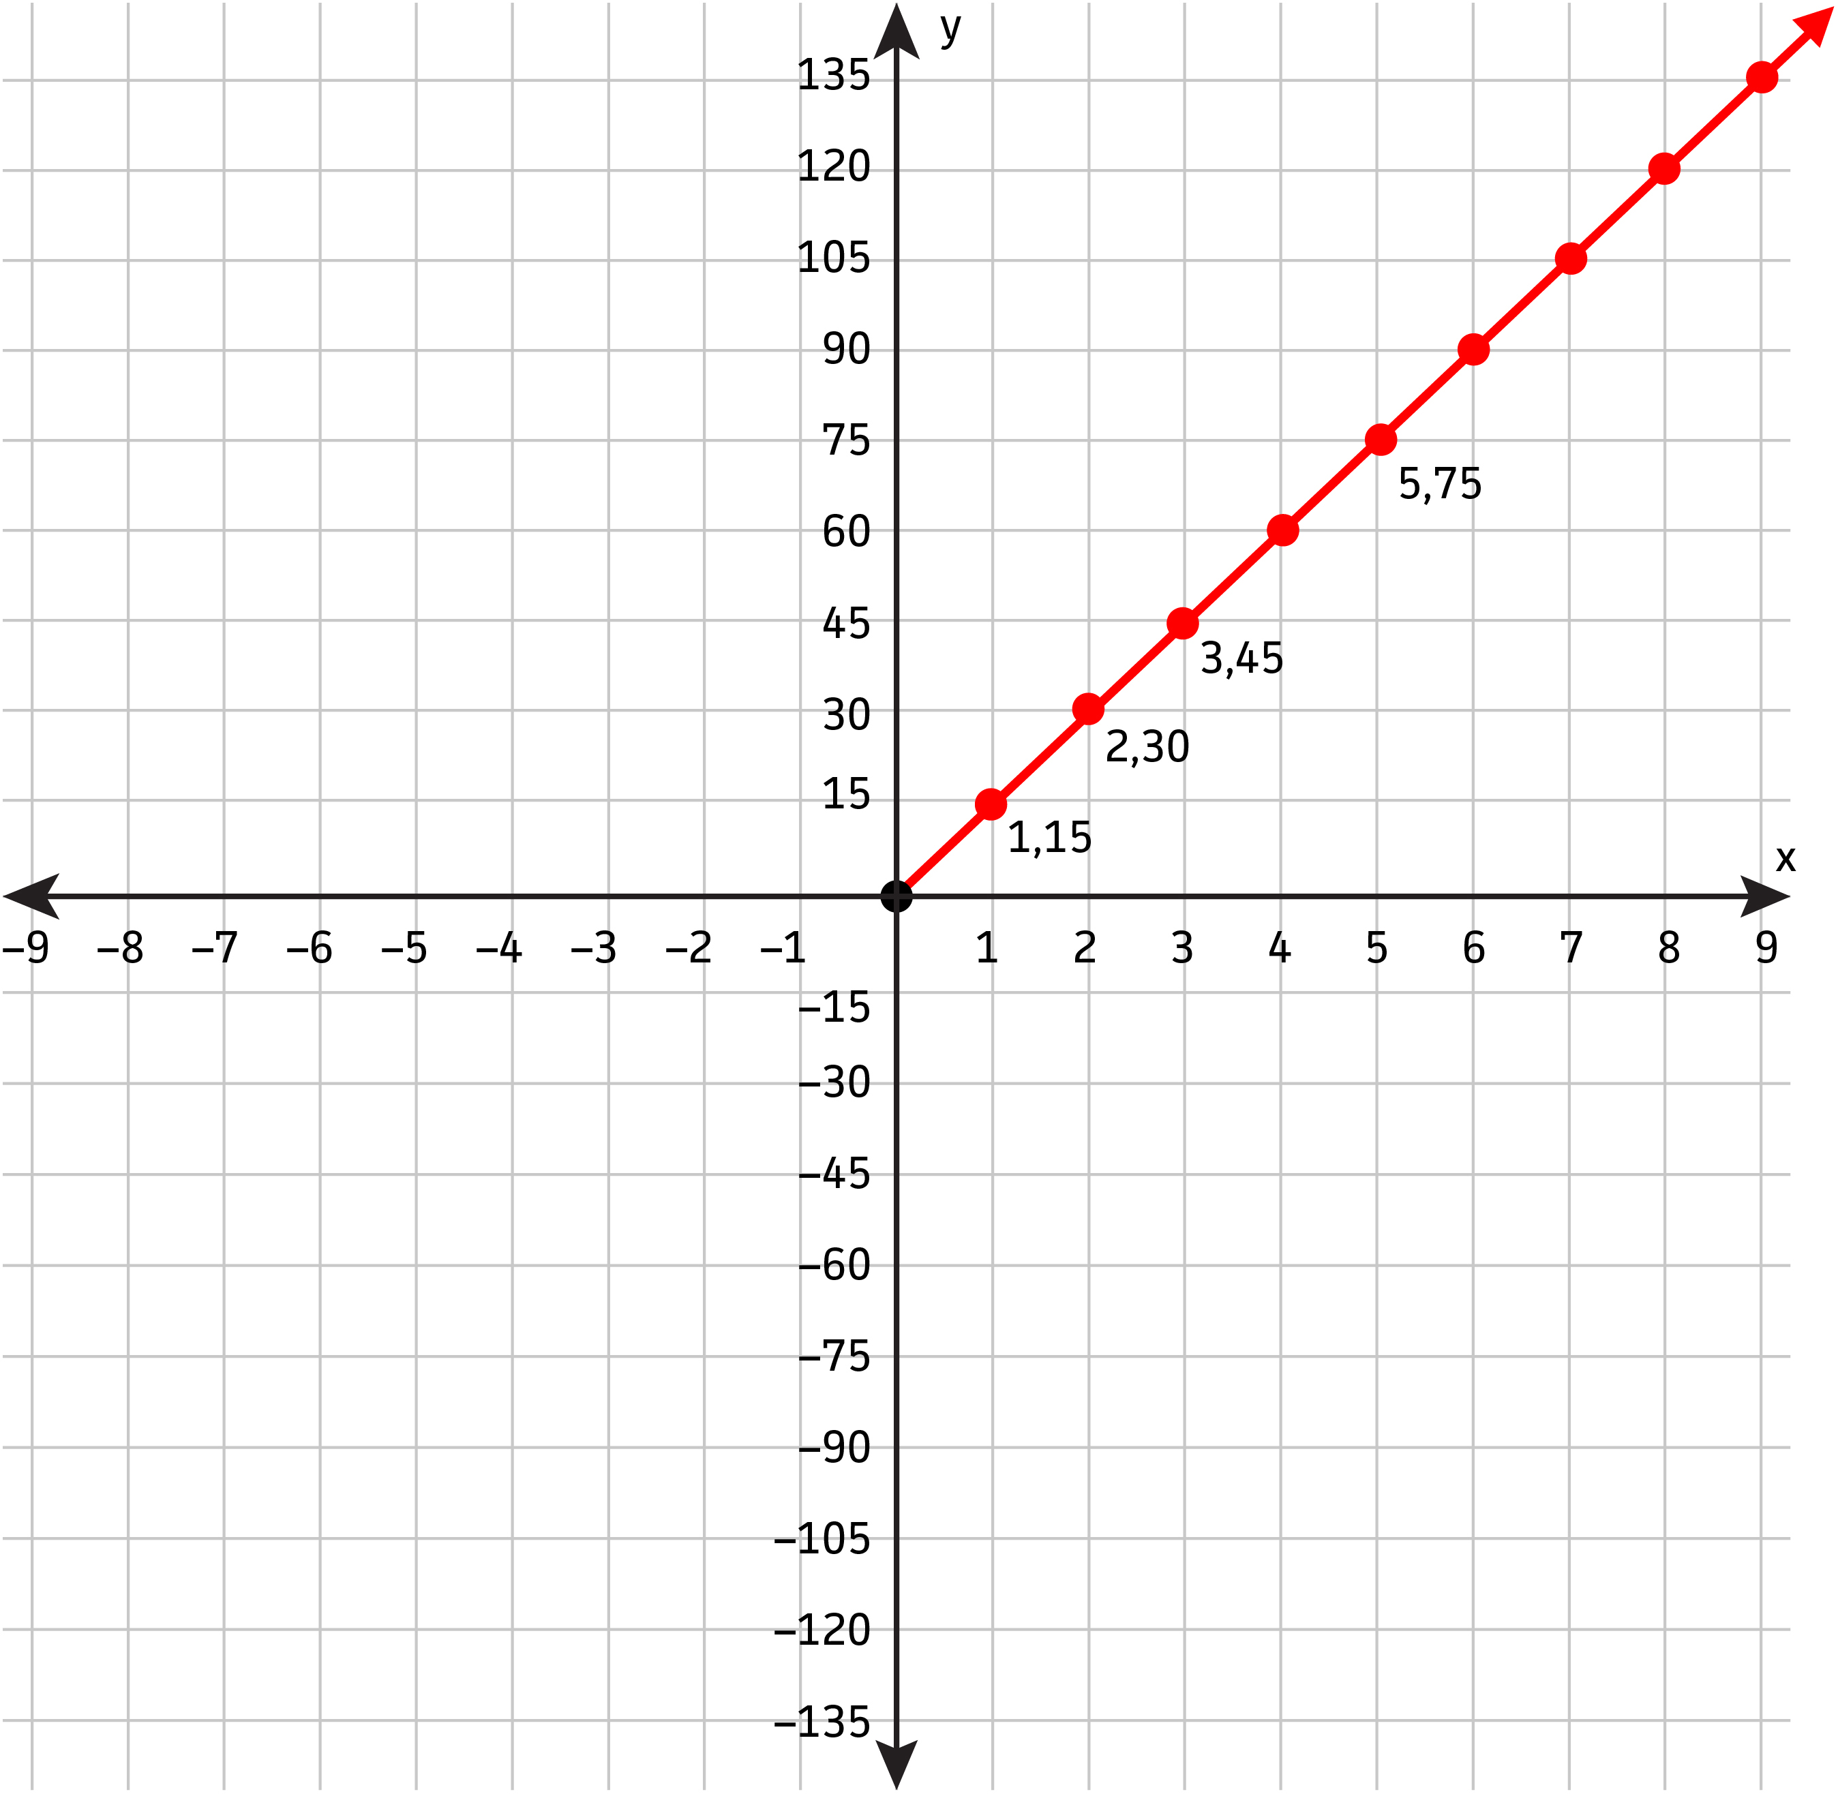
How are these similar? Different?
y = 2200x
y = 15x
Notes:
Similar because both go through the origin and are straight lines. Both are proportional.

Slide 15
How do the x and y values change?
x (Years) | y (Money)
1 | $2200
2 | $4400
3 | $6600
4 | $8800
5 | $11,000
Which Truth fact does this graph represent?
y = 2200x
THE AVERAGE PACK-A-DAY SMOKER SPENDS MORE THAN $2,200 PER YEAR ON CIGARETTES.
Notes:
Teacher links change in y to change in x as the rate of change of 2200.

Slide 16
How do the x and y values change?
x (Trees Killed) | y (Packs of Cigarettes)
1 | 15
2 | 30
3 | 45
5 | 75
10 | 150
Which Truth fact does this graph represent?
ONE TREE IS KILLED FOR 15 PACKS OF CIGARETTES.
y = 15x
Notes:
Teacher links change in y to change in x as the rate of change of 15. Point out to students that in this case, the rate of change is a ratio of y/x.

Slide 17





Let’s look more closely . . .
x (Trees Killed) | y (Packs of Cigarettes) | Rate of Change = y/x
1 | 15
2 | 30
3 | 45
5 | 75
10 | 150
Constant means the same. What stayed constant in this table?
Notes:
Teacher uses phrase When the requirements for proportionality are satisfied, the Rate of Change is the same as Constant of Proportionality (k). It is the same ratio of y/x. Therefore, K = y/x

Slide 18
Another term for Rate of Change
y = 2200x
y = 15x
Rate of Change
Constant of Proportionality (k)
This is a proportional relationship, so that means . . .
The Constant of Proportionality (k) is the same as Rate of Change.
What is the equation for k?
Notes:
Teacher uses phrase Rate of Change is the same as Constant of Proportionality (k). Since the rate of change ratio is y/x then K = y/x.

Slide 19
Summary of Learning
For proportional relationships, the rate of change is the ratio of ___ to ___. Constant means the ____. When the relationship is proportional, the term Constant of Proportionality is the same as ____ of Change. Constant of _____________ is represented by the letter __. k = y/x is an equation that stands for how a ____________ graph changes. In the example of 1 tree killed for 15 packs of cigarettes, we could write the equation __________.
Notes:
For proportional relationships, the rate of change is the ratio of y to x. Constant means the same. When the relationship is proportional, the term Constant of Proportionality is the same as Rate of Change. Constant of Proportionality is represented by the letter k. K = y/x is an equation that stands for how a proportional graph changes. In the example of 1 tree killed for 15 packs of cigarettes, we could write the equation y = 15x.

Slide 20
Assignment:
Constant of Proportionality WS

