Slide 1
Single-Use Plastics

Slide 2
Lesson 1

Slide 3
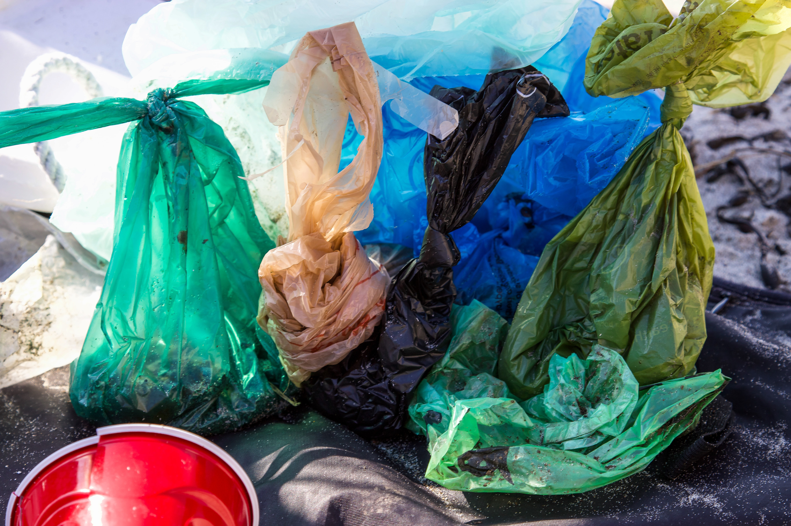
Should single-use plastic items be banned in California?
Source: Brian Yrasits/unsplash.com
Source: FLY: D/unsplash.com

Slide 4
Do you think California’s plastic bans are a good idea?
In November 2016, California voters approved Proposition 87, the state- wide Single-Use Carryout Bag Ban. As a result, most grocery stores will no longer be able to provide single use plastic carryout bags for their customers. Instead, they may provide a reusable or recycled bag for ten cents. | Passed in November 2018, California Assembly Bill 1884 prohibits full-service restaurants from providing single-use plastic straws unless they are requested.
Notes:
Give students an overview of California’s bans on plastic bags and straws to provide background information for the lesson.

Slide 5
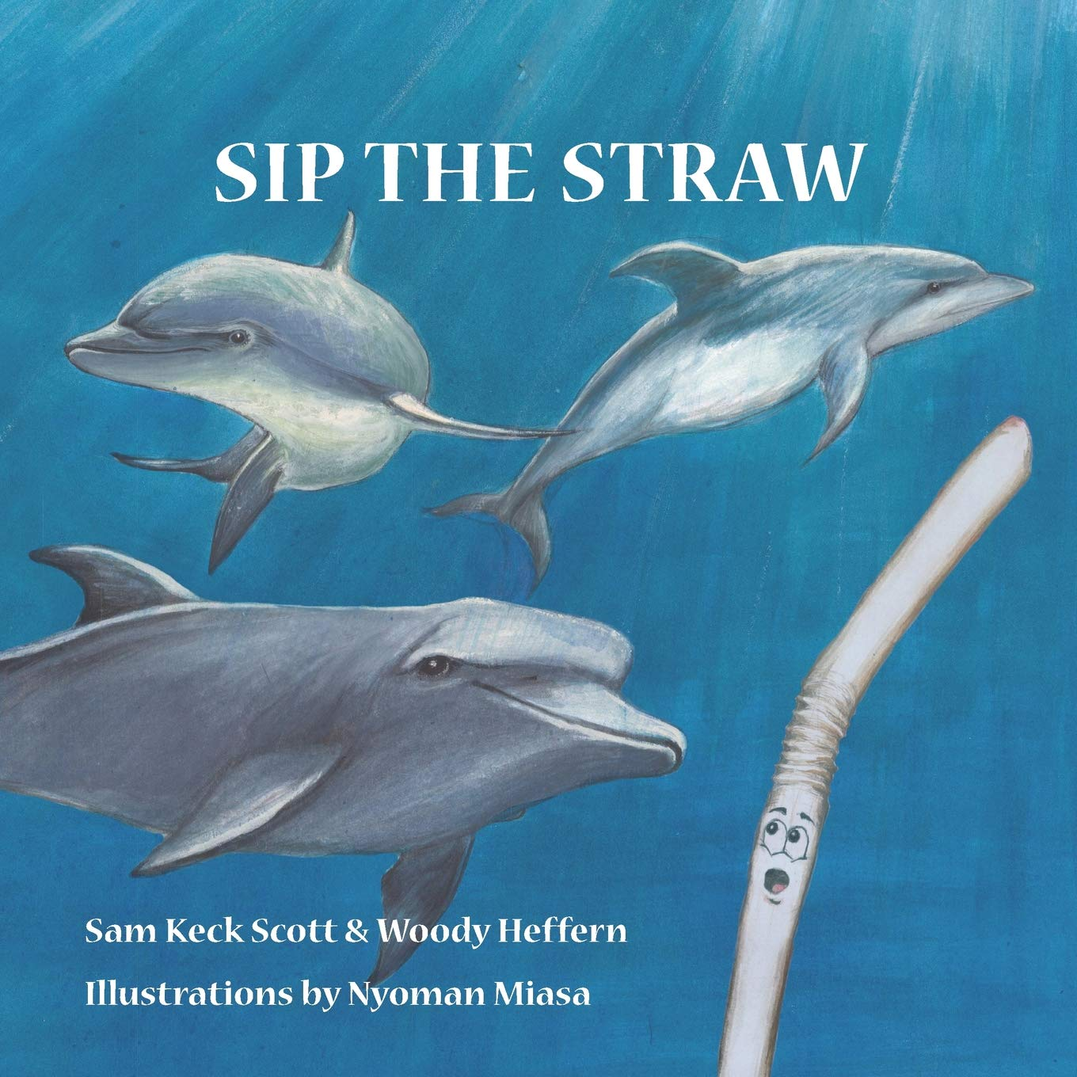
Cover image courtesy of
Social Motion Publishing
Notes:
Optional: Read the children’s book Sip the Straw. The book provides a story of a straw’s “life” told from the perspective of the straw: starting with the excitement of being used to help a person enjoy their drink, to being tossed in the trash, to going out to the Great Pacific Garbage Patch, to washing up on a shore. The story introduces students to the enormity of the amount of trash and plastics being dumped into the oceans.

Slide 6
PBS Video: How Much Plastic Is in the Ocean?
Notes:
Show students the PBS Video “How Much Plastic is in the Ocean?”
Following the Video, ask:
What do you notice?
What do you wonder?
Chart student responses

Slide 7
What Do You Notice? What Do You Wonder?
Notes:
Chart students’ responses and keep them for later, to refer back to throughout the lesson and to possibly use to create future investigations or lessons based on students’ interests.

Slide 8
How much is that?
PBS reports that Americans use 500 million straws per day. Other ways to think about this:
If we line these straws up, they would wrap around the Earth four times—every day!
This is an average of 1.6 straws per day per person.
Based on the national average, each person will use 38,000 or more straws between the ages of 5 and 65.

Slide 9
How much is that?
If the average person uses 1.6 straws per day, how many straws would . . .
. . . the average person use in one week? Do you use this many straws in one week?
. . . your family use in one month?
. . . our school community use in one year?
The average person uses 38,000+ straws in their lifetime.
How many straws would you need for your family?
How much space would you need to store those straws?
Notes:
Using the data from the video (or other data you find), you may pose different math tasks.

Slide 10
California Plastic Bans
Passed in November 2016, California voters approved Proposition 87, the statewide Single-Use Carryout Bag Ban. As a result, most grocery stores and food marts will no longer be able to provide single use plastic carryout bags to their customers. Instead, they may provide a resusable or recycled bag for ten cents. | Passed in November 2018, California Assembly Bill 1884 prohibits full-service restaurants from providing single use plastic straws unless they are requested.
Why do you think California is imposing these bans? Do you think these bans help our environment? Why or why not?

Slide 11
Discussion Questions
What will you think of when you see single-use plastic items such as bags and straws now? What, if anything, do you think California should do to address the abundance of plastic in our landfills and oceans?
How did using mathematics help you to think about the impact of plastic in our environment?
What are some things you can do to reduce, reuse, recycle, rethink, repair, refuse?

Slide 12
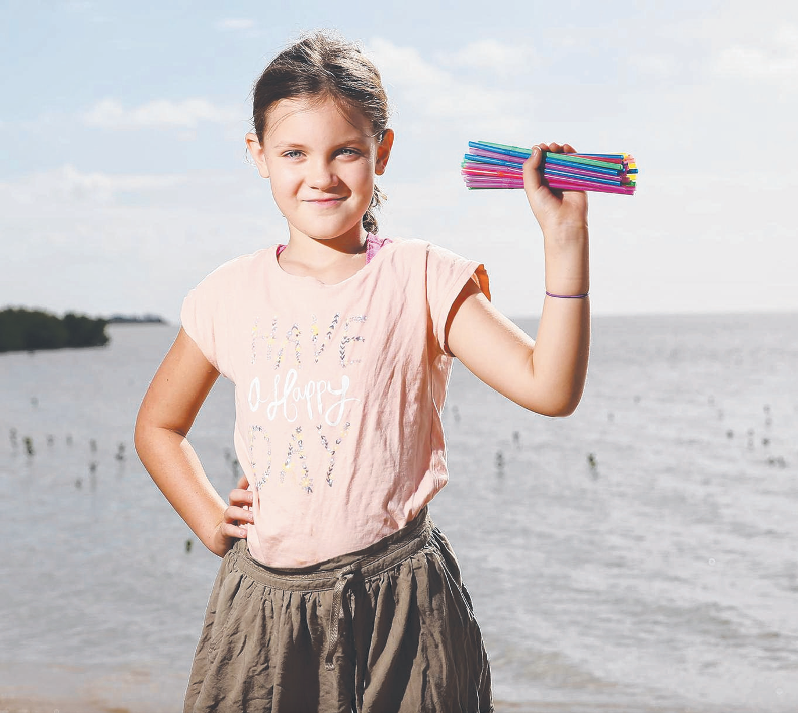
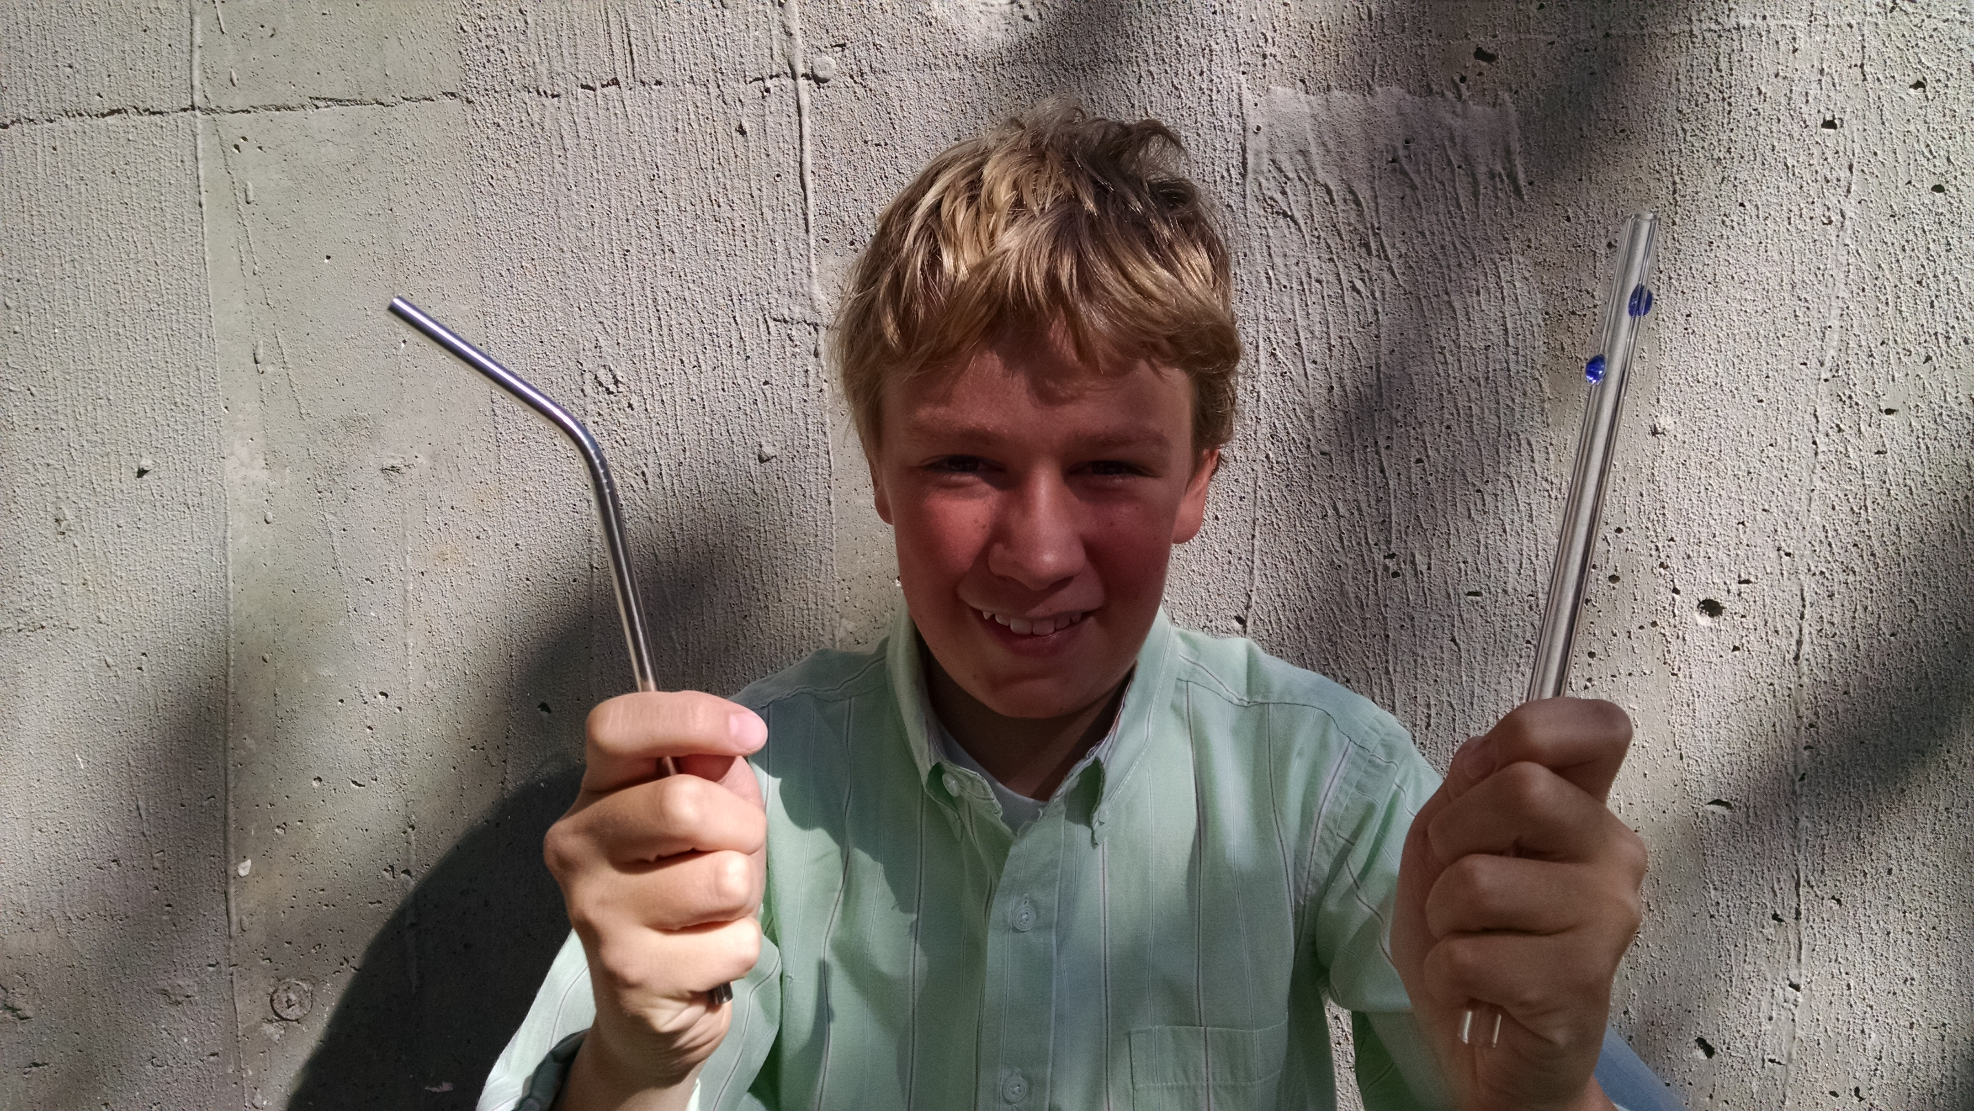
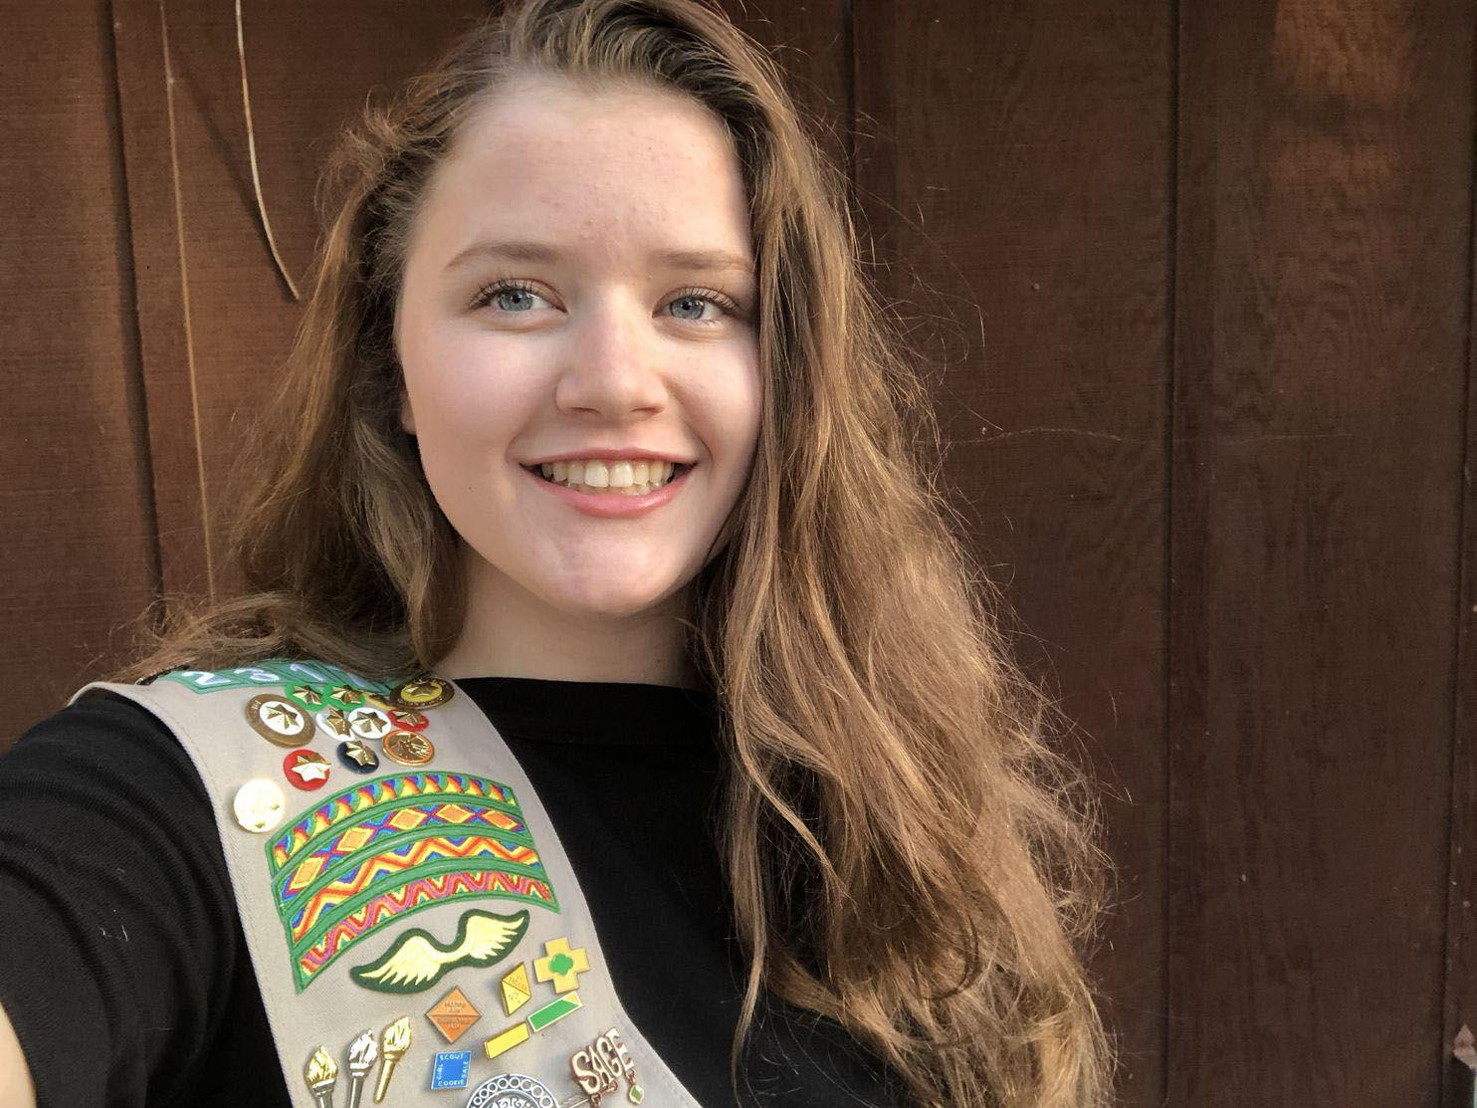
What do these three children have in common?
Notes:
https://www.strawnomore.org/about/
Milo Cress: https://www.thedailybeast.com/this-kid-single-handedly-launched-the-plastic-straw-ban-movement
Shelby O-Neil: https://www.marthastewart.com/1522743/california-no-straw-november

Slide 13
Milo Cress, founder of Be Straw Free at the age of 9.
Source: Milo Cress
Molly Steers, Straw No More Project. She began at age 9.
Source: Jules Steer
Shelby O-Neil: No Straw November Campaign in Monterey, CA & Founder, Jr. Ocean Guardians. She began at age 16.
Source: Jr Ocean Guardians
Change Makers!
Notes:
https://www.strawnomore.org/about/
Milo Cress: https://www.thedailybeast.com/this-kid-single-handedly-launched-the-plastic-straw-ban-movement
Shelby O-Neil: https://www.marthastewart.com/1522743/california-no-straw-november

Slide 14
Straw No More Project, Molly Steers
https://www.youtube.com/watch?v=Rr5Py1r9xjw
https://www.strawnomore.org/
https://www.1millionwomen.com.au/blog/10-year-old-girl-ending-plastic-straw-pollution-heres-how/
Notes:
Ask students what they can do to impact their environment.
Show the video about the Straws No More Project by Molly Steers.
Ask students to share their reactions to the video and Molly Steers’s Straw No More Project.
Engage class in a discussion about the power we have as informed citizens and as young people) to take action against injustices we are passionate about.

Slide 15
Think-Ink-Pair-Share What can we do to positively impact our environment?
Think-Ink: Take 2 minutes to write your ideas
Pair-Share: You and your partner will have 5 minutes to talk about your ideas
Whole Class Discussion will follow

Slide 16
Keep Thinking & Talking . . .
Share highlights from this lesson with your students’ families along with the ideas generated in the Think-Ink-Pair-Share discussion on ways to positively impact the environment.
Offer an article to read together at home: Reducing Plastic as a Family is Easy. Here’s How.
https://www.nationalgeographic.com/news/2018/06/reduce-plastic-use-families-kids-environment-culture/
Encourage students and families to add more ideas to a class poster.

Slide 17
Class Poster: Social Actions We Can Take . . .
Become a strawbassador
Start or improve a recycling program at your school
Use a refillable water bottle and/or filter drinking water
Avoid using plastic utensils
Use reusable bags whenever possible
Create a toy library so more children can enjoy toys before they get discarded
Stop chewing gum- it is made from synthetic rubber (aka plastic)
Speak up! Teach others what you know
Add your students’ and families’ ideas here too!
Notes:
Important Note: Begin with your students’ ideas.

Slide 18
Lesson 2

Slide 19
Plastics in Our Environment
Where are plastics and what impact do they have on me and my community?

Slide 20
Plastics Production
We produce 300 million tons of plastic each year worldwide, half of which is for single-use items. That’s nearly equivalent to the weight of the entire human population.
What do you think the world population is (total number of living humans on the planet)?
Notes:
https://www.nrdc.org/stories/single-use-plastics-101
World population is 7.8 billion people

Slide 21
Plastics
300,000,000 tons of plastic is produced each year.
91% of plastics is never recycled.
Plastics do not break down. They break into smaller pieces.
Where does all this plastic go?

Slide 22
Where are Scientists Finding Plastic?
Waterways via rain and storm drains
Microplastics are everywhere!
Oceans & rivers—impacting wildlife and humans
In the food we eat
In the dust we breathe
Facial scrubs & clothing
Greenhouse gas emissions
Notes:
More information on dust and clothes: https://www.forbes.com/sites/jeffmcmahon/2020/06/28/most-dust-motes-in-your-home-are-toxic-microplastics-and-the-saharan-dust-storm-may-bring-more/?sh=7fe68cd06c25

Slide 23
Are we really eating plastic?

Slide 24
View this World Wildlife Fund image:
https://bit.ly/3rR67LD

Slide 25
WWF Australia: Revealed: plastic ingestion by people could be equation to a credit card a week
Notes:
https://www.wwf.org.au/news/news/2019/revealed-plastic-ingestion-by-people-could-be-equating-to-a-credit-card-a-week#gs.o4tev1
https://www.consumerreports.org/health-wellness/how-to-eat-less-plastic-microplastics-in-food-water/
https://www.nationalgeographic.com/environment/2019/06/you-eat-thousands-of-bits-of-plastic-every-year/

Slide 26
How Much Plastic Would the Average Human Eat . . .
It is estimated that the average person eats 5 grams of plastic each week.
How much plastic would an average person eat in one month? In one year? In one lifetime?

Slide 27
Share Your Strategies
If the average person eats 5 grams of plastic in one week, how much plastic would she/he/they eat in one year?
If the average person eats 5 grams of plastic in one week, how much plastic would she/he/they eat in a lifetime?
Notes:
Lead a whole class discussion, where you invite students to share their strategies for determining the amount of plastic eaten in either one year and/or one lifetime.

Slide 28
Where is this ingested plastic coming from?
Bottled Water
Fish
Sea Salt
Air
Dust
Food, especially if packaged in plastic

Slide 29
Individual & Collective Data Gathering
For the next three days, jot down where you see plastic at school, home, and in your community. What do you notice? What do you wonder?

Slide 30
Three days later . . .

Slide 31
Where did we find plastic in our community?
Plastics we use and/or play with:
Potentially ingested plastics:

Slide 32
Share Your Thoughts!
What did you learn about plastic and its impact on people, animals, and the environment? How did math help you think about plastic?
Plastic is everywhere! It is hard to imagine our world without plastics.
Take action! What can you do to minimize the impact of plastics in your own body, for other humans and/or animals, in your environment, or in our world?

