Slide 1
Majority and Power

Slide 2
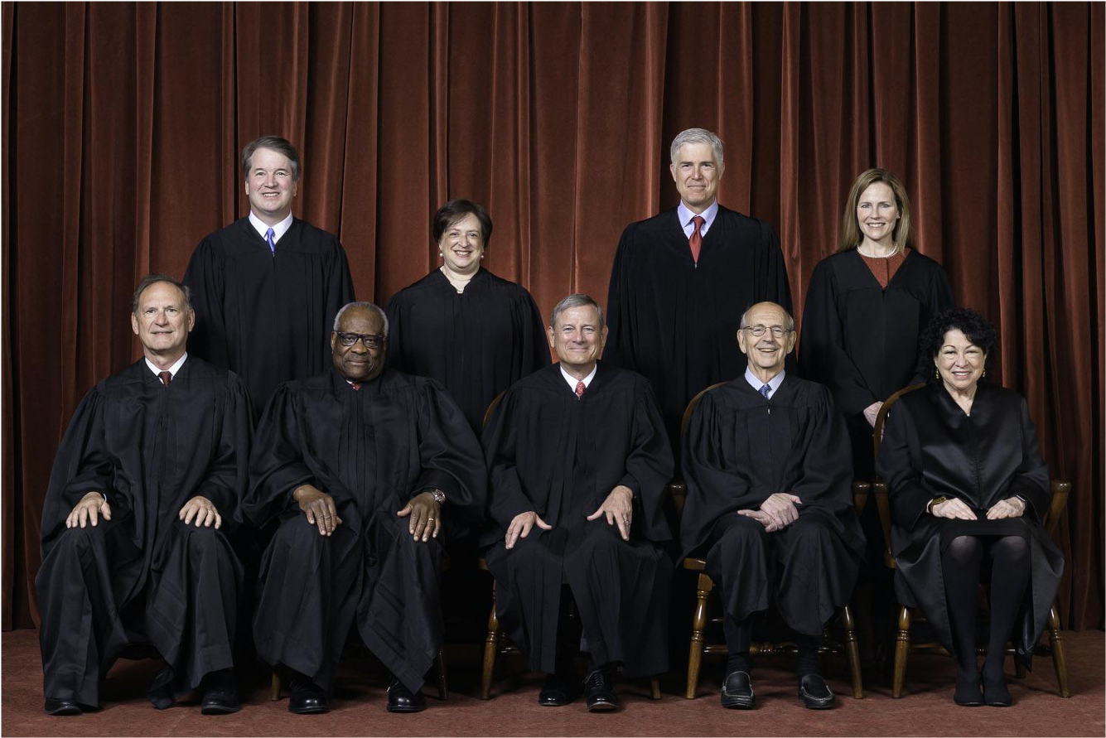
Supreme Court
Source: Fred Schilling, Collection of the Supreme Court of the United States

Slide 3
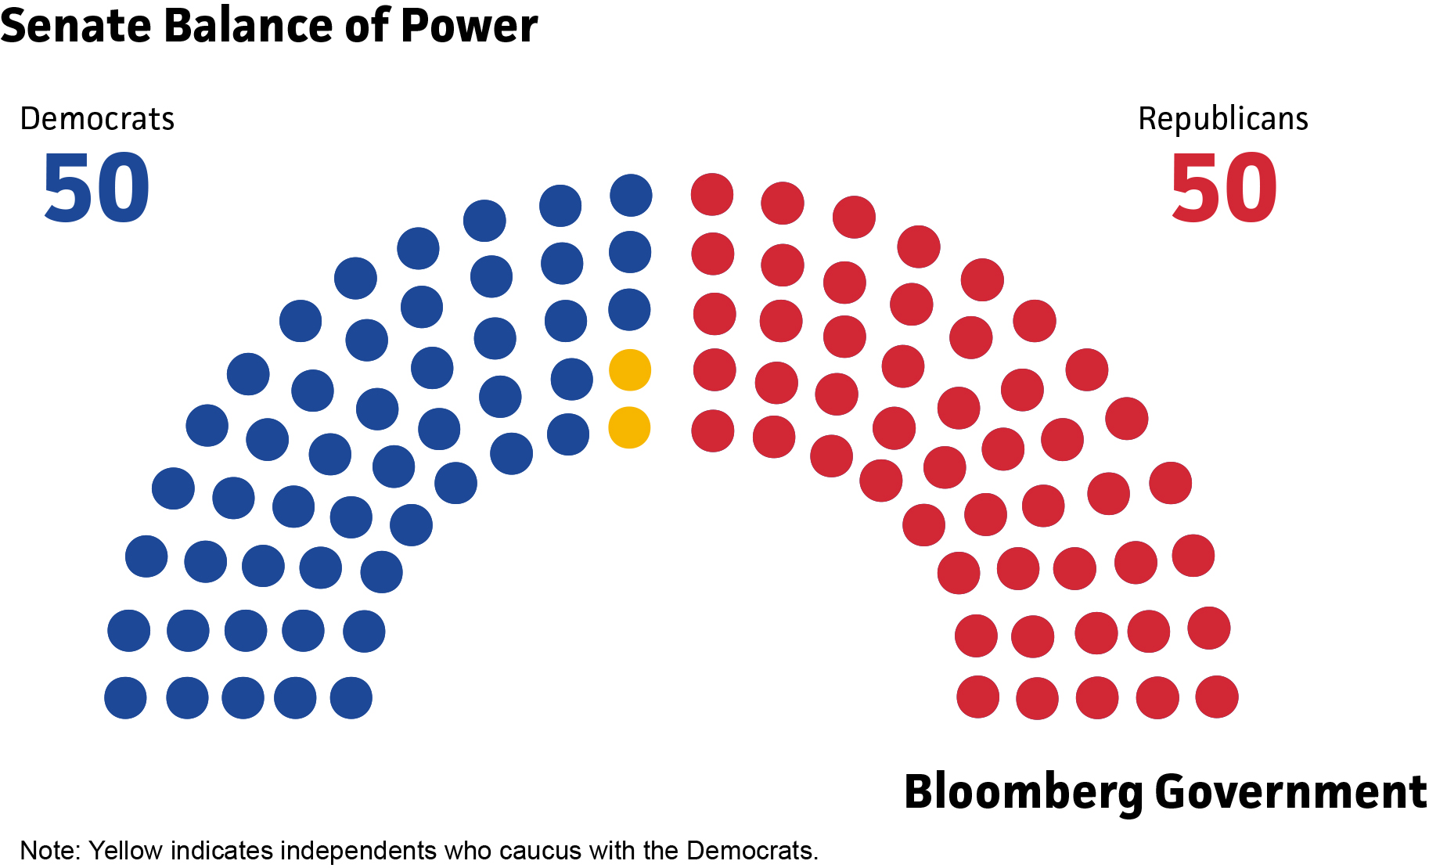
Congress: Senate

Slide 4
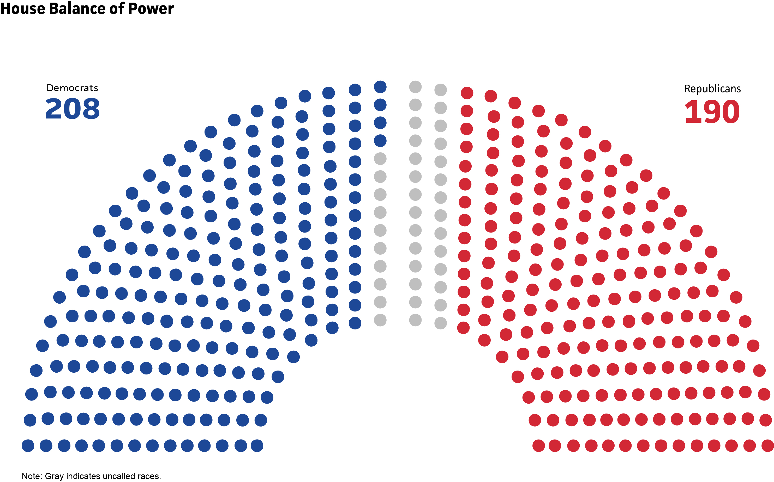
Congress: House of Representatives
Source: The Associated Press as of Nov. 5 as of 1 p.m. EST
Note: Gray indicates uncalled races.
Bloomberg Government

