Slide 1
IMPORTANT NOTES
How Do We See Our World: Map Projection Investigation
This slide deck is not intended for instruction with students.
This slide deck allows you to make edits to the slide as necessary for you and your instructional setting. The Student Slides presentation has each slide imported as an image, so students cannot accidentally make changes. However, the various shapes (squares, triangles, and circles) that are available to tile over countries are movable.
Some slides have additional notes in the “speaker notes” section to aid in facilitation.
If you want to edit the slides, do so in this file. If you would like your edited slides to be unable to be manipulated by students, follow these steps:
With your edited slide selected, go to File > Download > PNG Image (this will download a high-quality image the size of the slide).
In this slide deck, insert a new blank slide.
Go to Slide > Change Background and a pop-up window should appear.
In that window, click “Choose Image” and locate your downloaded PNG file.
Copy the shape tiles from this file into the student slides so students can use them to tile their countries.

Slide 2
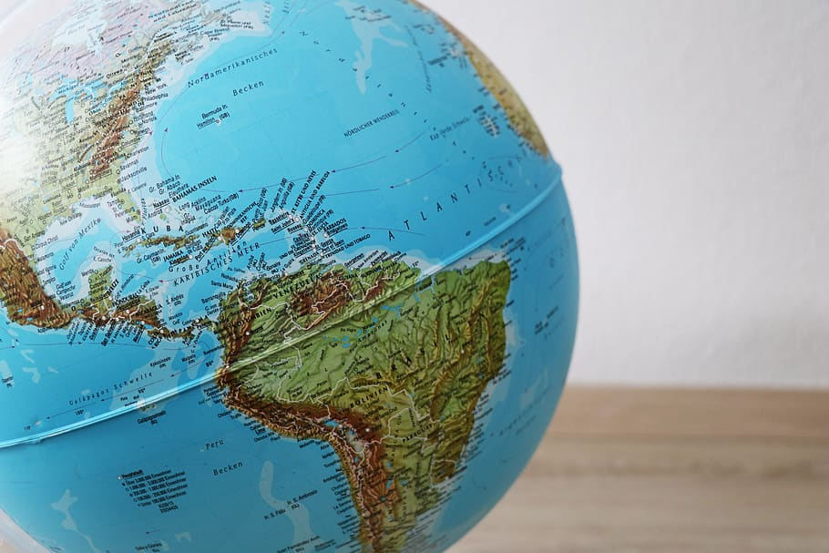
HOW DO WE SEE OUR WORLD?

Slide 3
Get a mental picture of the Earth in your mind . . .
Notes:
Location in Lesson Plan: Day 1 Launch

Slide 4
From memory, what do you think are the 10 largest countries?
Notes:
Location in Lesson Plan: Day 1 Launch

Slide 5
Would you like to revise your answer?
Notes:
Location in Lesson Plan: Day 1 Launch

Slide 6
Ten Largest Countries
Russia
Canada
United States
China
Brazil
Australia
India
Argentina
Kazakhstan
Algeria
Notes:
Location in Lesson Plan: Day 1 Launch

Slide 7
Why might it be important to have a true understanding of a country’s size?
Notes:
Location in Lesson Plan: Day 1 Launch
Social Justice Related Question

Slide 8
Aside from using the internet, how could we determine the size of the United States?
What information would we need?
Notes:
Location in Lesson Plan: Day 1 Launch
Deep Mathematical Question

Slide 9
Map from geology.com
Notes:
Location in Lesson Plan: Day 1 Launch
Deep Mathematical Question

Slide 10
Explore
**Be prepared to share your strategies and what you learned.**
You have three tasks with your partner:
Write your hypothesis comparing the size of the two countries.
Estimate the size of each country in square miles (you can move around the shapes, but be mindful of the map’s scale).
Answer the final question. Share what you learned and how you answered the question.
Notes:
Location in Lesson Plan: Day 1 Explore

Slide 11
COMPARING THE SIZES OF COLOMBIA & FRANCE
Notes:
Location in Lesson Plan: Day 1 Explore

Slide 12
FRANCE
COLOMBIA
Notes:
Location in Lesson Plan: Day 1 Explore

Slide 13
QUESTIONS:
Compare the sizes of Colombia and France in the map on the previous slide. Do you think one country is larger than the other? If so, which one and why?
Approximately how much larger do you think one country might be?
ANSWERS (type here):
Notes:
Location in Lesson Plan: Day 1 Explore

Slide 14
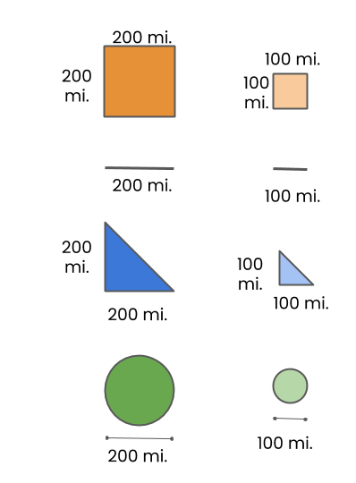
COLOMBIA
Estimate the size of Colombia in square miles.
Source: Map data ©2021 Google
Notes:
Location in Lesson Plan: Day 1 Explore

Slide 15
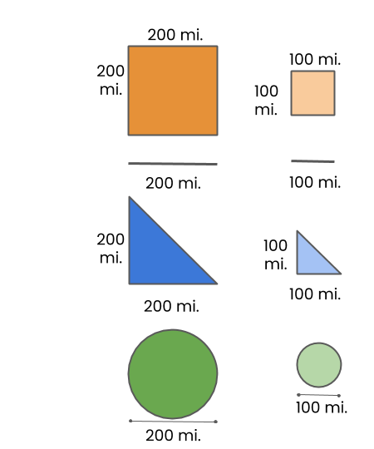
FRANCE
Estimate the size of France in square miles.
Source: Map data ©2021 Google
Notes:
Location in Lesson Plan: Day 1 Explore

Slide 16
QUESTIONS:
How did you compare the sizes of France and Colombia? What did you learn?
ANSWERS (type here):
Notes:
Location in Lesson Plan: Day 1 Explore

Slide 17
COMPARING THE SIZES OF FINLAND & KENYA
Notes:
Location in Lesson Plan: Day 1 Explore

Slide 18
FINLAND
KENYA
Notes:
Location in Lesson Plan: Day 1 Explore

Slide 19
QUESTIONS:
Compare the sizes of Finland and Kenya in the map on the previous slide. Do you think one country is larger than the other? If so, which one and why? Approximately how much larger do you think one country might be?
ANSWERS (type here):
Notes:
Location in Lesson Plan: Day 1 Explore

Slide 20
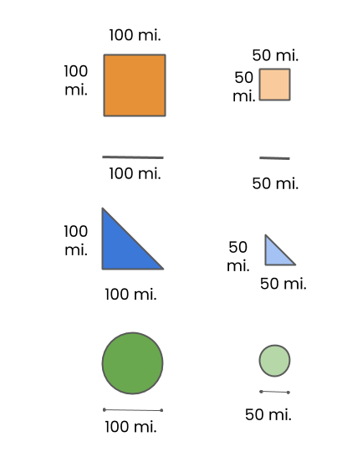
FINLAND
Estimate the size of Finland in square miles.
Notes:
Location in Lesson Plan: Day 1 Explore

Slide 21
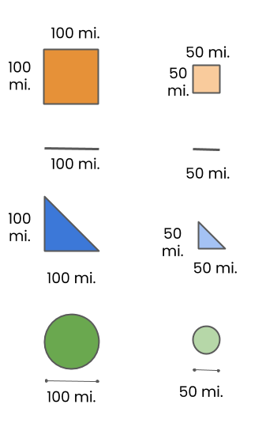
KENYA
Estimate the size of Kenya in square miles.
** The image represents approximate country borders due to disputed territorial claims. **
Source: Map data ©2021 Google
Notes:
Location in Lesson Plan: Day 1 Explore

Slide 22
QUESTIONS:
How did you compare the sizes of Finland and Kenya? What did you learn?
ANSWERS (type here):
Notes:
Location in Lesson Plan: Day 1 Explore

Slide 23
COMPARING THE SIZES OF ICELAND & ECUADOR
Notes:
Location in Lesson Plan: Day 1 Explore

Slide 24
ICELAND
ECUADOR
Notes:
Location in Lesson Plan: Day 1 Explore

Slide 25
QUESTIONS:
Compare the sizes of Iceland and Ecuador in the map on the previous slide. Do you think one country is larger than the other? If so, which one and why?
Approximately how much larger do you think one country might be?
ANSWERS (type here):
Notes:
Location in Lesson Plan: Day 1 Explore

Slide 26
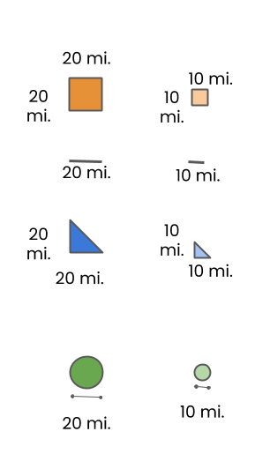
ICELAND
Estimate the size of Iceland in square miles.
Source: Map data ©2021 Google
Notes:
Location in Lesson Plan: Day 1 Explore

Slide 27
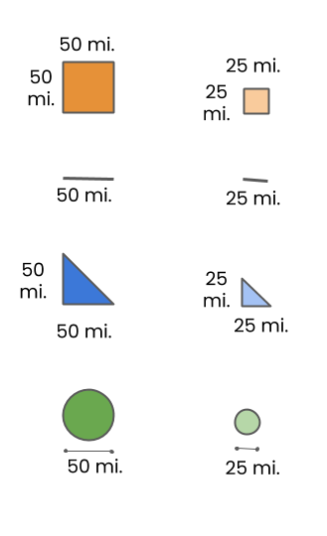
ECUADOR
Estimate the size of Ecuador in square miles.
Source: Map data ©2021 Google
Notes:
Location in Lesson Plan: Day 1 Explore

Slide 28
QUESTIONS:
How did you compare the sizes of Iceland and Ecuador? What did you learn?
ANSWERS (type here):
Notes:
Location in Lesson Plan: Day 1 Explore

Slide 29
COMPARING THE SIZES OF INDIA & GREENLAND
Notes:
Location in Lesson Plan: Day 1 Explore

Slide 30
INDIA
GREENLAND
Notes:
Location in Lesson Plan: Day 1 Explore

Slide 31
QUESTIONS:
Compare the sizes of India and Greenland in the map on the previous slide. Do you think one country is larger than the other? If so, which one and why?
Approximately how much larger do you think one country might be?
ANSWERS (type here):
Notes:
Location in Lesson Plan: Day 1 Explore

Slide 32
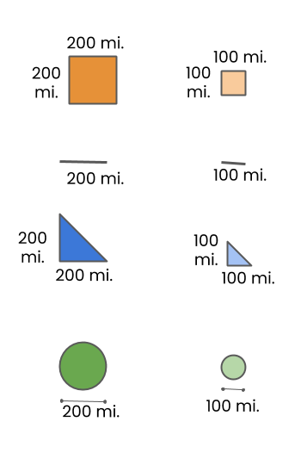
INDIA
Estimate the size of India in square miles.
**The image represents approximate country borders due to disputed territorial claims.**
Notes:
Location in Lesson Plan: Day 1 Explore

Slide 33
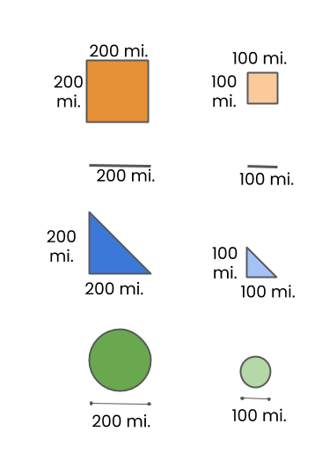
GREENLAND
Estimate the size of Greenland in square miles.
Source: Map data ©2021 Google
Notes:
Location in Lesson Plan: Day 1 Explore

Slide 34
QUESTIONS:
How did you compare the sizes of India and Greenland? What did you learn?
ANSWERS (type here):
Notes:
Location in Lesson Plan: Day 1 Explore

Slide 35
COMPARING THE SIZES OF OMAN & POLAND
Notes:
Location in Lesson Plan: Day 1 Explore

Slide 36
POLAND
OMAN
Notes:
Location in Lesson Plan: Day 1 Explore

Slide 37
QUESTIONS:
Compare the sizes of Oman and Poland in the map on the previous slide. Do you think one country is larger than the other? If so, which one and why?
Approximately how much larger do you think one country might be?
ANSWERS (type here):
Notes:
Location in Lesson Plan: Day 1 Explore

Slide 38
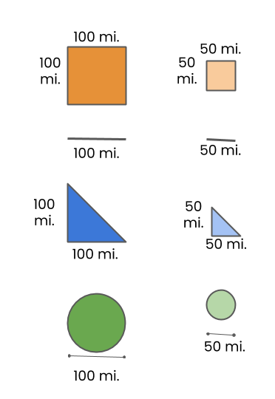
OMAN
Estimate the size of Oman in square miles.
Notes:
Location in Lesson Plan: Day 1 Explore

Slide 39
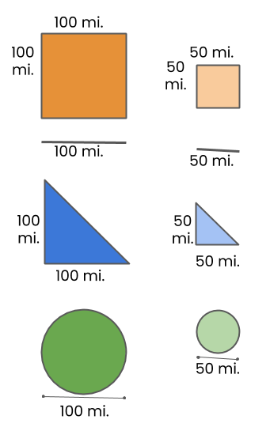
POLAND
Estimate the size of Poland in square miles.
Source: Map data ©2021 Google
Notes:
Location in Lesson Plan: Day 1 Explore

Slide 40
QUESTIONS:
How did you compare the sizes of Oman and Poland? What did you learn?
ANSWERS (type here):
Notes:
Location in Lesson Plan: Day 1 Explore

Slide 41
Country Pair Group Discussion
Each set of partners will meet with the other partners who investigated the same country pairing.
Discuss the following questions:
What was your strategy to estimate the area?
Why did you select the shapes you used to estimate the area?
Which shapes did you start with and why?
Do you think that your estimate is an overestimate, an underestimate, or fairly accurate? Why?
Notes:
Location in Lesson Plan: Day 1 Explore
Deep Mathematical Questions

Slide 42
Whole-Class Discussion
Share what your group of country pairings discovered and how you discovered it.
What are some common themes in what we learned?
Notes:
Location in Lesson Plan: Day 1 Summarize / Day 2 Launch (begin by talking about what common themes were identified in the previous lesson)
Additional Questions to Consider:
Compare your results with your predictions. Why do you think your original predictions were correct or incorrect?
What did you notice as you worked? What do you wonder?

Slide 43
True Size Website
Go to The True Size website: thetruesize.com
Navigate through the website.
In groups, investigate the countries that you thought were the 10 largest countries at the start of this lesson or your country pairings.
What do you notice? What do you wonder?
Notes:
Location in Lesson Plan: Day 2 Launch

Slide 44
What Is the Purpose of a Map?
What information do maps provide?
What do we use maps for?
Do you think that the purpose of a map has historically been the same? Why or why not?
Notes:
Location in Lesson Plan: Day 2 Explore
Social Justice Related Questions
These questions spark conversation around why we need maps, what we use them for, and how the purpose of maps have changed over hundreds of years.
Traditionally maps were necessary for sailing and navigation, this is why the Mercator projection is a prominently used map. Yes, it obstructs the true size of countries, but it preserves the shape and direction, which would be necessary for sailing (See https://www.britannica.com/science/Mercator-projection).

Slide 45
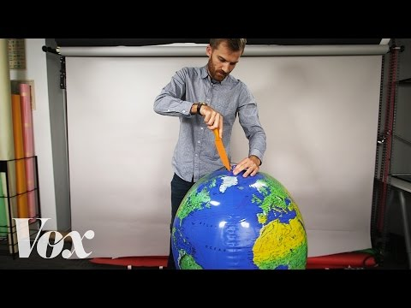
Notes:
Location in Lesson Plan: Day 2 Explore

Slide 46
“Why All World Maps Are Wrong” Discussion
The narrator comments: “One modern critique (of the Mercator projection) is that this distortion perpetuates imperialist attitudes of European domination over the southern hemisphere” (Timestamp 3:08). Do you agree or disagree and why?
Notes:
Location in Lesson Plan: Day 2 Explore
Social Justice Related Questions
Revisit the list from the Launch portion of the Lesson 1 about why our understanding of countries’ sizes might matter to support students in thoughtfully engaging with this question.

Slide 47
Let’s revisit the 10 largest countries and see what they look like in different map projections.
Notes:
Location in Lesson Plan: Day 2 Explore

Slide 48
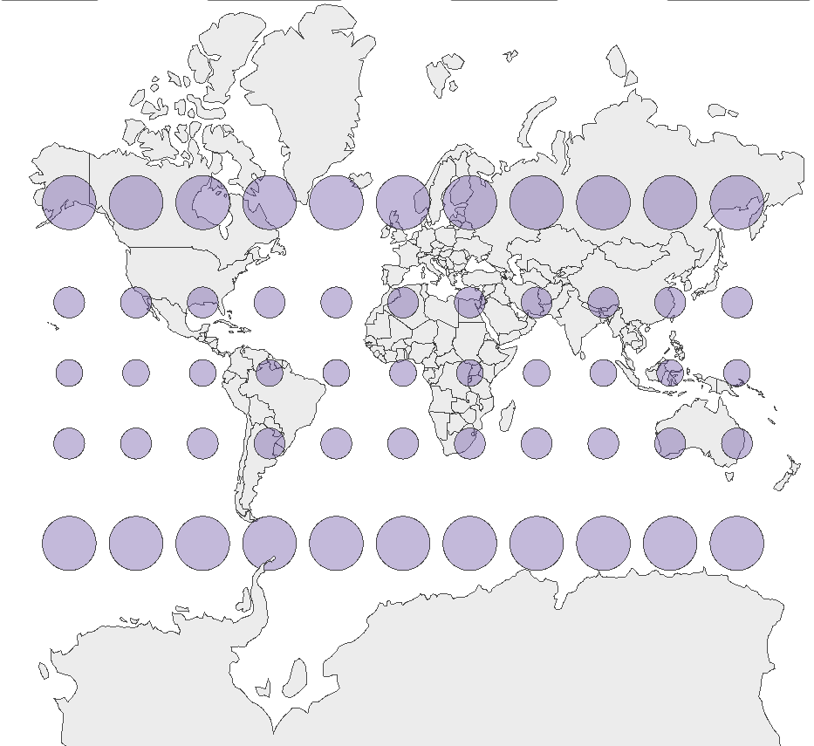
Mercator
Projection
Source: Created by Metrocosm, http://metrocosm.com/mercator/
Notes:
Location in Lesson Plan: Day 2 Explore

Slide 49
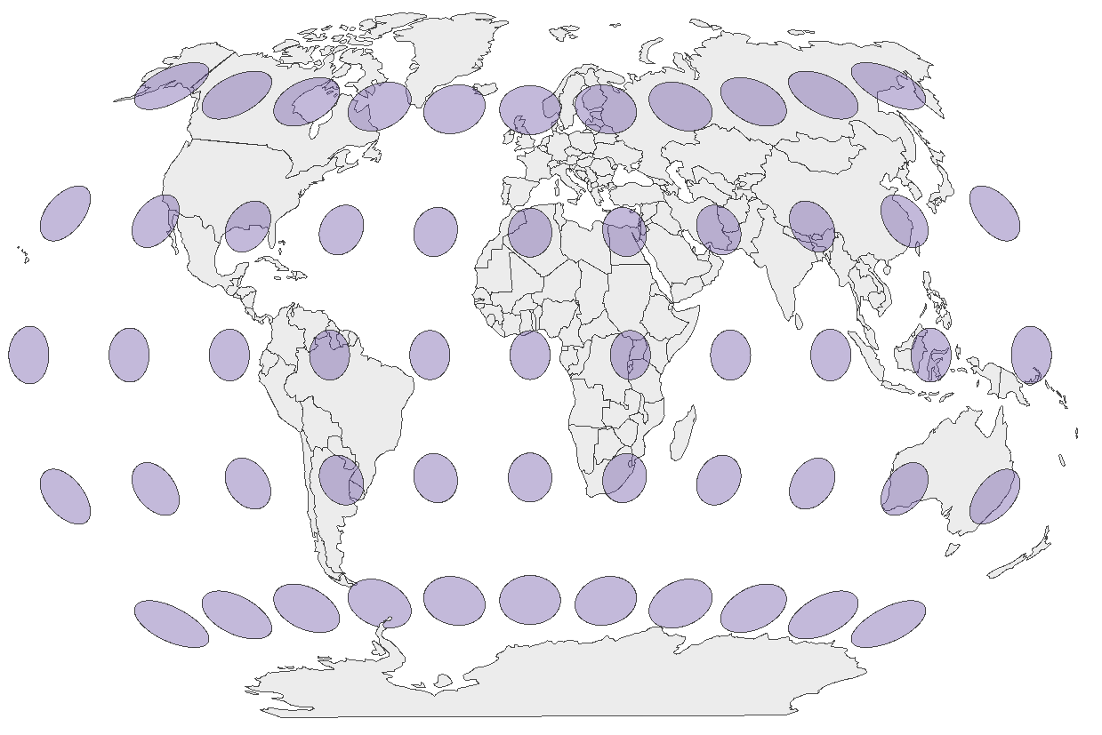
Winkle-Triple Projection
Source: Created by Metrocosm, http://metrocosm.com/mercator/
Notes:
Location in Lesson Plan: Day 2 Explore

Slide 50
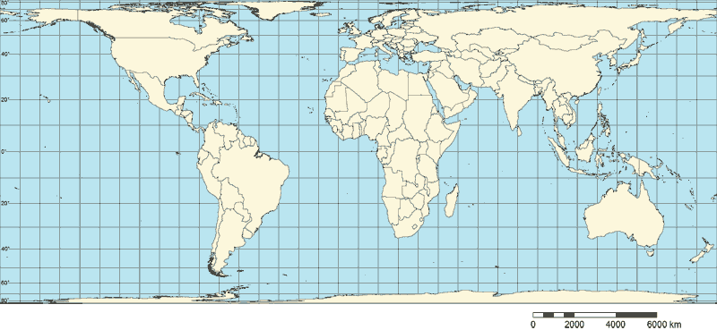
Behrman* Projection
*This is an area-preserving projection, much like the Gall-Peters.
Notes:
Location in Lesson Plan: Day 2 Explore

Slide 51
What Are Alternatives to the Mercator Projection?
Use this app to compare the distortions in 8 map projections.
Notes:
Location in Lesson Plan: Day 2 Explore
If students have not already brought this up, it would be a good time to discuss how maps are often viewed as objective truth that simply portray the “facts”. However, we saw in this lesson that is not the case. By the nature of forcing a spherical object to be represented on a plane, some aspect has to be distorted. Each projection has to distort reality in some way. However, what is distorted has an impact on how we view our world.

Slide 52
Should We Make Changes?
Our local elementary school has decided to purchase new, large wall maps for every classroom. Officials figure they will simply replace every map with a new version of the same projection, the Mercator projection. Write a letter to the administrators addressing the following:
Given what you learned in this lesson, do you think that this is the best option for the school? Use the knowledge you gained about the area and size of countries, along with other concerns addressed in this lesson, to support your decision:
Why should the school purchase new Mercator projection maps? What advantages does the Mercator projection have over the other projections?
If you don’t think that the school should purchase Mercator projections, which of the projections that you explored do you think the school should purchase? Why? What advantages does your chosen projection have over the Mercator projection?
Notes:
Location in Lesson Plan: Day 2 Summary
Social Justice Related Questions

