Slide 1
BEFORE YOU BEGIN
How Do We See Our World: Map Projection Investigation
This slide deck is intended for student exploration.
All images and text are imported as a background so they cannot be moved by students. However, the various shapes (squares, triangles, and circles) that are available to tile over countries are movable.
Some slides have additional notes in the “speaker notes” section to aid in facilitation.
If you want to edit the slides, do so in the Map Projection Editable Teacher Template. If you would like your edited slides to not be manipulated by students, follow these steps:
With your edited slide selected, go to File > Download > PNG Image (this will download a high-quality image the size of the slide).
In this slide deck, insert a new blank slide.
Go to Slide > Change Background and a pop-up window should appear.
In that window, click “Choose Image” and locate your downloaded PNG file.
Copy the shape tiles from the template into the student slides so students can use them to tile their countries.

Slide 2
BEFORE YOU BEGIN
How Do We See Our World: Map Projection Investigation
Before you begin:
Each class period should have their own copy of this slide deck.
Each pair of partners in the Exploration should have their own set countries to investigate. If you have more than 5 partner sets, you will have to duplicate the five slides for each country pairing investigation (The five slides are: title slide, location on map, prediction, and two slides for area estimation) so that each set of partners can work on the investigation.
Students who investigate the same country pairing will be given space to discuss their solutions.

Slide 3
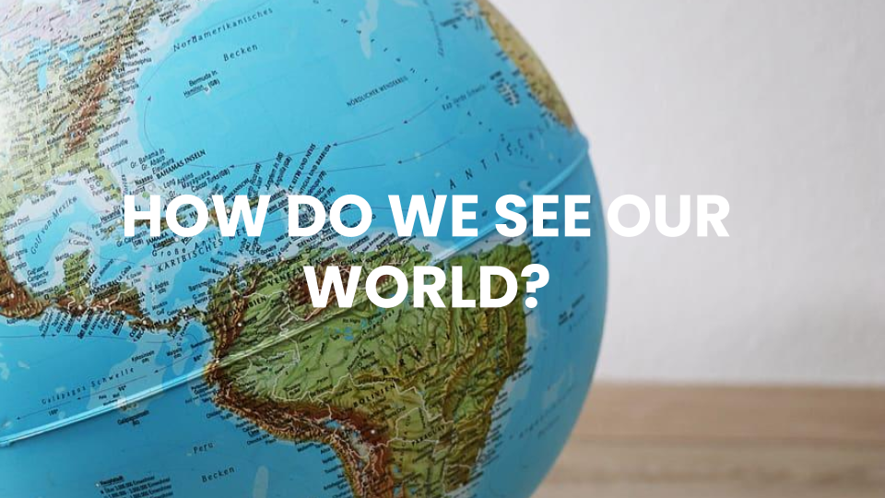

Slide 4

Notes:
Location in Lesson Plan: Day 1 Launch

Slide 5

Notes:
Location in Lesson Plan: Day 1 Launch

Slide 6
Would you like to revise your answer?
Notes:
Location in Lesson Plan: Day 1 Launch

Slide 7
Ten Largest Countries
Russia
Canada
United States
China
Brazil
Australia
India
Argentina
Kazakhstan
Algeria
Notes:
Location in Lesson Plan: Day 1 Launch

Slide 8
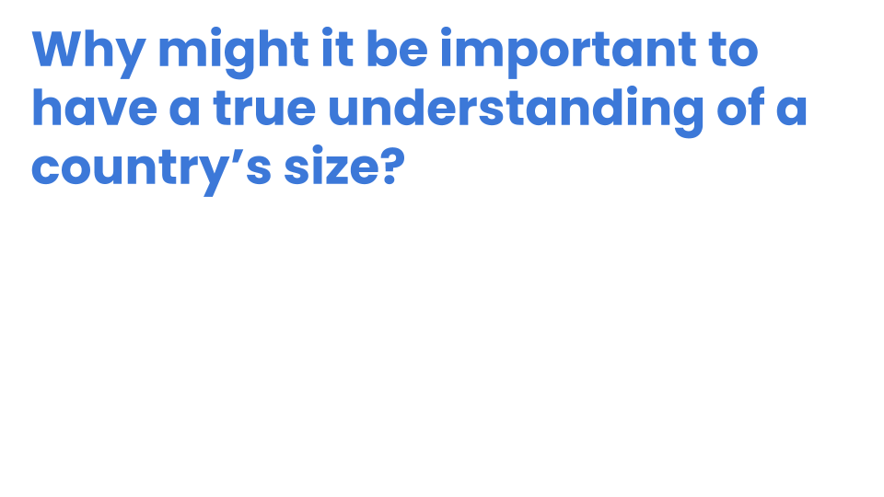
Notes:
Location in Lesson Plan: Day 1 Launch
Social Justice Related Question

Slide 9
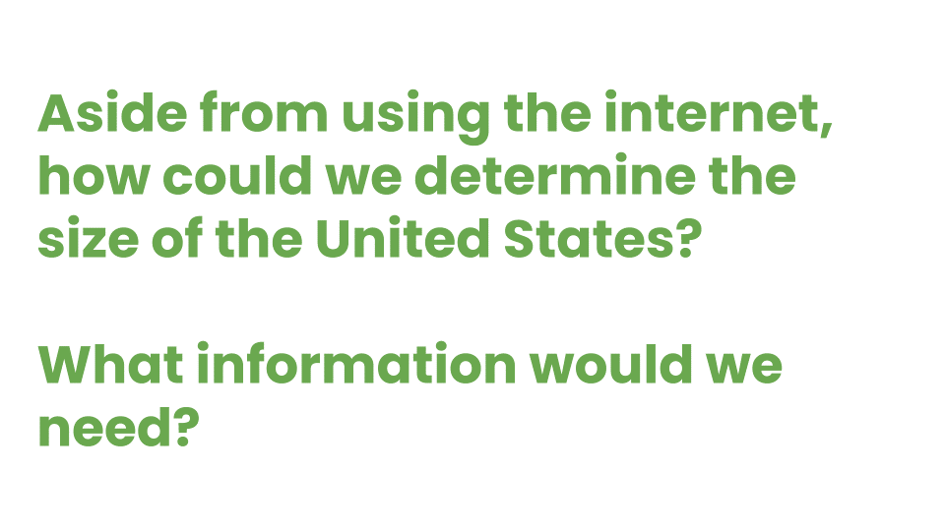
Notes:
Location in Lesson Plan: Day 1 Launch
Deep Mathematical Question

Slide 10
Notes:
Location in Lesson Plan: Day 1 Launch
Deep Mathematical Question

Slide 11
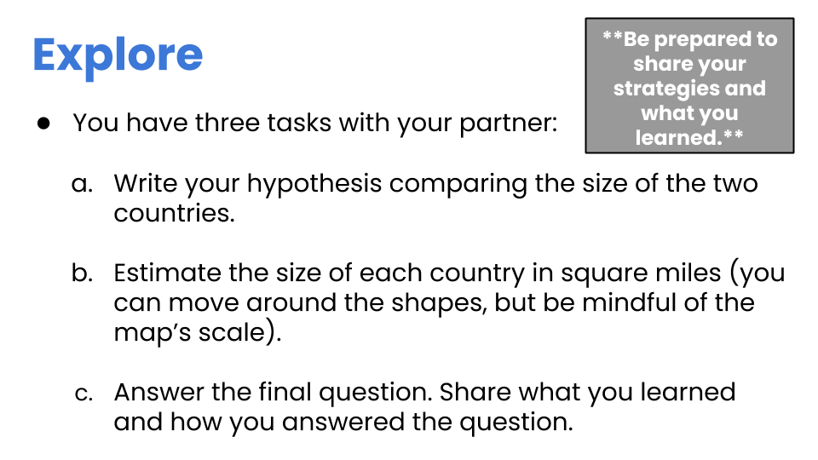
Notes:
Location in Lesson Plan: Day 1 Explore

Slide 12

Notes:
Location in Lesson Plan: Day 1 Explore

Slide 13
FRANCE
COLOMBIA
Notes:
Location in Lesson Plan: Day 1 Explore

Slide 14
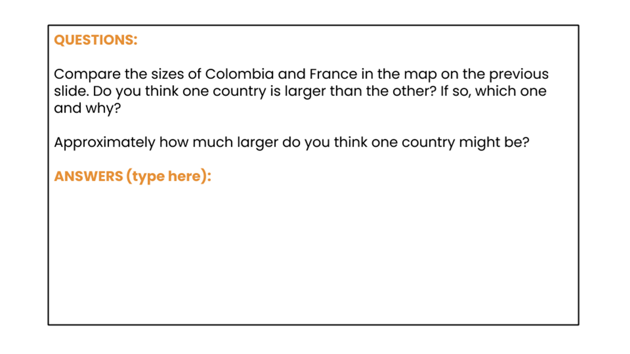
Notes:
Location in Lesson Plan: Day 1 Explore

Slide 15
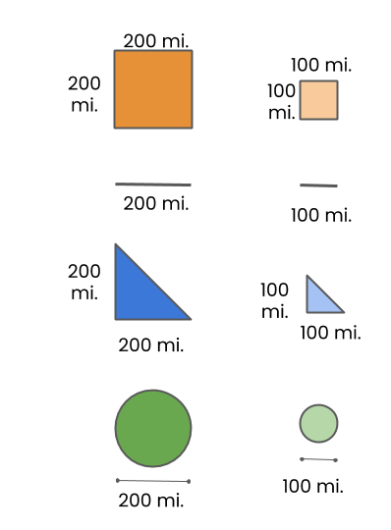
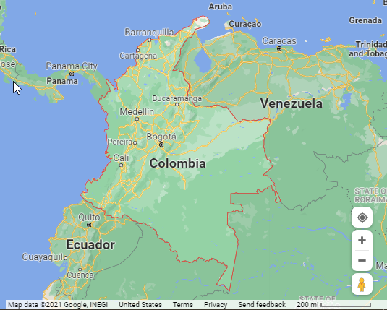
COLOMBIA
Estimate the size of Colombia in square miles.
Source: Map data ©2021 Google
Notes:
Location in Lesson Plan: Day 1 Explore

Slide 16
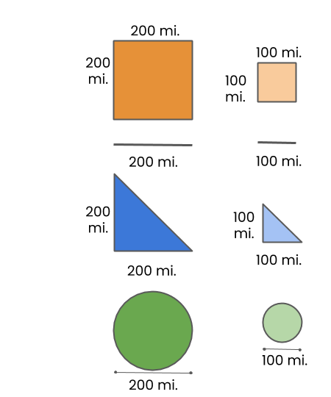
FRANCE
Estimate the size of France in square miles.
Source: Map data ©2021 Google
Notes:
Location in Lesson Plan: Day 1 Explore

Slide 17
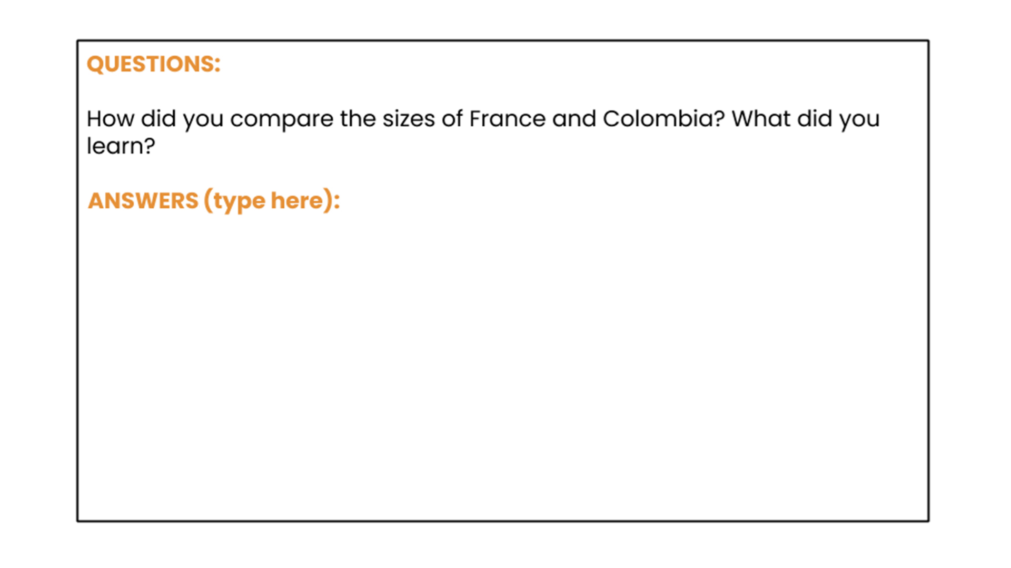
Notes:
Location in Lesson Plan: Day 1 Explore

Slide 18

Notes:
Location in Lesson Plan: Day 1 Explore

Slide 19
FINLAND
KENYA
Notes:
Location in Lesson Plan: Day 1 Explore

Slide 20
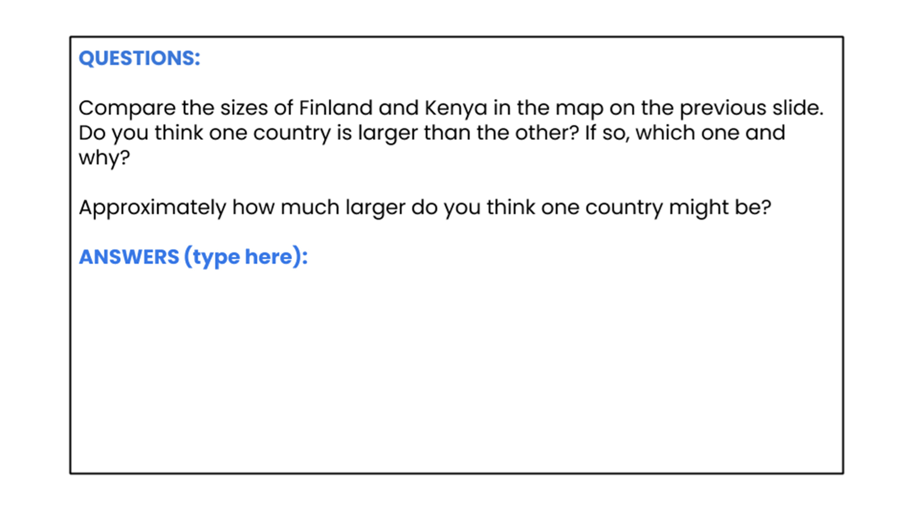
Notes:
Location in Lesson Plan: Day 1 Explore

Slide 21
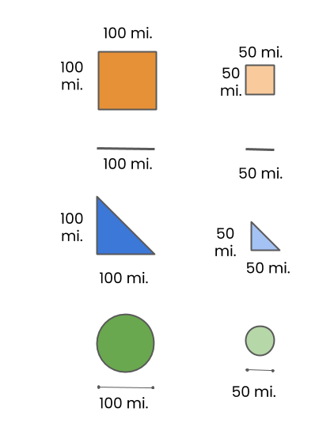
FINLAND
Estimate the size of Finland in square miles.
Notes:
Location in Lesson Plan: Day 1 Explore

Slide 22
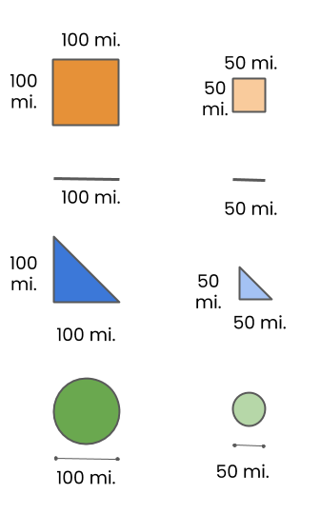
KENYA
Estimate the size of Kenya in square miles.
** The image represents approximate country borders due to disputed territorial claims. **
Source: Map data ©2021 Google
Notes:
Location in Lesson Plan: Day 1 Explore

Slide 23
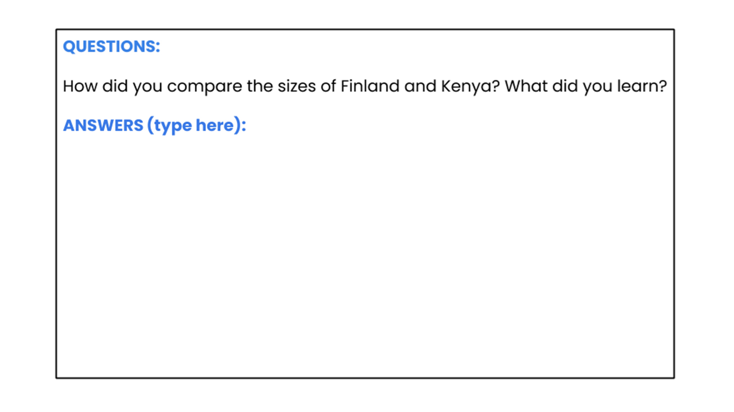
Notes:
Location in Lesson Plan: Day 1 Explore

Slide 24
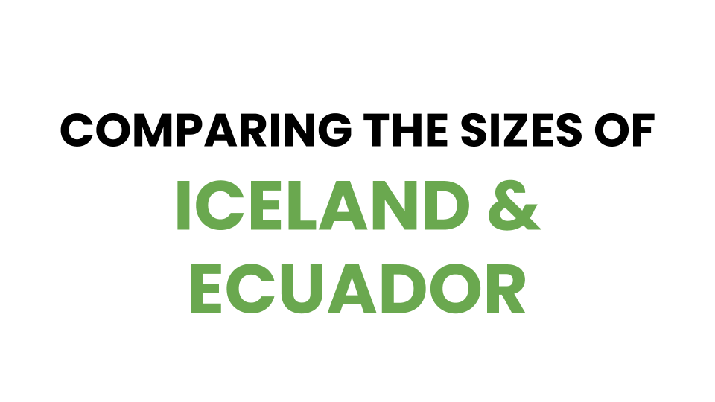
Notes:
Location in Lesson Plan: Day 1 Explore

Slide 25
ICELAND
ECUADOR
Notes:
Location in Lesson Plan: Day 1 Explore

Slide 26
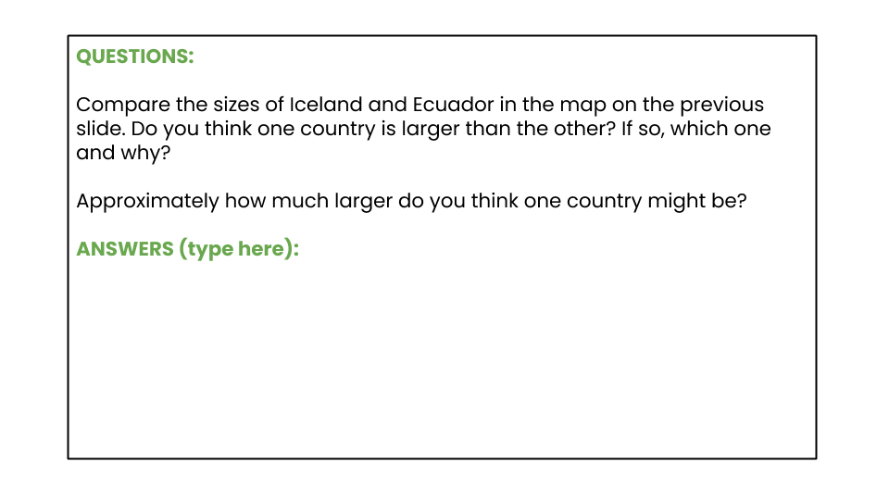
Notes:
Location in Lesson Plan: Day 1 Explore

Slide 27
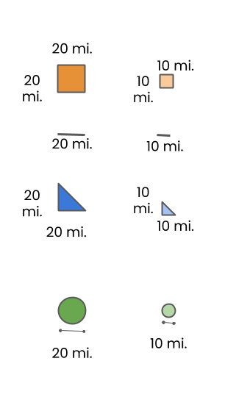
ICELAND
Estimate the size of Iceland in square miles.
Source: Map data ©2021 Google
Notes:
Location in Lesson Plan: Day 1 Explore

Slide 28
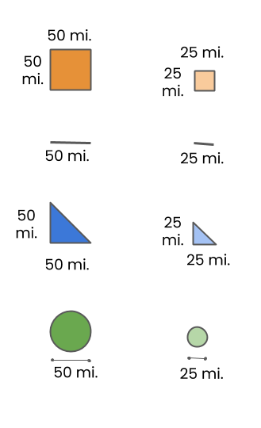
ECUADOR
Estimate the size of Ecuador in square miles.
Source: Map data ©2021 Google
Notes:
Location in Lesson Plan: Day 1 Explore

Slide 29
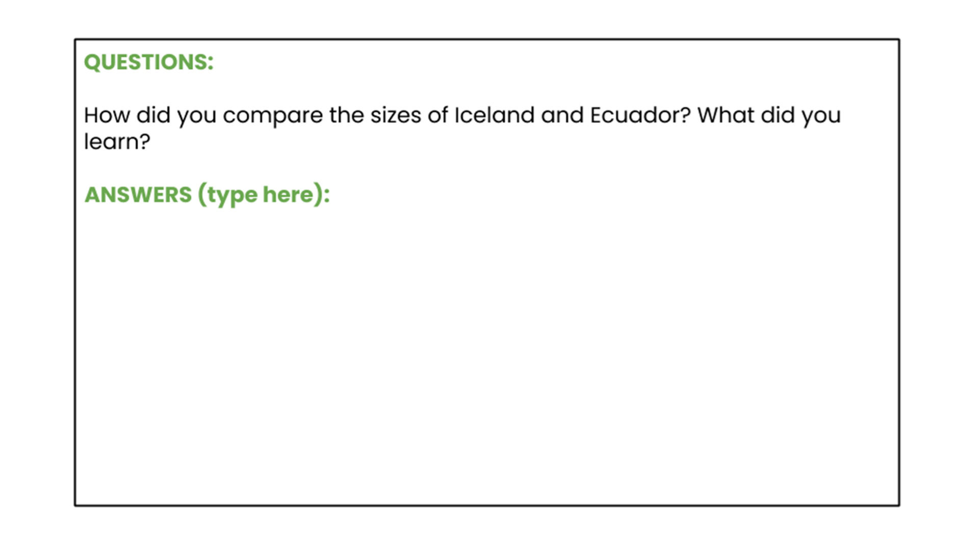
Notes:
Location in Lesson Plan: Day 1 Explore

Slide 30

Notes:
Location in Lesson Plan: Day 1 Explore

Slide 31
INDIA
GREENLAND
Notes:
Location in Lesson Plan: Day 1 Explore

Slide 32
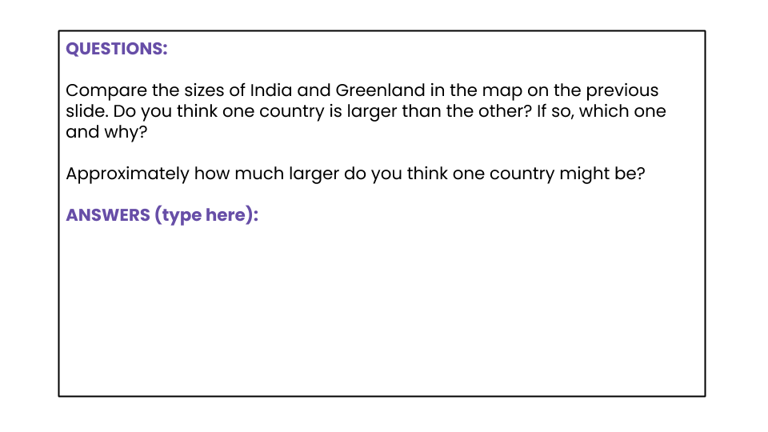
Notes:
Location in Lesson Plan: Day 1 Explore

Slide 33
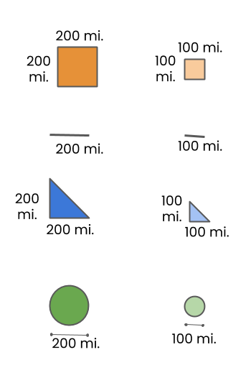
INDIA
Estimate the size of India in square miles.
** The image represents approximate country borders due to disputed territorial claims. **
Notes:
Location in Lesson Plan: Day 1 Explore

Slide 34
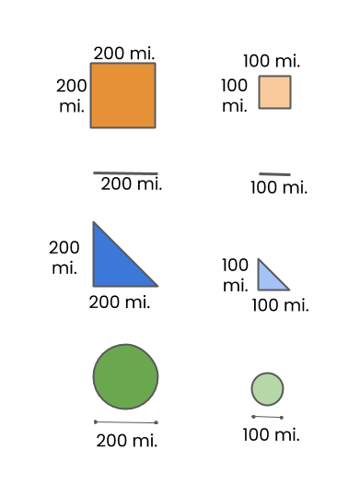
GREENLAND
Estimate the size of Greenland in square miles.
Source: Map data ©2021 Google
Notes:
Location in Lesson Plan: Day 1 Explore

Slide 35
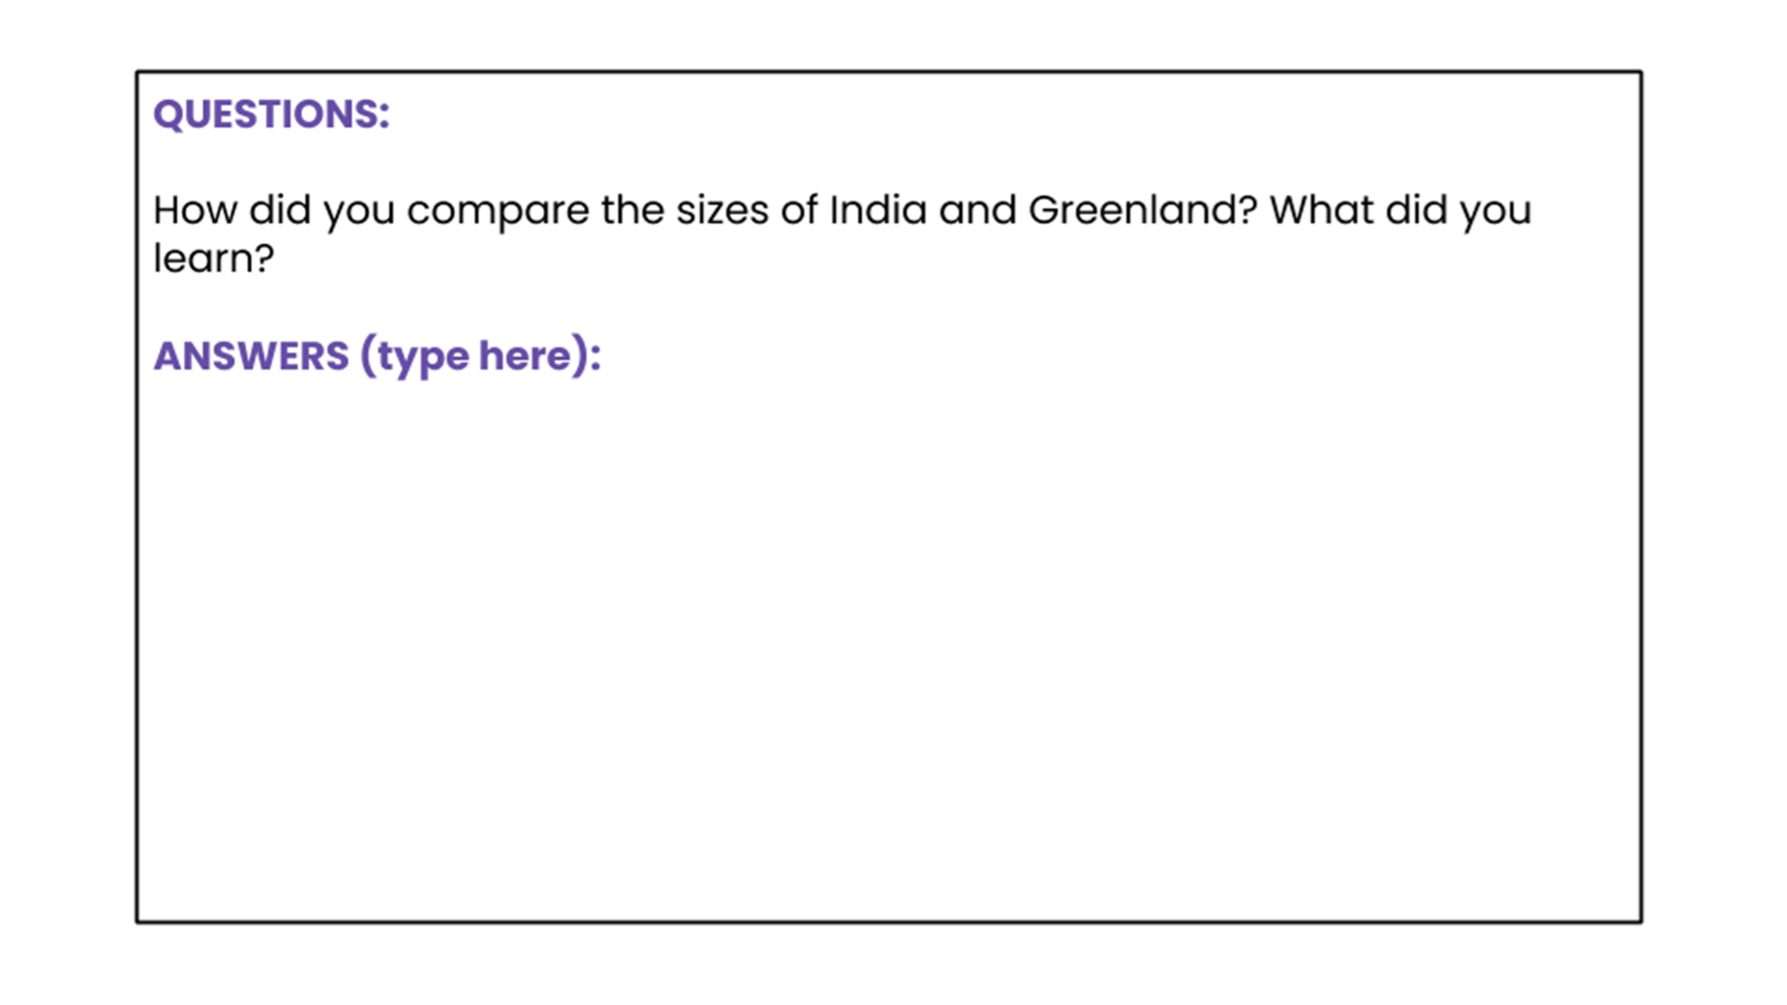
Notes:
Location in Lesson Plan: Day 1 Explore

Slide 36

Notes:
Location in Lesson Plan: Day 1 Explore

Slide 37
POLAND
OMAN
Notes:
Location in Lesson Plan: Day 1 Explore

Slide 38
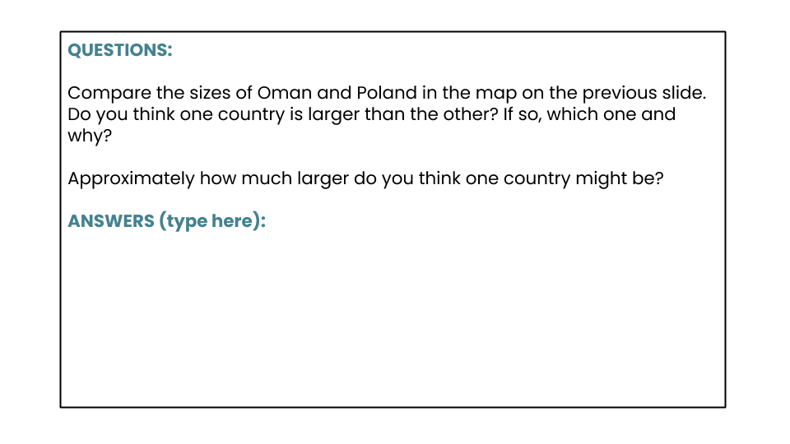
Notes:
Location in Lesson Plan: Day 1 Explore

Slide 39
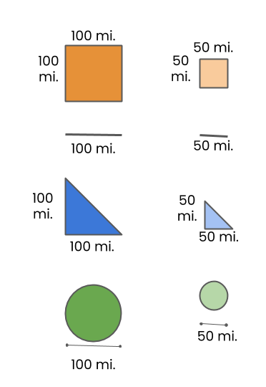
OMAN
Estimate the size of Oman in square miles.
Notes:
Location in Lesson Plan: Day 1 Explore

Slide 40
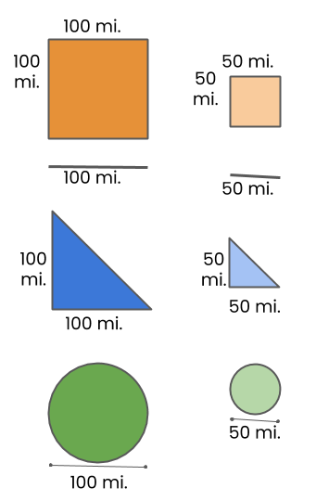
POLAND
Estimate the size of Poland in square miles.
Source: Map data ©2021 Google
Notes:
Location in Lesson Plan: Day 1 Explore

Slide 41
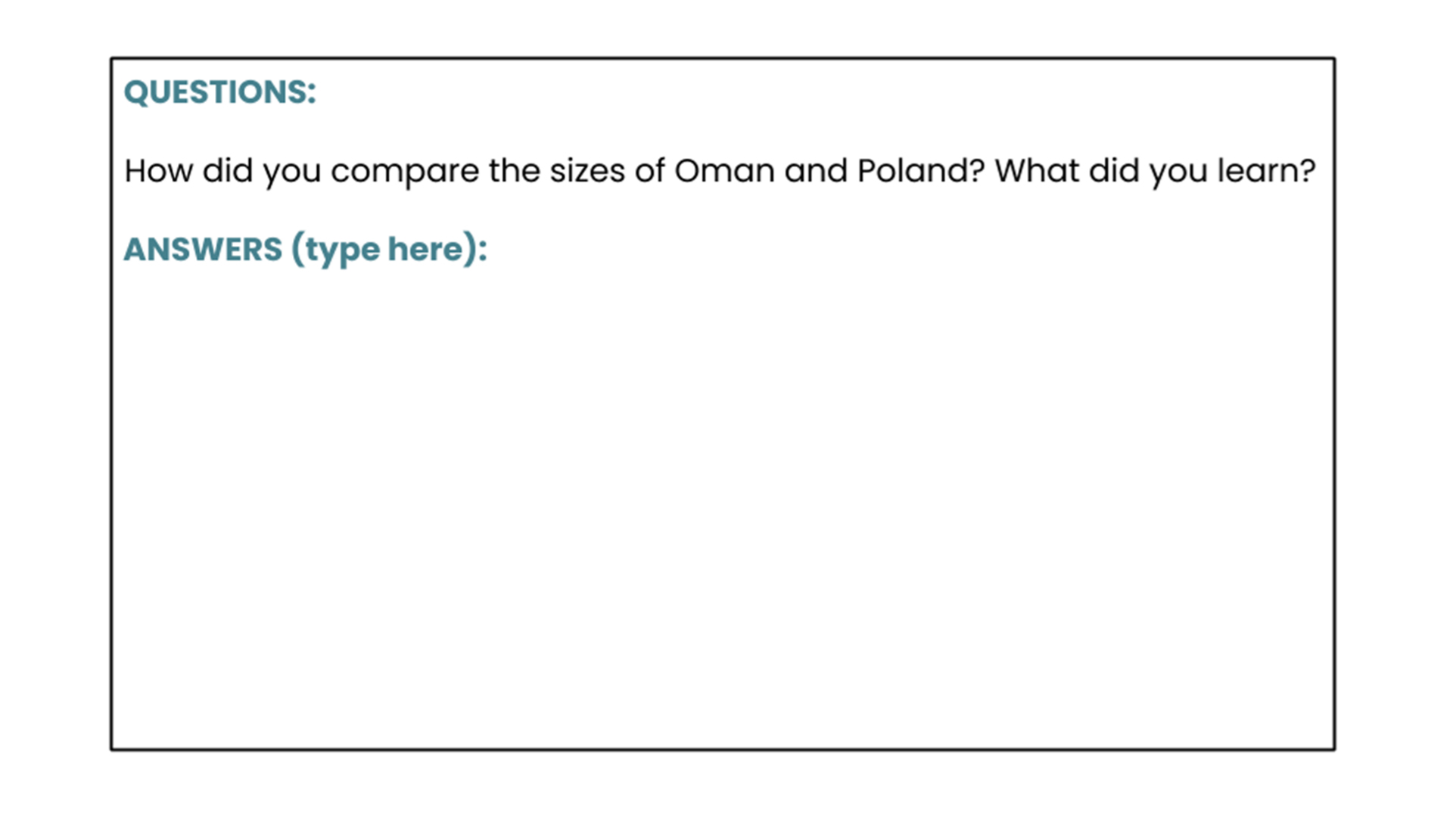
Notes:
Location in Lesson Plan: Day 1 Explore

Slide 42
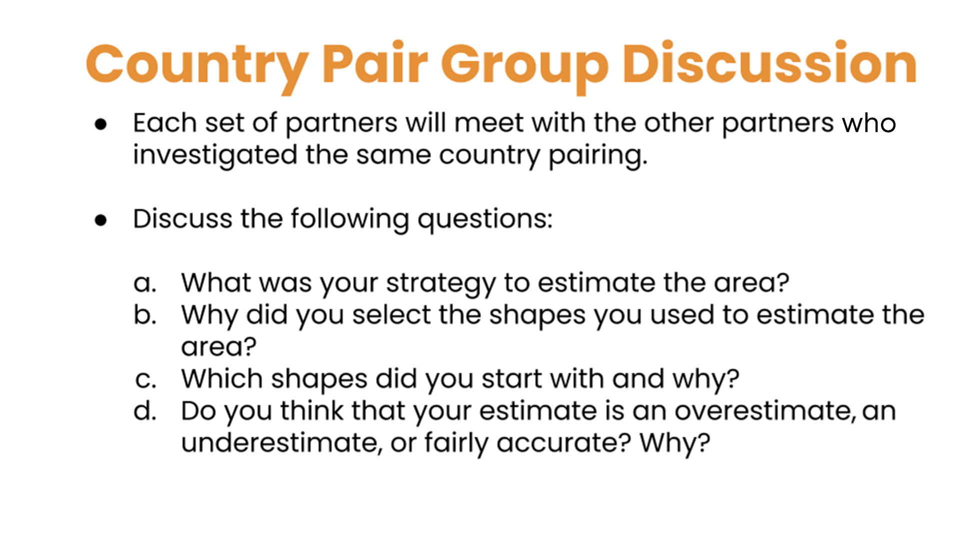
Notes:
Location in Lesson Plan: Day 1 Explore
Deep Mathematical Questions

Slide 43

Notes:
Location in Lesson Plan: Day 1 Summarize / Day 2 Launch (begin by talking about what common themes were identified in the previous lesson)
Additional Questions to Consider:
Compare your results with your predictions. Why do you think your original predictions were correct or incorrect?
What did you notice as you worked? What do you wonder?

Slide 44
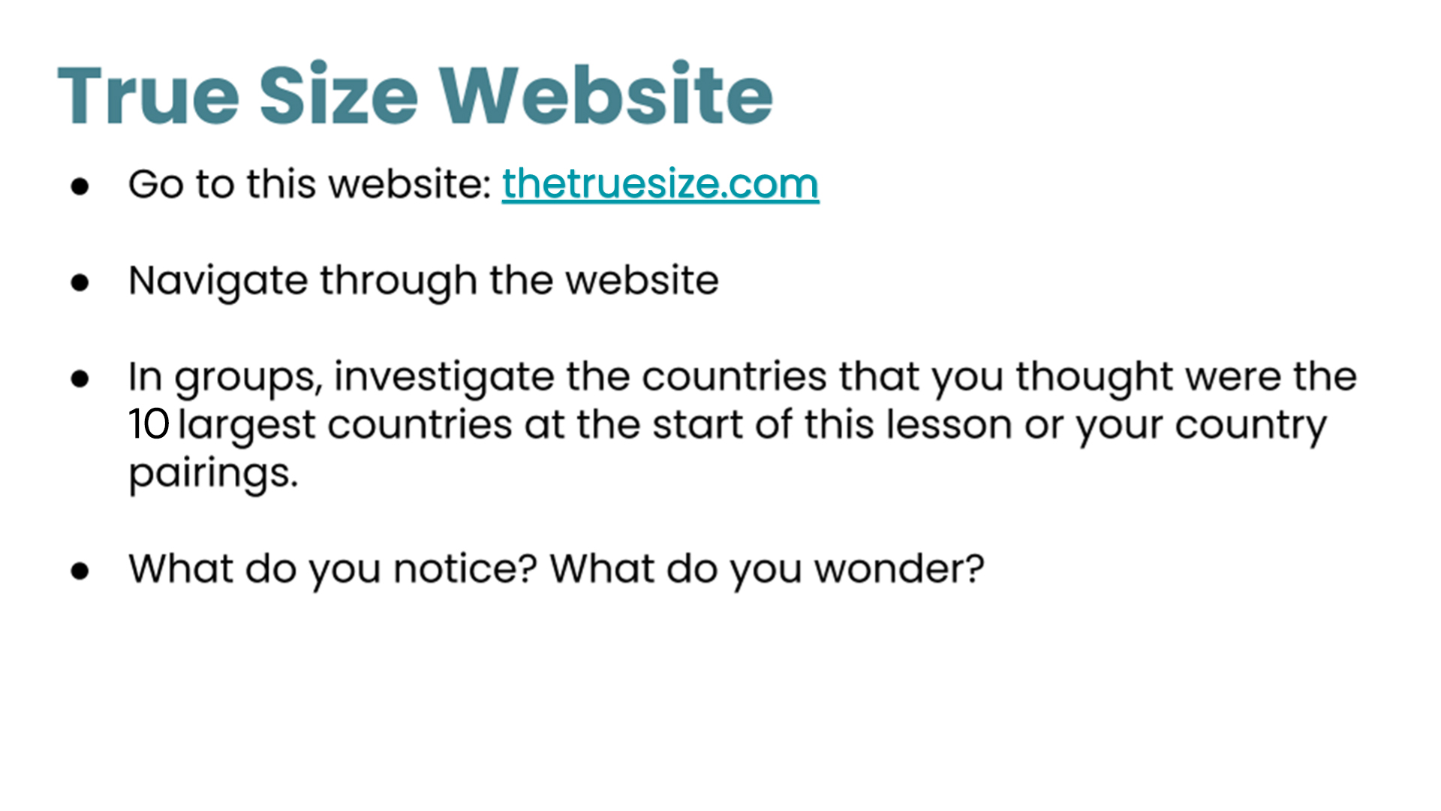
thetruesize.com
Notes:
Location in Lesson Plan: Day 2 Launch

Slide 45
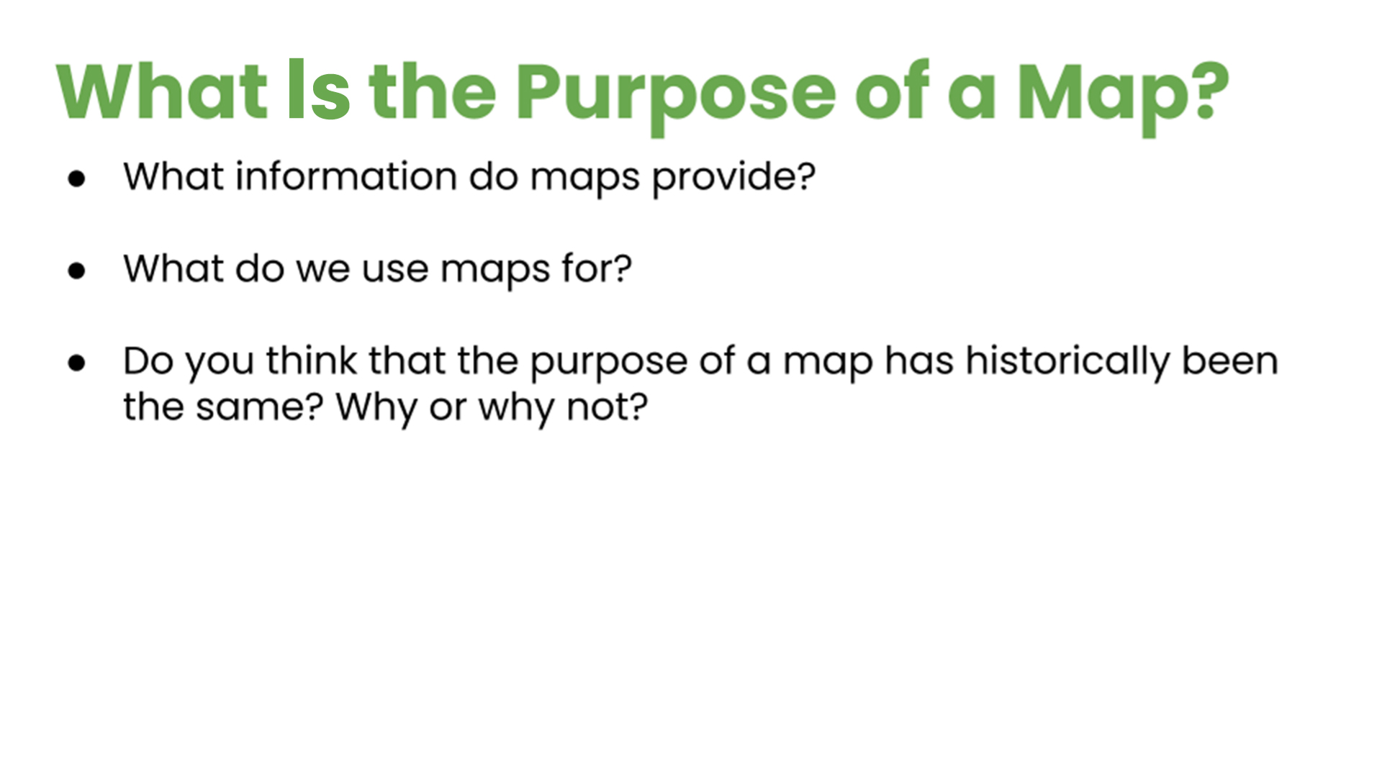
Notes:
Location in Lesson Plan: Day 2 Explore
Social Justice Related Questions
These questions spark conversation around why we need maps, what we use them for, and how the purpose of maps have changed over hundreds of years.
Traditionally maps were necessary for sailing and navigation, this is why the Mercator projection is a prominently used map. Yes, it obstructs the true size of countries, but it preserves the shape and direction, which would be necessary for sailing (See https://www.britannica.com/science/Mercator-projection).

Slide 46
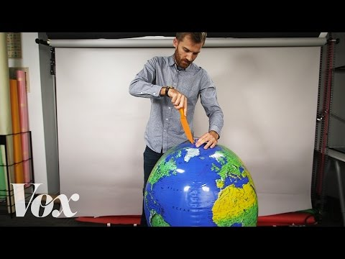
Notes:
Location in Lesson Plan: Day 2 Explore

Slide 47
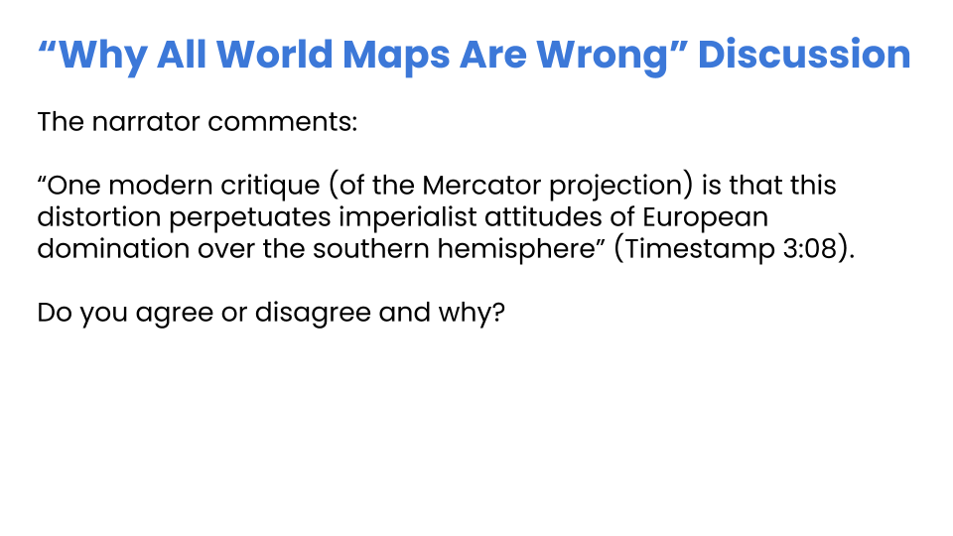
Notes:
Location in Lesson Plan: Day 2 Explore
Social Justice Related Questions
Revisit the list from the Launch portion of the Lesson 1 about why our understanding of countries’ sizes might matter to support students in thoughtfully engaging with this question.

Slide 48
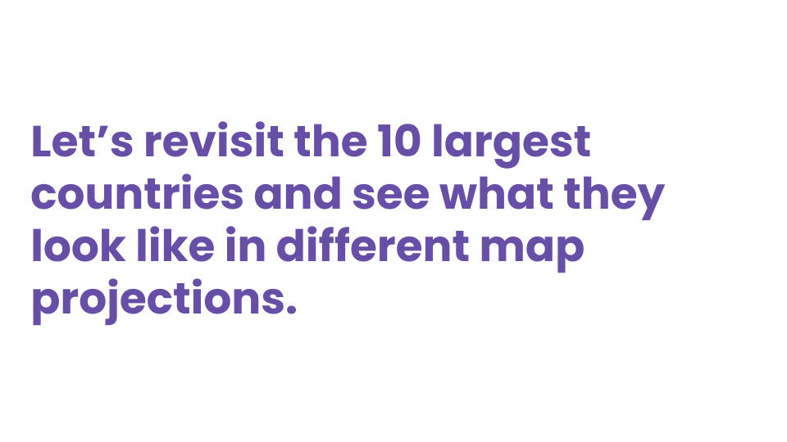
Notes:
Location in Lesson Plan: Day 2 Explore

Slide 49
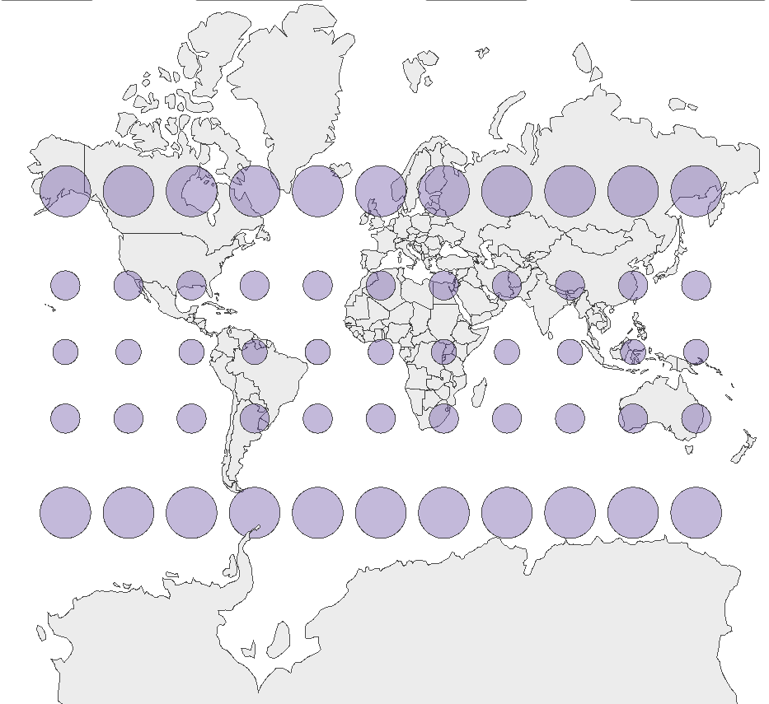
Mercator
Projection
Source: Created by Metrocosm, http://metrocosm.com/mercator/
Notes:
Location in Lesson Plan: Day 2 Explore

Slide 50
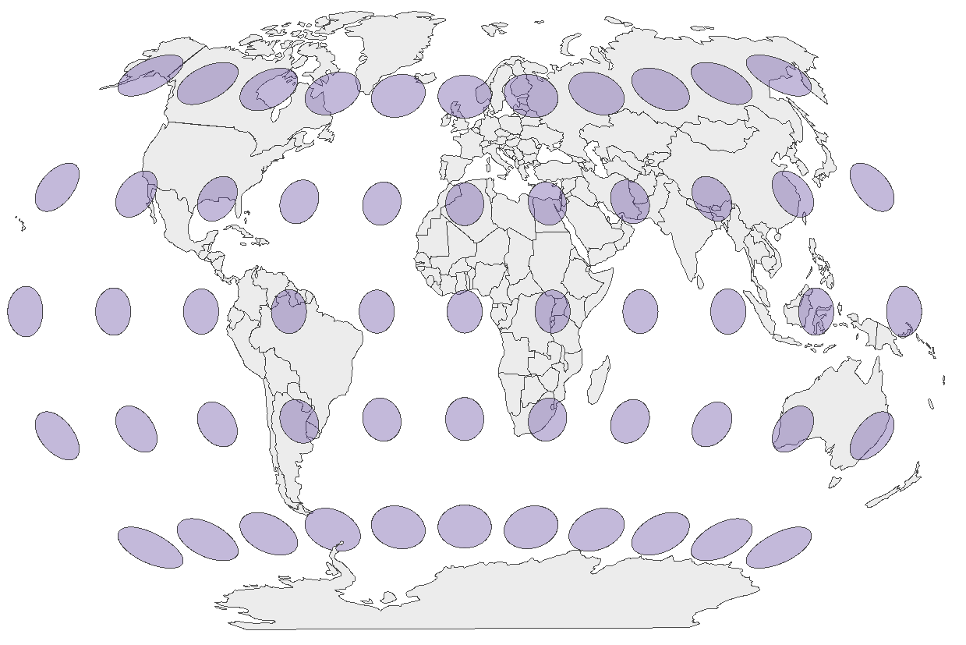
Winkle-Triple Projection
Source: Created by Metrocosm, http://metrocosm.com/mercator/
Notes:
Location in Lesson Plan: Day 2 Explore

Slide 51
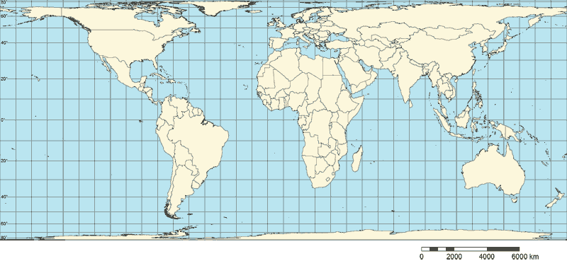
Behrman* Projection
*This is an area-preserving projection, much like the Gall-Peters.
Notes:
Location in Lesson Plan: Day 2 Explore

Slide 52
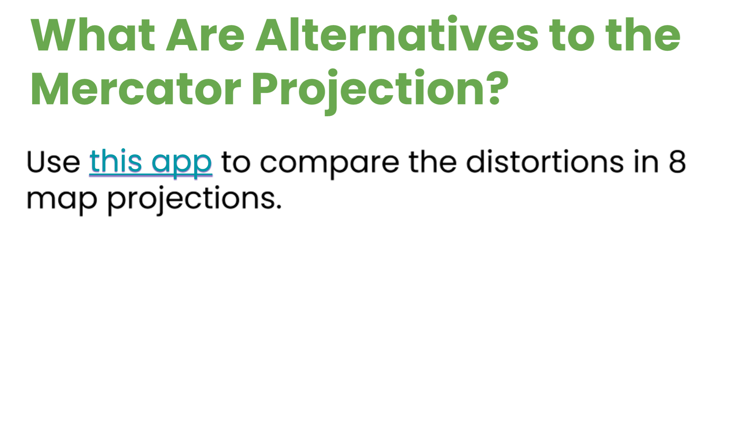
this app
Notes:
Location in Lesson Plan: Day 2 Explore
If students have not already brought this up, it would be a good time to discuss how maps are often viewed as objective truth that simply portray the “facts”. However, we saw in this lesson that is not the case. By the nature of forcing a spherical object to be represented on a plane, some aspect has to be distorted. Each projection has to distort reality in some way. However, what is distorted has an impact on how we view our world.

Slide 53
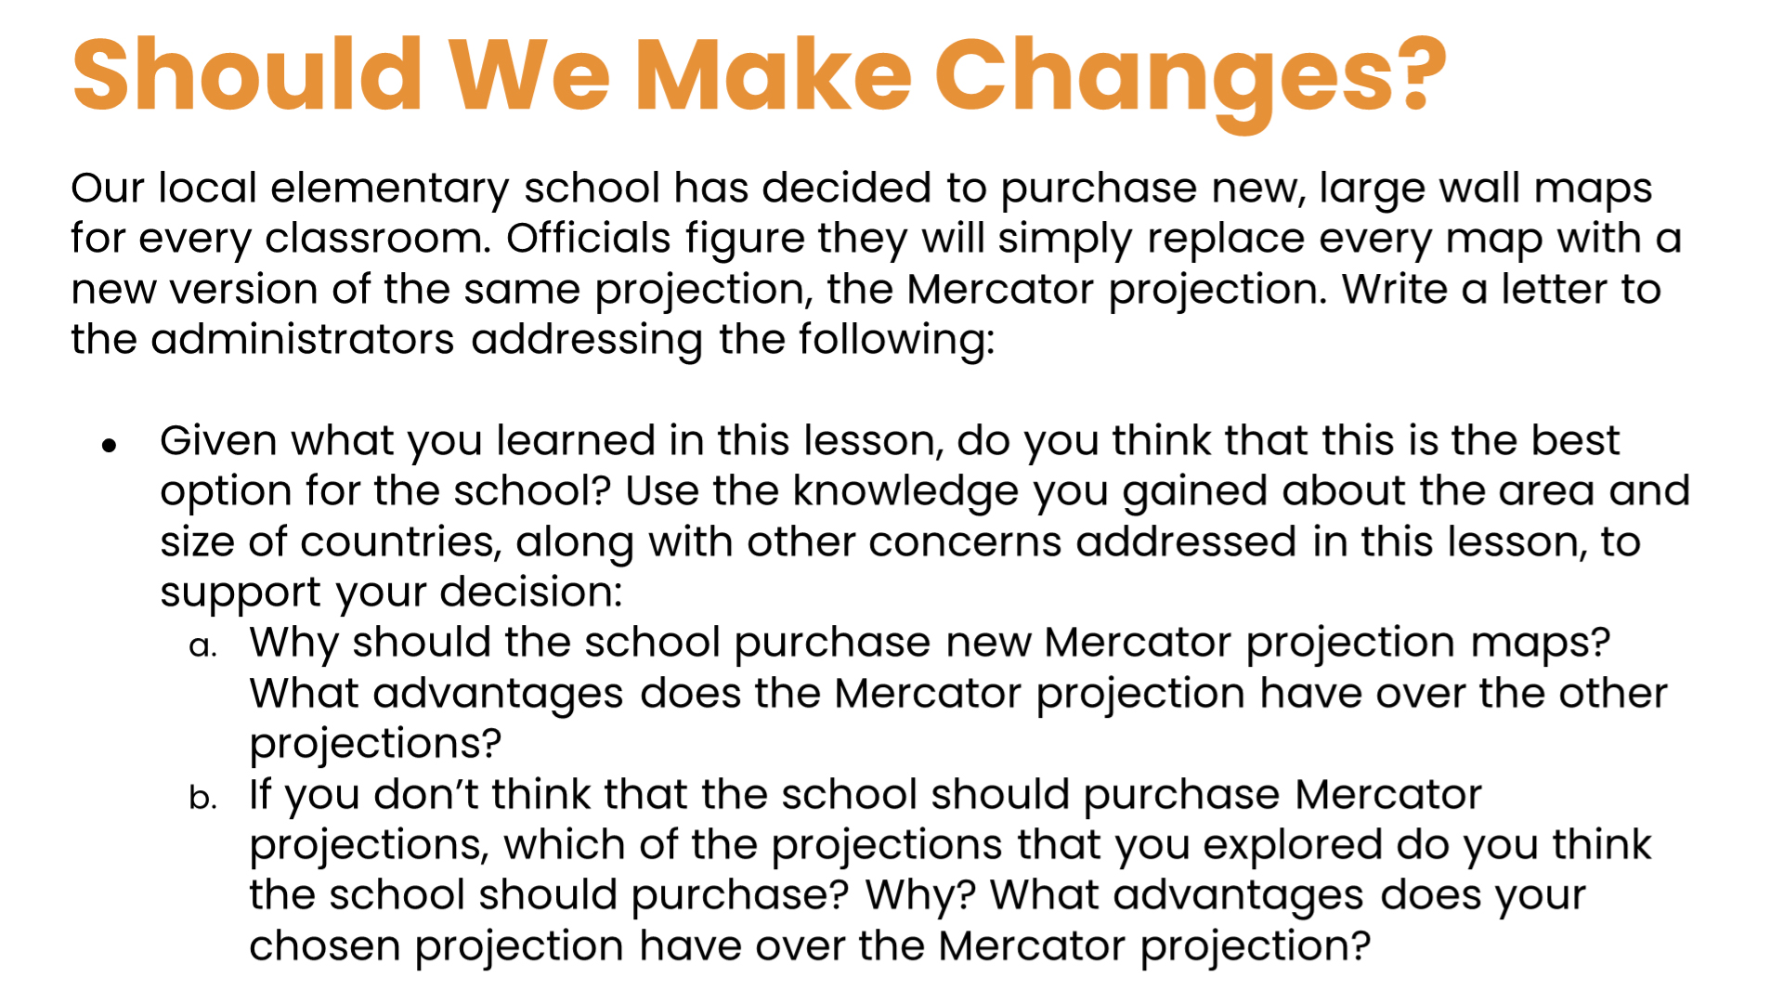
Notes:
Location in Lesson Plan: Day 2 Summary
Social Justice Related Questions

