Slide 1
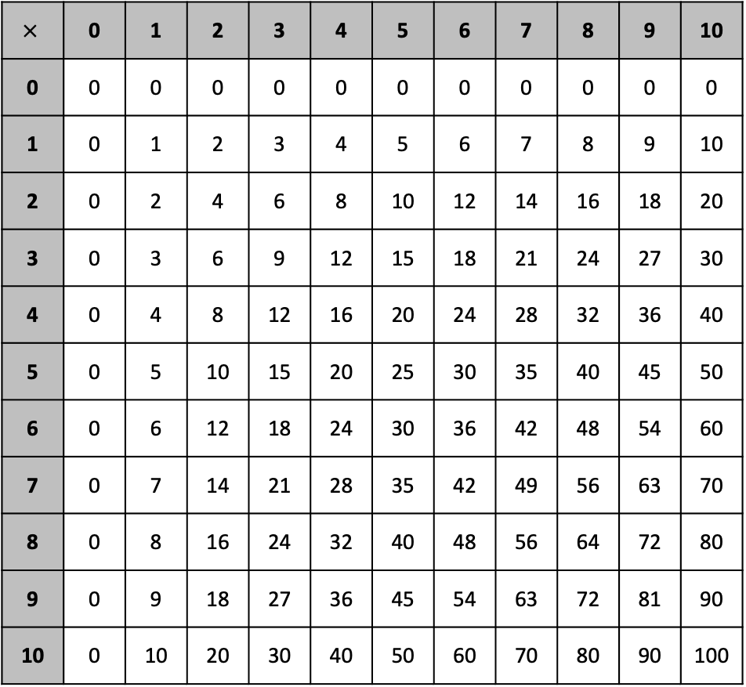
Multiplication Chart
$$×$$ | 0 | 1 | 2 | 3 | 4 | 5 | 6 | 7 | 8 | 9 | 10
0 | 0 | 0 | 0 | 0 | 0 | 0 | 0 | 0 | 0 | 0 | 0
1 | 0 | 1 | 2 | 3 | 4 | 5 | 6 | 7 | 8 | 9 | 10
2 | 0 | 2 | 4 | 6 | 8 | 10 | 12 | 14 | 16 | 18 | 20
3 | 0 | 3 | 6 | 9 | 12 | 15 | 18 | 21 | 24 | 27 | 30
4 | 0 | 4 | 8 | 12 | 16 | 20 | 24 | 28 | 32 | 36 | 40
5 | 0 | 5 | 10 | 15 | 20 | 25 | 30 | 35 | 40 | 45 | 50
6 | 0 | 6 | 12 | 18 | 24 | 30 | 36 | 42 | 48 | 54 | 60
7 | 0 | 7 | 14 | 21 | 28 | 35 | 42 | 49 | 56 | 63 | 70
8 | 0 | 8 | 16 | 24 | 32 | 40 | 48 | 56 | 64 | 72 | 80
9 | 0 | 9 | 18 | 27 | 36 | 45 | 54 | 63 | 72 | 81 | 90
10 | 0 | 10 | 20 | 30 | 40 | 50 | 60 | 70 | 80 | 90 | 100

