Slide 1
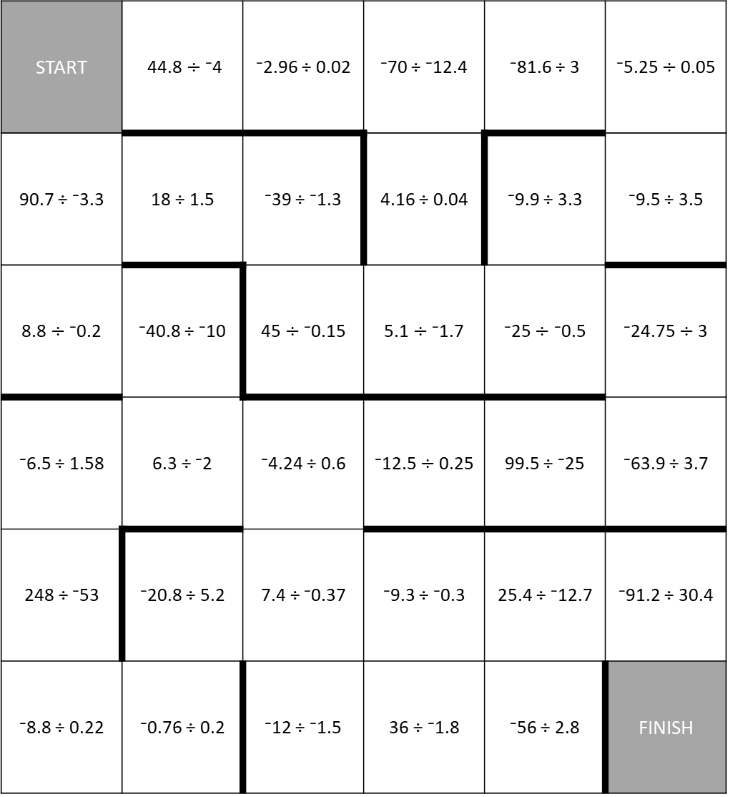
A-MAZE-ing Race
Directions: Choose an open space that touches the space you are in to move. Tell how you solve the problem. If correct, move to the new space. You cannot cross dark lines. Be the first to get to the finish.
START | 44.8 $÷$ ⁻4 | ⁻2.96 ÷ 0.02 | ⁻70 ÷ ⁻12.4 | ⁻81.6 ÷ 3 | ⁻5.25 $÷$ 0.05
90.7 ÷ ⁻3.3 | 18 ÷ 1.5 | ⁻39 ÷ ⁻1.3 | 4.16 ÷ 0.04 | ⁻9.9 ÷ 3.3 | ⁻9.5 ÷ 3.5
8.8 $÷$ ⁻0.2 | ⁻40.8 ÷ ⁻10 | 45 $÷$ ⁻0.15 | 5.1 $÷$ ⁻1.7 | ⁻25 $÷$ ⁻0.5 | ⁻24.75 $÷$ 3
⁻6.5 ÷ 1.58 | 6.3 ÷ ⁻2 | ⁻4.24 ÷ 0.6 | ⁻12.5 $÷$ 0.25 | 99.5 ÷ ⁻25 | ⁻63.9 ÷ 3.7
248 ÷ ⁻53 | ⁻20.8 ÷ 5.2 | 7.4 ÷ ⁻0.37 | ⁻9.3 ÷ ⁻0.3 | 25.4 ÷ ⁻12.7 | ⁻91.2 ÷ 30.4
⁻8.8 ÷ 0.22 | ⁻0.76 ÷ 0.2 | ⁻12 ÷ ⁻1.5 | 36 ÷ ⁻1.8 | ⁻56 ÷ 2.8 | FINISH

