Slide 1
Solving Equations: How Will I Solve It?
Directions: Spin the spinner. Find a problem card that matches the approach you spin. Keep the problem card if you solve it correctly.
Use Relational Reasoning
Choose Basic Transformations
Please see PDF in case the formatting of this file changes.

Slide 2
Solving Equations: How Will I Solve It?
Directions: Spin the spinner. Find a problem card for which you would use that basic transformation as your first step. Keep the problem card if you solve it correctly.
Add/Subtract On Both Sides of the Equation
Combine Like Terms
Use Distributive Property
Multiply/Divide On Both Sides of the Equation

Slide 3
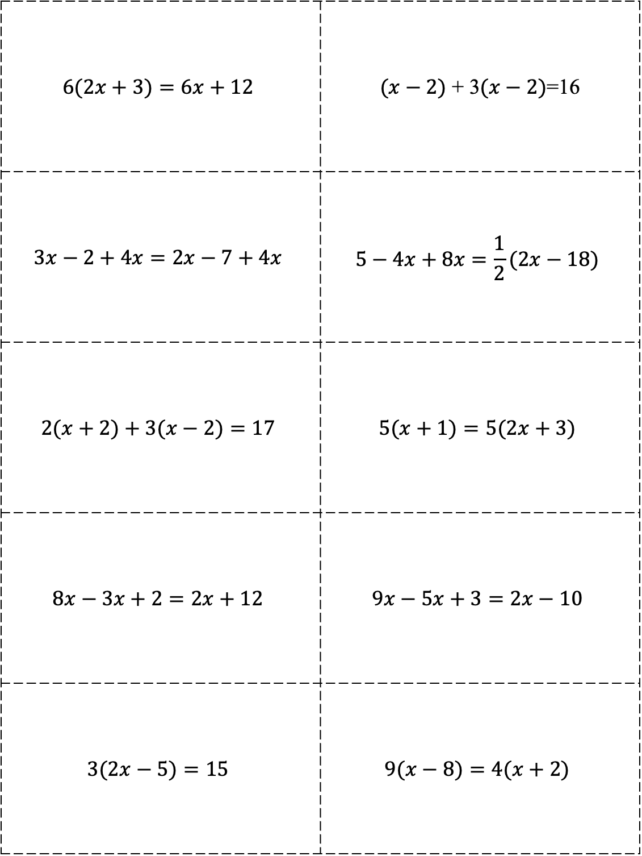
$$6(2x+3)=6x+12$$ | $(x−2)$ + 3$(x−2)$=16
$$3x−2+4x=2x−7+4x$$ | $$5−4x+8x=\frac{1}{2}(2x−18)$$
$$2(x+2)+3(x−2)=17$$ | $$5(x+1)=5(2x+3)$$
$$8x−3x+2=2x+12$$ | $$9x−5x+3=2x−10$$
$$3(2x−5)=15$$ | $$9(x−8)=4(x+2)$$

Slide 4
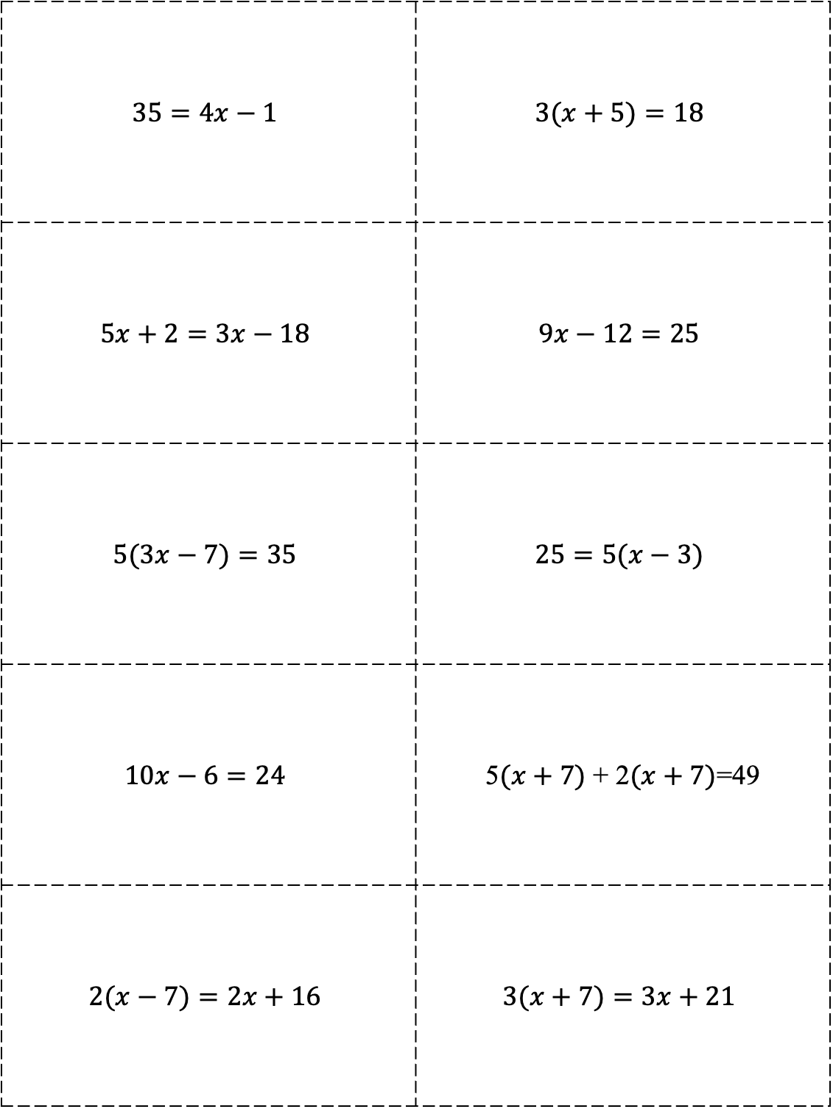
$$35=4x−1$$ | $$3(x+5)=18$$
$$5x+2=3x−18$$ | $$9x−12=25$$
$$5(3x−7)=35$$ | $$25=5(x−3)$$
$$10x−6=24$$ | 5$(x+7)$ + 2$(x+7)$=49
$$2(x−7)=2x+16$$ | $$3(x+7)=3x+21$$

Slide 5
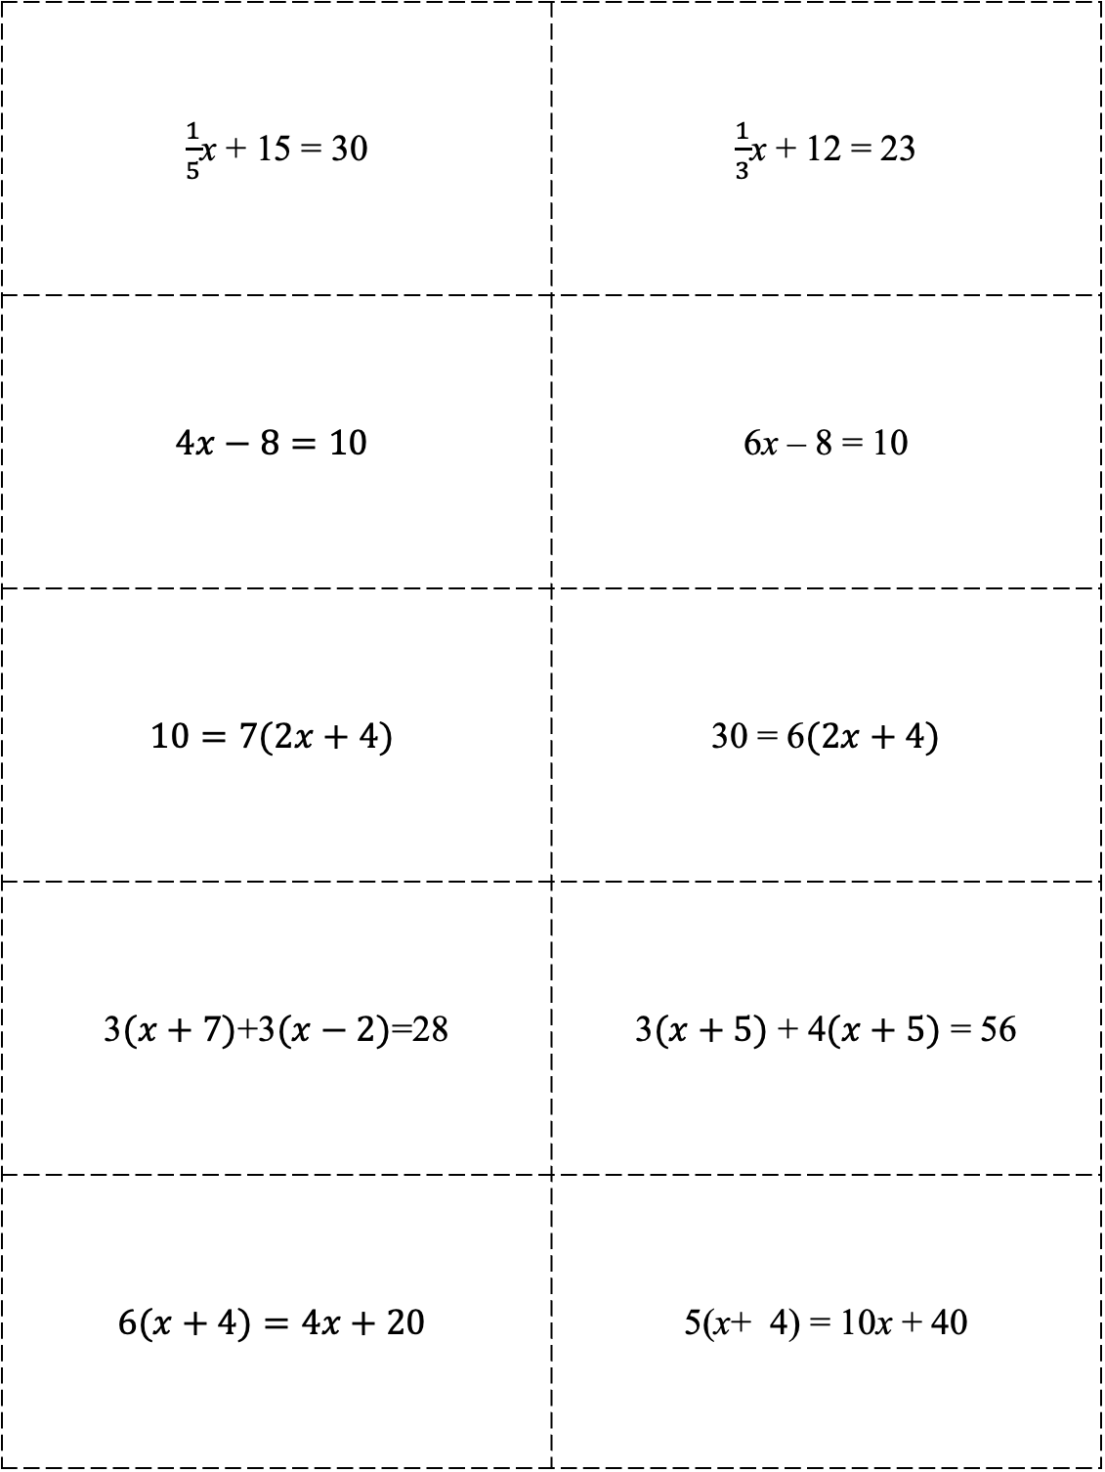
$\frac{1}{5}$x + 15 = 30 | $\frac{1}{3}$x + 12 = 23
$$4x−8=10$$ | 6x – 8 = 10
$$10=7(2x+4)$$ | 30 = 6$(2x+4)$
3$(x+7)$+3$(x−2)$=28 | 3$(x+5)$ + 4$(x+5)$ = 56
$$6(x+4)=4x+20$$ | 5(x+ 4) = 10x + 40

Slide 6
$$5 – 2(x +1)=1$$ | $3\left(a+1\right)–2=7$
$$−4= \frac{b}{20} −5$$ | $$3\left(a+1\right)–2=7$$
$$\frac{m+9}{3}+2=−6$$ | $c−1=5c+3c −8$
$$3\left(n+1\right)−2\left(n+1\right)=8$$ | $12=−4(−6x −3)$
$$2(4x−3)−8 =4+2x$$ | $−20=−4x −6x$

Slide 7
$$10+5(x +1)=40$$ | $3\left(a+1\right)–4a=6a+10$
$$20= \frac{n}{5}+5$$ | $$8m –2=5m+7$$
$\frac{5m−6}{2}=\frac{m}{2}$ + 3 | $18x –24=6x+12$
$$4\left(n−3\right)=3\left(n−3\right)$$ | $10x=7x −15$
$$5\left(x+1\right)=20$$ | $$8(x+1)−4=12$$

Slide 8
$$6x+6−x=−9$$ | $$32=8\left(x –2\right)$$
$$6−2(x−2)=4\left(x –2\right)$$ | $$x+6=5x −9+x$$
$$32=8\left(x –2\right)$$ | $$5\left(n+7\right)=3\left(n+7\right)+16$$
$$4\left(x−3\right)=−24$$ | $$4\left(x−3\right)+1=−23$$
$$\frac{2}{3}\left(9a+15\right)=4$$ | $$4\left(x+1\right)+x+1=10$$

Slide 9
Systems of Equations: How Will I Solve It?
Directions: Spin the spinner. Find a problem card that matches the approach you spin. Keep the problem card if you solve it correctly.
Table
Graph
Substitution
Elimination

Slide 10
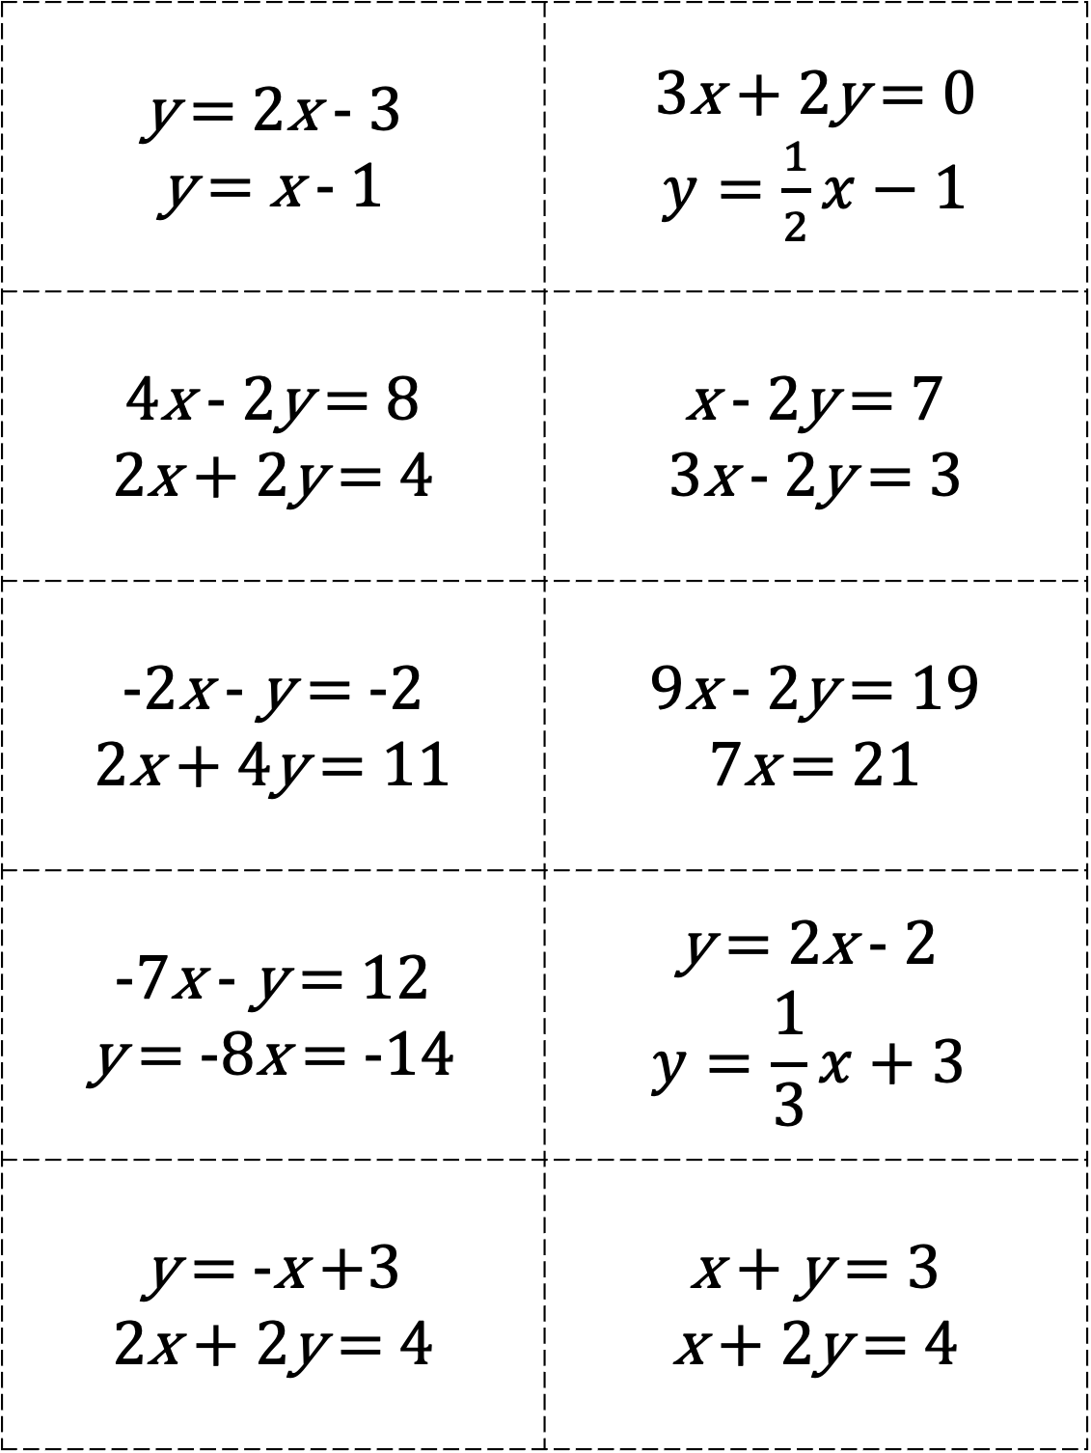
y = 2x - 3 y = x - 1 | 3x + 2y = 0 $y=\frac{1}{2}x−1$
4x - 2y = 8 2x + 2y = 4 | x - 2y = 7 3x - 2y = 3
-2x - y = -2 2x + 4y = 11 | 9x - 2y = 19 7x = 21
-7x - y = 12 y = -8x = -14 | y = 2x - 2 $$y=\frac{1}{3}x+3$$
y = -x +3 2x + 2y = 4 | x + y = 3 x + 2y = 4

Slide 11
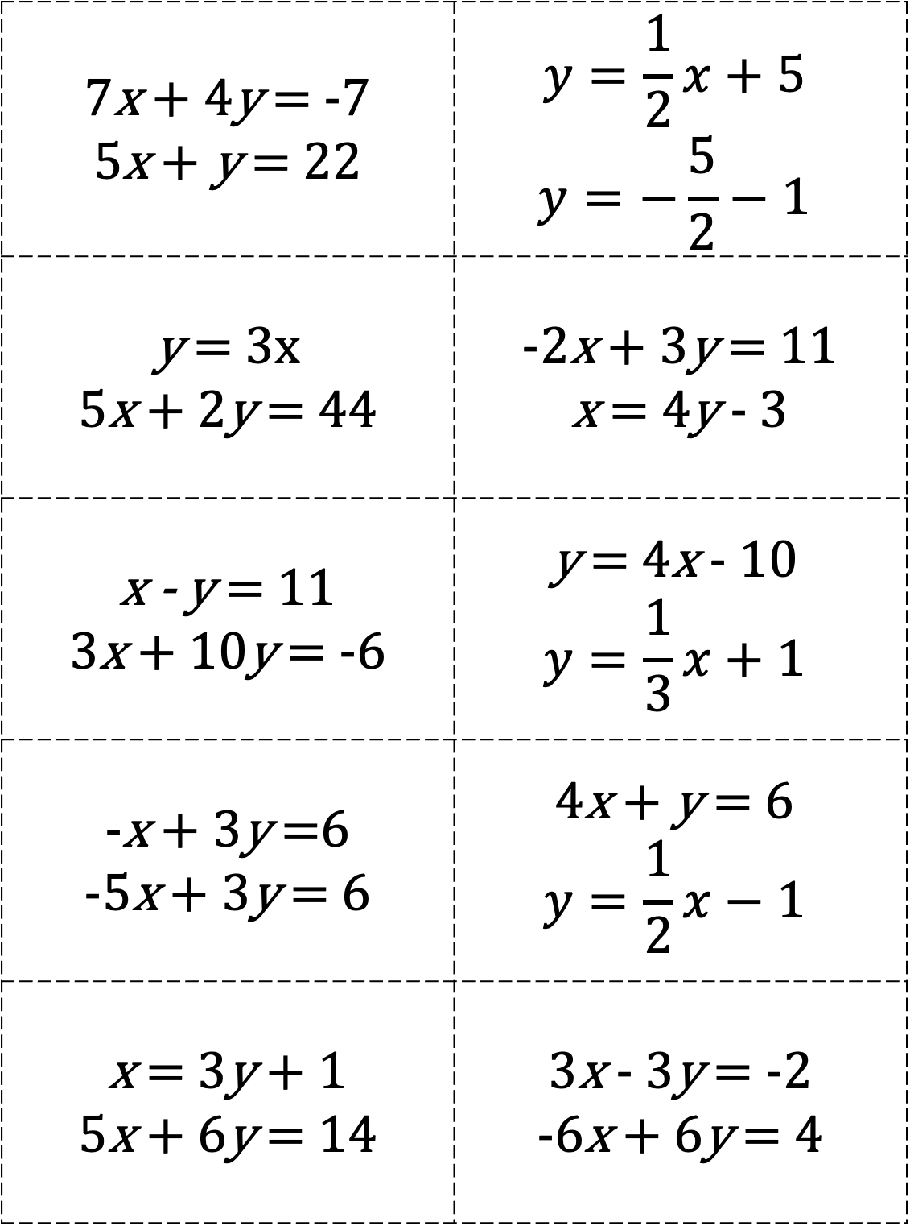
7x + 4y = -7 5x + y = 22 | $$y=\frac{1}{2}x+5$$ $$y=−\frac{5}{2}−1$$
y = 3x 5x + 2y = 44 | -2x + 3y = 11 x = 4y - 3
x - y = 11 3x + 10y = -6 | y = 4x - 10 $$y=\frac{1}{3}x+1$$
-x + 3y =6 -5x + 3y = 6 | 4x + y = 6 $$y=\frac{1}{2}x−1$$
x = 3y + 1 5x + 6y = 14 | 3x - 3y = -2 -6x + 6y = 4

Slide 12
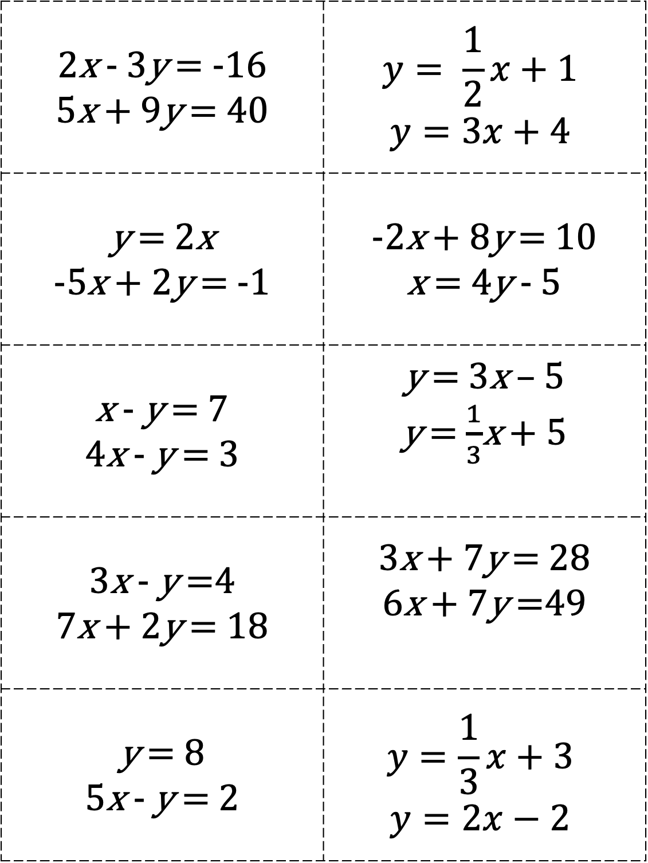
2x - 3y = -16 5x + 9y = 40 | $$y= \frac{1}{2}x+1$$ $$y=3x+4$$
y = 2x -5x + 2y = -1 | -2x + 8y = 10 x = 4y - 5
x - y = 7 4x - y = 3 | y = 3x – 5 y = $\frac{1}{3}$x + 5
3x - y =4 7x + 2y = 18 | 3x + 7y = 28 6x + 7y =49
y = 8 5x - y = 2 | $$y=\frac{1}{3}x+3$$ $$y=2x−2$$

