Slide 1
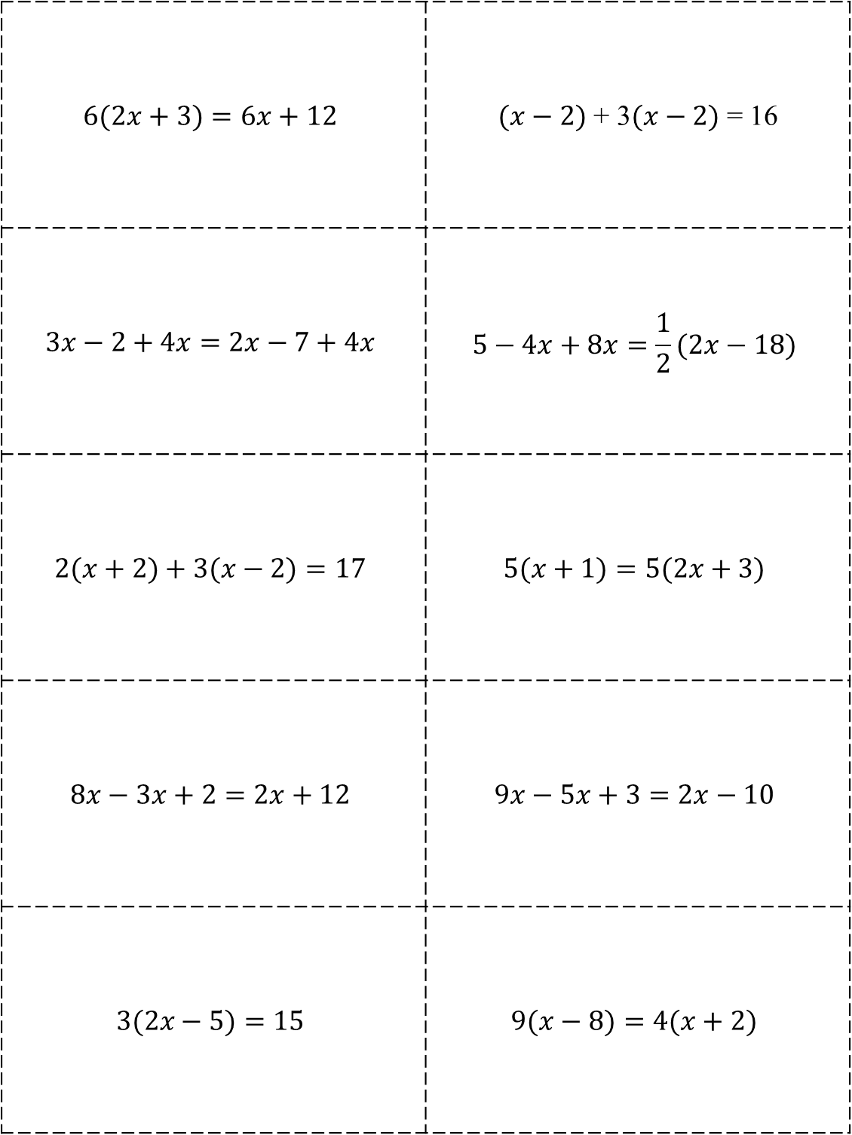
$$6(2x+3)=6x+12$$ | $(x−2)$ + 3$(x−2)$ = 16
$$3x−2+4x=2x−7+4x$$ | $$5−4x+8x=\frac{1}{2}(2x−18)$$
$$2(x+2)+3(x−2)=17$$ | $$5(x+1)=5(2x+3)$$
$$8x−3x+2=2x+12$$ | $$9x−5x+3=2x−10$$
$$3(2x−5)=15$$ | $$9(x−8)=4(x+2)$$

Slide 2
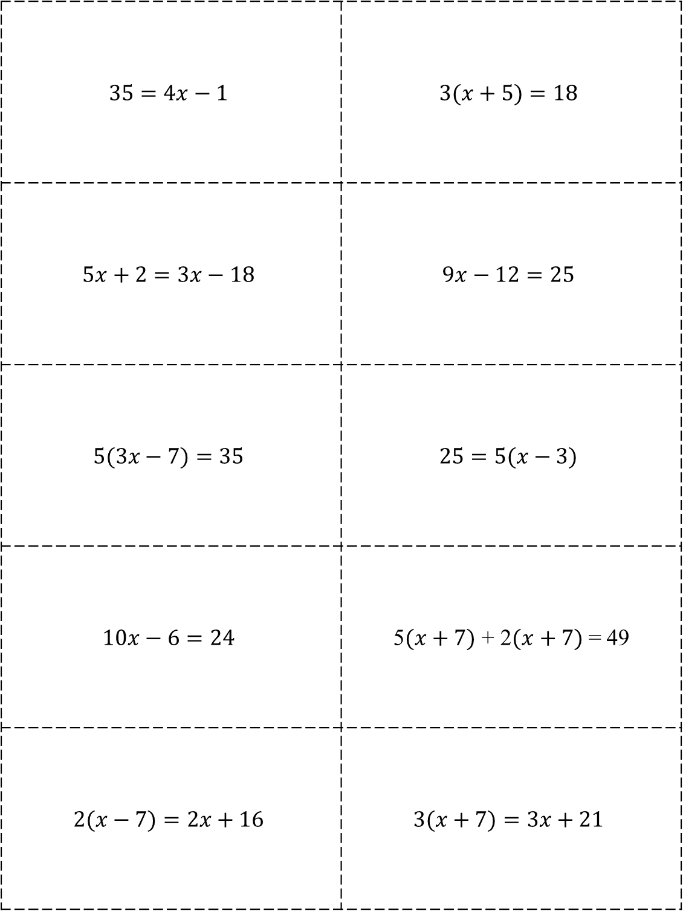
$$35=4x−1$$ | $$3(x+5)=18$$
$$5x+2=3x−18$$ | $$9x−12=25$$
$$5(3x−7)=35$$ | $$25=5(x−3)$$
$$10x−6=24$$ | 5$(x+7)$ + 2$(x+7)$ = 49
$$2(x−7)=2x+16$$ | $$3(x+7)=3x+21$$

Slide 3
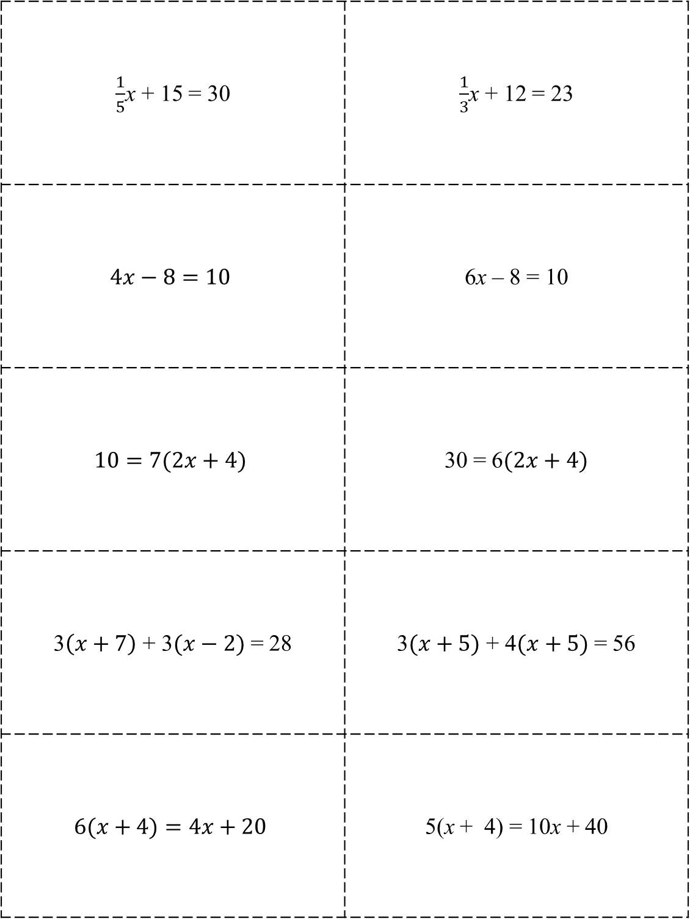
$\frac{1}{5}$x + 15 = 30 | $\frac{1}{3}$x + 12 = 23
$$4x−8=10$$ | 6x – 8 = 10
$$10=7(2x+4)$$ | 30 = 6$(2x+4)$
3$\left(x+7\right)$ + 3$(x−2)$ = 28 | 3$(x+5)$ + 4$(x+5)$ = 56
$$6(x+4)=4x+20$$ | 5(x + 4) = 10x + 40

Slide 4
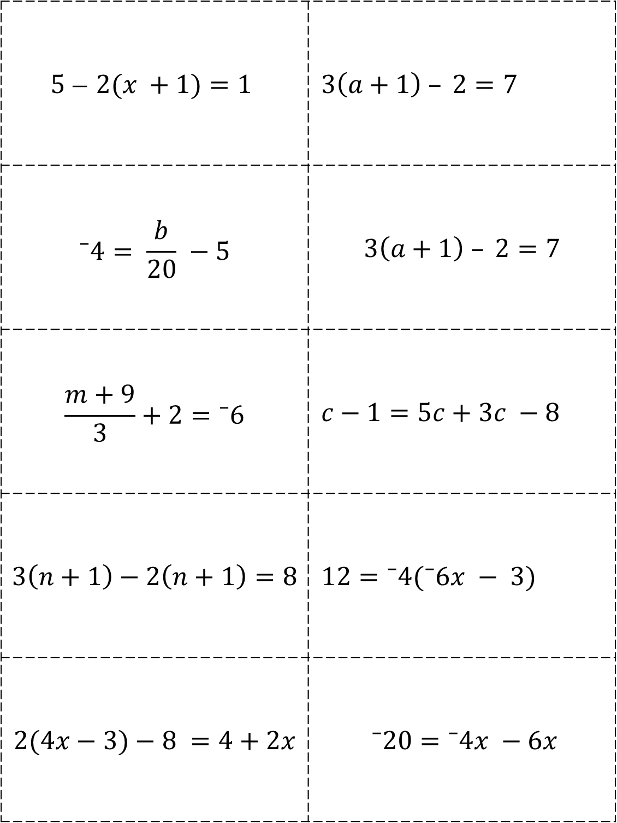
$$5 ̶ 2(x +1)=1$$ | $3\left(a+1\right) – 2=7$
$$⁻4= \frac{b}{20} −5$$ | $$3\left(a+1\right) – 2=7$$
$$\frac{m+9}{3}+2=⁻6$$ | $c−1=5c+3c −8$
$$3\left(n+1\right)−2\left(n+1\right)=8$$ | $12=⁻4(⁻6x − 3)$
$$2(4x−3)−8 =4+2x$$ | $⁻20=⁻4x −6x$

Slide 5
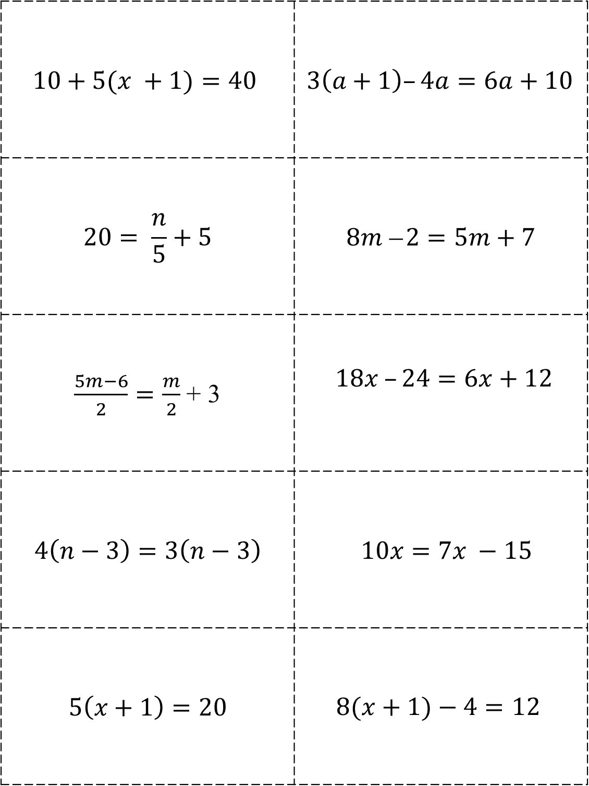
$$10+5(x +1)=40$$ | $3\left(a+1\right)–4a=6a+10$
$$20= \frac{n}{5}+5$$ | $$8m ̶ 2=5m+7$$
$\frac{5m−6}{2}=\frac{m}{2}$ + 3 | $18x –24=6x+12$
$$4\left(n−3\right)=3\left(n−3\right)$$ | $10x=7x −15$
$$5\left(x+1\right)=20$$ | $$8(x+1)−4=12$$

Slide 6
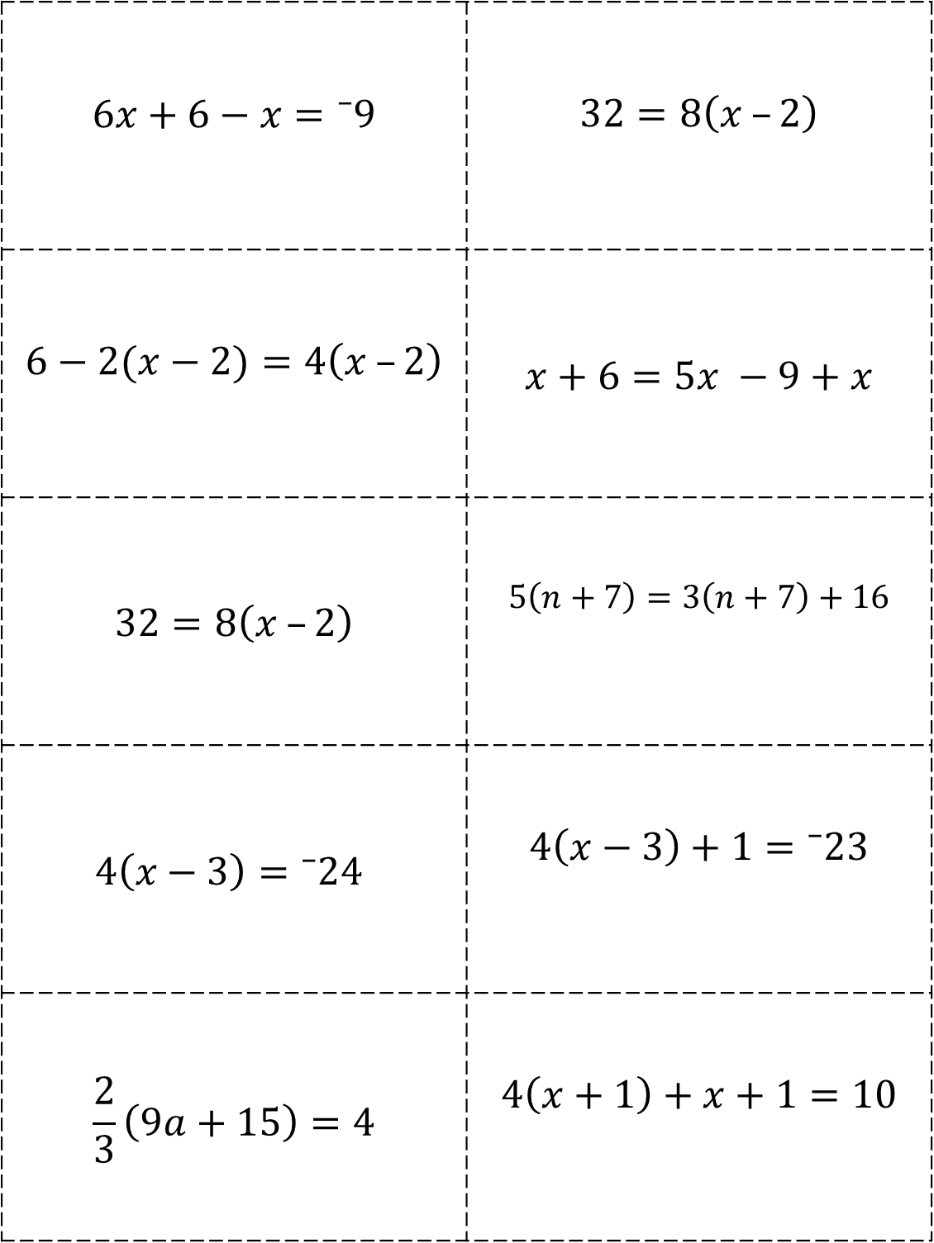
$$6x+6−x=⁻9$$ | $$32=8\left(x –2\right)$$
$$6−2(x−2)=4\left(x –2\right)$$ | $$x+6=5x −9+x$$
$$32=8\left(x –2\right)$$ | $$5\left(n+7\right)=3\left(n+7\right)+16$$
$$4\left(x−3\right)=⁻24$$ | $$4\left(x−3\right)+1=⁻23$$
$$\frac{2}{3}\left(9a+15\right)=4$$ | $$4\left(x+1\right)+x+1=10$$

Slide 7
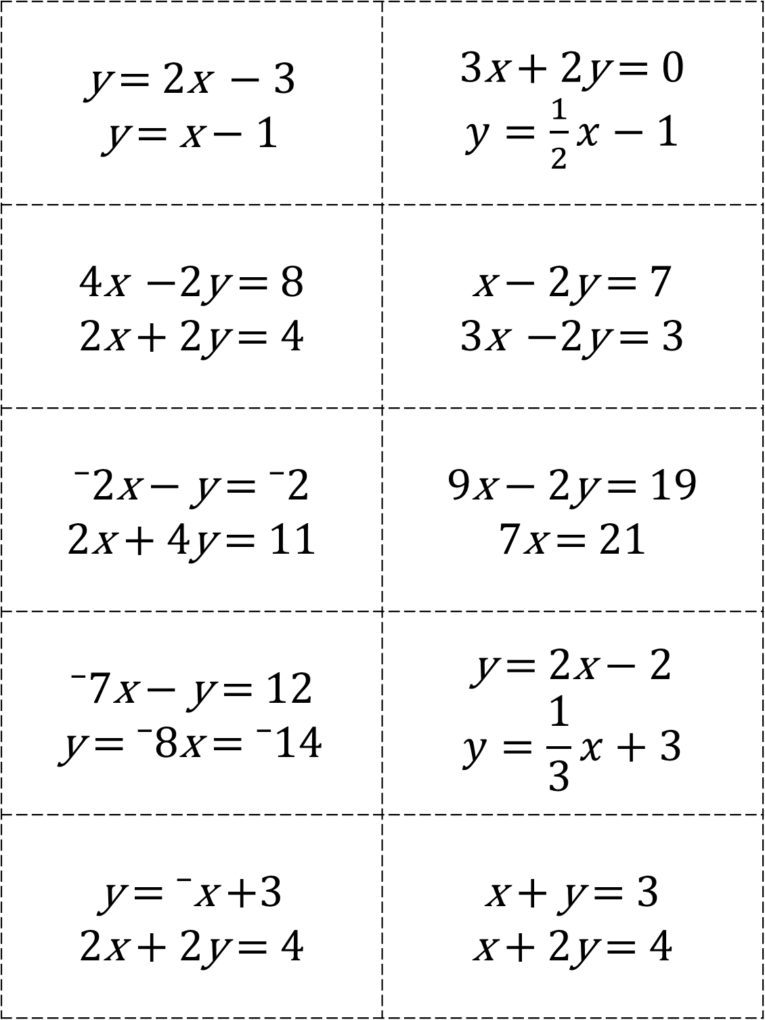
y = 2x $−$ 3 y = x $−$ 1 | 3x + 2y = 0 $y=\frac{1}{2}x−1$
4x $−$2y = 8 2x + 2y = 4 | x $−$ 2y = 7 3x $−$2y = 3
⁻2x $−$ y = ⁻2 2x + 4y = 11 | 9x $−$ 2y = 19 7x = 21
⁻7x $−$ y = 12 y = ⁻8x = ⁻14 | y = 2x $−$ 2 $$y=\frac{1}{3}x+3$$
y = ⁻x +3 2x + 2y = 4 | x + y = 3 x + 2y = 4

Slide 8
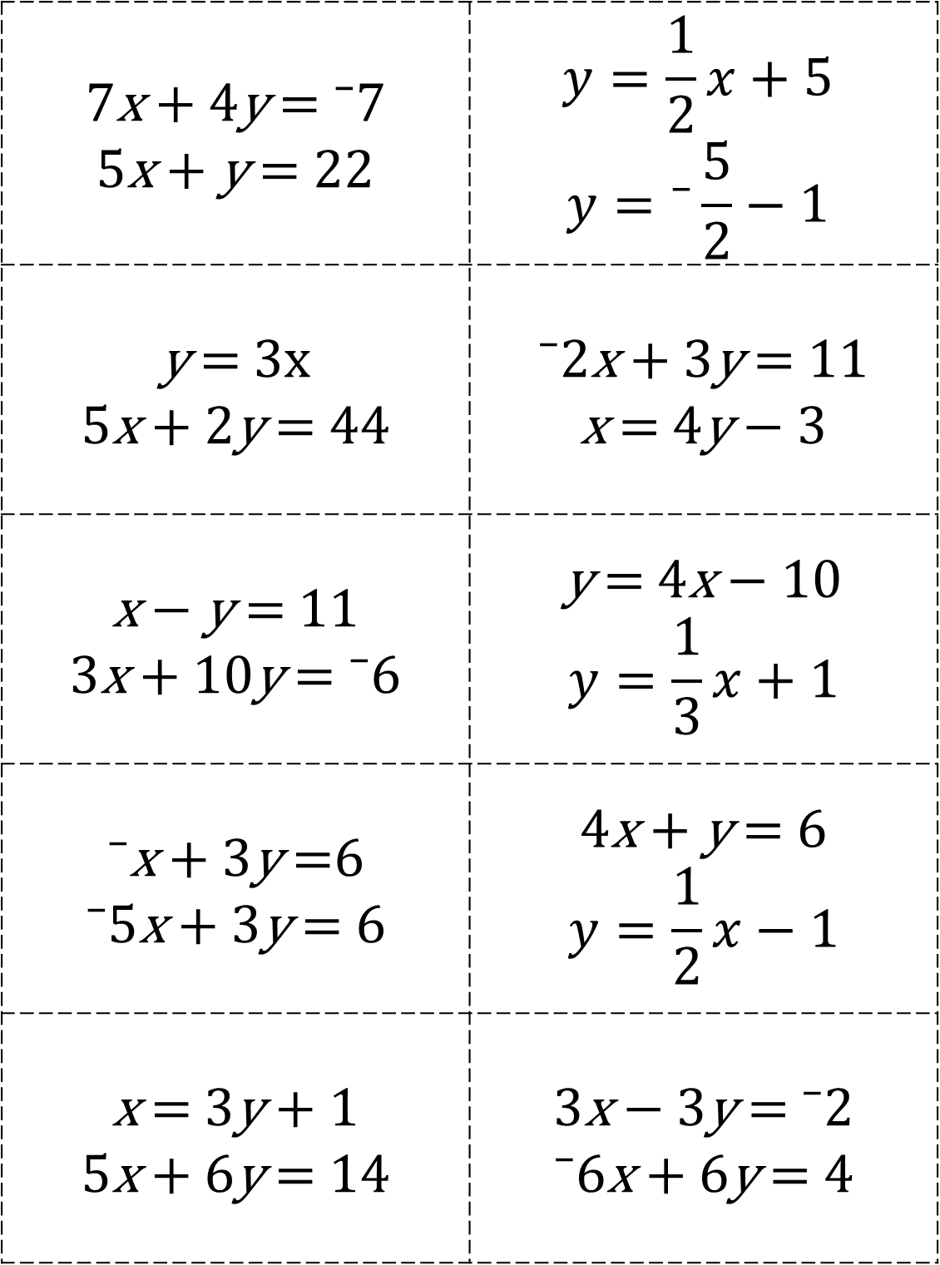
7x + 4y = ⁻7 5x + y = 22 | $$y=\frac{1}{2}x+5$$ $$y=⁻\frac{5}{2}−1$$
y = 3x 5x + 2y = 44 | ⁻2x + 3y = 11 x = 4y $−$ 3
x $−$ y = 11 3x + 10y = ⁻6 | y = 4x $−$ 10 $$y=\frac{1}{3}x+1$$
⁻x + 3y =6 ⁻5x + 3y = 6 | 4x + y = 6 $$y=\frac{1}{2}x−1$$
x = 3y + 1 5x + 6y = 14 | 3x $−$ 3y = ⁻2 ⁻6x + 6y = 4

Slide 9
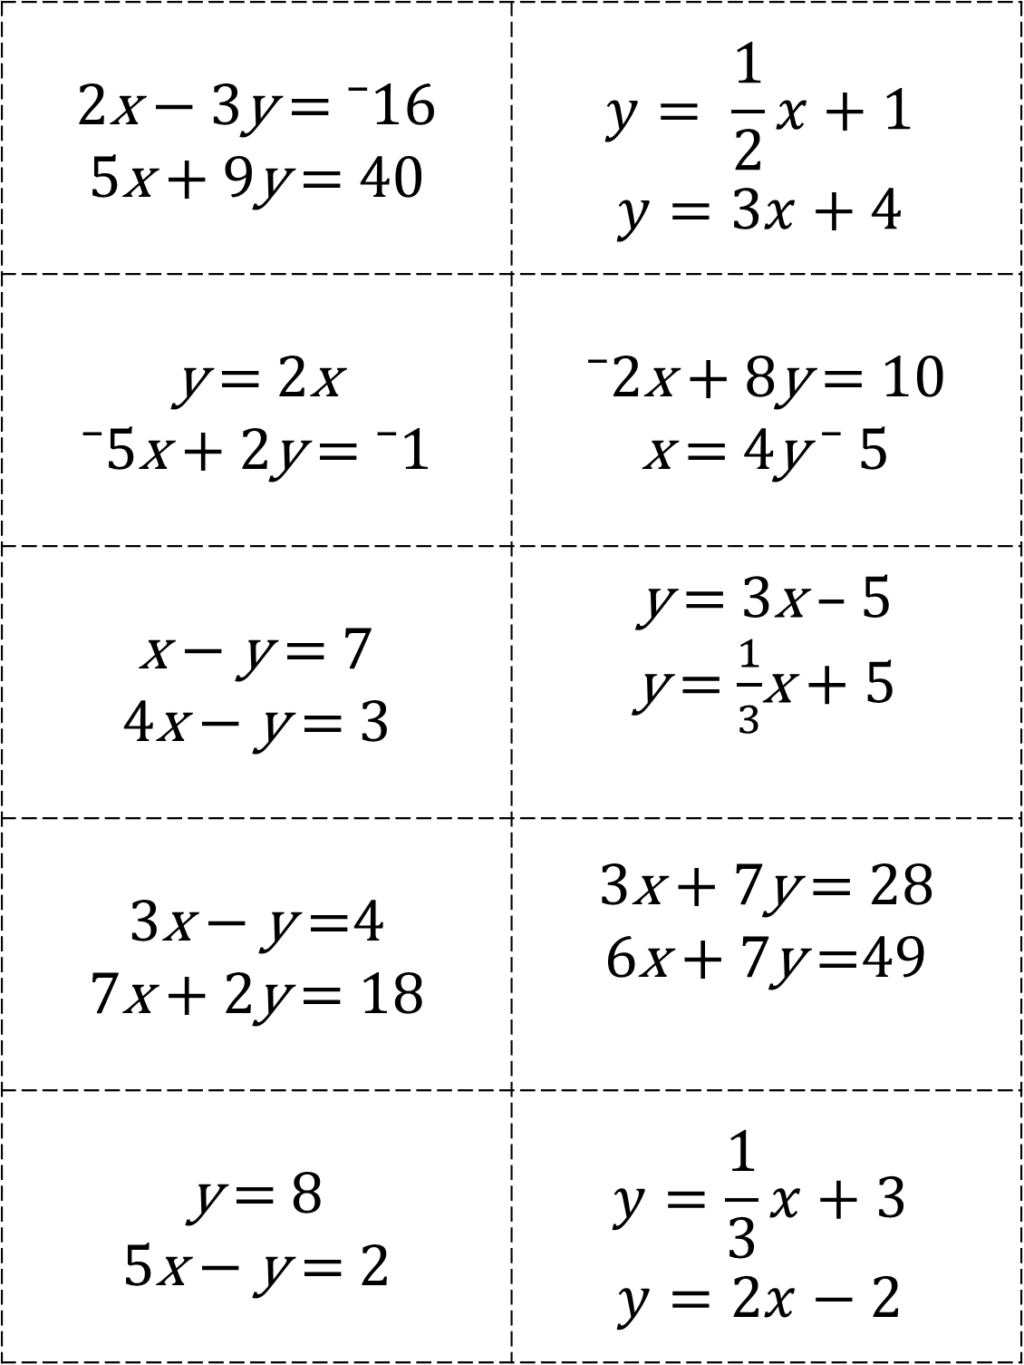
2x $−$ 3y = ⁻16 5x + 9y = 40 | $$y= \frac{1}{2}x+1$$ $$y=3x+4$$
y = 2x ⁻5x + 2y = ⁻1 | ⁻2x + 8y = 10 x = 4y ⁻ 5
x $−$ y = 7 4x $−$ y = 3 | y = 3x – 5 y = $\frac{1}{3}$x + 5
3x $−$ y =4 7x + 2y = 18 | 3x + 7y = 28 6x + 7y =49
y = 8 5x $−$ y = 2 | $$y=\frac{1}{3}x+3$$ $$y=2x−2$$

