Slide 1
Comparing Ratios: How Will I Solve It?
Directions: Spin the spinner. Find a problem card that matches the approach you spin. Keep the problem card if you solve it correctly.
Build Up/Break Down
Find a Unit Rate
Use a Scale Factor
Find Cross Products
Please see PDF in case the formatting of this file changes.

Slide 2
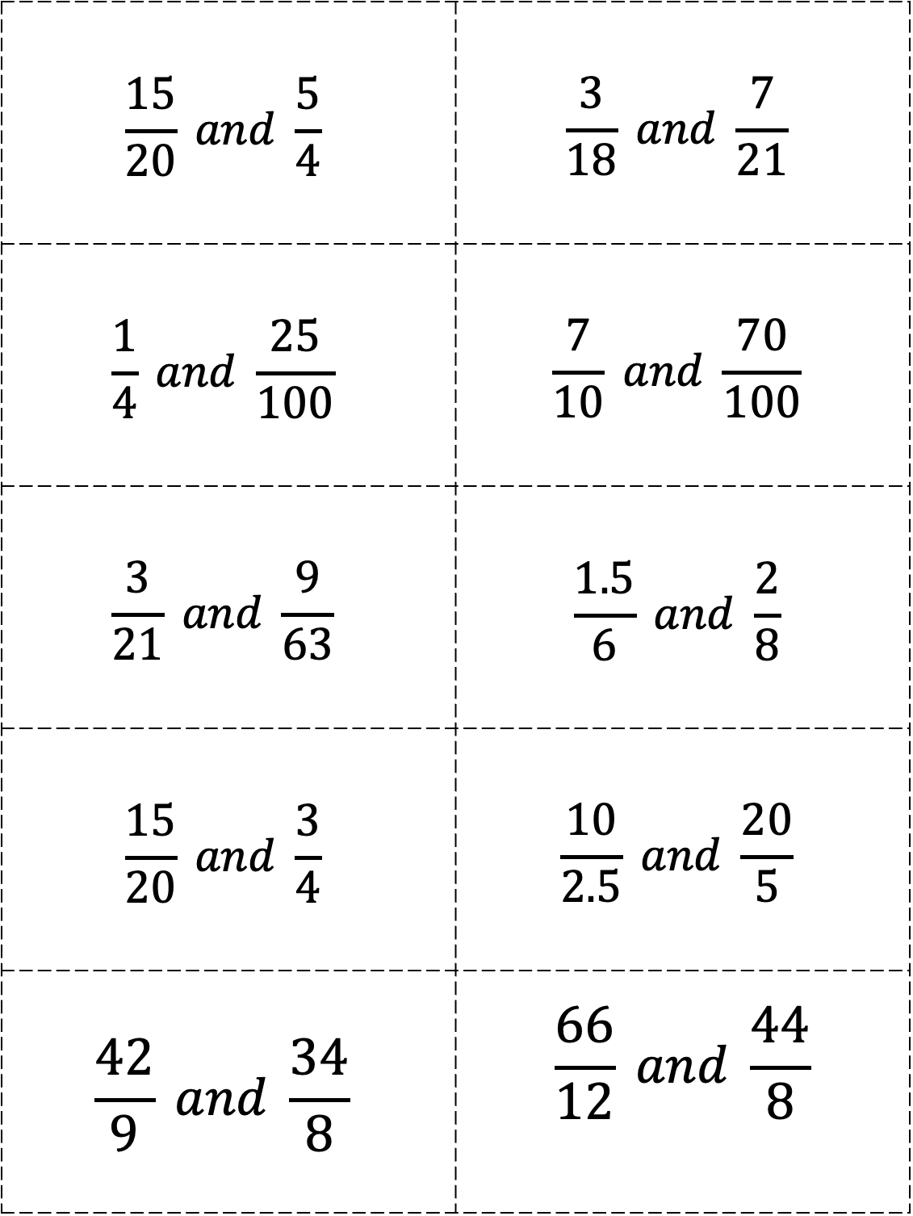
$$\frac{15}{20} and \frac{5}{4}$$ | $$\frac{3}{18} and \frac{7}{21}$$
$$\frac{1}{4} and \frac{25}{100}$$ | $$\frac{7}{10} and \frac{70}{100}$$
$$\frac{3}{21} and \frac{9}{63}$$ | $$\frac{1.5}{6} and \frac{2}{8}$$
$$\frac{15}{20} and \frac{3}{4}$$ | $$\frac{10}{2.5} and \frac{20}{5}$$
$$\frac{42}{9} and \frac{34}{8}$$ | $$\frac{66}{12} and \frac{44}{8}$$

Slide 3
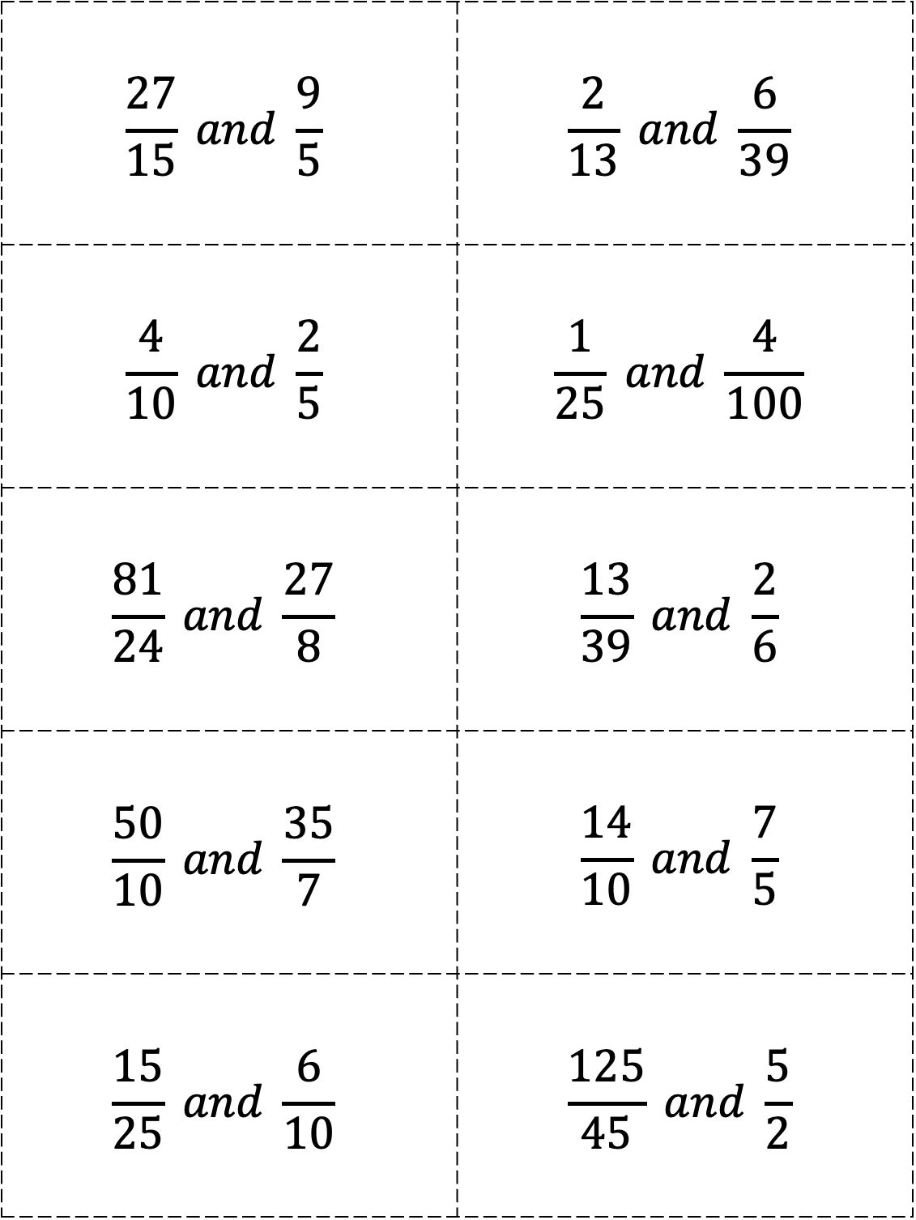
$$\frac{27}{15} and \frac{9}{5}$$ | $$\frac{2}{13} and \frac{6}{39}$$
$$\frac{4}{10} and \frac{2}{5}$$ | $$\frac{1}{25} and \frac{4}{100}$$
$$\frac{81}{24} and \frac{27}{8}$$ | $$\frac{13}{39} and \frac{2}{6}$$
$$\frac{50}{10} and \frac{35}{7}$$ | $$\frac{14}{10} and \frac{7}{5}$$
$$\frac{15}{25} and \frac{6}{10}$$ | $$\frac{125}{45} and \frac{5}{2}$$

Slide 4
Missing Value Proportions: How Will I Solve It?
Directions: Spin the spinner. Find a problem card that matches the approach you spin. Keep the problem card if you solve it correctly.
Build Up/Break Down
Find a Unit Rate
Use a Scale Factor
Find Cross Products
Use y=kx

Slide 5
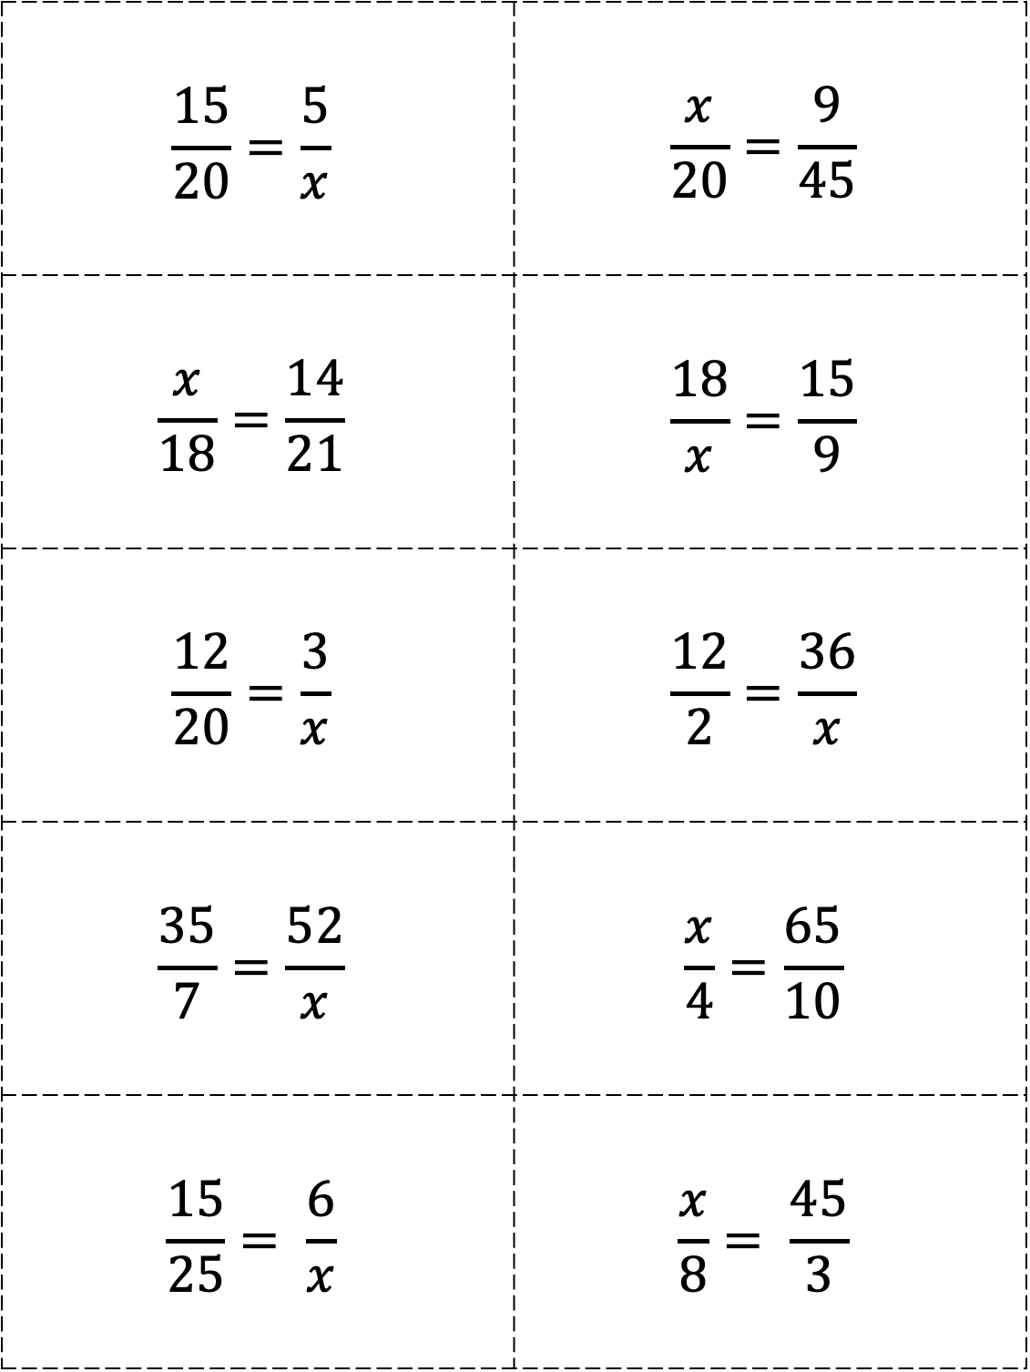
$$\frac{15}{20}=\frac{5}{x}$$ | $$\frac{x}{20}=\frac{9}{45}$$
$$\frac{x}{18}=\frac{14}{21}$$ | $$\frac{18}{x}=\frac{15}{9}$$
$$\frac{12}{20}=\frac{3}{x}$$ | $$\frac{12}{2}=\frac{36}{x}$$
$$\frac{35}{7}=\frac{52}{x}$$ | $$\frac{x}{4}=\frac{65}{10}$$
$$\frac{15}{25}= \frac{6}{x}$$ | $$\frac{x}{8}= \frac{45}{3}$$

Slide 6
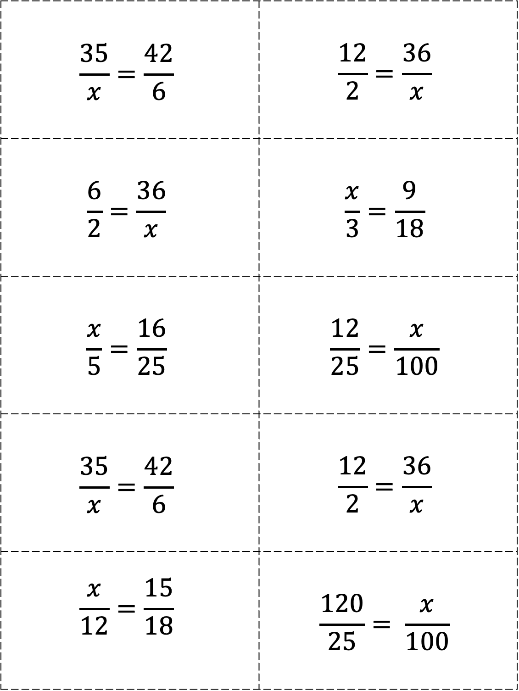
$$\frac{35}{x}=\frac{42}{6}$$ | $$\frac{12}{2}=\frac{36}{x}$$
$$\frac{6}{2}=\frac{36}{x}$$ | $$\frac{x}{3}=\frac{9}{18}$$
$$\frac{x}{5}=\frac{16}{25}$$ | $$\frac{12}{25}=\frac{x}{100}$$
$$\frac{35}{x}=\frac{42}{6}$$ | $$\frac{12}{2}=\frac{36}{x}$$
$$\frac{x}{12}=\frac{15}{18}$$ | $$\frac{120}{25}= \frac{x}{100}$$

