Slide 1
⁻59 × 8 | 31 × ⁻8
⁻35 × ⁻6 | 68 × 6
⁻52 × 4 | 55 × ⁻4
⁻27 × ⁻9 | 17 × 9
⁻67 × 3 | 45 × ⁻3

Slide 2
⁻29 × 13 | ⁻57 × ⁻17
⁻68 × 59 | 68 × 52
⁻21 × 35 | ⁻14 × ⁻75
86 × ⁻57 | ⁻32 × 19
⁻82 × ⁻15 | 83 × 49

Slide 3
2.4 × ⁻1.5 | ⁻9.9 × ⁻8
⁻6 × 5.9 | 6.8 × 0.5
⁻6 × ⁻3.5 | ⁻9.4 × 7.6
8 × ⁻57 | ⁻3.2 × ⁻1.9
⁻9.3 × 10 | 8 × 4.9

Slide 4
56 × 0.8 | 41 × 0.08
4.5 × 0.6 | 6.8 × 0.6
5.2 × 0.2 | 4.5 × 0.5
2.7 × 0.9 | 19.8 × 0.9
67 × 3 | 0.46 × 3

Slide 5
0.15 × 4 | 3.01 × 0.4
4.90 × 0.5 | 64.8 × 0.5
25.8 × 0.07 | 23.5 × 7
3.15 × 8 | 3.69 × 9
20.7 × 5 | 45 × 0.8

Slide 6
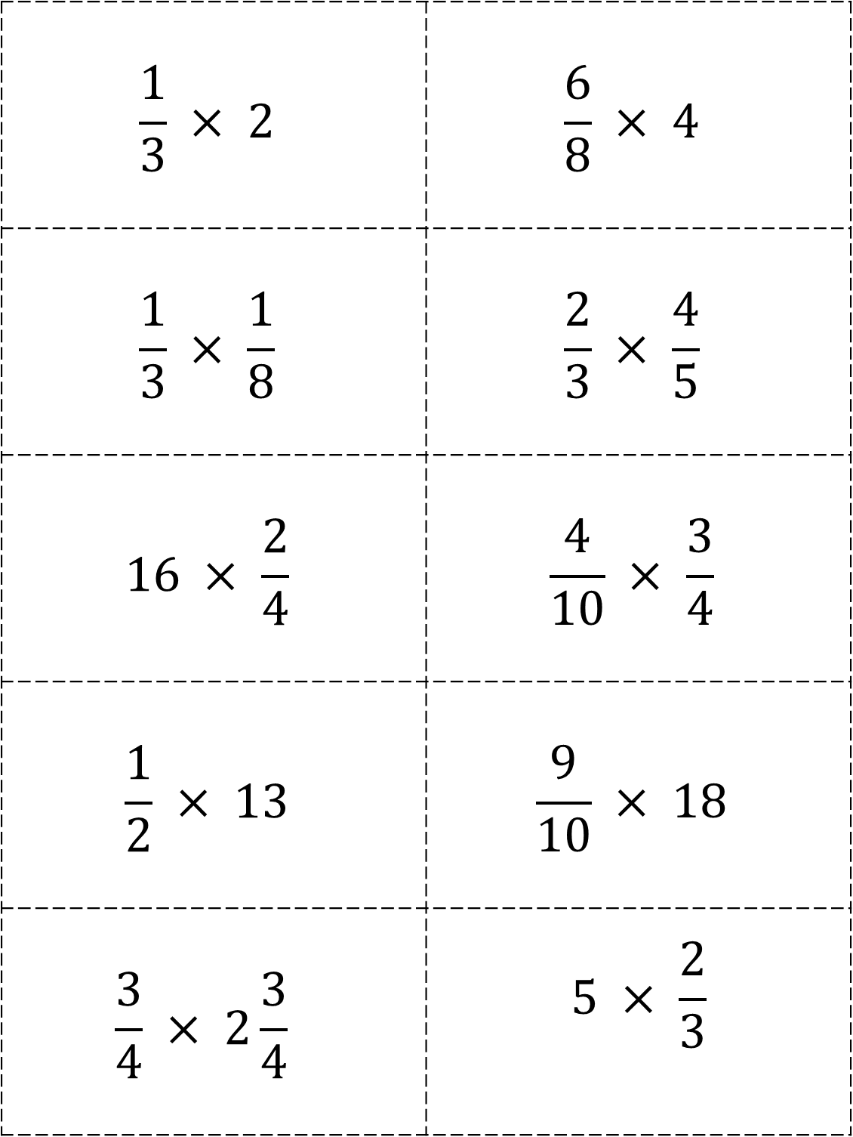
$$\frac{1}{3} × 2$$ | $$\frac{6}{8} × 4$$
$$\frac{1}{3} × \frac{1}{8}$$ | $$\frac{2}{3} × \frac{4}{5}$$
$$16 × \frac{2}{4}$$ | $$\frac{4}{10} × \frac{3}{4}$$
$$\frac{1}{2} × 13$$ | $$\frac{9}{10} × 18$$
$$\frac{3}{4} × 2\frac{3}{4}$$ | $$5 × \frac{2}{3}$$

Slide 7
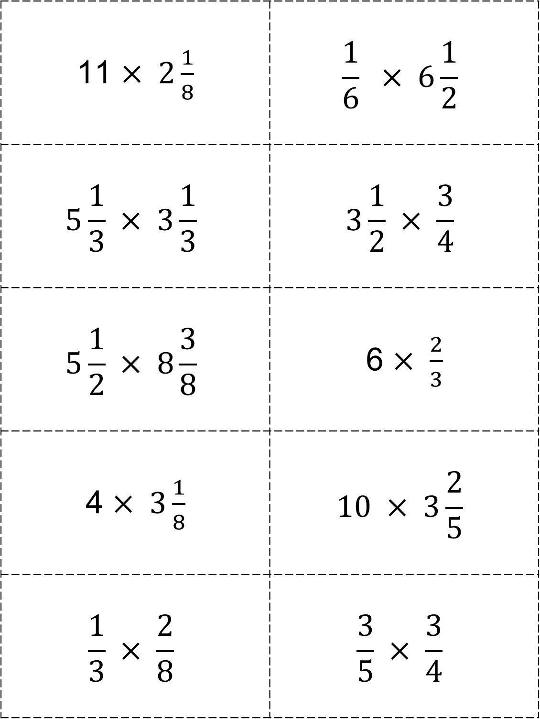
11 $× 2\frac{1}{8}$ | $$\frac{1}{6} × 6\frac{1}{2}$$
$$5\frac{1}{3} × 3\frac{1}{3}$$ | $$3\frac{1}{2} × \frac{3}{4}$$
$$5\frac{1}{2} × 8\frac{3}{8}$$ | 6 $× \frac{2}{3}$
4 $× 3\frac{1}{8}$ | $$10 × 3\frac{2}{5}$$
$$\frac{1}{3} × \frac{2}{8}$$ | $$\frac{3}{5} × \frac{3}{4}$$

Slide 8
⁻55 ÷ 5 | 59 ÷ ⁻5
⁻65 ÷ ⁻3 | 34 ÷ 3
⁻59 ÷ 7 | 21 ÷ ⁻7
⁻99 ÷ ⁻4 | 65 ÷ 4
⁻72 ÷ 6 | 72 ÷ ⁻7

Slide 9
⁻185 × 4 | 301 × ⁻4
⁻490 × ⁻5 | 648 × 5
258 × ⁻7 | ⁻135 × 7
315 × 6 | ⁻369 × ⁻6
⁻207 × 8 | ⁻465 × ⁻8

Slide 10
51.4 ÷ 4.28 | 75.3 ÷ 15.9
80.4 ÷ 4 | 42 ÷ 3.1
70.4 ÷ 2.1 | 31.5 ÷ 1.5
8.36 ÷ 4 | 59 ÷ 0.5
9 ÷ 1.8 | 3.4 ÷ 0.3

Slide 11
6.72 ÷ 6 | 366 ÷ 0.6
4.9 ÷ 2 | 5.18 ÷ 2
20.8 ÷ 0.4 | 20 ÷ 3.9
35 ÷ 0.7 | 49.7 ÷ 0.7
21 ÷ 5.5 | 2.15 ÷ 0.5

