Slide 1
Addition: How Will I Solve It?
Directions: Spin the spinner. Find a problem card that matches the approach you spin. Keep the problem card if you solve it correctly.
Standard
Algorithm
Count On
Partial
Sums
Compensation
Make Tens/
Make a Whole
Please see PDF in case the formatting of this file changes.

Slide 2
83 + -68 | -38 + -16
191 + -39 | -54 + 35
-87 + 28 | -68 + 39
-62 + -15 | 49 + -36

Slide 3
-33 + 45 | -97 + -53
-313 + 63 | -50 + 198
-60 + 87 | -53 + -21
78 + 89 | -59 + 71

Slide 4
-188 + 15 | -98 + -113
299 + -111 | -55 + 43
-78 + -28 | -89 + -36
-365 + 65 | 98 + -164

Slide 5
8.9 + 3.3 | 9.7 + 5.3
4.8 + 18.2 | 8.12 + 4.3
5.8 + 2.7 | 5.3 + 2.1
6.8 + 5.9 | 5.9 + 9.7

Slide 6
8.8 + 0.36 | 12.8 + 7.3
9.9 + 3.11 | 55.9 + 14.3
7.8 + 3.28 | 8.9 + 3.6
6.8 + 1.25 | 6.4 + 4.34

Slide 7
15.4 + 4.98 | 77.3 + 15.9
80.23 + 13.80 | 20.8 + 3.93
70.9 + 2.35 | 34.6 + 9.5
8.98 + 5.06 | 50.97 + 2.04

Slide 8
18.3 + 32.8 | 63.8 + 17.16
99.91 + 1.09 | 25.4 + 15.85
95.4 + 3.21 | 60.8 + 3.99
12.1 + 5.15 | 6.74 + 3.95

Slide 9
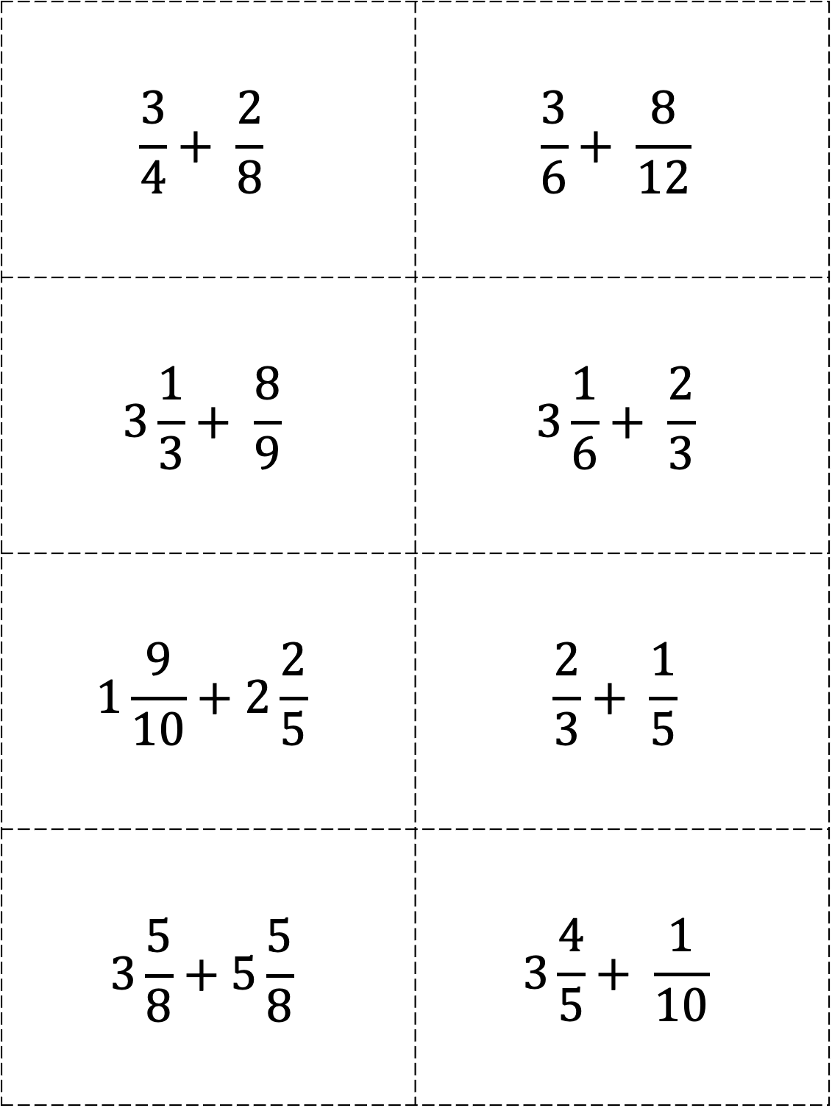
$$\frac{3}{4}+ \frac{2}{8}$$ | $$\frac{3}{6}+ \frac{8}{12}$$
$$3\frac{1}{3}+ \frac{8}{9}$$ | $$3\frac{1}{6}+ \frac{2}{3}$$
$$1\frac{9}{10}+2\frac{2}{5}$$ | $$\frac{2}{3}+ \frac{1}{5}$$
$$3\frac{5}{8}+5\frac{5}{8}$$ | $$3\frac{4}{5}+ \frac{1}{10}$$

Slide 10
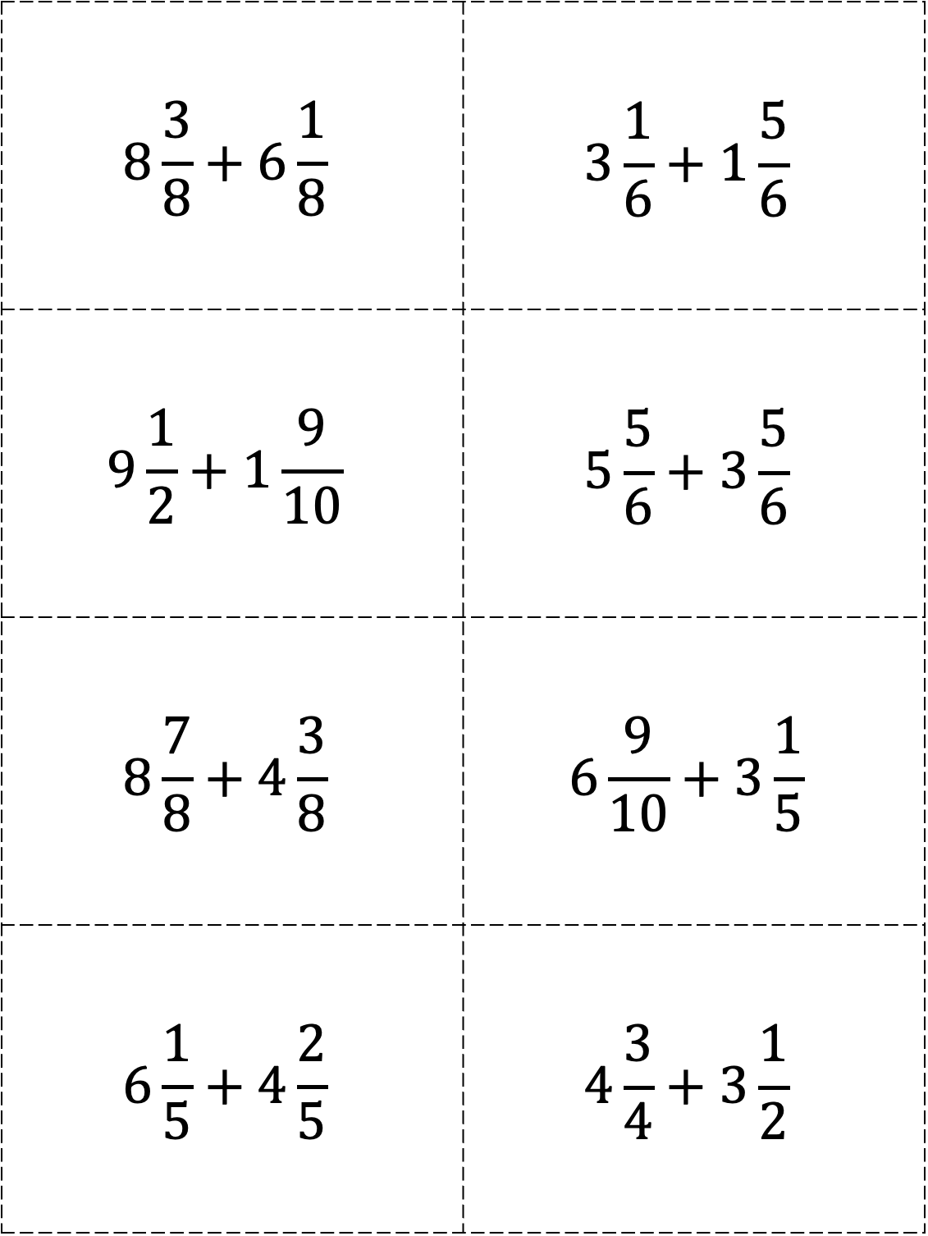
$$8\frac{3}{8}+6\frac{1}{8}$$ | $$3\frac{1}{6}+1\frac{5}{6}$$
$$9\frac{1}{2}+1\frac{9}{10}$$ | $$5\frac{5}{6}+3\frac{5}{6}$$
$$8\frac{7}{8}+4\frac{3}{8}$$ | $$6\frac{9}{10}+3\frac{1}{5}$$
$$6\frac{1}{5}+4\frac{2}{5}$$ | $$4\frac{3}{4}+3\frac{1}{2}$$

Slide 11
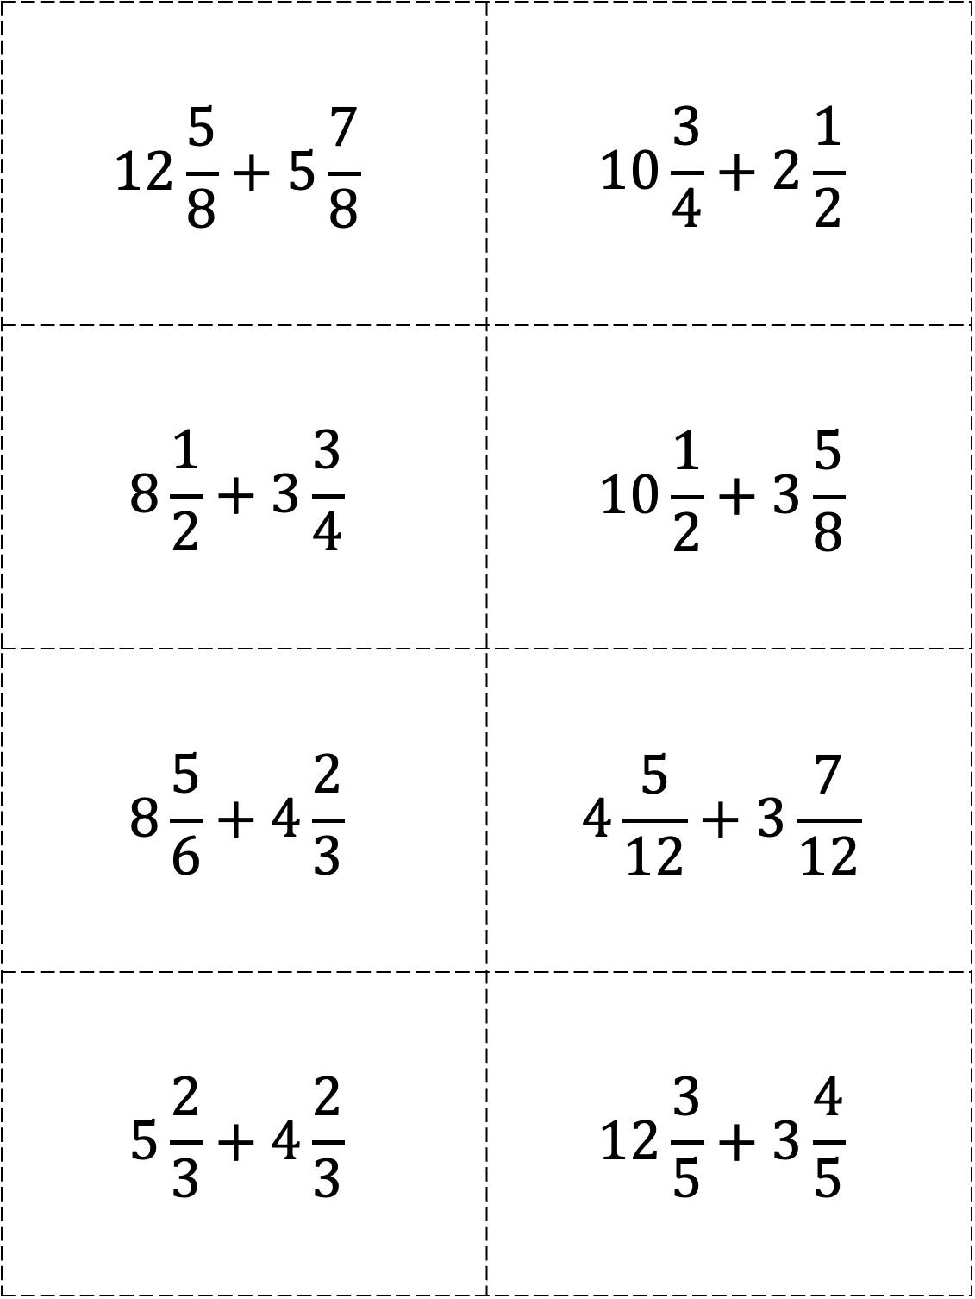
$$12\frac{5}{8}+5\frac{7}{8}$$ | $$10\frac{3}{4}+2\frac{1}{2}$$
$$8\frac{1}{2}+3\frac{3}{4}$$ | $$10\frac{1}{2}+3\frac{5}{8}$$
$$8\frac{5}{6}+4\frac{2}{3}$$ | $$4\frac{5}{12}+3\frac{7}{12}$$
$$5\frac{2}{3}+4\frac{2}{3}$$ | $$12\frac{3}{5}+3\frac{4}{5}$$

Slide 12
Subtraction: How Will I Solve It?
Directions: Spin the spinner. Find a problem card that matches the approach you spin. Keep the problem card if you solve it correctly.
Standard
Algorithm
Count Back (Separate)
Partial
Differences
Compensation
Think
Addition
(Find the Difference)

Slide 13
83 – -68 | -38 – 16
91 – -19 | -54 – 35
-87 – -28 | -68 – 39
-62 – -15 | 44 – -36

Slide 14
-48 – -19 | 97 – 53
33 – 45 | 50 – 198
-60 – 87 | -53 – -21
78 – 85 | -59 – 71

Slide 15
-188 – 15 | -98 – -13
99 – -11 | -55 – 43
-78 – 28 | -89 – -36
365 – 650 | 63 – 164

Slide 16
-823 – -780 | 638 – -116
-391 – 109 | -254 – 185
654 – 321 | -608 – -399
621 – -515 | -474 – -395

Slide 17
4.8 – 2.5 | 9.7 – 5.3
8.9 – 3.3 | 8.2 – 4.3
5.4 – 2.7 | 5.3 – 2.1
6.8 – 5.5 | 5.9 – 1.7

Slide 18
8.8 – 0.36 | 6.8 – 1.3
9.9 – 0.11 | 55 – 4.3
7.8 – 4.28 | 8.9 – 3.6
6.5 – 1.2 | 6.4 – 2.34

Slide 19
55.4 – 4.28 | 77.3 – 15.9
80 – 3.80 | 40.8 – 3.93
70.4 – 2.35 | 32.5 – 1.5
8.52 – 5.06 | 50.7 – 2.4

Slide 20
88.3 – 76.8 | 63.8 – 19.8
3.91 – 1.09 | 25.4 – 1.95
65.4 – 3.21 | 60.8 – 3.99
62.1 – 5.15 | 4.74 – 3.95

Slide 21
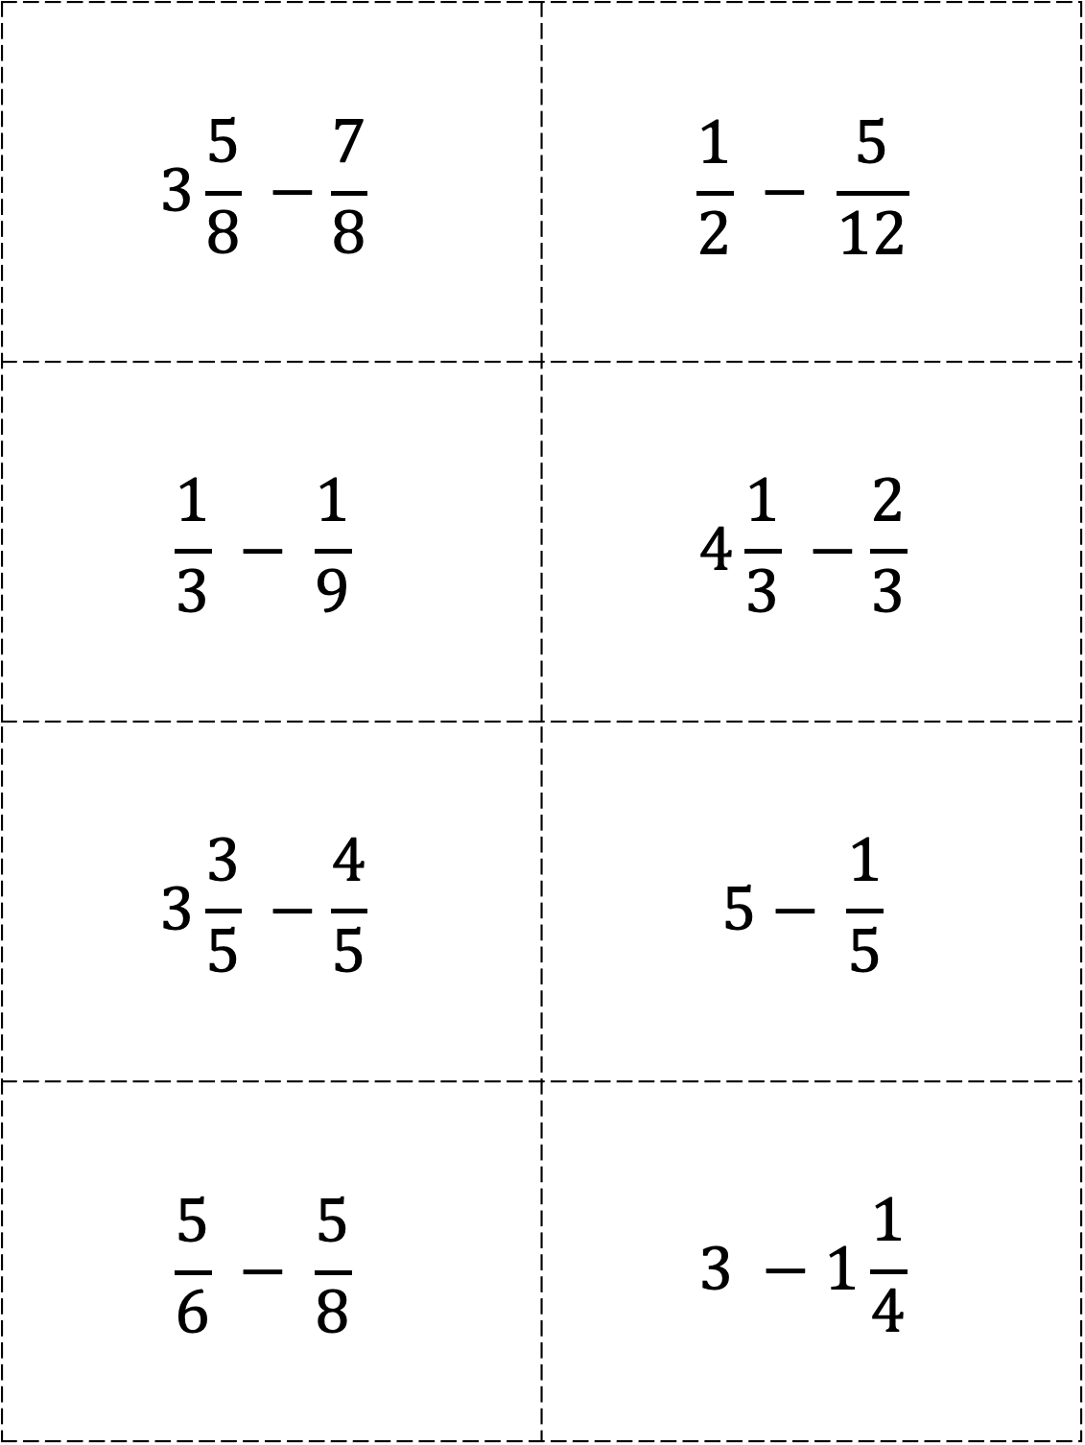
$$3\frac{5}{8} −\frac{7}{8}$$ | $$\frac{1}{2} − \frac{5}{12}$$
$$\frac{1}{3} − \frac{1}{9}$$ | $$4\frac{1}{3} −\frac{2}{3}$$
$$3\frac{3}{5} −\frac{4}{5}$$ | $$5− \frac{1}{5}$$
$$\frac{5}{6} − \frac{5}{8}$$ | $$3 −1\frac{1}{4}$$

Slide 22
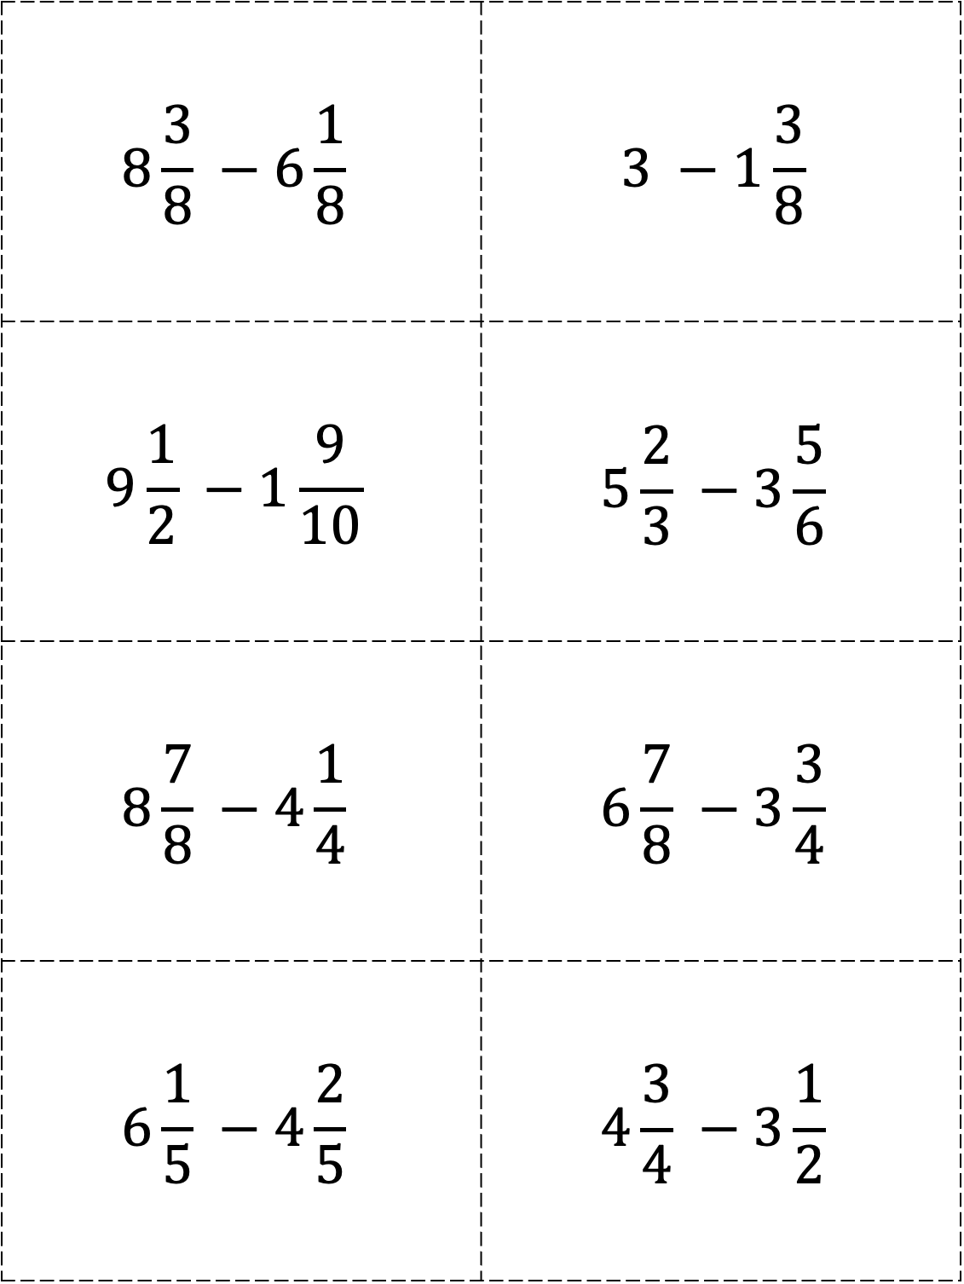
$$8\frac{3}{8} −6\frac{1}{8}$$ | $$3 −1\frac{3}{8}$$
$$9\frac{1}{2} −1\frac{9}{10}$$ | $$5\frac{2}{3} −3\frac{5}{6}$$
$$8\frac{7}{8} −4\frac{1}{4}$$ | $$6\frac{7}{8} −3\frac{3}{4}$$
$$6\frac{1}{5} −4\frac{2}{5}$$ | $$4\frac{3}{4} −3\frac{1}{2}$$

Slide 23
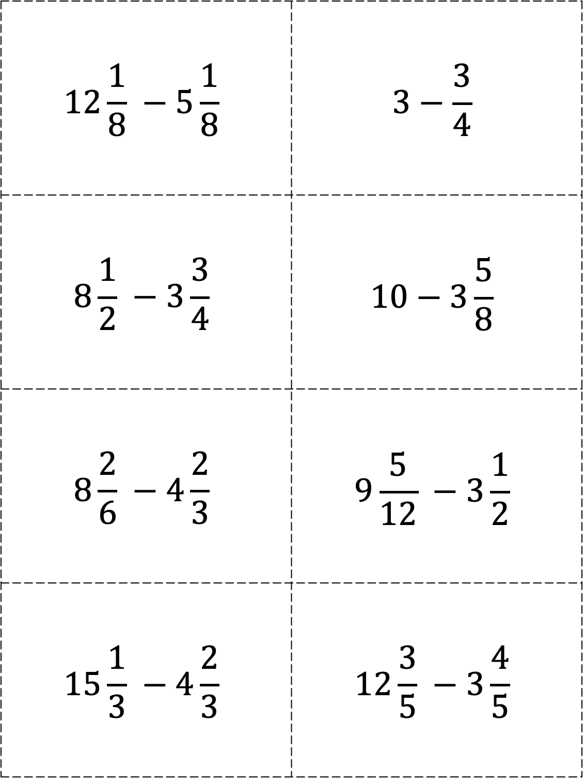
$$12\frac{1}{8} −5\frac{1}{8}$$ | $$3−\frac{3}{4}$$
$$8\frac{1}{2} −3\frac{3}{4}$$ | $$10−3\frac{5}{8}$$
$$8\frac{2}{6} −4\frac{2}{3}$$ | $$9\frac{5}{12} −3\frac{1}{2}$$
$$15\frac{1}{3} −4\frac{2}{3}$$ | $$12\frac{3}{5} −3\frac{4}{5}$$

