Slide 1
83 + ⁻68 | ⁻38 + ⁻16
191 + ⁻39 | ⁻54 + 35
⁻87 + 28 | ⁻68 + 39
⁻62 + ⁻15 | 49 + ⁻36

Slide 2
⁻33 + 45 | ⁻97 + ⁻53
⁻313 + 63 | ⁻50 + 198
⁻60 + 87 | ⁻53 + ⁻21
78 + 89 | ⁻59 + 71

Slide 3
⁻188 + 15 | ⁻98 + ⁻113
299 + ⁻111 | ⁻55 + 43
⁻78 + ⁻28 | ⁻89 + ⁻36
⁻365 + 65 | 98 + ⁻164

Slide 4
8.9 + 3.3 | 9.7 + 5.3
4.8 + 18.2 | 8.12 + 4.3
5.8 + 2.7 | 5.3 + 2.1
6.8 + 5.9 | 5.9 + 9.7

Slide 5
8.8 + 0.36 | 12.8 + 7.3
9.9 + 3.11 | 55.9 + 14.3
7.8 + 3.28 | 8.9 + 3.6
6.8 + 1.25 | 6.4 + 4.34

Slide 6
15.4 + 4.98 | 77.3 + 15.9
80.23 + 13.80 | 20.8 + 3.93
70.9 + 2.35 | 34.6 + 9.5
8.98 + 5.06 | 50.97 + 2.04

Slide 7
18.3 + 32.8 | 63.8 + 17.16
99.91 + 1.09 | 25.4 + 15.85
95.4 + 3.21 | 60.8 + 3.99
12.1 + 5.15 | 6.74 + 3.95

Slide 8
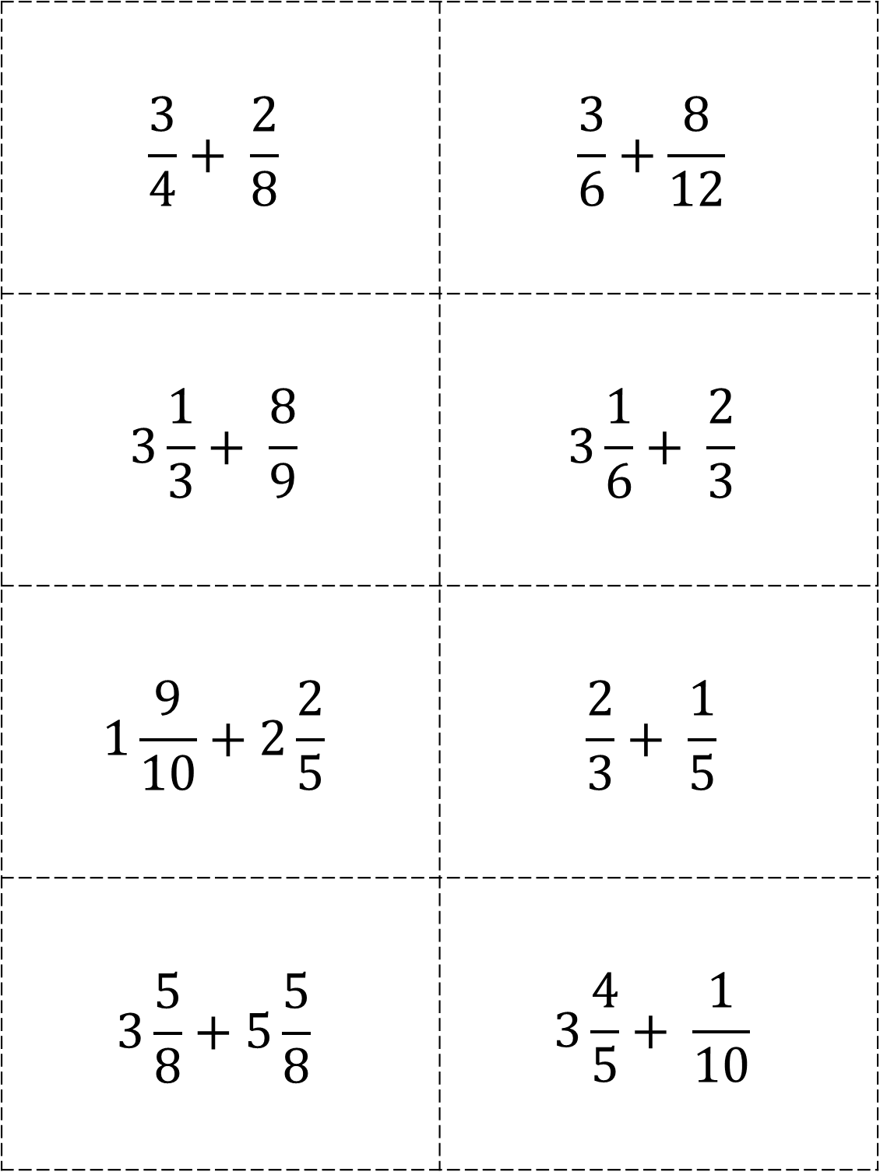
$$\frac{3}{4}+ \frac{2}{8}$$ | $$\frac{3}{6}+\frac{8}{12}$$
$$3\frac{1}{3}+ \frac{8}{9}$$ | $$3\frac{1}{6}+ \frac{2}{3}$$
$$1\frac{9}{10}+2\frac{2}{5}$$ | $$\frac{2}{3}+ \frac{1}{5}$$
$$3\frac{5}{8}+5\frac{5}{8}$$ | $$3\frac{4}{5}+ \frac{1}{10}$$

Slide 9
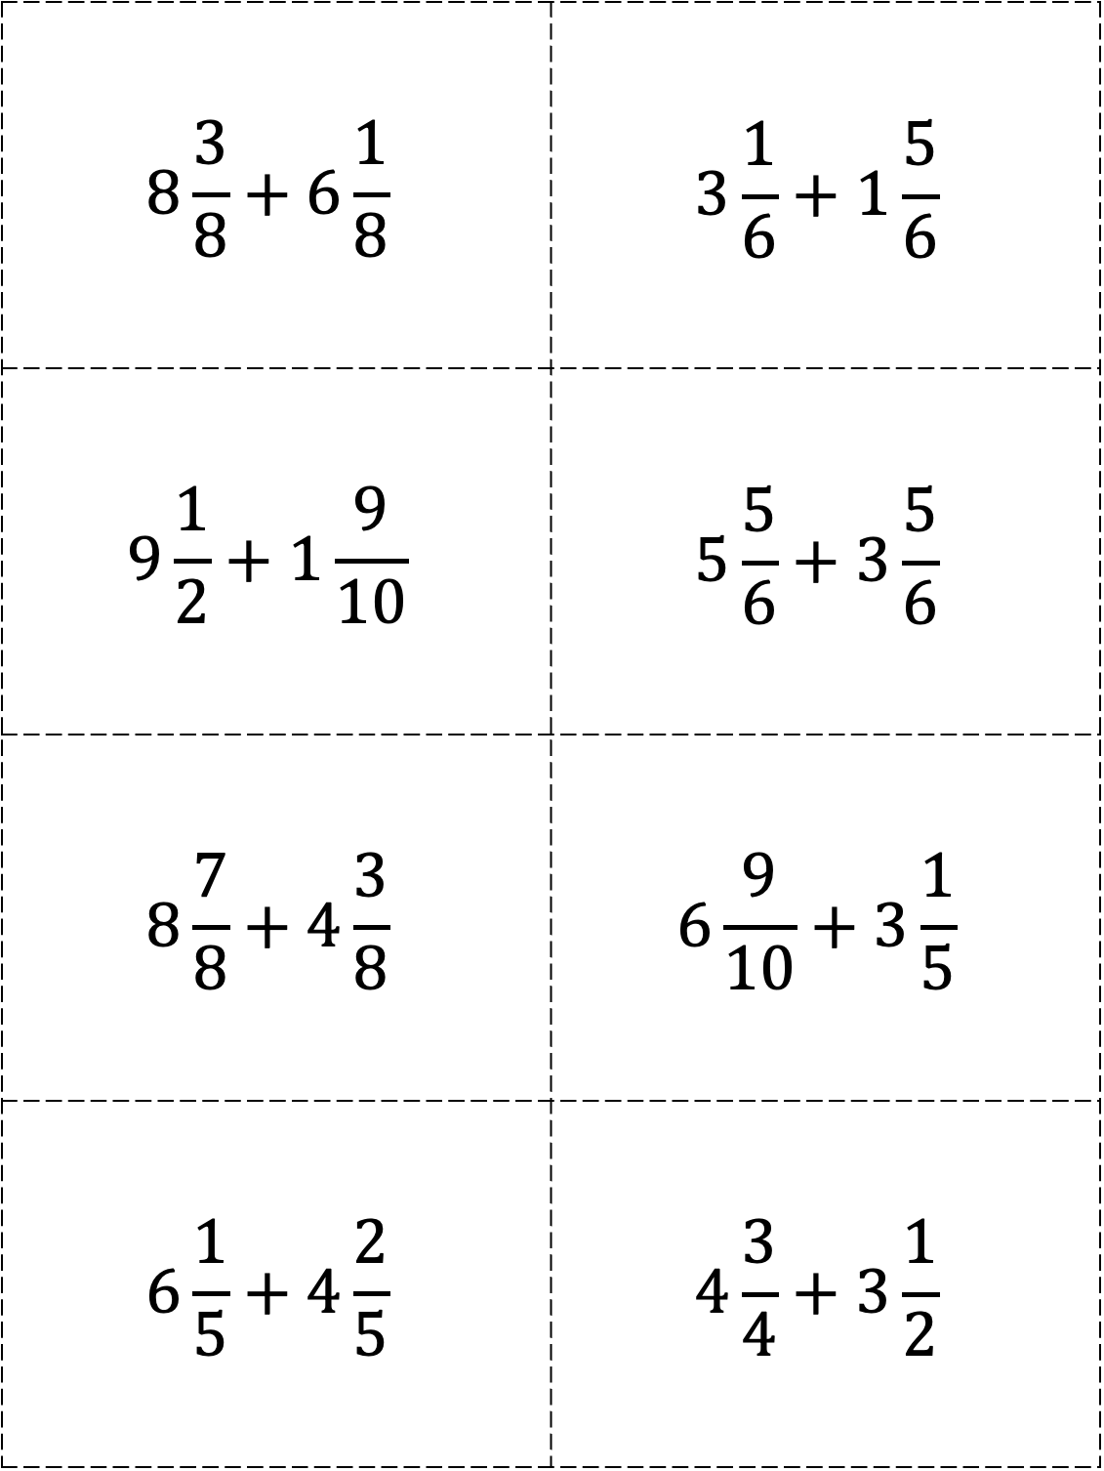
$$8\frac{3}{8}+6\frac{1}{8}$$ | $$3\frac{1}{6}+1\frac{5}{6}$$
$$9\frac{1}{2}+1\frac{9}{10}$$ | $$5\frac{5}{6}+3\frac{5}{6}$$
$$8\frac{7}{8}+4\frac{3}{8}$$ | $$6\frac{9}{10}+3\frac{1}{5}$$
$$6\frac{1}{5}+4\frac{2}{5}$$ | $$4\frac{3}{4}+3\frac{1}{2}$$

Slide 10
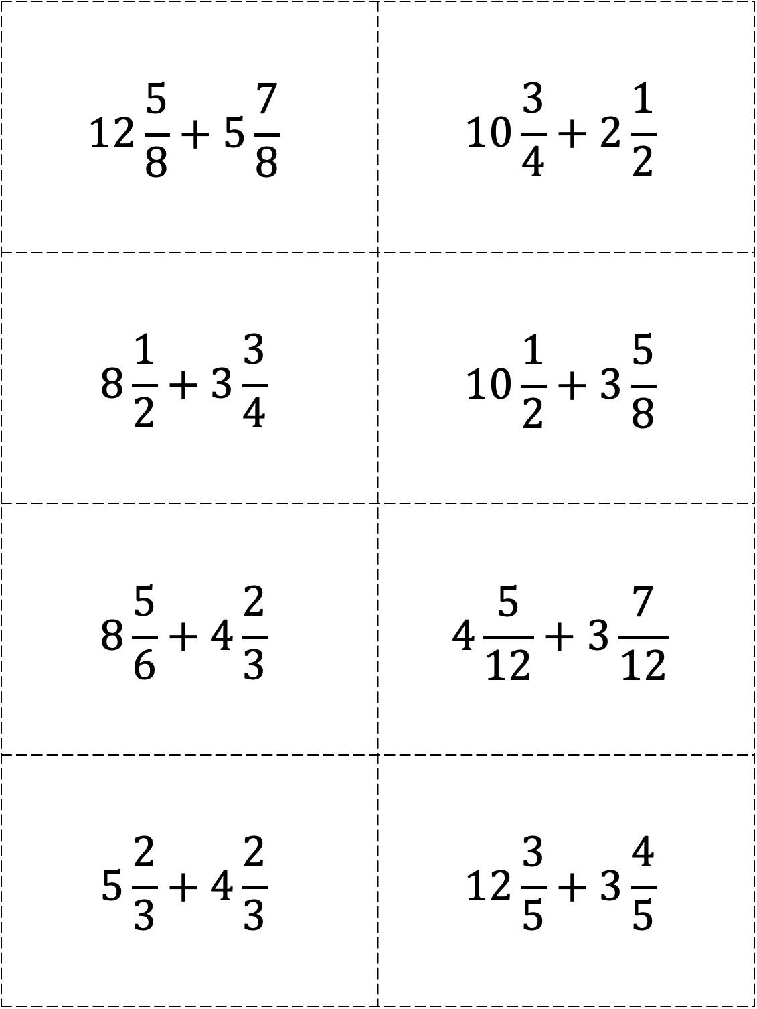
$$12\frac{5}{8}+5\frac{7}{8}$$ | $$10\frac{3}{4}+2\frac{1}{2}$$
$$8\frac{1}{2}+3\frac{3}{4}$$ | $$10\frac{1}{2}+3\frac{5}{8}$$
$$8\frac{5}{6}+4\frac{2}{3}$$ | $$4\frac{5}{12}+3\frac{7}{12}$$
$$5\frac{2}{3}+4\frac{2}{3}$$ | $$12\frac{3}{5}+3\frac{4}{5}$$

Slide 11
83 – ⁻68 | ⁻38 – 16
91 – ⁻19 | ⁻54 – 35
⁻87 – ⁻28 | ⁻68 – 39
⁻62 – ⁻15 | 44 – ⁻36

Slide 12
⁻48 – ⁻19 | 97 – 53
33 – 45 | 50 – 198
⁻60 – 87 | ⁻53 – ⁻21
78 – 85 | ⁻59 – 71

Slide 13
⁻188 – 15 | ⁻98 – ⁻13
99 – ⁻11 | ⁻55 – 43
⁻78 – 28 | ⁻89 – ⁻36
365 – 650 | 63 – 164

Slide 14
⁻823 – ⁻780 | 638 – ⁻116
⁻391 – 109 | ⁻254 – 185
654 – 321 | ⁻608 – ⁻399
621 – ⁻515 | ⁻474 – ⁻395

Slide 15
4.8 – 2.5 | 9.7 – 5.3
8.9 – 3.3 | 8.2 – 4.3
5.4 – 2.7 | 5.3 – 2.1
6.8 – 5.5 | 5.9 – 1.7

Slide 16
8.8 – 0.36 | 6.8 – 1.3
9.9 – 0.11 | 55 – 4.3
7.8 – 4.28 | 8.9 – 3.6
6.5 – 1.2 | 6.4 – 2.34

Slide 17
55.4 – 4.28 | 77.3 – 15.9
80 – 3.80 | 40.8 – 3.93
70.4 – 2.35 | 32.5 – 1.5
8.52 – 5.06 | 50.7 – 2.4

Slide 18
88.3 – 76.8 | 63.8 – 19.8
3.91 – 1.09 | 25.4 – 1.95
65.4 – 3.21 | 60.8 – 3.99
62.1 – 5.15 | 4.74 – 3.95

Slide 19
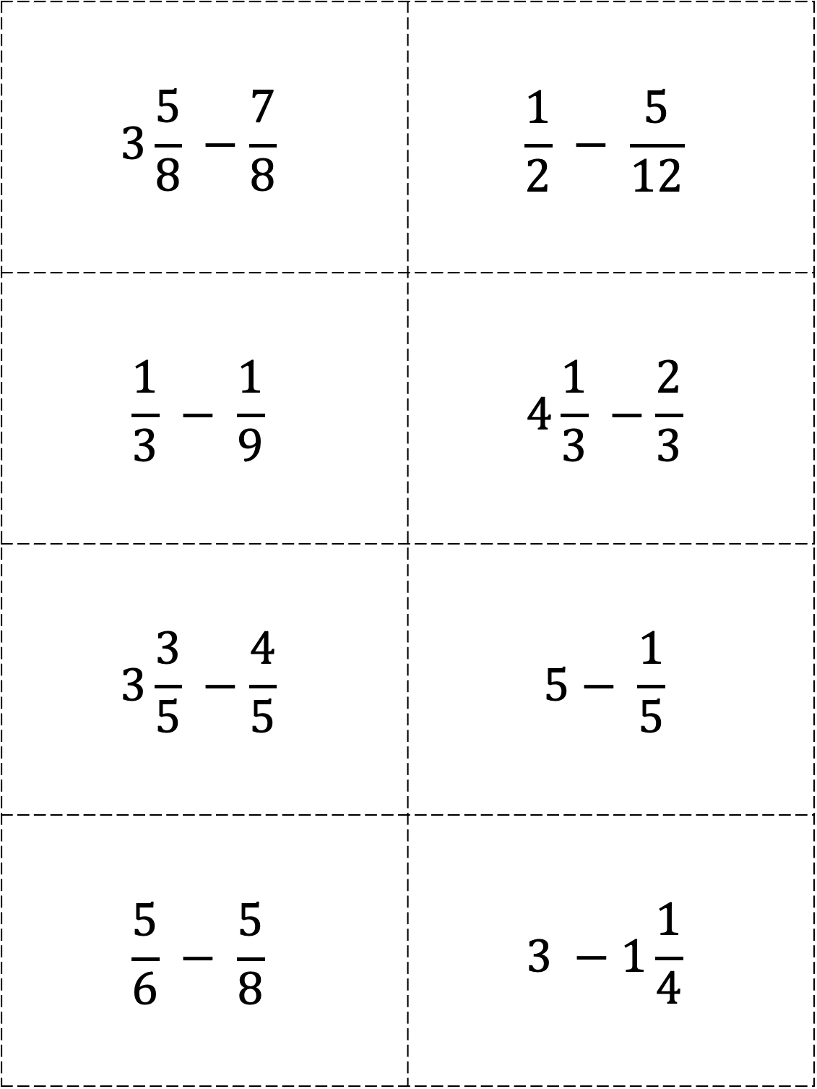
$$3\frac{5}{8} −\frac{7}{8}$$ | $$\frac{1}{2} − \frac{5}{12}$$
$$\frac{1}{3} − \frac{1}{9}$$ | $$4\frac{1}{3} −\frac{2}{3}$$
$$3\frac{3}{5} −\frac{4}{5}$$ | $$5− \frac{1}{5}$$
$$\frac{5}{6} − \frac{5}{8}$$ | $$3 −1\frac{1}{4}$$

Slide 20
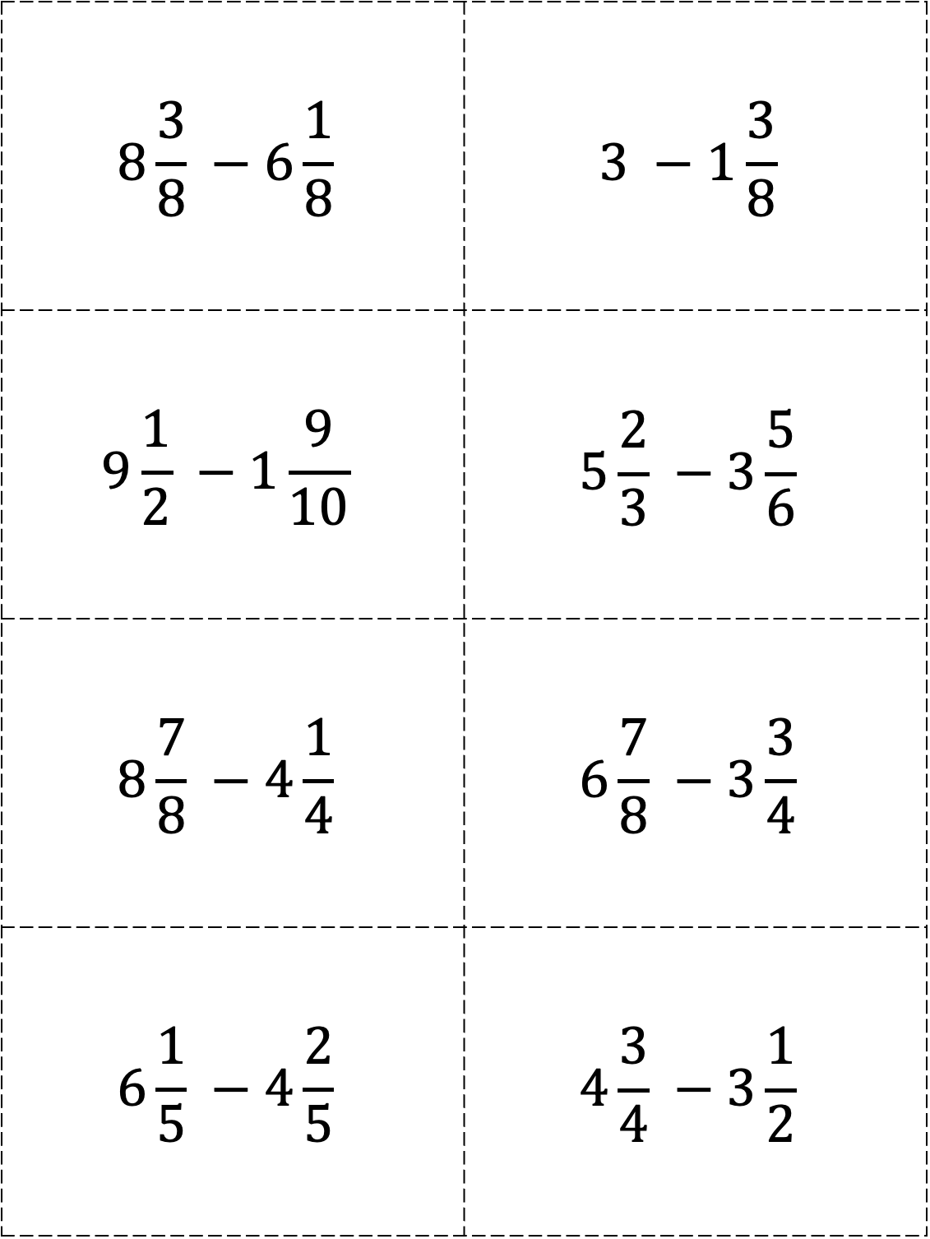
$$8\frac{3}{8} −6\frac{1}{8}$$ | $$3 −1\frac{3}{8}$$
$$9\frac{1}{2} −1\frac{9}{10}$$ | $$5\frac{2}{3} −3\frac{5}{6}$$
$$8\frac{7}{8} −4\frac{1}{4}$$ | $$6\frac{7}{8} −3\frac{3}{4}$$
$$6\frac{1}{5} −4\frac{2}{5}$$ | $$4\frac{3}{4} −3\frac{1}{2}$$

Slide 21
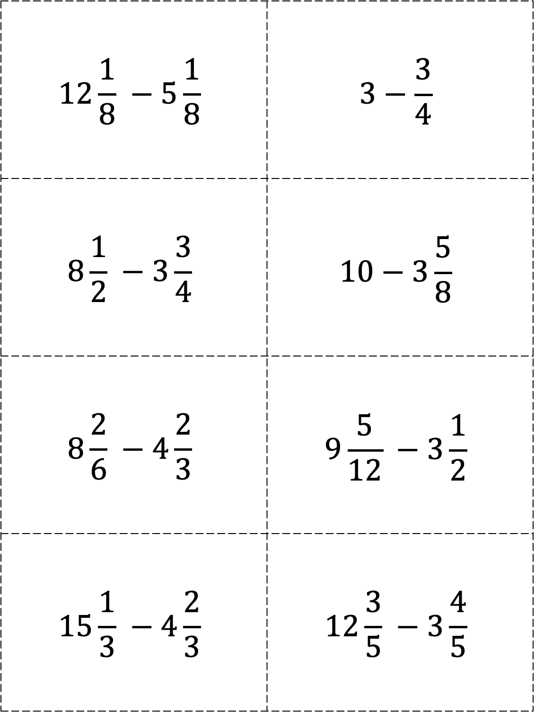
$$12\frac{1}{8} −5\frac{1}{8}$$ | $$3−\frac{3}{4}$$
$$8\frac{1}{2} −3\frac{3}{4}$$ | $$10−3\frac{5}{8}$$
$$8\frac{2}{6} −4\frac{2}{3}$$ | $$9\frac{5}{12} −3\frac{1}{2}$$
$$15\frac{1}{3} −4\frac{2}{3}$$ | $$12\frac{3}{5} −3\frac{4}{5}$$

