Slide 1
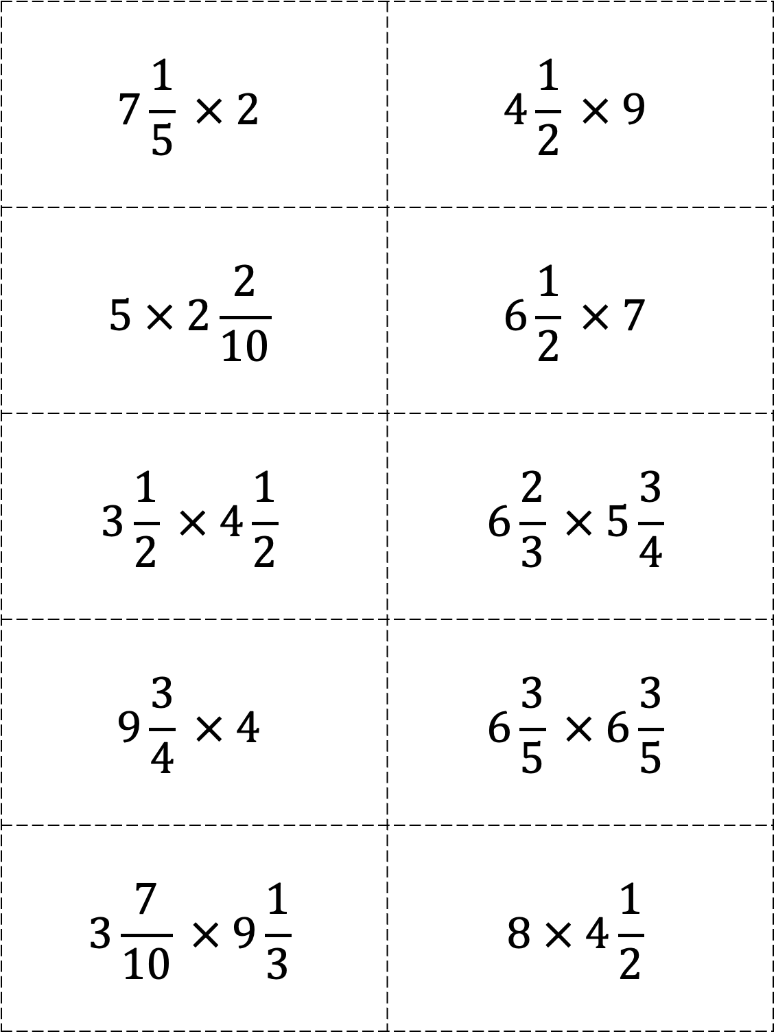
$$7\frac{1}{5} × 2$$ | $$4\frac{1}{2} × 9$$
$$5 × 2\frac{2}{10}$$ | $$6\frac{1}{2} × 7$$
$$3\frac{1}{2} × 4\frac{1}{2}$$ | $$6\frac{2}{3} × 5\frac{3}{4}$$
$$9\frac{3}{4} × 4$$ | $$6\frac{3}{5} × 6\frac{3}{5}$$
$$3\frac{7}{10} × 9\frac{1}{3}$$ | $$8 × 4\frac{1}{2}$$

Slide 2
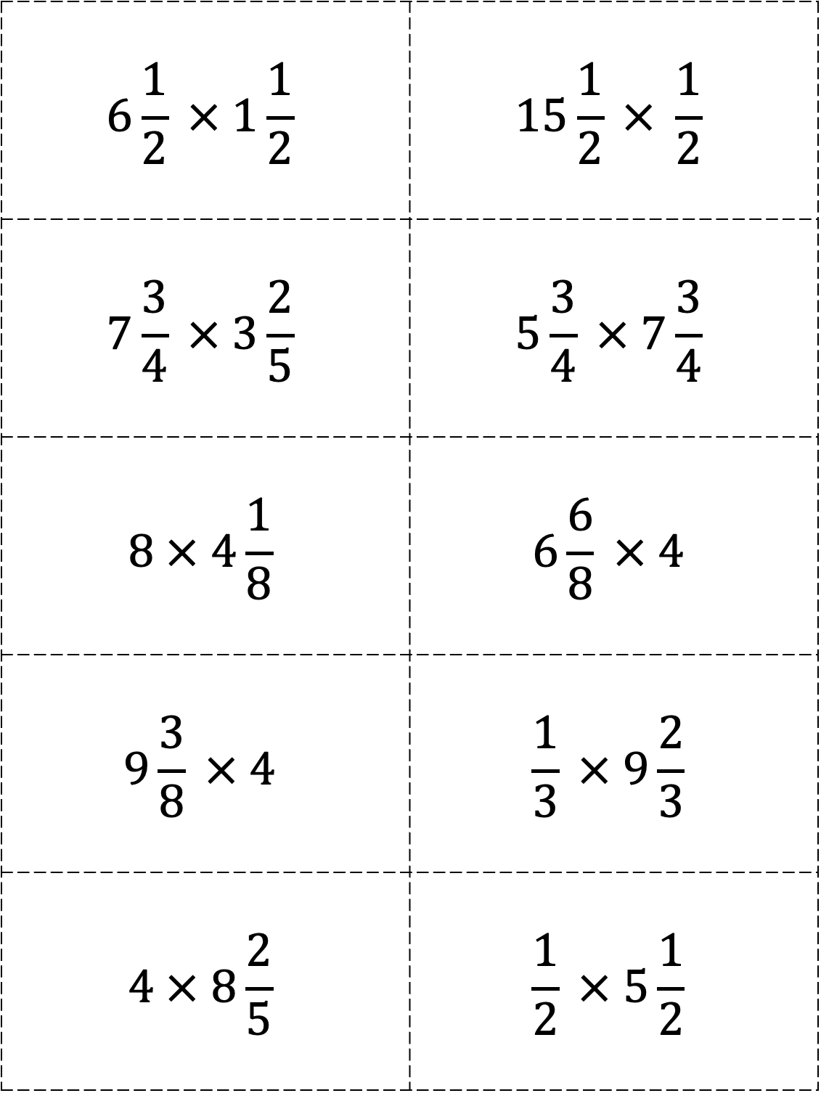
$$6\frac{1}{2} × 1\frac{1}{2}$$ | $$15\frac{1}{2} × \frac{1}{2}$$
$$7\frac{3}{4} × 3\frac{2}{5}$$ | $$5\frac{3}{4} × 7\frac{3}{4}$$
$$8 × 4\frac{1}{8}$$ | $$6\frac{6}{8} × 4$$
$$9\frac{3}{8} × 4$$ | $$\frac{1}{3} × 9\frac{2}{3}$$
$$4 × 8\frac{2}{5}$$ | $$\frac{1}{2} × 5\frac{1}{2}$$

Slide 3
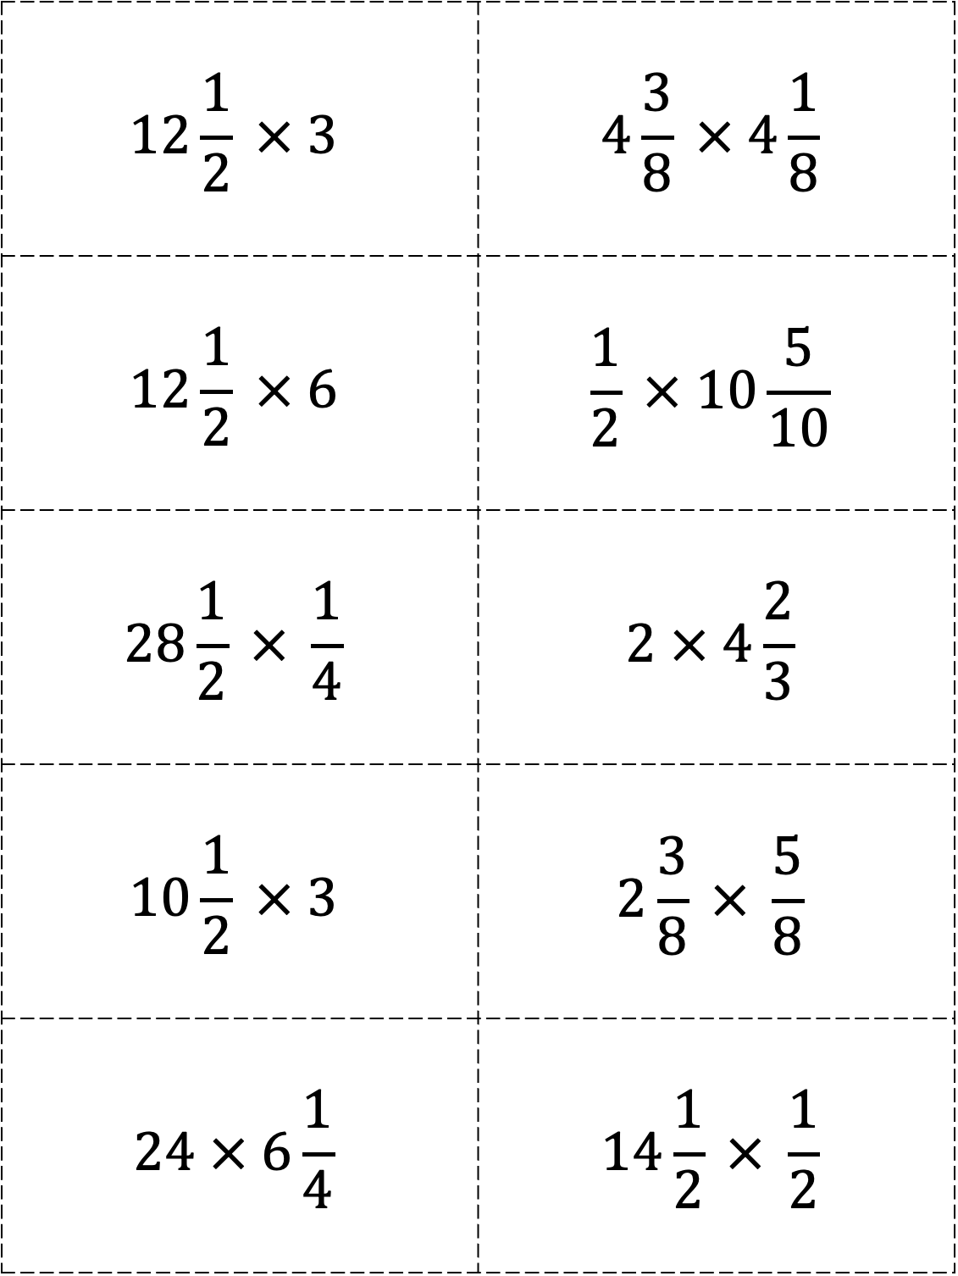
$$12\frac{1}{2} × 3$$ | $$4\frac{3}{8} × 4\frac{1}{8}$$
$$12\frac{1}{2} × 6$$ | $$\frac{1}{2} × 10\frac{5}{10}$$
$$28\frac{1}{2} × \frac{1}{4}$$ | $$2 × 4\frac{2}{3}$$
$$10\frac{1}{2} × 3$$ | $$2\frac{3}{8} × \frac{5}{8}$$
$$24 × 6\frac{1}{4}$$ | $$14\frac{1}{2} × \frac{1}{2}$$

