Slide 1
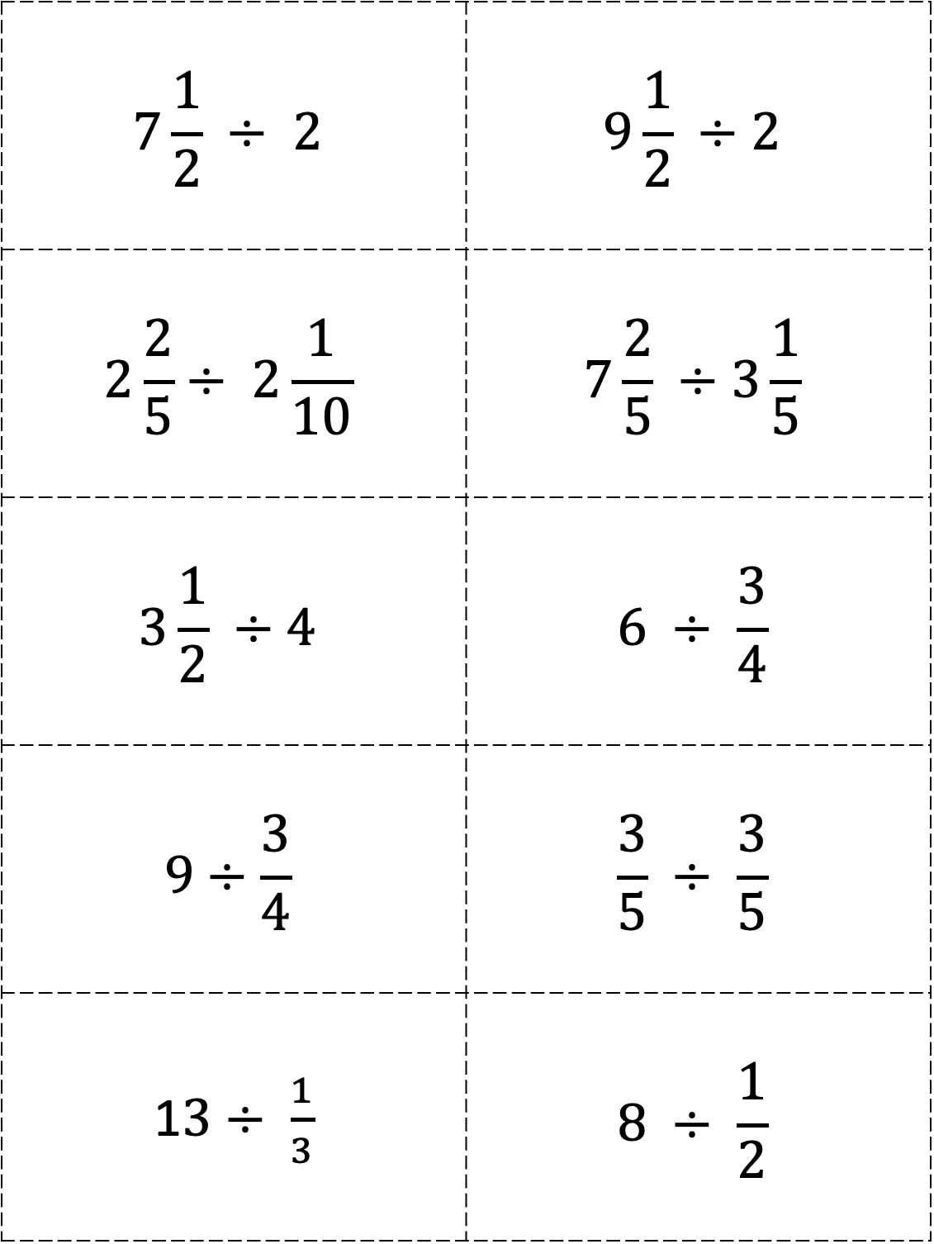
$$7\frac{1}{2} ÷ 2$$ | $$9\frac{1}{2} ÷2$$
$$2\frac{2}{5}÷ 2\frac{1}{10}$$ | $$7\frac{2}{5} ÷3\frac{1}{5}$$
$$3\frac{1}{2} ÷4$$ | $$6 ÷ \frac{3}{4}$$
$$9÷\frac{3}{4}$$ | $$\frac{3}{5} ÷ \frac{3}{5}$$
1$3÷ \frac{1}{3}$ | $$8 ÷ \frac{1}{2}$$

Slide 2
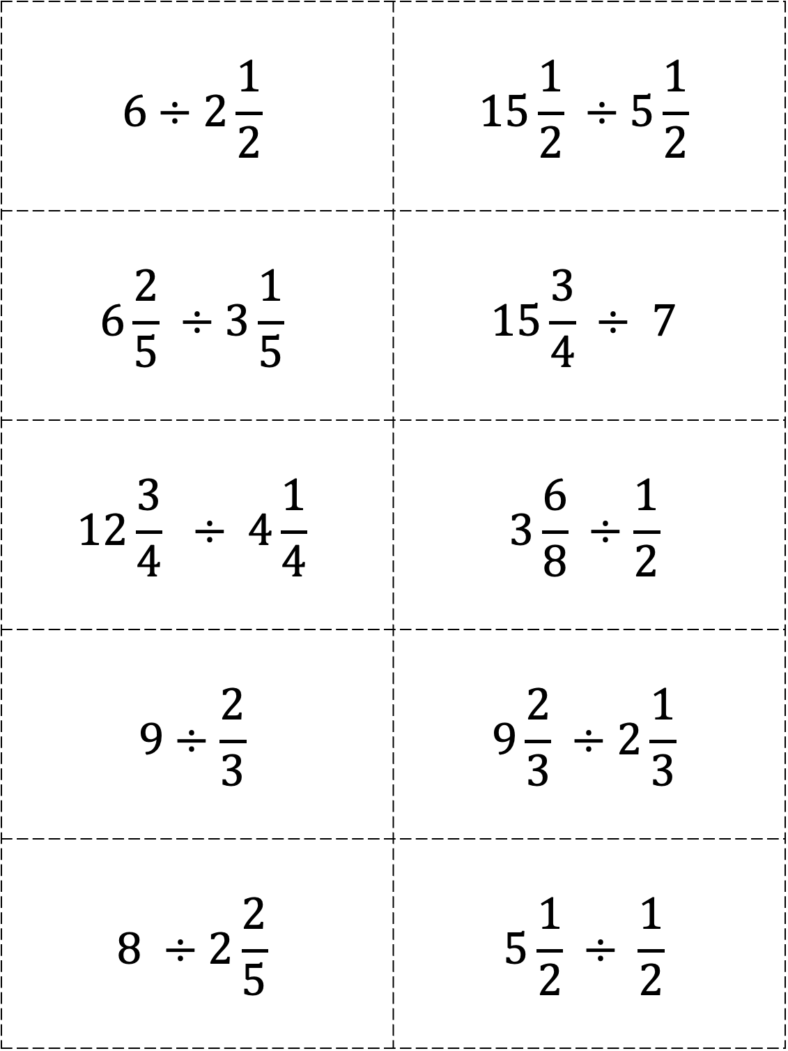
$$6÷2\frac{1}{2}$$ | $$15\frac{1}{2} ÷5\frac{1}{2}$$
$$6\frac{2}{5} ÷3\frac{1}{5}$$ | $$15\frac{3}{4} ÷ 7$$
$$12\frac{3}{4} ÷ 4\frac{1}{4}$$ | $$3\frac{6}{8} ÷\frac{1}{2}$$
$$9÷\frac{2}{3}$$ | $$9\frac{2}{3} ÷2\frac{1}{3}$$
$$8 ÷2\frac{2}{5}$$ | $$5\frac{1}{2} ÷ \frac{1}{2}$$

Slide 3
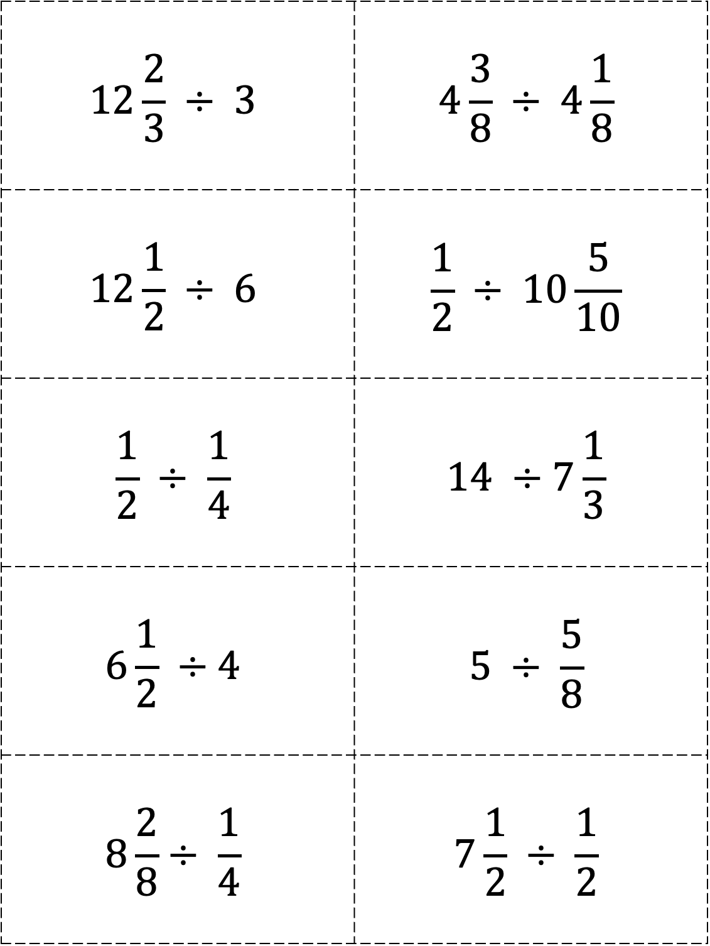
$$12\frac{2}{3} ÷ 3$$ | $$4\frac{3}{8} ÷ 4\frac{1}{8}$$
$$12\frac{1}{2} ÷ 6$$ | $$\frac{1}{2} ÷ 10\frac{5}{10}$$
$$\frac{1}{2} ÷ \frac{1}{4}$$ | $$14 ÷7\frac{1}{3}$$
$$6\frac{1}{2} ÷4$$ | $$5 ÷ \frac{5}{8}$$
$$8\frac{2}{8}÷ \frac{1}{4}$$ | $$7\frac{1}{2} ÷ \frac{1}{2}$$

