Slide 1
56 × 0.8 | 41 × 0.08
4.5 × 0.6 | 6.8 × 0.6
5.2 × 0.2 | 4.5 × 0.5
2.7 × 0.9 | 19.8 × 0.9
67 × 3 | 0.46 × 3
Please see PDF in case the formatting of this file changes.

Slide 2
0.15 × 4 | 3.01 × 0.4
4.90 × 0.5 | 64.8 × 0.5
25.8 × 0.07 | 23.5 × 7
3.15 × 8 | 3.69 × 9
20.7 × 5 | 45 × 0.8

Slide 3
51.4 ÷ 4.28 | 75.3 ÷ 15.9
80.4 ÷ 4 | 42 ÷ 3.1
70.4 ÷ 2.1 | 31.5 ÷ 1.5
8.36 ÷ 4 | 59 ÷ 0.5
9 ÷ 1.8 | 3.4 ÷ 0.3

Slide 4
6.72 ÷ 6 | 366 ÷ 0.6
4.9 ÷ 2 | 5.18 ÷ 2
20.8 ÷ 0.4 | 20 ÷ 3.9
35 ÷ 0.7 | 49.7 ÷ 0.7
21 ÷ 5.5 | 2.15 ÷ 0.5

Slide 5
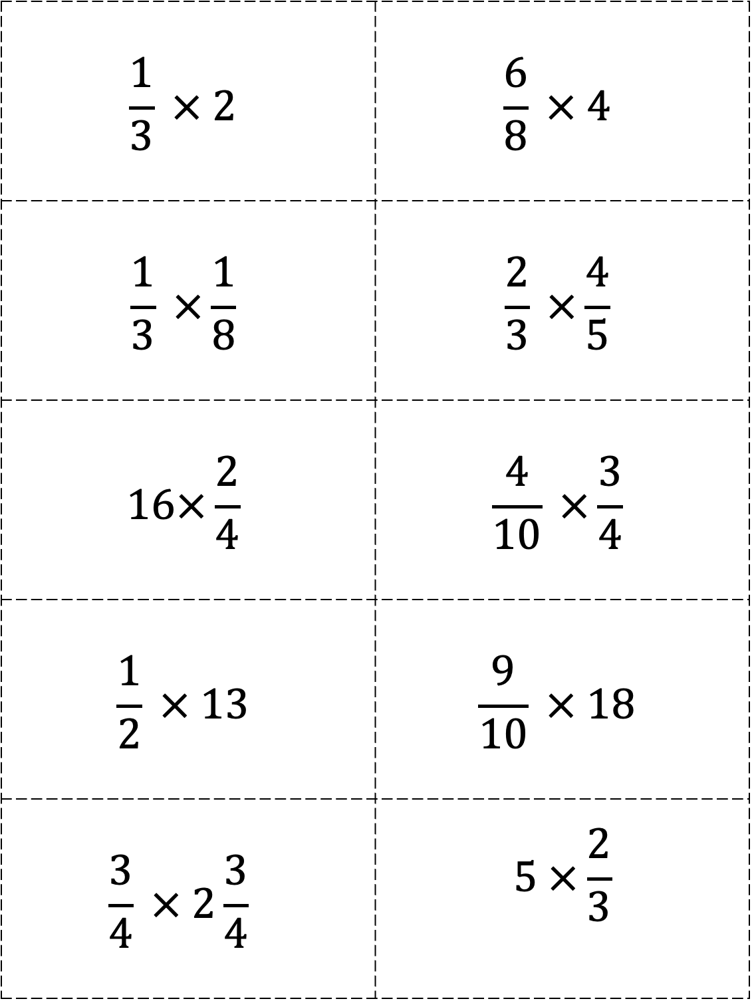
$$\frac{1}{3} × 2$$ | $$\frac{6}{8} × 4$$
$$\frac{1}{3} ×\frac{1}{8}$$ | $$\frac{2}{3} ×\frac{4}{5}$$
$$16×\frac{2}{4}$$ | $$\frac{4}{10} ×\frac{3}{4}$$
$$\frac{1}{2} × 13$$ | $$\frac{9}{10} × 18$$
$$\frac{3}{4} × 2\frac{3}{4}$$ | $$5 ×\frac{2}{3}$$

Slide 6
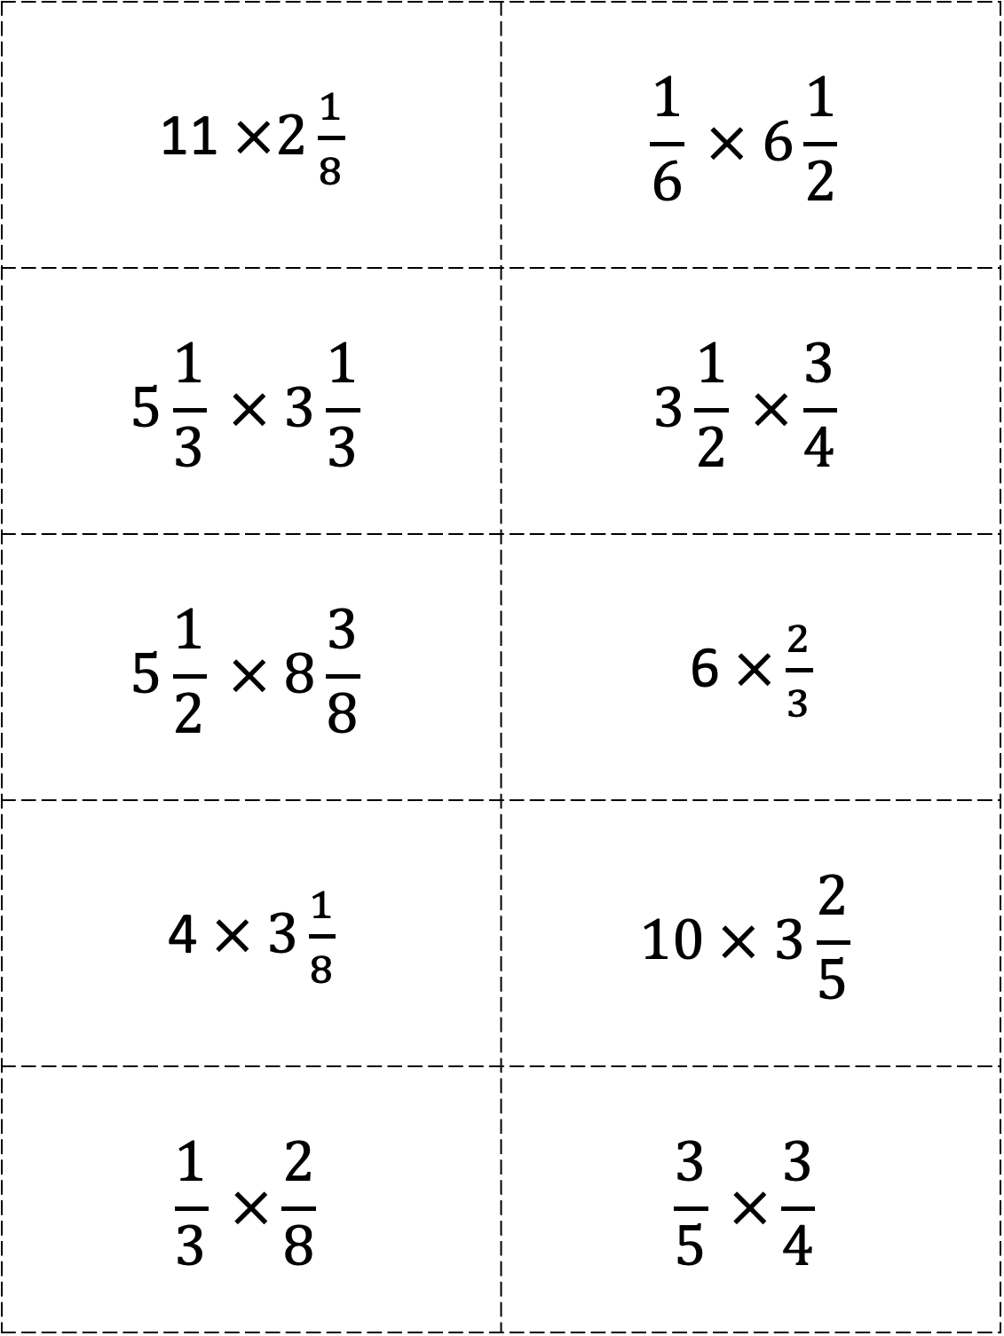
11 $×2\frac{1}{8}$ | $$\frac{1}{6} × 6\frac{1}{2}$$
$$5\frac{1}{3} × 3\frac{1}{3}$$ | $$3\frac{1}{2} ×\frac{3}{4}$$
$$5\frac{1}{2} × 8\frac{3}{8}$$ | 6 $×\frac{2}{3}$
4 $× 3\frac{1}{8}$ | $$10 × 3\frac{2}{5}$$
$$\frac{1}{3} ×\frac{2}{8}$$ | $$\frac{3}{5} ×\frac{3}{4}$$

