Slide 1
5.3 x 2.7 5 x 2 = 10 5 x 0.7 = 3.5 0.3 x 2 = 0.6 0.3 x 0.7 = 0.21 14.31 | 4.16 x 3 4 x 3 = 12 0.1 x 3 = 0.3 0.06 x 3 = 0.18 12.48
4.2 x 0.36 4 x 0.3 = 1.2 4 x 0.06 = 0.24 0.2 x 0.3 = 0.06 0.3 x 0.06 = 0.012 1.512 | 26 x 1.3 20 x 1 = 20 20 x 0.3 = 6 6 x 1 = 6 6 x 0.3 = 1.8 33.8
Please see PDF in case the formatting of this file changes.

Slide 2
45.83 x 0.6 40 x 0.6 = 24 5 x 0.6 = 3 0.8 x 0.6 = 0.48 0.03 x 0.6 = 0.018 27.498 | 4 x 8.08 4 x 8 = 32 4 x 0.08 = 0.32 32.32
0.3 x 2.97 0.3 x 2 = 0.6 0.3 x 0.9 = 0.27 0.3 x 0.07 = 0.021 0.891 | 2 x 42.61 2 x 40 = 80 2 x 2 = 4 2 x 0.6 = 1.2 2 x 0.01 = 0.02 85.22

Slide 3
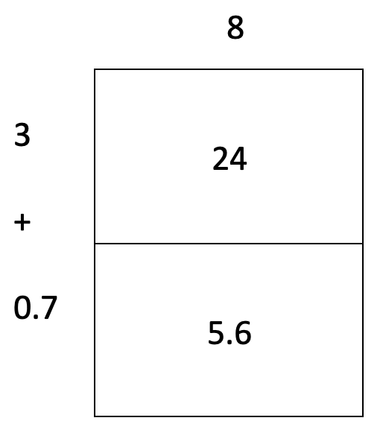
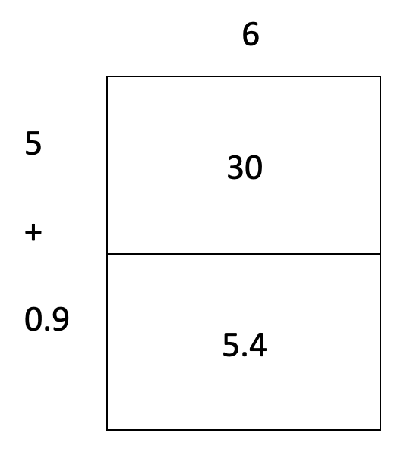
7.03 x 3.5 7 x 3 = 21 7 x 0.5 = 3.5 0.03 x 3 = 0.09 0.03 x 0.5 = 0.015 24.605 | 3.8 x 7.6 3 x 7 = 21 3 x 0.6 = 1.8 0.8 x 7 = 5.6 0.8 x0.6 = 0.48 28.88

Slide 4
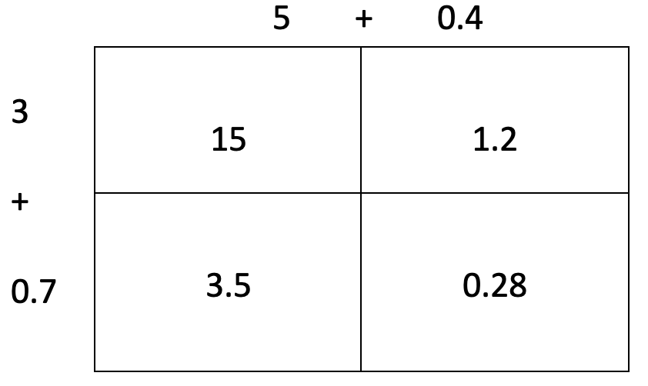
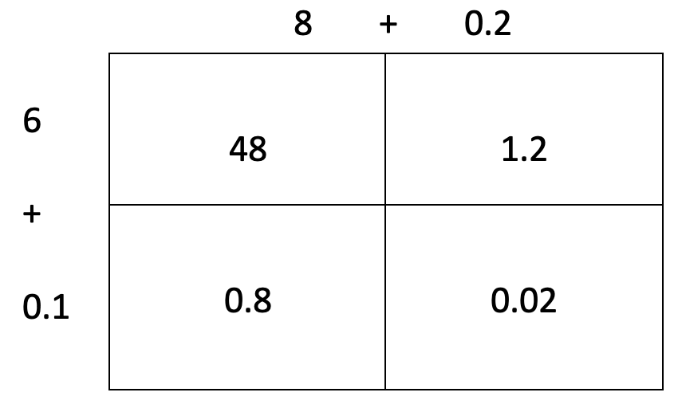
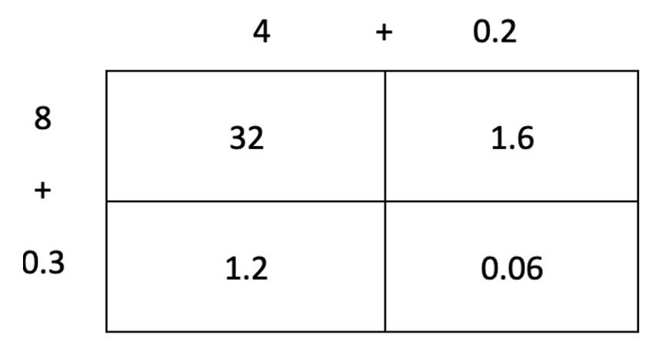
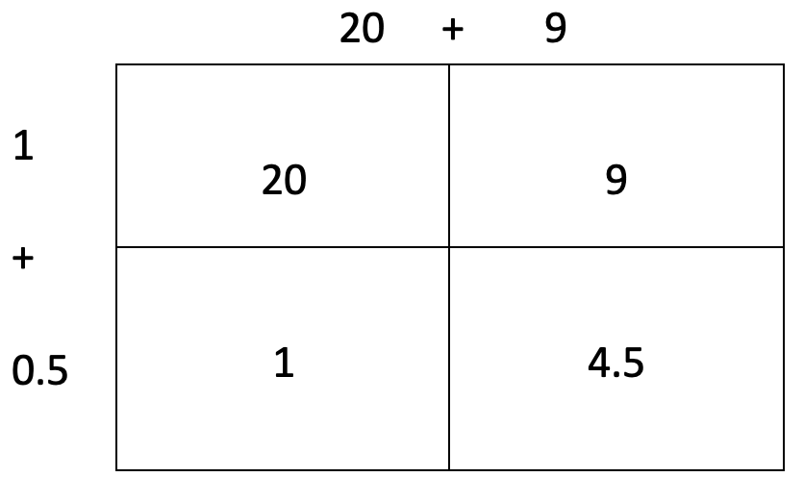

Slide 5
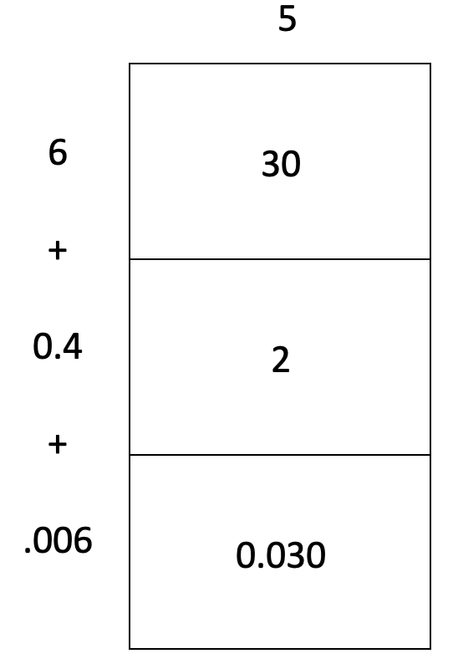
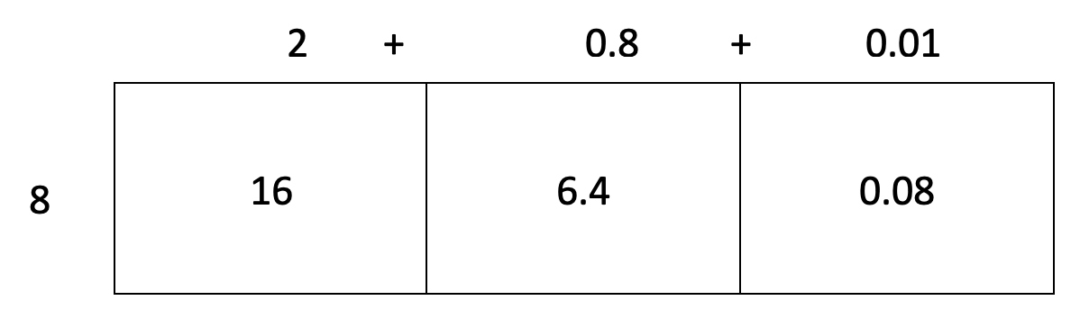
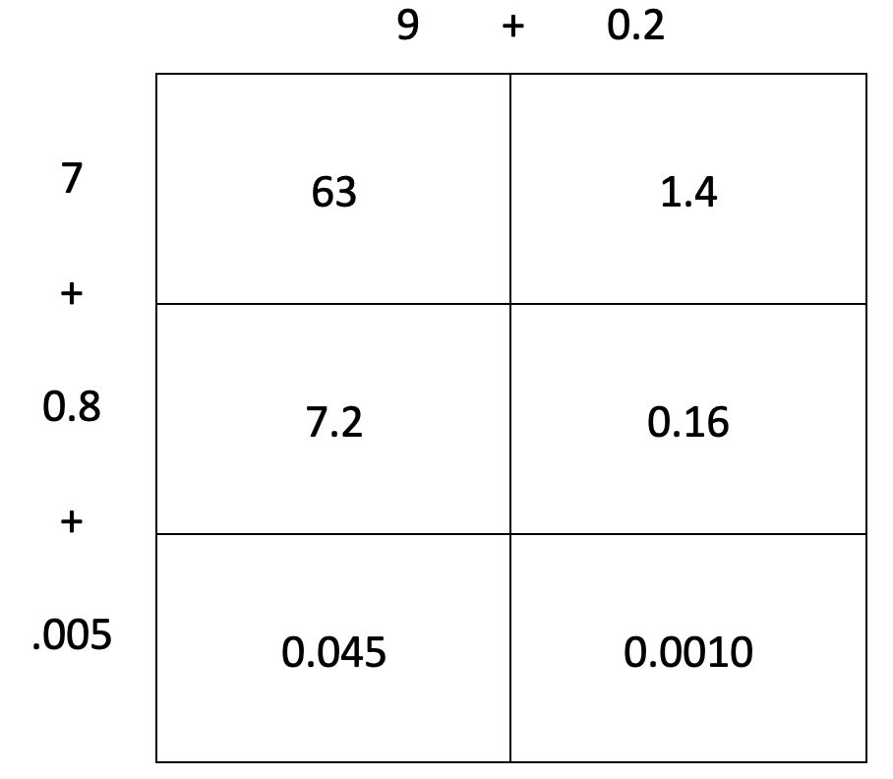
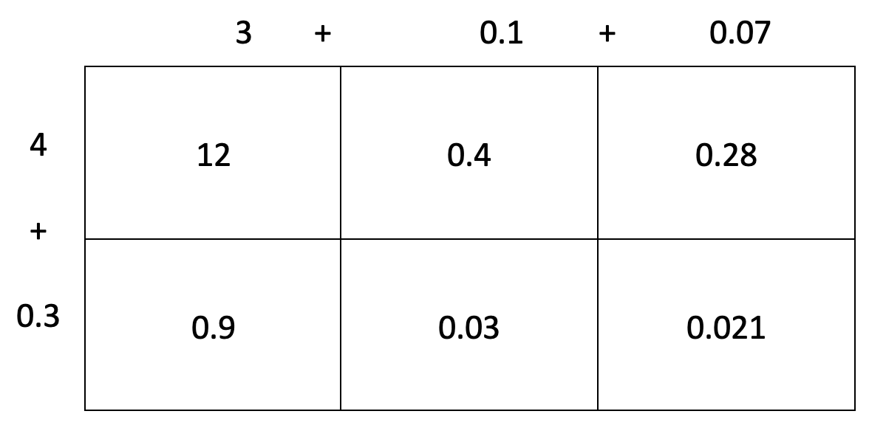

Slide 6
4.878 ➗0.6 6 48.78 -48 8 0.7 -0.6 0.1 0.18 -0.18 0.03 0 8.13 4.878 ➗0.6 = 8.13 | 8.97 ➗0.3 3 8.91 -6 2 2.9 -2.7 0.9 0.21 -0.21 0.07 0 2.97 8.97 ➗0.3 = 2.97
7.621 ➗0.5 5 76.210 -50 10 26 -25 5 1.2 -1.0 0.2 0.21 -0.20 0.04 0.010 -0.010 0.005 0 15.245 7.621 ➗0.5 = 15.245 | 3.44 ➗0.8 8 34.4 -32 4 2.4 -2.4 0.3 0 4.3 3.44 ➗0.8 = 4.3

Slide 7
9.72 ➗1.5 15 97.20 -30 2 67 -60 4 7.2 -6.0 0.4 1.20 - 1.20 0.08 0 6.48 9.72 ➗1.5 = 6.48 | 1.512 ➗0.36 151.2 ➗36 36 x 10 = 360 36 x 5 = 180 36 x 2 = 72 36 x 4 =144 36 151.2 -144 4 7.2 -7.2 0.2 0 4.2 1.512 ➗0.36 = 4.2

