Slide 1
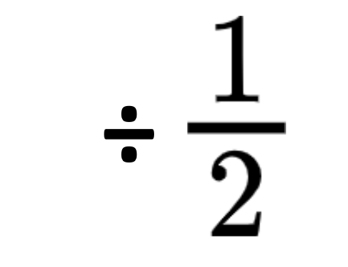
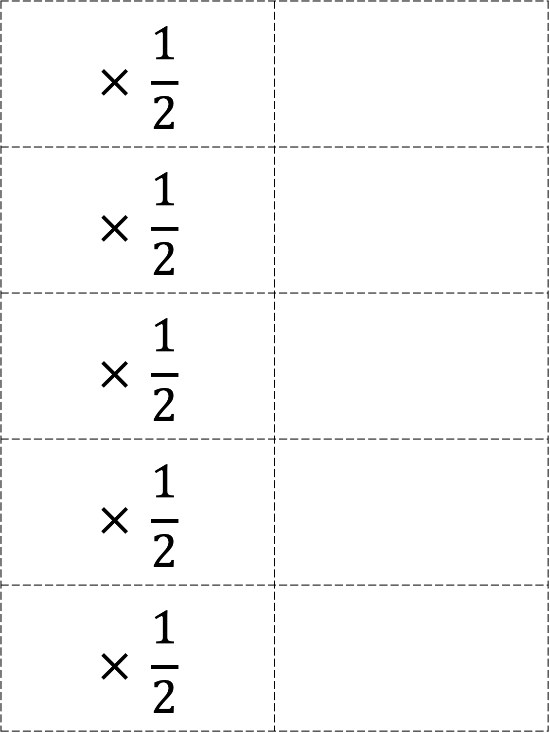
$$× \frac{1}{2}$$
$$× \frac{1}{2}$$
$$× \frac{1}{2}$$
$$× \frac{1}{2}$$
$$× \frac{1}{2}$$
Please see PDF in case the formatting of this file changes.

Slide 2
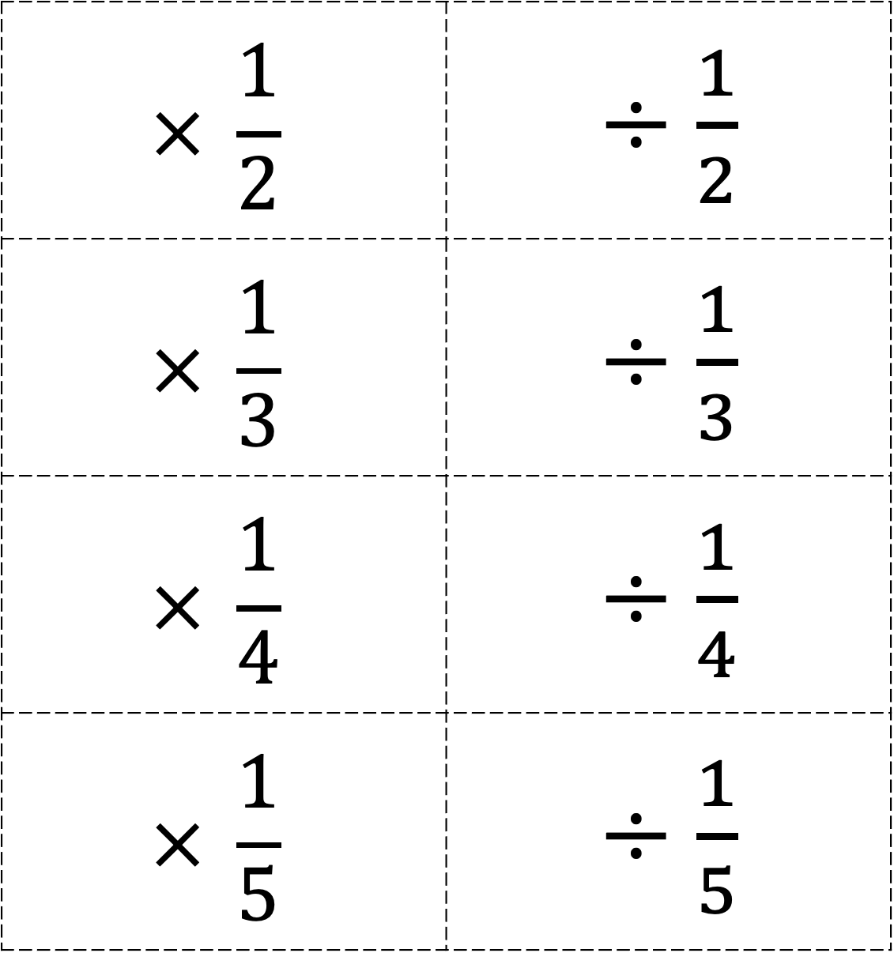
$$× \frac{1}{2}$$ | $÷$ $\frac{1}{2}$
$$× \frac{1}{3}$$ | $÷$ $\frac{1}{3}$
$$× \frac{1}{4}$$ | $÷$ $\frac{1}{4}$
$$× \frac{1}{5}$$ | $÷$ $\frac{1}{5}$

