Slide 1
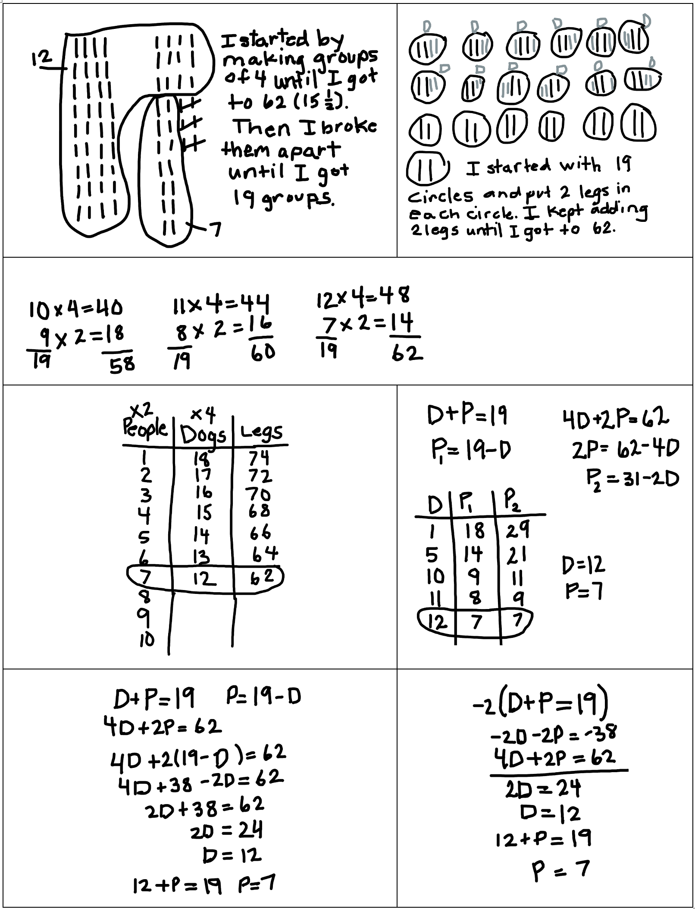
Student Solutions for Activity 7.2 Visit to the Dog Park

