Slide 1
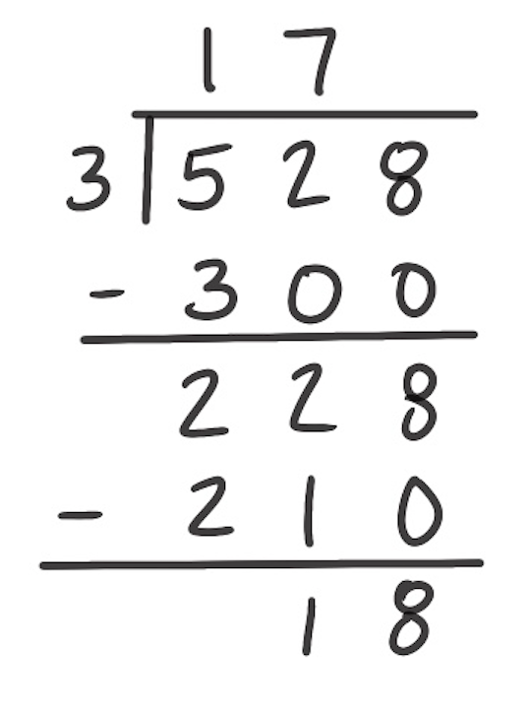
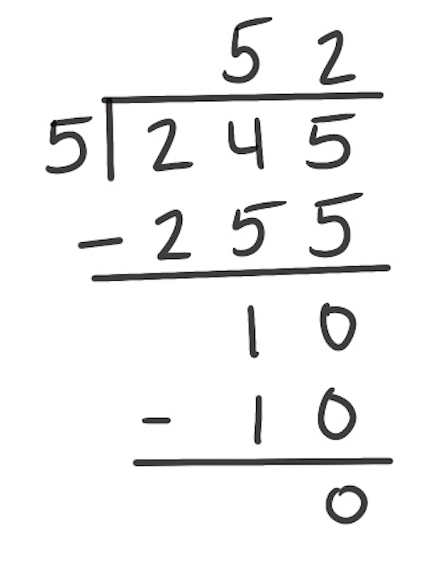
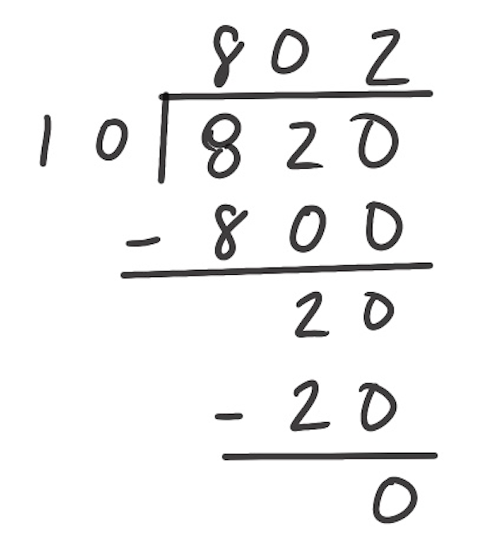
Correct the Error
Directions: Review the problem in the first column. Find the error. Write down what the error is in the second column. In the third column, solve the problem correctly.
The Problem | What Is the Error? | Solve

Slide 2
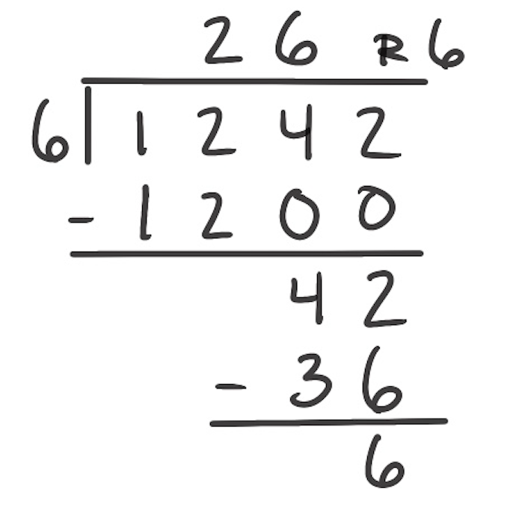
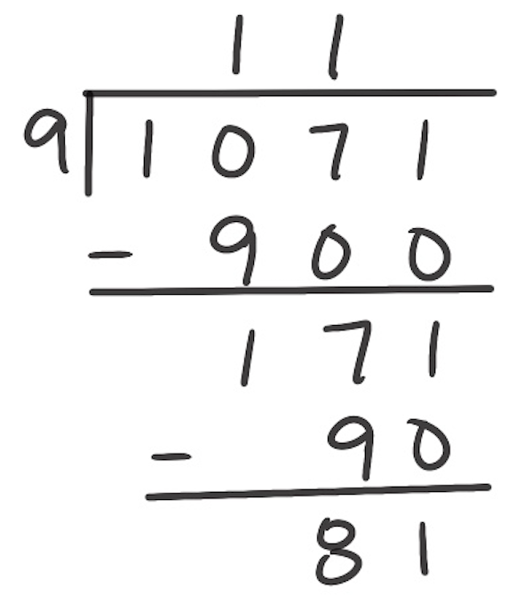
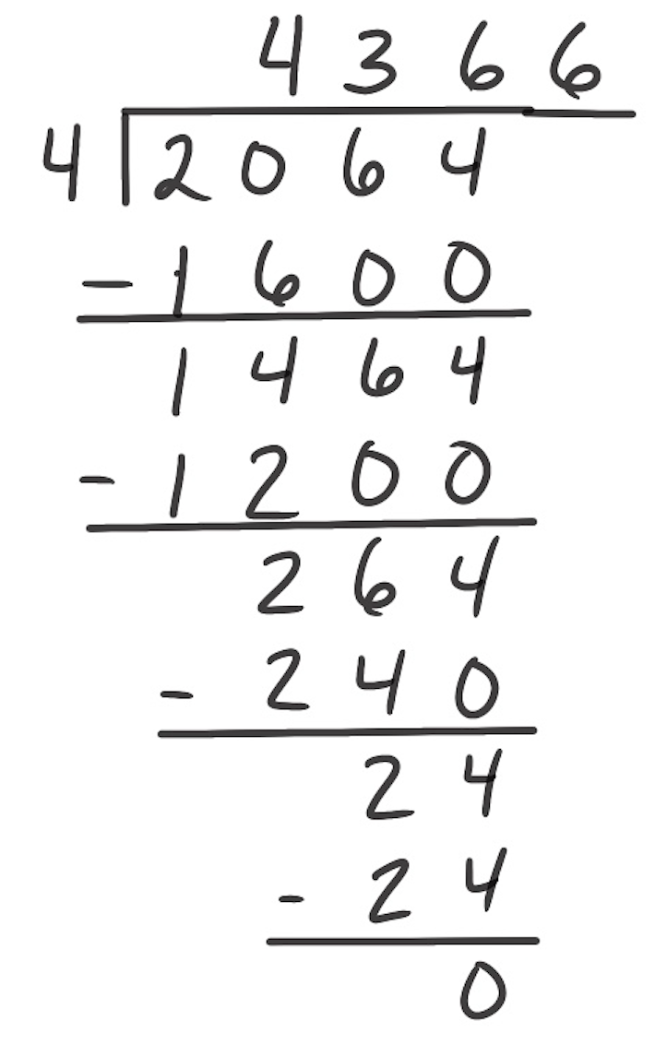
Correct the Error
Directions: Review the problem in the first column. Find the error. Write down what the error is in the second column. In the third column, solve the problem correctly.
The Problem | What Is the Error? | Solve

Slide 3
Correct the Error
Directions: Review the problem in the first column. Find the error. Write down what the error is in the second column. In the third column, solve the problem correctly.
The Problem | What Is the Error? | Solve

