Slide 1
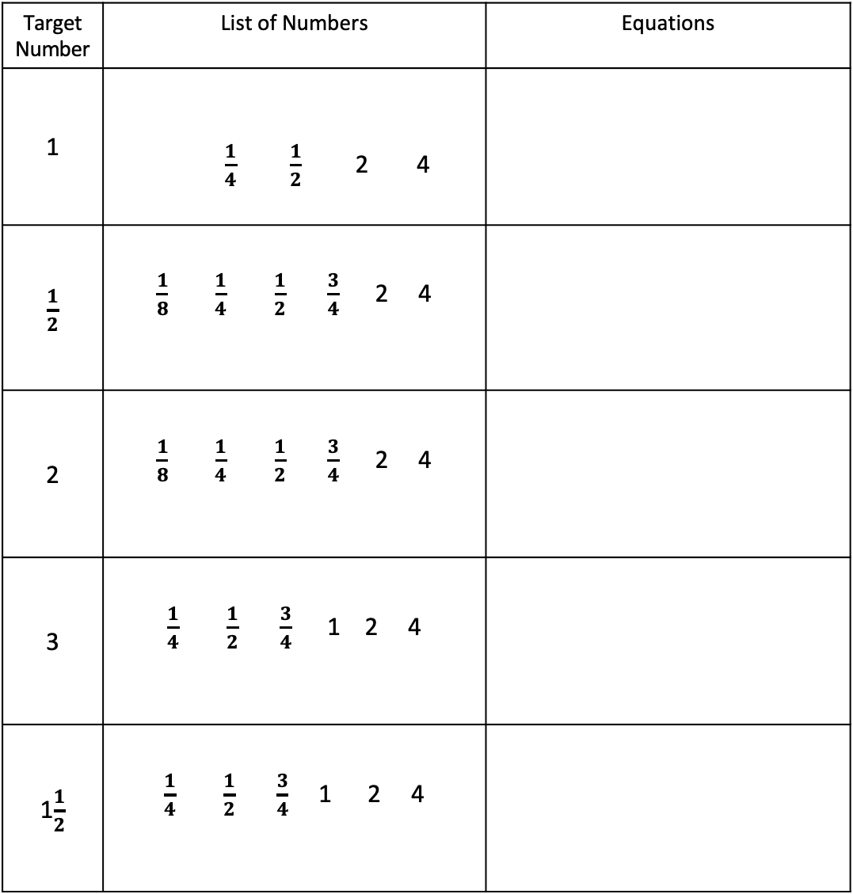
Hit the Target Equation Creation
Directions: Use the list of numbers to create at least 5 equations for the Target Number. You can use as many values from the list. You can use the number more than once. You can use all four operations and parenthesis.
Target Number | List of Numbers | Equations
1 | $\frac{1}{4}$ $\frac{1}{2}$ 2 4
$\frac{1}{2}$ | $\frac{1}{8}$ $\frac{1}{4}$ $\frac{1}{2}$ $\frac{3}{4}$ 2 4
2 | $\frac{1}{8}$ $\frac{1}{4}$ $\frac{1}{2}$ $\frac{3}{4}$ 2 4
3 | $\frac{1}{4}$ $\frac{1}{2}$ $\frac{3}{4}$ 1 2 4
1$\frac{1}{2}$ | $\frac{1}{4}$ $\frac{1}{2}$ $\frac{3}{4}$ 1 2 4

