Slide 1
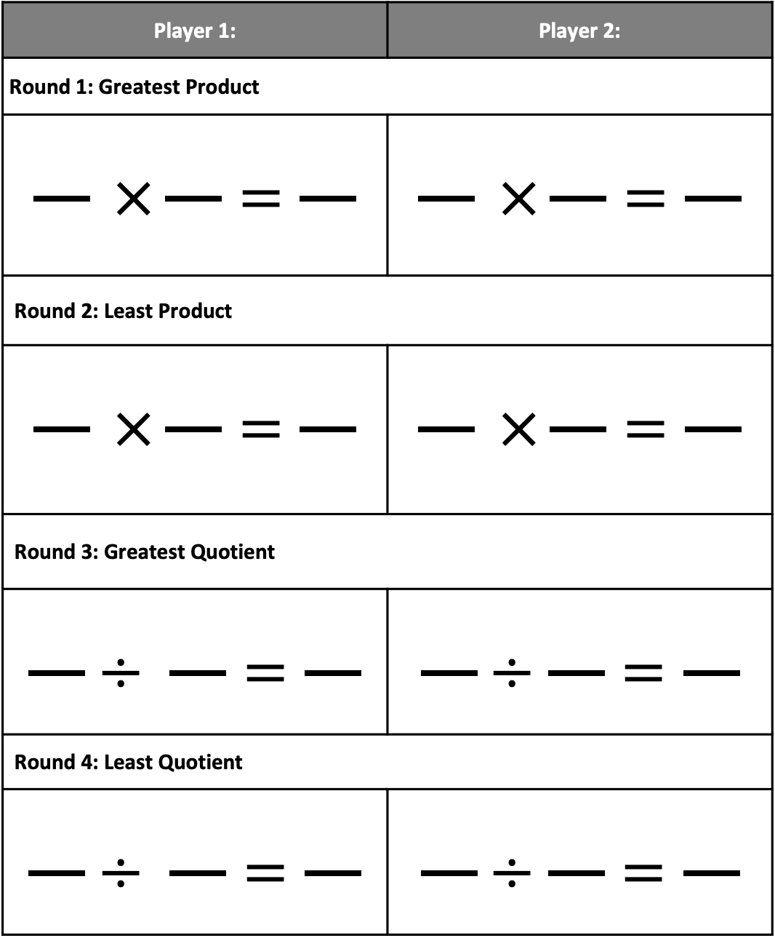
Roll to Win
Directions: Each player rolls 4 dice or flip 4 digit cards. . Arrange the digits to win each round. The target is to get the greatest product, least product, greatest quotient and the least quotient. Please see PDF in case the formatting of this file changes.
Player 1: | Player 2:
Round 1: Greatest Product
$$\frac{}{} ×\frac{}{}=\frac{}{}$$ | $$\frac{}{} ×\frac{}{}=\frac{}{}$$
Round 2: Least Product
$$\frac{}{} ×\frac{}{}=\frac{}{}$$ | $$\frac{}{} ×\frac{}{}=\frac{}{}$$
Round 3: Greatest Quotient
$$\frac{}{}÷ \frac{}{}=\frac{}{}$$ | $$\frac{}{}÷\frac{}{}=\frac{}{}$$
Round 4: Least Quotient
$$\frac{}{}÷ \frac{}{}=\frac{}{}$$ | $$\frac{}{}÷\frac{}{}=\frac{}{}$$

