Slide 1
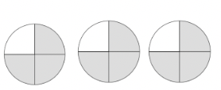
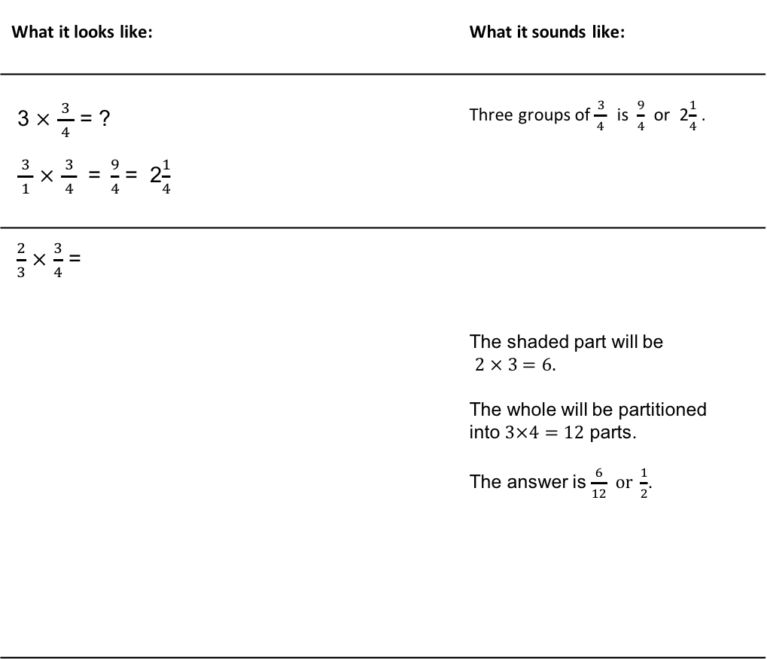
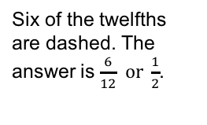


Standard Algorithm
for Multiplying Fractions
What it is: Multiplying fractions involves multiplying the numerators across and then the denominators across and simplifying if necessary. Multiplication is about finding how many groups (or rows) of a given number in a group (or column). Here are some illustrations:
What it looks like: | What it sounds like:
3 $×$ $\frac{ 3 }{4}$ = ? $\frac{ 3 }{1}$ $×$ $\frac{ 3 }{4}$ =$\frac{9}{4}$ = 2$\frac{1}{4}$ | Three groups of $\frac{ 3 }{4}$ is $\frac{9}{4}$ or 2$\frac{1}{4}$ .
$\frac{2}{3}$ $×$ $\frac{3}{4}$ = | The shaded part will be $2 × 3=6.$ The whole will be partitioned into $3×4=12$ parts. The answer is $\frac{6}{12} or \frac{1}{2}$.
$\frac{3}{4}$ of a whole is shaded.
Now, $\frac{2}{3}$ of the $\frac{3}{4}$ is dashed.
Six of the twelfths are dashed. The answer is $\frac{6}{12} or \frac{1}{2}$.
When it’s useful: This algorithm is often the most efficient option when multiplying two fractions, unless they are a special case.

Slide 2
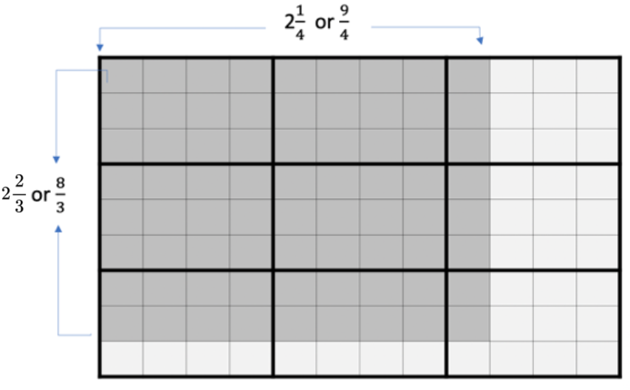
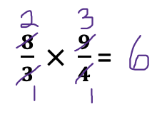


Standard Algorithm
for Multiplying Mixed Numbers
What it is: This strategy relies on converting mixed numbers into fractions greater than a whole (improper fractions) before multiplying with the standard algorithm.
What it looks like:
What it sounds like: This problem is too complicated for a reasoning strategy, so I will change the mixed numbers to fractions. Then I will look to see if I can simplify before I multiply. Yes, 9 and 3 can both be divided by 3, and 8 and 4 can both be divided by 4. That leaves $2 × 3,$which equals 6.
When it’s useful: This algorithm is often the most efficient option when multiplying two mixed numbers.
$$2\frac{2}{3} × 2\frac{1}{4}= \frac{8}{3} × \frac{9}{4}$$
Then you can choose to multiply the fractions, then simplify, or simplify then multiply, as shown here:

Slide 3

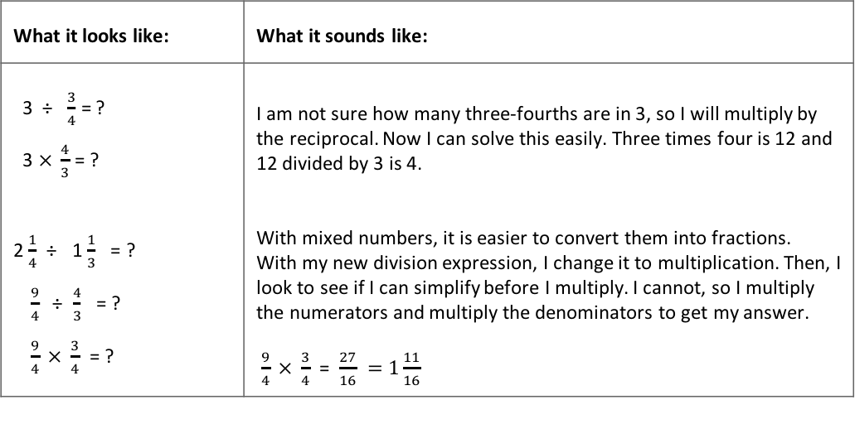
Standard Algorithm
for Dividing Fractions
What it is: The standard algorithm in the United States, often called “invert and multiply,” changes a division problem into a related multiplication problem to solve it. The problem 3 ÷ $\frac{1}{4}$ means, “How many fourths are in 3?” Think of servings of pizza. If a serving is $\frac{1}{4}$ of a pizza, then you can get 12 servings from 3 pizzas. The answer is found by multiplying by 4. Thus, it looks like invert and multiply.
If the numerator was a number other than 1, then it’s a little harder. For 3÷ $\frac{3}{4}$, think of servings of $\frac{3}{4}$ of a pizza. Now you take those 12 servings and group them by 3s (divide by 3) and you have 4 of these larger servings. Thus, dividing a number by a fraction is the same as multiplying that number by the reciprocal of that fraction.
Dividing mixed numbers involves changing mixed numbers into fractions greater than 1 (improper fractions). Then, the process is the same: multiply by the reciprocal of the divisor. Simplify first, if possible.
What it looks like: | What it sounds like:
3 ÷ $\frac{3}{4}$ = ? 3 $× \frac{4}{3}$ = ? 2 $\frac{1}{4}$ ÷ 1 $\frac{1}{3}$ = ? $\frac{9}{4}$ ÷$\frac{4}{3}$ = ? $\frac{9}{4} × \frac{3}{4}$ = ? | I am not sure how many three-fourths are in 3, so I will multiply by the reciprocal. Now I can solve this easily. Three times four is 12 and 12 divided by 3 is 4. With mixed numbers, it is easier to convert them into fractions. With my new division expression, I change it to multiplication. Then, I look to see if I can simplify before I multiply. I cannot, so I multiply the numerators and multiply the denominators to get my answer. $\frac{9}{4} × \frac{3}{4}$ = $\frac{27}{16} =1\frac{11}{16}$
When it’s useful: This algorithm is useful when the problem cannot be solved mentally using a reasoning strategy.

Slide 4

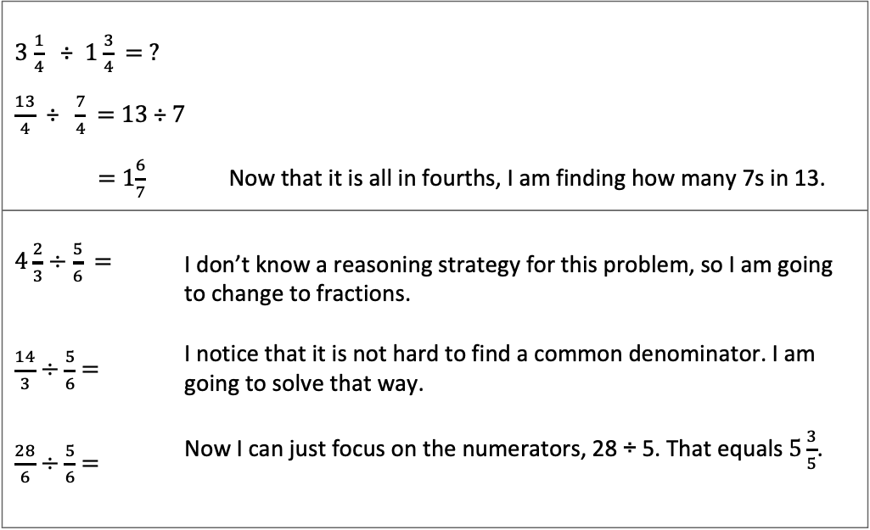
Dividing Fractions Using Common Denominators
What it is: Dividing by common denominator is an underused algorithm that is efficient and well connected to models. If there is a common denominator, you can divide just the numerators and get the quotient.
For example, in the problem below, the question is, how many 7 fourths are in 13 fourths? The quotient is 1 $\frac{6}{7}$.
What it looks and sounds like:
3 $\frac{1}{4}$ ÷ 1 $\frac{3}{4}$ = ? $\frac{13}{4}$ ÷ $\frac{7}{4}$ = 13 ÷ 7 = 1$\frac{6}{7}$ Now that it is all in fourths, I am finding how many 7s in 13.
$4\frac{2}{3}÷\frac{5}{6}$ = $\frac{14}{3}÷\frac{5}{6}$ = $\frac{28}{6}÷\frac{5}{6}$ = | I don’t know a reasoning strategy for this problem, so I am going to change to fractions. I notice that it is not hard to find a common denominator. I am going to solve that way. Now I can just focus on the numerators, 28 ÷ 5. That equals $5\frac{3}{5}$.
When it’s useful: This strategy is useful when the problem already has a common denominator, or it is not difficult to find common denominators.

