Slide 1
Tic-Tac-Take
Directions: Players take turns selecting an expression on the game board. Both players solve the problem using Partial Quotients. If both players’ answers are the same, the player who selected the expression places their mark on that spot. If players disagree, they check the problem with a calculator. The player who is correct takes the spot. The first player to get three in a row wins.
64.26 ÷ 9 | 17.35 ÷ 5 | 29.04 ÷ 6
14.31 ÷ 3 | 1.374 ÷ 2 | 231.6 ÷ 4
27.498 ÷ 6 | 8.911 ÷ 7 | 7.19 ÷ 5

Slide 2
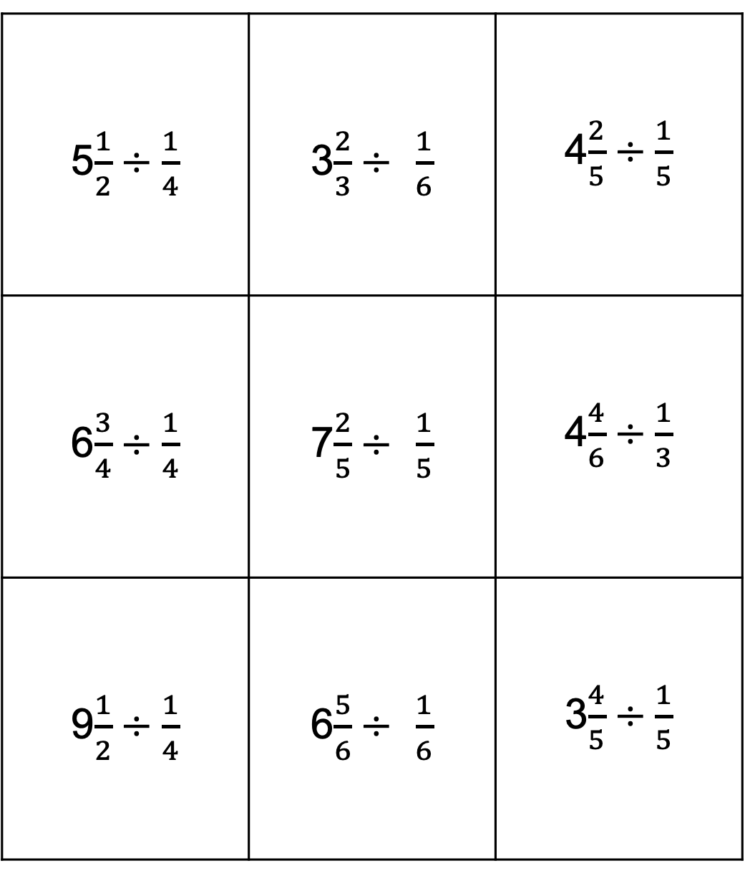
Tic-Tac-Take
Directions: Players take turns selecting an expression on the game board. Both players solve the problem using Partial Quotients. If both players’ answers are the same, the player who selected the expression places their mark on that spot. If players disagree, they check and must prove their answers . The player who is correct takes the spot. The first player to get three in a row wins.
5$\frac{1}{2}÷\frac{1}{4}$ | 3$\frac{2}{3}÷$ $\frac{1}{6}$ | 4$\frac{2}{5}÷\frac{1}{5}$
6$\frac{3}{4}÷\frac{1}{4}$ | 7$\frac{2}{5}÷$ $\frac{1}{5}$ | 4$\frac{4}{6}÷\frac{1}{3}$
9$\frac{1}{2}÷\frac{1}{4}$ | 6$\frac{5}{6}÷$ $\frac{1}{6}$ | 3$\frac{4}{5}÷\frac{1}{5}$

