Slide 1
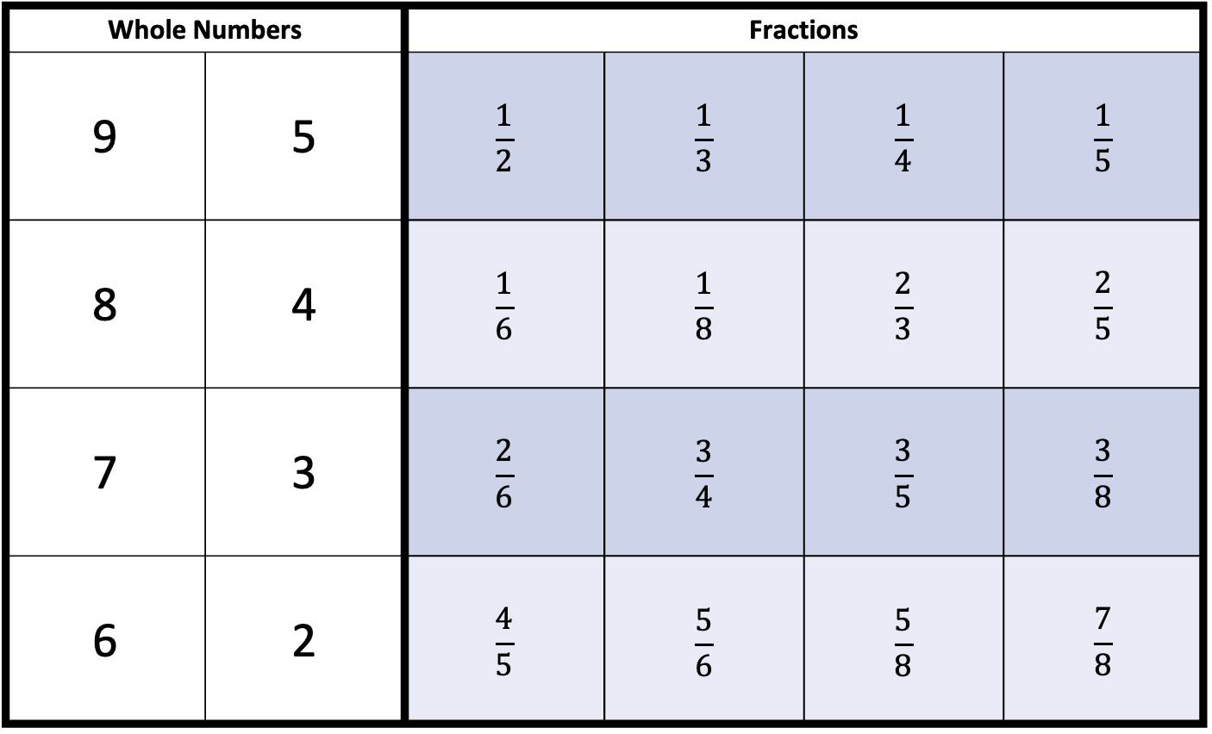
Sum Duel
Directions: Place 2 counters on the board (1 whole number and 1 fraction) to make a mixed number. Have your opponent place 2 counters on the board to make another mixed number. Find the sum of the two numbers. Then, flip Sum Duel condition cards. If your sum matches the Sum Duel condition you get a point. The first player with 5 points wins.
Whole Numbers |  | Fractions
9 | 5 | $$\frac{1}{2}$$ | $$\frac{1}{3}$$ | $$\frac{1}{4}$$ | $$\frac{1}{5}$$
8 | 4 | $$\frac{1}{6}$$ | $$\frac{1}{8}$$ | $$\frac{2}{3}$$ | $$\frac{2}{5}$$
7 | 3 | $$\frac{2}{6}$$ | $$\frac{3}{4}$$ | $$\frac{3}{5}$$ | $$\frac{3}{8}$$
6 | 2 | $$\frac{4}{5}$$ | $$\frac{5}{6}$$ | $$\frac{5}{8}$$ | $$\frac{7}{8}$$

