Slide 1
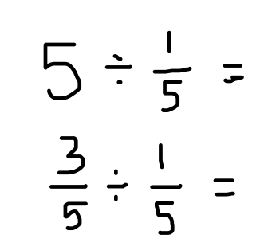
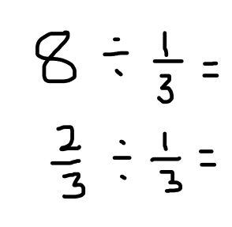
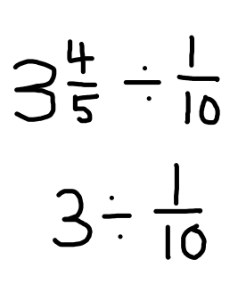
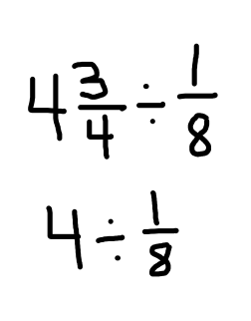
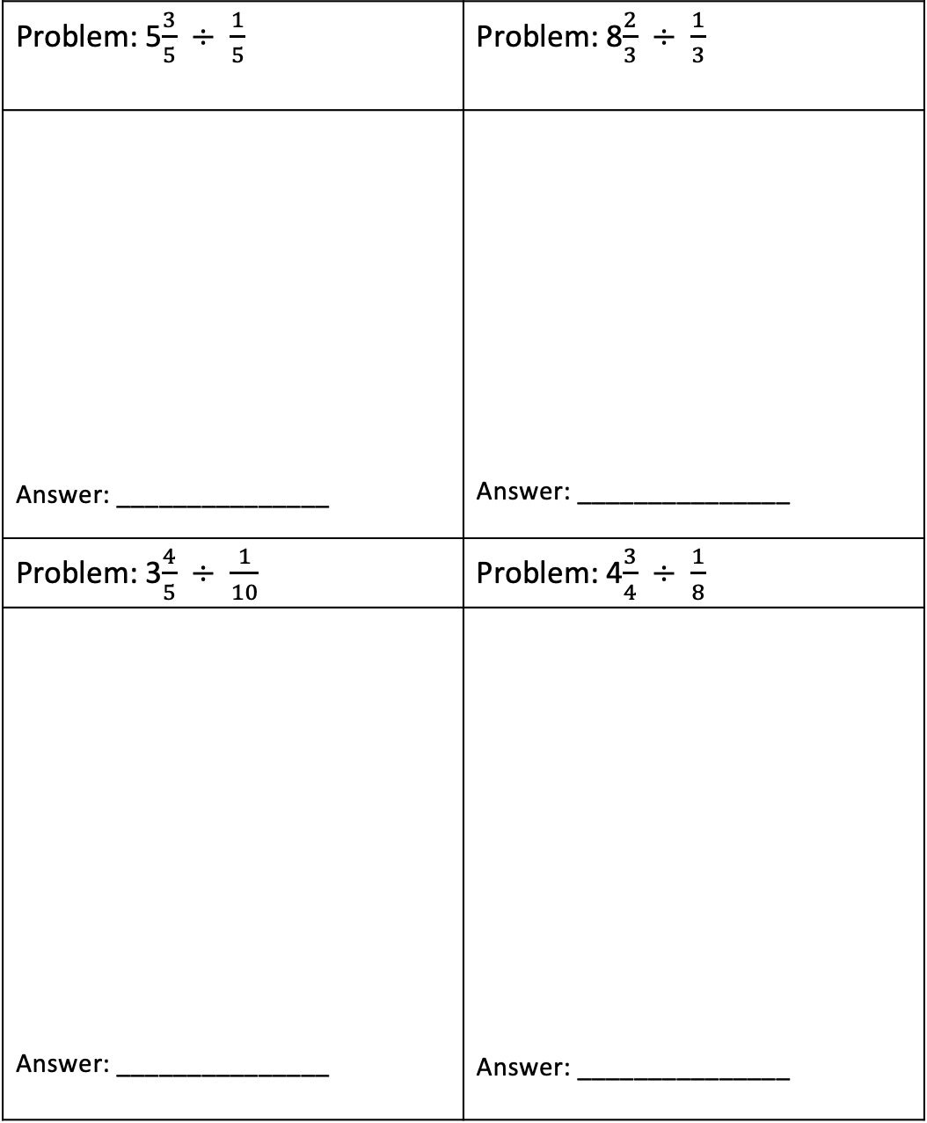
Complete the Partials
Directions: Complete the partial quotient for each of the problems.
Problem: 5$\frac{3}{5}$ $÷ \frac{1}{5}$ | Problem: 8$\frac{2}{3}$ $÷ \frac{1}{3}$
Answer: _______________ | Answer: _______________
Problem: 3$\frac{4}{5}$ $÷ \frac{1}{10}$ | Problem: 4$\frac{3}{4}$ $÷ \frac{1}{8}$
Answer: _______________ | Answer: _______________

Slide 2
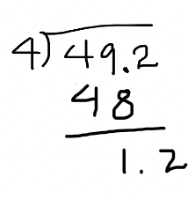
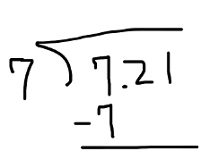


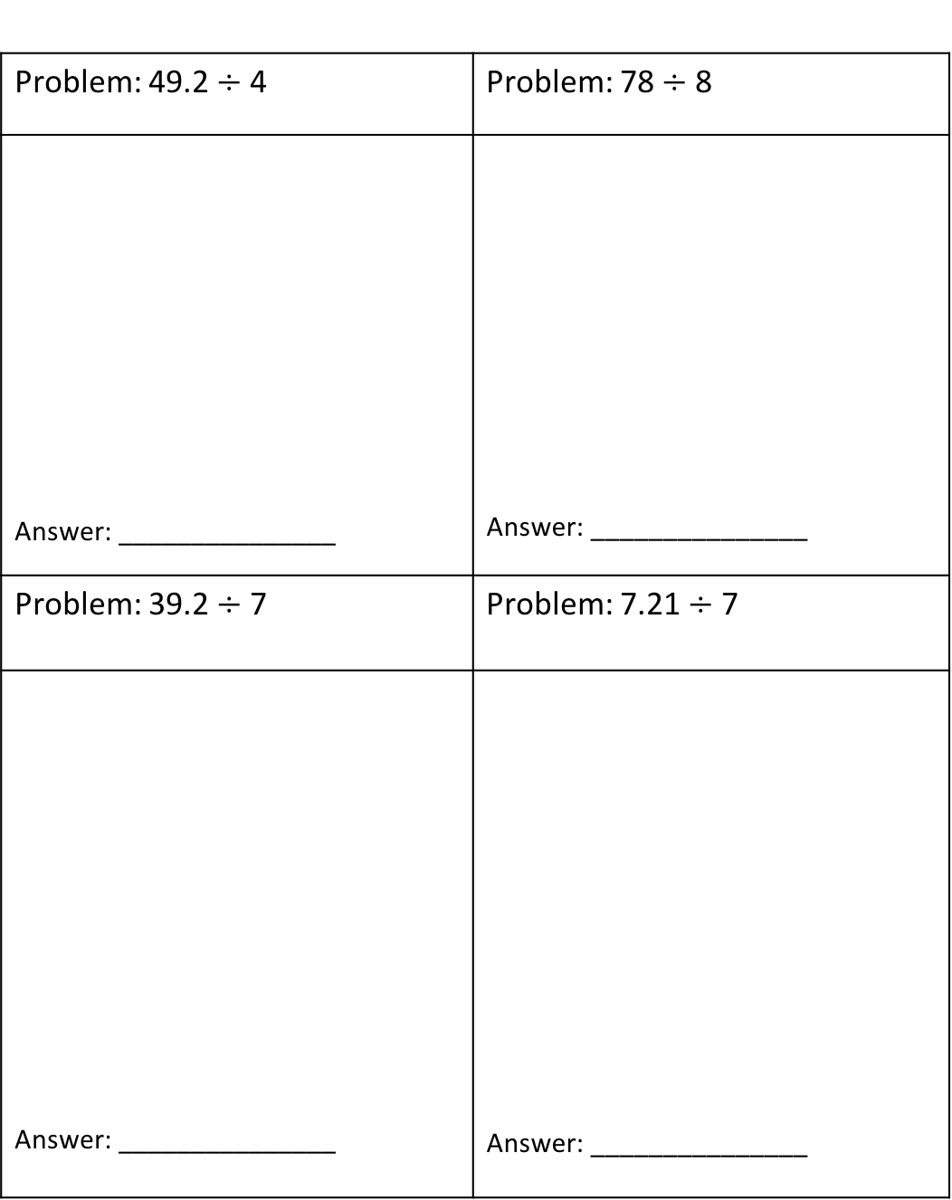




Complete the Partials
Directions: Complete the partial quotient for each of the problems.
Problem: 49.2 $÷$ 4 | Problem: 78$÷$ 8
Answer: _______________ | Answer: _______________
Problem: 39.2 $÷$ 7 | Problem: 7.21 $÷$ 7
Answer: _______________ | Answer: _______________
49.2 $÷$ 4
What fact can I use?
4 × 12
1.2 $÷$ 4 = ?
78 $÷$ 8
What fact can I use?
8 × 9
6.0 $÷$ 8
39.2 $÷$ 7
What fact can I use?
7 × 5
4.2 $÷$ 7 = ?
7.21 $÷$ 7
What fact can I use?
7 × 1
.21 $÷$ 7 = ?

