Slide 1
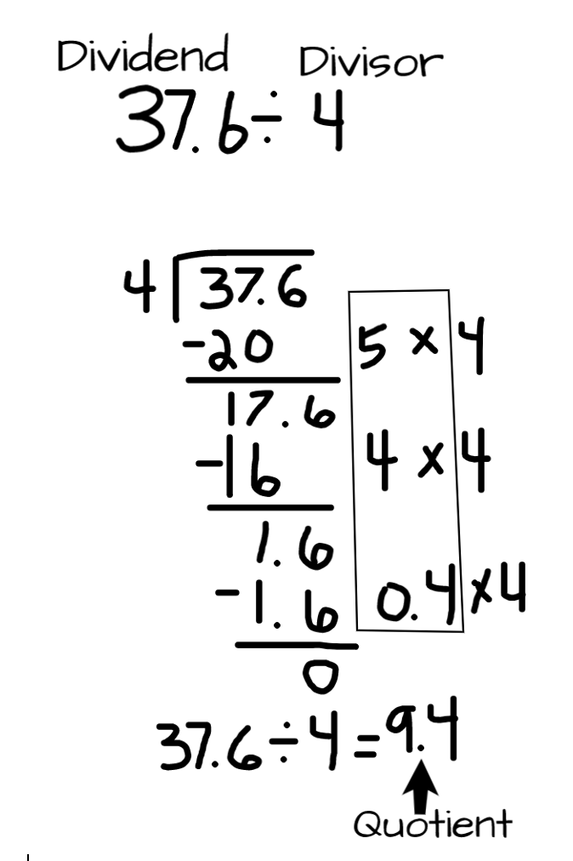
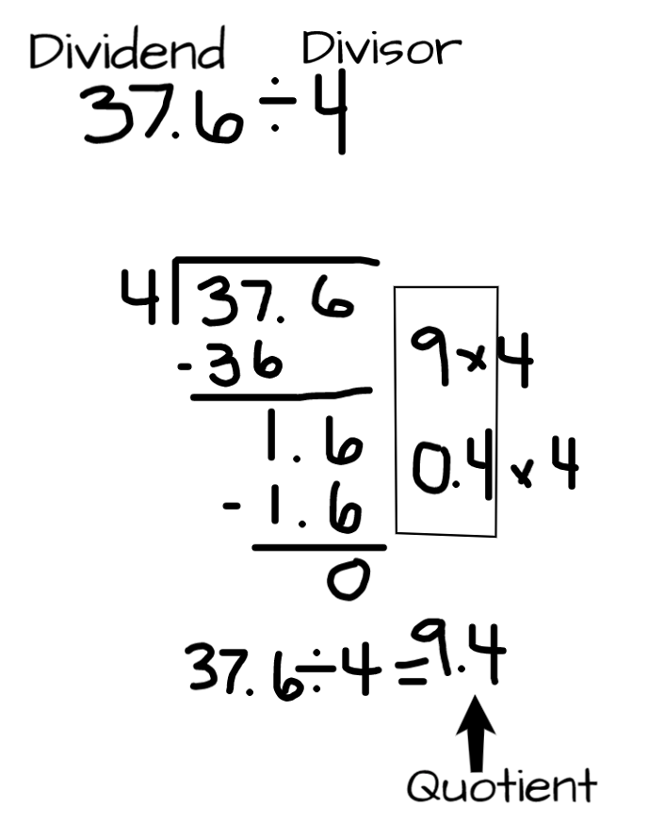
Partial Quotients With Decimals
What it is: This strategy focuses on removing easy-to-find groups from the dividend until there are no more groups to remove. The quotient (answer to the division problem) is the total number of groups taken away.
Let’s consider 37.6 ÷ 4
What it sounds like: What it looks like:
When it’s useful: Partial Quotients is almost always useful. It can become difficult to use as the number of digits increases in the divisor or dividend.
First, I begin by thinking about an easy-to-find multiplication fact for 4 that will get close to 37.6. I decide to start with 5 × 4. I record the fact, 20 is removed, and 17.6 is left. Then I see that 4 groups of 4 can be removed. I record the fact, remove 16, and 1.6 is left. Then I see that 4 groups of 0.4 can be removed and now there is nothing left. Finally, I add up the partial quotients (in the box) and my quotient is 9.4.
However, I could do this more efficiently if I start with 9 × 4. I record the fact that 36 is removed, and 1.6 is left. Like before, I see that 4 groups of 0.4 can be removed and now there is nothing left.

