Slide 1
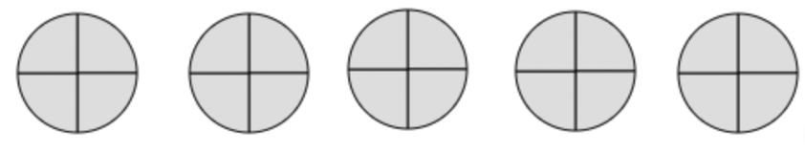
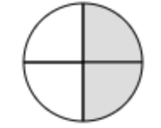


Partial Quotients with Fractions
What it is: This strategy relies on breaking apart mixed numbers to divide by fractions. Partial quotient can be efficient when you can mentally see how many of the divisor are in the dividend as in the example below.
What is sounds like: For a problem like 5 $\frac{ 1}{ 2}$ ÷ $\frac{ 1}{ 4}$ one might think about using the measurement model of division to ask, How many $\frac{ 1}{4}$ can I measure off from 1? Four. Then if I have 5 that would be 4 x 5 =20.
I still have $\frac{ 1}{2}$ , so my next question is, how many $\frac{ 1}{4}$ goes into $\frac{ 1}{2}$ ? 2.
So I can add the partial quotient, 20 + 2 to get 22.
What it looks like: The example below show the partial quotients. The groups are removed and this is continued until nothing is left to remove. The example shows how the partial quotients are
quotient.
5 $\frac{ 1}{ 2}$ ÷ $\frac{ 1}{ 4}$ = 20 + 2 =22
Another example might look like 3 $\frac{ 3}{ 4}$ ÷ $\frac{ 1}{ 2}$ = 6 +1 $\frac{ 1}{ 2}$ = 7 $\frac{ 1}{ 2}$
When It’s Useful: Partial quotients is
most useful when we have a mixed number divided by a fraction. A key is to look for when the fraction is friendly and breaking apart a mixed number allows one to see how many groups of the divisor will fit in the dividend.
Please see PDF in case the formatting of this file changes.

