Slide 1
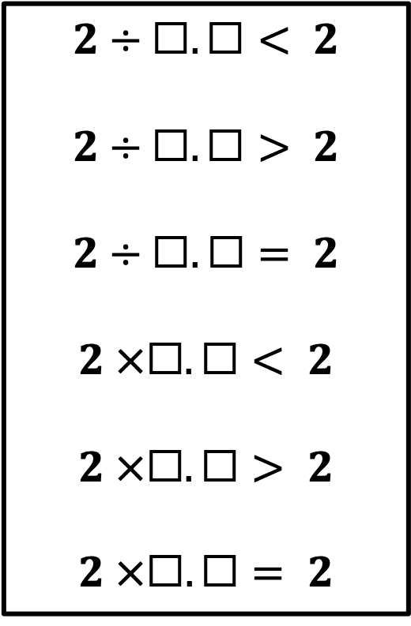
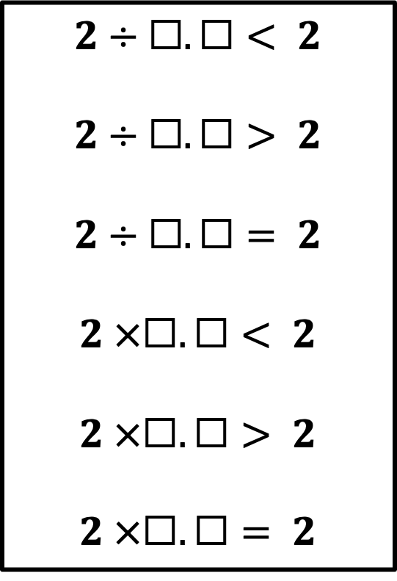
True Equation and Inequality Quest
True Equation and Inequality Quest
Directions: Roll two die or turn 2 digit cards and fill in the equations to make them true. Be the first to make all the equations true.
Directions: Roll two die or turn 2 digit cards and fill in the equations to make them true. Be the first to make all the equations true.
Player name:
Player name:
$$2÷☐.☐< 2$$
$$2÷☐.☐> 2$$
$$2÷☐.☐= 2$$
$$2 ×☐.☐< 2$$
$$2 ×☐.☐> 2$$
$$2 ×☐.☐= 2$$
$$2÷☐.☐< 2$$
$$2÷☐.☐> 2$$
$$2÷☐.☐= 2$$
$$2 ×☐.☐< 2$$
$$2 ×☐.☐> 2$$
$$2 ×☐.☐= 2$$
Please see PDF in case the formatting of this file changes.

Slide 2
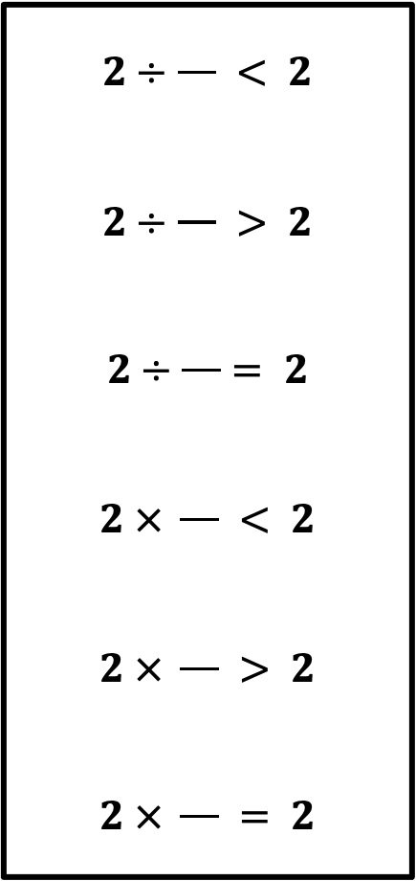
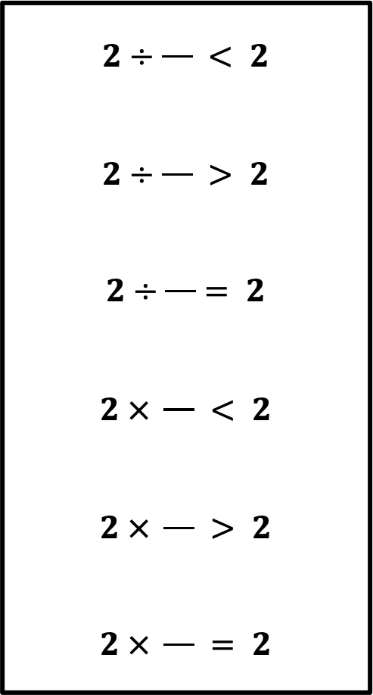
True Equation and Inequality Quest
True Equation and Inequality Quest
Directions: Roll two die or turn 2 digit cards and fill in the equations to make them true. Be the first to make all the equations true.
Directions: Roll two die or turn 2 digit cards and fill in the equations to make them true. Be the first to make all the equations true.
Player name:
Player name:
$$2÷\frac{}{} < 2$$
$$2÷\frac{}{} > 2$$
$$2÷\frac{}{}= 2$$
$$2 × \frac{}{} < 2$$
$$2 × \frac{}{} > 2$$
$$2 × \frac{}{} = 2$$
$$2÷\frac{}{} < 2$$
$$2÷\frac{}{} > 2$$
$$2÷\frac{}{}= 2$$
$$2 × \frac{}{} < 2$$
$$2 × \frac{}{} > 2$$
$$2 × \frac{}{} = 2$$

