Slide 1
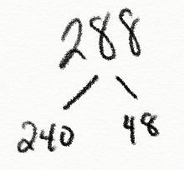
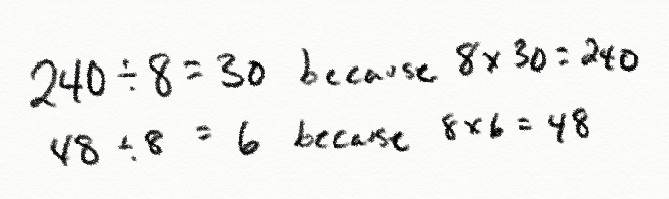
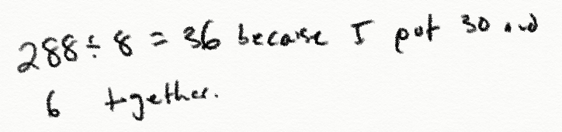
Finding the Breaks
Directions: Select a division problem. Break apart the dividend into multiples of the divisor. Use multiplication to divide the breaks.
Problem | Break Apart the Dividend | Divide the Breaks Using Multiplication to Help | So…
288 ÷ 8

